Slide 1






CELTIC-NEXT
Proposers Brokerage Day
24th February 2025, Barcelona
Pitch of the Project Proposal
Zero Touch GreenHouse
Pr. Abdelhamid Mellouk, Pr. Stefano Giordano, Dr. Thiago Abreu, Abdelhak Heroucha
{mellouk, thiago.abreu, abdelhak.heroucha}@u-pec.fr, stefano.giordano@unipi.it

Slide 2

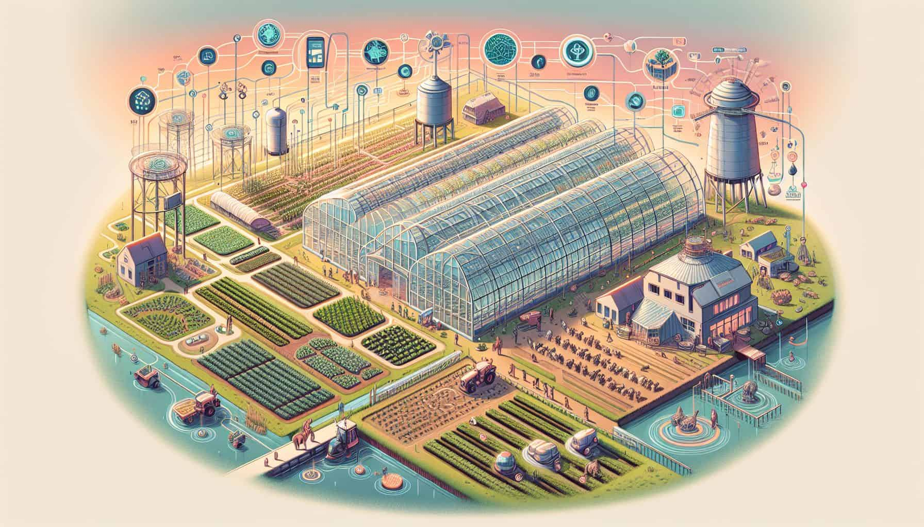
Teaser
Fully automated, sustainable greenhouse system (Zero Touch GreenHouse).
Reduces operational costs and increases productivity.
Addresses Industry 5.0 & Society 5.0 goals with plant-driven control.
Reduction of water usage (90% less with hydroponics).
Plant-driven approach: Plants control their own growth environment
www.celticnext.eu Zero Touch GreenHouse, UPEC/uniPi

Slide 3
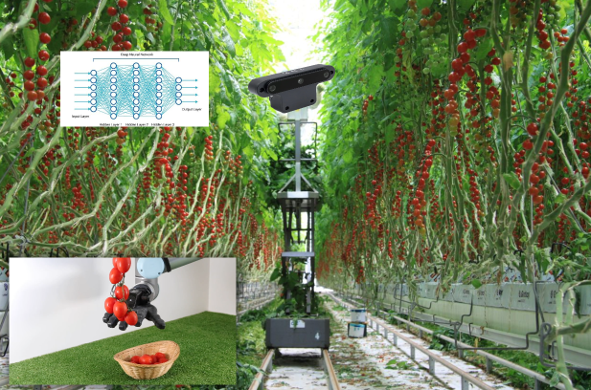
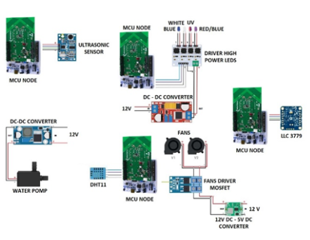
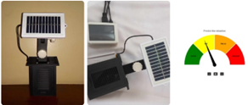
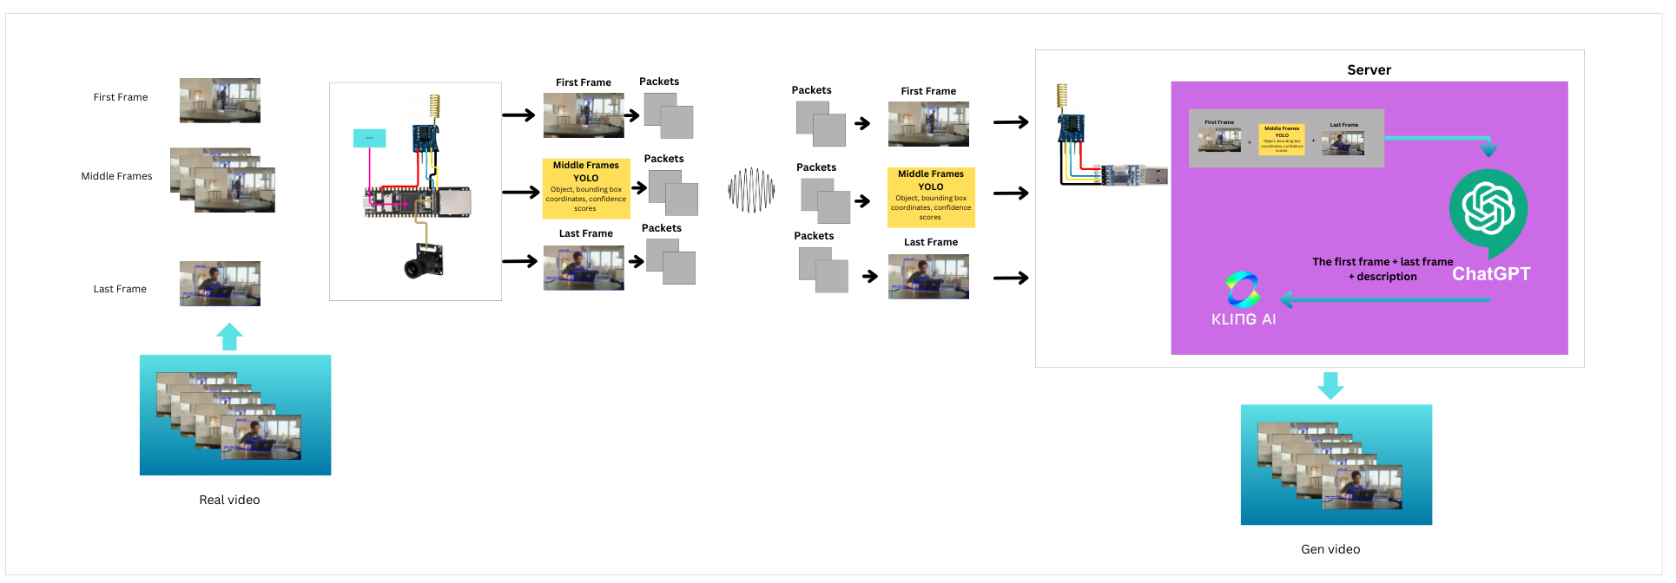
Organisation Profile
www.celticnext.eu Zero Touch GreenHouse, UPEC/uniPi

Slide 4

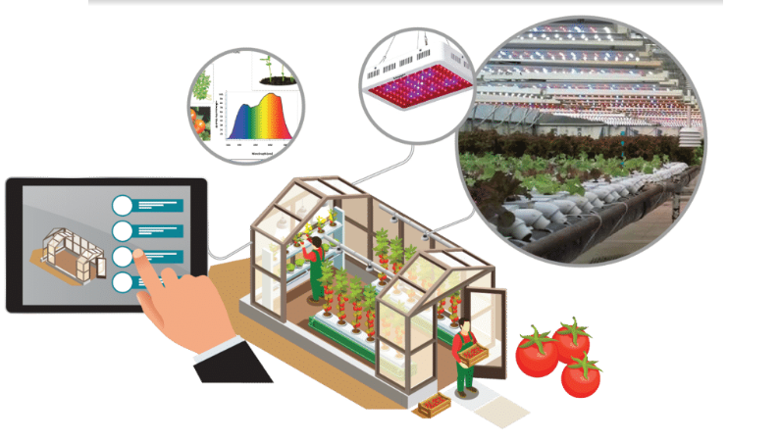
Proposal Introduction (1)
Zero Touch GreenHouse (Tomatoes)
Multimodal model AI for plant analysis
Plant-driven Environment Control Model
Predictive Water and Nutrient Management .
AI-Generated Digital Twins.
Water treatment unit.
Solar energy.
Communication platform.
Central control unit.
Test and verify the prototype in lab and real environment.
www.celticnext.eu Zero Touch GreenHouse, UPEC/uniPi
Notes:
system prototype demonstrated in an operational environment

Slide 5
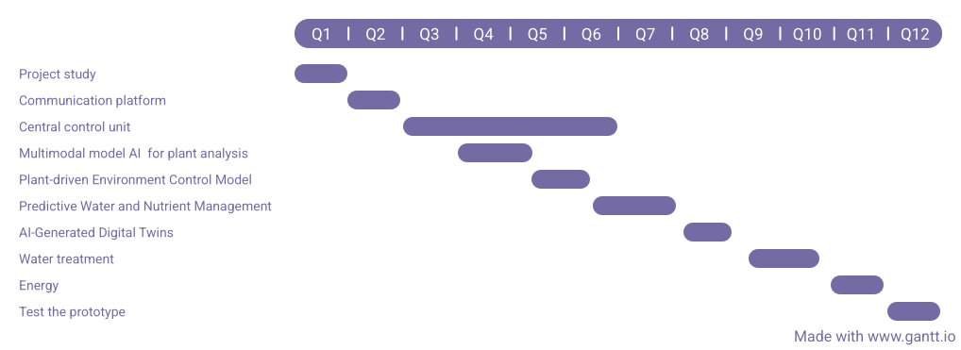
Proposal Introduction (2)
www.celticnext.eu Zero Touch GreenHouse, UPEC/uniPi

Slide 6
Partners
For equipment and financing:
Agricultural industry partners.
IoT & 5G solution providers.
Estimated budget of €2M for prototype development and testing.
www.celticnext.eu Zero Touch GreenHouse, UPEC/uniPi

Slide 7

Contact Info
For more information and for interest to participate please contact:
Presentation is available via:
Pr. Abdelhamid Mellouk, Pr. Stefano Giordano, Dr. Thiago Abreu, Abdelhak Heroucha
{mellouk, thiago.abreu, abdelhak.heroucha}@u-pec.fr, stefano.giordano@unipi.it

