Slide 1

Celtic-Plus Event
28-29 April 2016, Stockholm
Smartly connected world based on low threshold Ge on Si laser
Wan-Gyu Lee and National NanoFab Center
Wan-Gyu LEE
NNFC, Where Nanotechnology Meets!

Slide 2
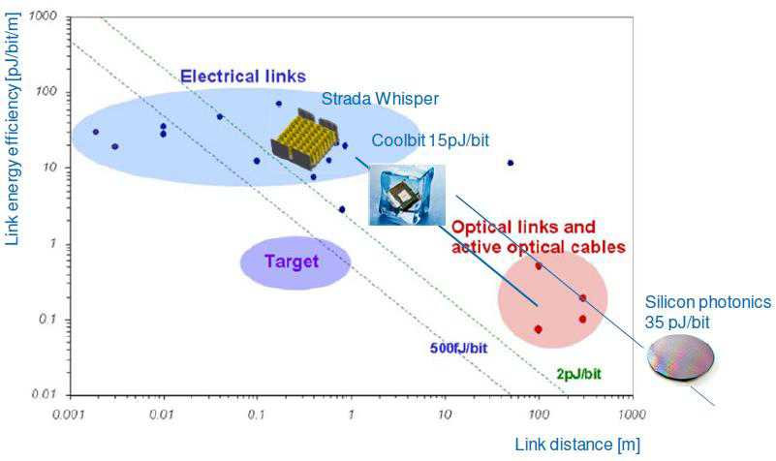
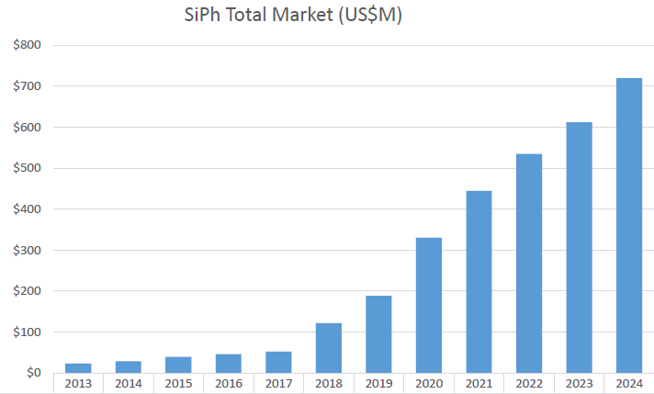
Teaser
One of the most efficient solutions for the increasing demand in bandwidth, distance, and energy consumption; data centers face.
The lowest power Ge laser on Si photonics provides; single mode optics, longer distance (>300m), highest data rates (100Gbps).
Si photonics markets will grow
very fast; 38% in CAGR.
38%
Wan-Gyu LEE, National NanoFab Center, & wangyulee@nnfc.re.kr

Slide 3
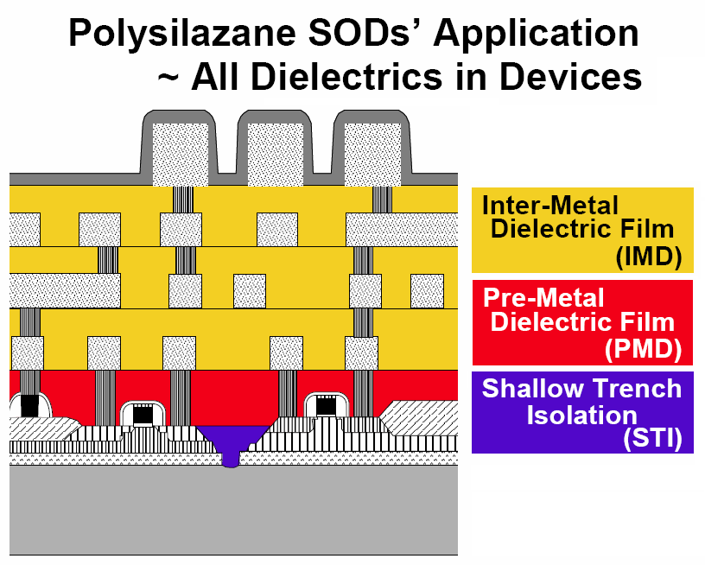
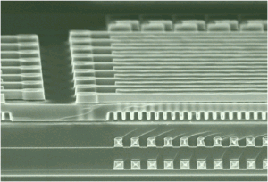
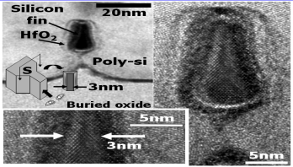
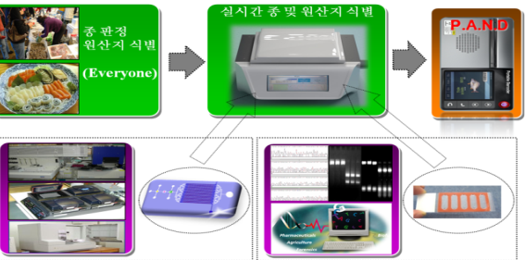
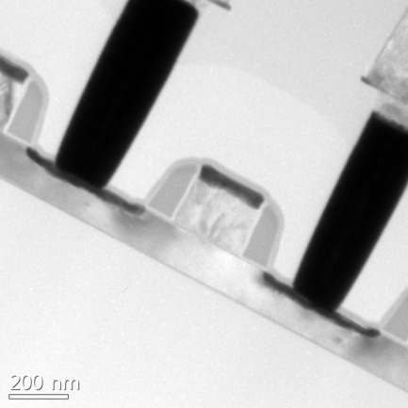
Organisation(NNFC) Profile
Development of 3D-IC Technology
& Vertical Device
(Cooperated with Besang Inc. & SNF)
Development of SOD Material
(Joint R&D with A, B Inc.)
Development of 2D Dopant
Profile Techniques (NNFC)
Educational center by government
Promoted as an Institute
2006
2007
2008
2009
2010
2011
2012
2013
CMOS baseline technology
Certified ISO 9001
Certified ISO 14001
Development of Smallest 3nm
FinFet in the world
(Collaborated with KAIST)
Development of Portable Barcode for the identification of species and the place of origin using DNA chip and Lab-on a chip
Technology transfer for mass production of 180nm SOI RF
(to Magnachip)
Unit TR
BOX
Wan-Gyu LEE, National NanoFab Center, & wangyulee@nnfc.re.kr

Slide 4
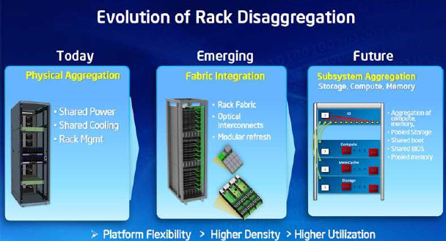
Proposal Introduction (1)
Smartly connected world based on low threshold Ge on Si laser.
-. Vision: Smartly connected world between multiple big data with low power
processing
-. Motivation: Si technology evolves to higher value systems, through
monolithic integration of electronics & photonics together into one platform .
-. Content: to realize
▪ Defect free high doping
▪ Optimum confinement
of electrons & holes
▪ State-of-the art
Ge epitaxy on Si
Wan-Gyu LEE, National NanoFab Center, & wangyulee@nnfc.re.kr

Slide 5

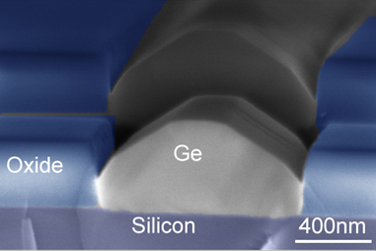
Proposal Introduction (2)
Expected outcome:
-. Monolithically integrated Ge on Si laser
operating at room temperature
with 1/100 low threshold power providing
an energy efficient processing of big data
from the connectivity of IoT
Impacts:
-. Higher optical functions
-. Architecture change in data center
-. cost/operation cut
Schedule:
-. 1/10 current threshold power @2018
1/50 current threshold power @2019
Wan-Gyu LEE, National NanoFab Center, & wangyulee@nnfc.re.kr

Slide 6




Partners
  NNFC has been looking for research and business partners who will collaborate in convergence technology of Ge epitaxy on Si photonics & Si electronics, as well as R & D prototype & production technology, IPR sharing, joint venture or venture companies.
  ; system engineering that adopt Si photonics allowing much faster digital
  signaling than is currently possible with optical interconnection
  ; manufacturer who wants to adopt monolithic opto-electronic devices in
  a low cost Si process
(1)
SME
-. System engineering
- Signal processing IC
-. Biasing IC
-. S/W
ASIC
S/W
Ge on
Si laser
Si photonics
&
Integration
National NanoFab Center
-. Si photonics
-. Process integration
-. Device fabrication
(2)
Anaysis
Simulation
(3)
Institute or University
-. Simulation
-. Physical analysis
Wan-Gyu LEE, National NanoFab Center, & wangyulee@nnfc.re.kr

Slide 7
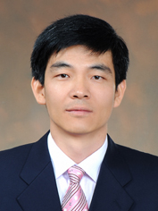
Contact Info
For more information and for interest to participate please contact:
National NanoFab Center
wangyulee@nnfc.re.kr
82-42-366-1602
291 Daehak-ro, Yuseong-gu, Daejeon
34141 Republic of Korea
http://www.nnfc.re.kr
Wan-Gyu LEE, National NanoFab Center, & wangyulee@nnfc.re.kr

