Slide 1
Celtic-Plus Event 28-29 April 2016, Stockholm
IoT Device Connectivity Platform
A better way to manage “Things”
Dr. C. Paul Slaby
pslaby@teslonix.com

Slide 2
How do we connect and manage billions of “things” (IoT)?
These “things” are IoT edge devices (sensors, RFID tags, wearables, etc.,) which need to be powered, connected, located, identified, tracked and communicated with.
We need a better way to manage “things” (IoT)
Technology efficiently linking billions of “things” which interface us to the physical world:
Enable passive / low-power devices by removing the need for batteries
Provide IoT device management to create efficient low-power IoT networks
Provide contextual, localization and state-awareness layers
Offer long-range connectivity while reducing infrastructure costs
Why should you participate in my proposal?
Development partners gain access to a huge new business opportunity based on cutting edge technology that makes mass deployment of passive IoT nodes possible
Opportunity to develop new specialized hardware products, software products and platforms addressing IoT-device specific security concerns, analytics and management issues
Dr. Paul Slaby, Teslonix Inc. pslaby@teslonix.com

Slide 3
Organisation Profile
Teslonix is a technology company specializing in wireless power systems using RF-based energy transfer.
Inventor of smartRFpowerTM
8 patents pending
Strong in-house R&D expertise in wireless systems development
Strong research organizations and university linkages
Partnerships with leading IoT players
www.teslonix.com
Dr. Paul Slaby, Teslonix Inc. pslaby@teslonix.com

Slide 4
Proposal Introduction (1)
Development of IoT Device Connectivity Platform enabling efficient linking of billions of “things” interfacing with the physical world around us to the Internet while taking care of power, context, 3D location, tracking and communication.
Develop IoT reader/interrogator system
Develop passive sensors that take full advantage of all smartRFpowerTM capabilities
Develop new software layer to facilitate management and communication between system and nodes
Design products for specific application and markets (i.e. Smart Cities, Smart Parking, Smart Security, etc.)
Implement smartRFpower as a way of energizing passive electronics devices or charging active devices thus reducing the need for batteries, their replacement and maintenance
Make mass IoT deployments possible by bringing active node functionality using more affordable passive electronic devices
Build a better way to manage “things” (IoT)
Dr. Paul Slaby, Teslonix Inc. pslaby@teslonix.com

Slide 5
Proposal Introduction (2)
Expected outcome
IoT Device Platform bundling infrastructure components into a single product including: low-level device control and operations (power, management, security, communications), data acquisition & management with hooks to IoT application development
Impacts
Opens mass IoT deployments
Offers new functionality more effective in powering, locating, tracking and communicating with nodes in smart application deployments
An economic solution permitting massive deployments of billions of IoT nodes
Schedule
Consortium in place Q3/2016
System architecture Q1/2017
Prototypes Q3/2017
Commercial availability 2018
Dr. Paul Slaby, Teslonix Inc. pslaby@teslonix.com

Slide 6
Partners
Looking for partners interested in jointly developing IoT device solutions that bridge software and the physical environment; also partners developing technology capabilities to fit a specific market application
Initial partnership talks involve:
Electronic component manufacturer (global - Germany, Austria, Holland)
Integrated sensor vendor (Spain)
Teslonix (Canada) - initiating partner
A couple of research institutions and universities
Profile, expertise and type of partners we are looking for:
Semiconductor vendor with capabilities of on-chip integration, design, manufacturing and supply
Integrated sensor/RFID developer
IoT Software platform expertise
Partners with RTLS hardware expertise
Dr. Paul Slaby, Teslonix Inc. pslaby@teslonix.com

Slide 7
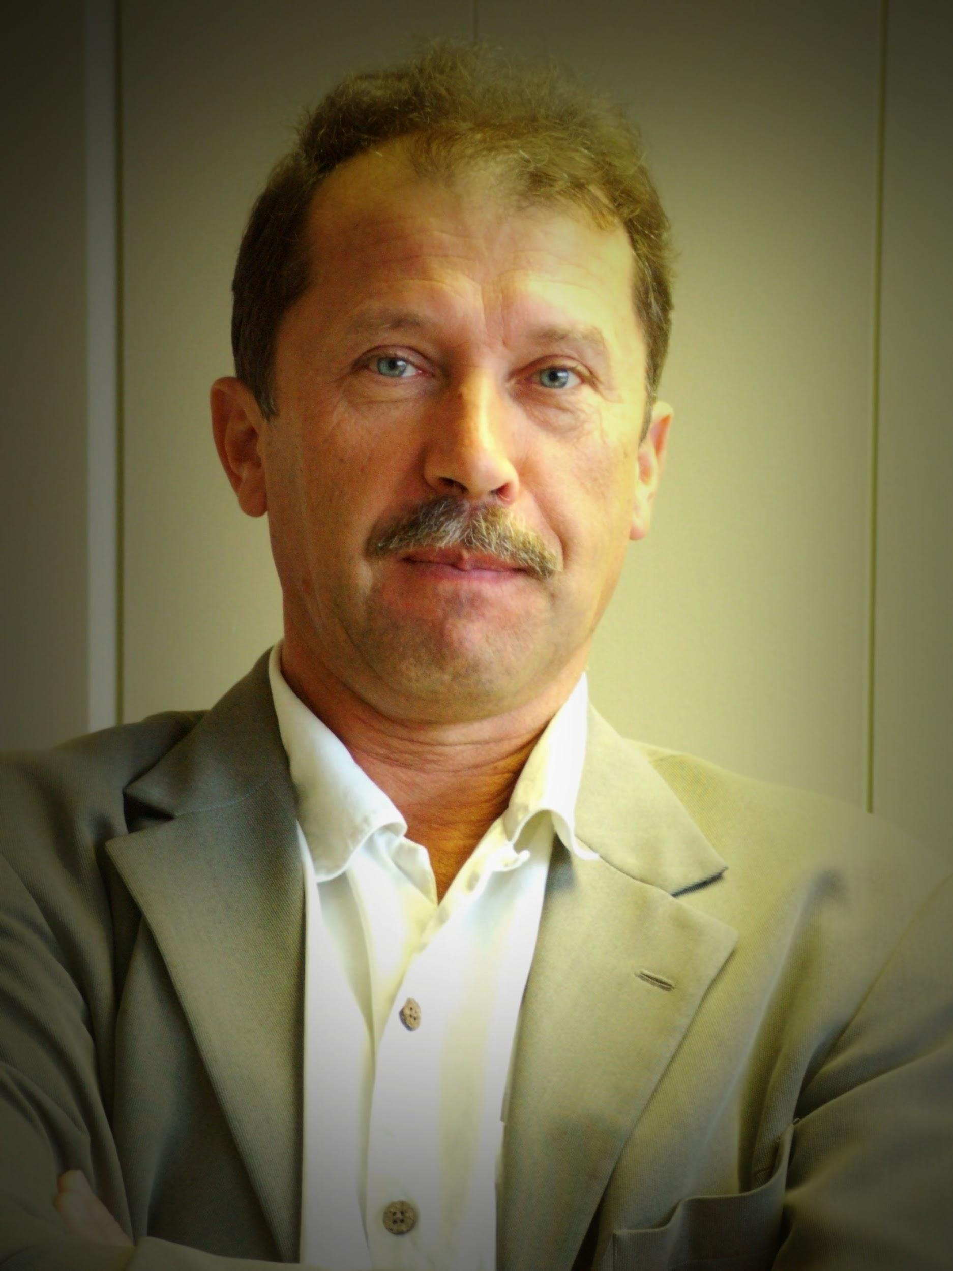
Contact Info
For more information and for interest to participate please contact:
Dr. C. Paul Slaby
pslaby@teslonix.com
+1 613 699 1485
Teslonix Inc.
320 March Rd. Suite 400
Ottawa, ON K2K 2E3
Canada
www.teslonix.com
Dr. Paul Slaby, Teslonix Inc. pslaby@teslonix.com

