Slide 1
Celtic-Plus Event 28-29 April 2016, Stockholm
Thermal Resonance
for Heat Transfer Enhancement
Jae Won Kim, Sun Moon University
jwk@sunmoon.ac.kr

Slide 2
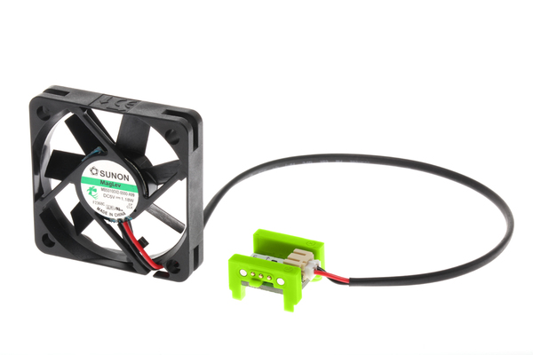
Teaser
For Uniform Temperature, An additional agitator is necessary
Then, requires more energy and device !
Consequently, noise is additional loss in case of adoption of fan.
Physical Domain
Heat Source
Name, affiliation & e-mail of presenter

Slide 3
Organisation Profile
R&D
Research Infra
Industry-University Corporation Foundation
Education for Employees
Business Networking
Name, affiliation & e-mail of presenter

Slide 4
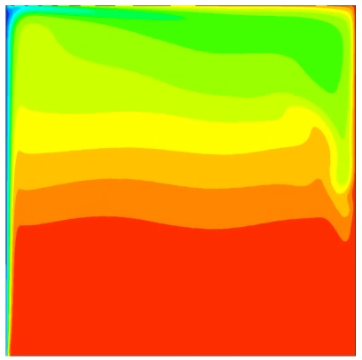
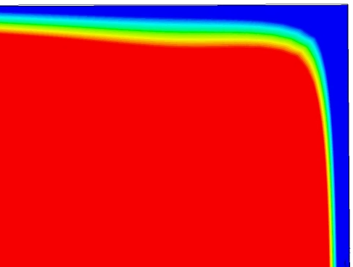
Proposal Introduction
Strong stratified
Almost Uniform
Name, affiliation & e-mail of presenter

Slide 5
Partners
Pronounced Performance by Resonance
Goal !
Agitator
Instantaneous Sensing
Looking
for
Name, affiliation & e-mail of presenter

Slide 6
Contact Info
For more information and for interest to participate please contact:
Jaewon KIM at Sun Moon University
jwk@sunmoon.ac.kr
+82 10 9770 2337
221 Sunmoon-ro, Tangjeong
Asan, Chungnam, 336-708
Korea
Name, affiliation & e-mail of presenter

