Slide 1
Celtic-Plus Event 28-29 April 2016, Stockholm
Wherever, Indoor/Outdoor Location Service
<Kyle Hwang, Director, AscenKorea>
<kyhwang@ascen.co.kr>

Slide 2
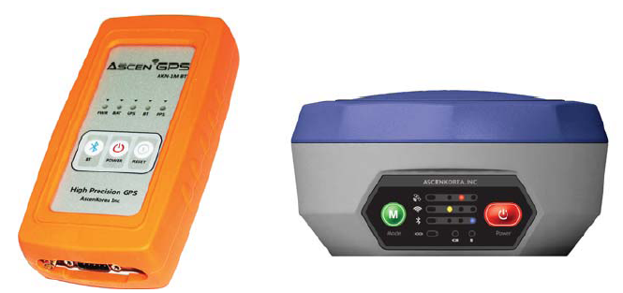
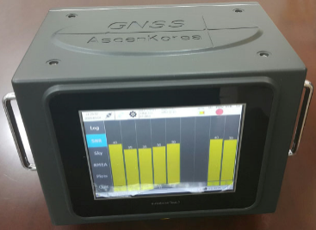
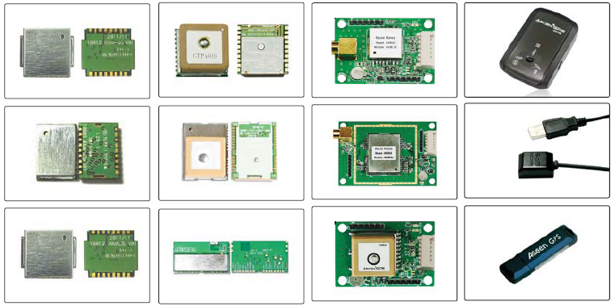
Teaser
Wherever, I can find you!!
Indoor, Outdoor, Inter building
Precision, Accurate Positioning data
Name, affiliation & e-mail of presenter

Slide 3
GNSS Based Location
Sensor Based Location
High Precision GNSS receiver.
Combo GNSS receiver.
GNSS data interface. WIFI, RF.
Pedestrian Dead Reckoning
RF / IMU MEMS Module
Indoor Navigation Module
Outdoor
Indoor
Wherever
I can know!
Intersection
GNSS / Sensor Based Location
UWB based system integration.
GNSS, MEMS IMU supporting.
Urban, Factory, Location service.

Slide 4
Organisation Profile
Organization Chart
CEO
Technique Counsel
Quality Control
R&D Center
Technique sales
Management
GNSS Module
Sales
Planning
GNSS Receiver
Sales Supporting
Purchasing
GNSS LBS
Marketing
Accounting
Devices
Customer Satisfaction
Manager
Oversea Branch
Name, affiliation & e-mail of presenter

Slide 5
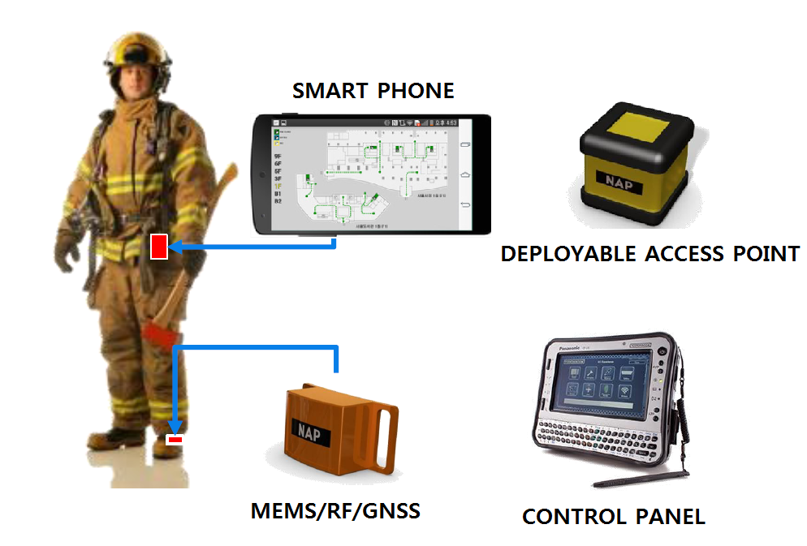
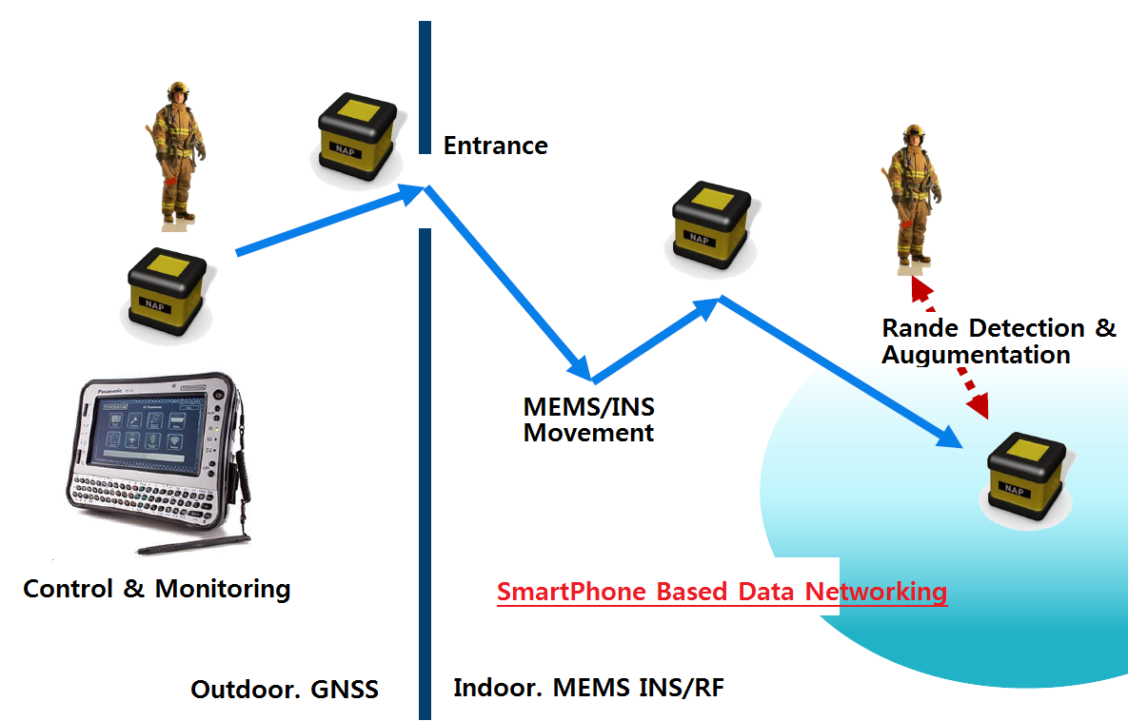
Proposal Introduction
Indoor Navigation
Accuracy 2.0m (100m way)
Sensor Monitoring
*High Precision
20cm
Outdoor Navigation
Accuracy 1.5m
GNSS Signal Receiving
*High Precision
2cm
Name, affiliation & e-mail of presenter

Slide 6
Partners
Hyunday
High Precision
GNSS Testing
Device
System for
Vehicle
Human
Robot
Vessel
Submarine
Smart Factory
Technology of
RF, Digital, GNSS
Sensor, MEMS
Indoor algorithm
Outdoor algorithm
RF Jamming Detection
Handheld device
Military
Submarine
GNSS Receiver
Samsung
RFID/UWB
LBS Module
System
AscenKorea
Aviation Institute
RF Based
Indoor Navigation
MBC
DMB GNSS
Receiver
Ministry
Indoor
Navigation
Name, affiliation & e-mail of presenter

Slide 7
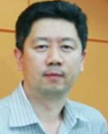
Contact Info
For more information and for interest to participate please contact:
Kyle Hwang
Kyhwang@ascen.co.kr
82-10-2298-6628
Post No 08588
rm710, 53 Gasandigital2ro,Gasandong
Gumcheongu, Seoul Korea
www.AscenKorea.com
Your
Photo
Name, affiliation & e-mail of presenter

