Slide 1
Celtic-Plus Event 28-29 April 2016, Stockholm
“BEYOND WORDS” We visualize your knowledge
JohanLundell, Founder & CEO of nodd
Johan.lundell@nodd.se

Slide 2
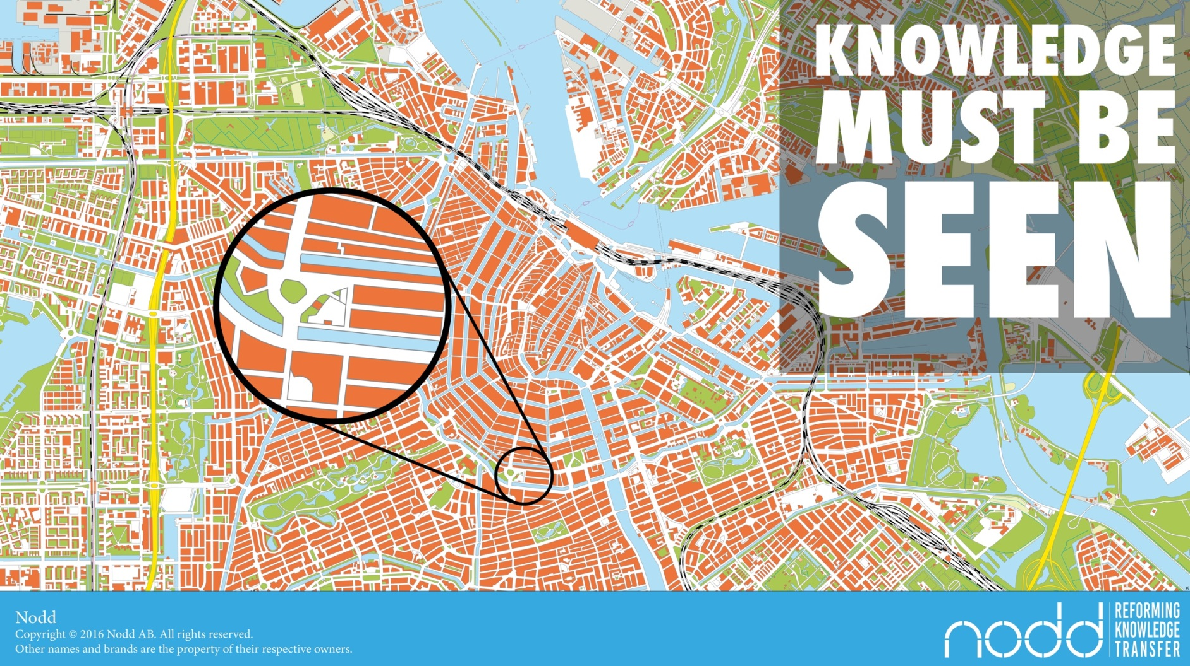
Teaser
Johan Lundell, Nodd, johan.lundell@nodd.se

Slide 3
Teaser
Johan Lundell, Nodd, johan.lundell@nodd.se

Slide 4
Organisation Profile
Knowledge
Skills
Information
Production
Maintenance
Big Data
Sports
Movements
Actions
Strategy
Tactics
Johan Lundell, Nodd, johan.lundell@nodd.se

Slide 5
Proposal Introduction
“BEYOND WORDS” We visualize your knowledge
Nodd turns your implicit knowledge to explicit knowledge
Nodd lets you understand your data by carrying it in better ways.
Nodd lets you communicate without words and without translations.
Johan Lundell, Nodd, johan.lundell@nodd.se

Slide 6
Partners
YOU
Johan Lundell, Nodd, johan.lundell@nodd.se

Slide 7
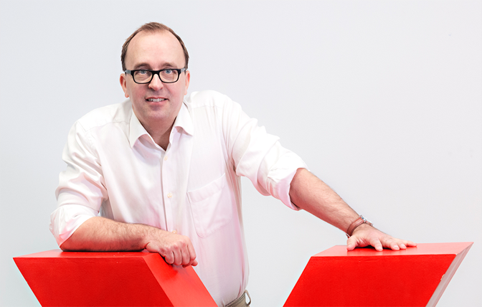
Contact Info
For more information & for interest to participate please contact:
Johan Lundell, CEO
johan.lundell@nodd.se
+46 707 88 06 88
Nodd, Sällinge 41 755 98 Uppsala SWEDEN
www.nodd.se
Johan Lundell, Nodd, johan.lundell@nodd.se

