Slide 1
Celtic-Plus Event 28-29 April 2016, Stockholm
WINS@HI
Wearable IoT Network Solution for Work Safety in Hazardous Industrial Environments
Caner Aksoy, Technical Coordinator
caksoy@netas.com.tr

Slide 2
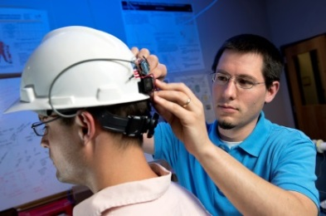
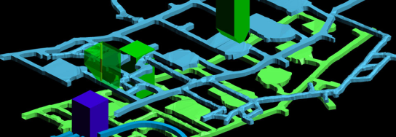
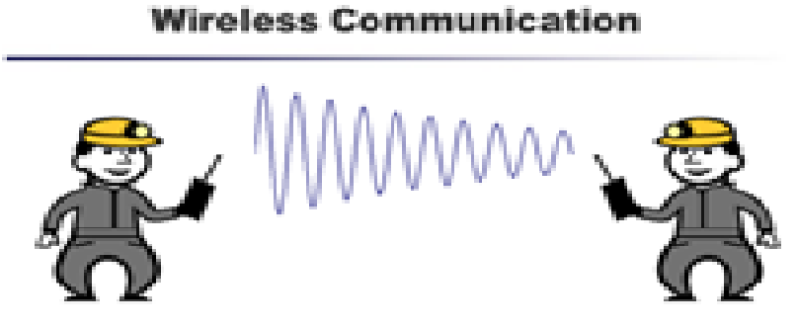
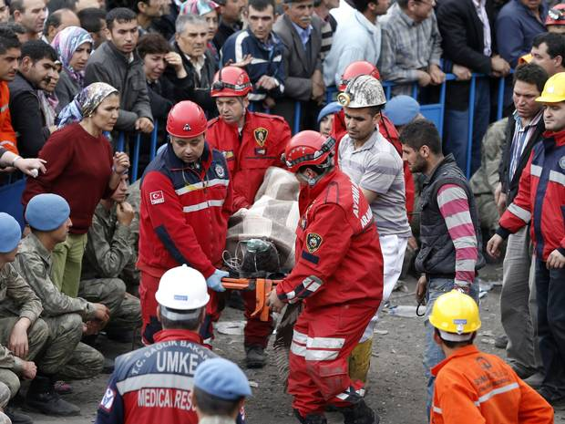
Teaser
Main Goal
Assessment of risks and preventing accidents
Improving work safety of underground workers
In case of occupational injuries and hazards
Tracking location of workers
Remote health monitoring
Guiding emergency and rescue units
Description
Wearable sensor networks
Wireless underground / indoor communication
Data analytics
Network anomaly detection and monitoring algorithms
Disaster / emergency management
Status
Project is labeled and due to start-up
Caner Aksoy, Technical Coordinator, caksoy@netas.com.tr

Slide 3
Organisation Profile
Telecom Service Providers
Networking Solutions
Government and Public Safety
Cloud Solutions
ICT Security Solutions
M2M / IoT
Maintenance and Support Services
Custom R&D for Enterprises and Service Providers
48 years of experience, global presence, field proven hardware \ software & application development, 1500+ businesses, Turkey #1 converged (carrier and enterprise) system-integrator also serving the region
Caner Aksoy, Technical Coordinator, caksoy@netas.com.tr

Slide 4
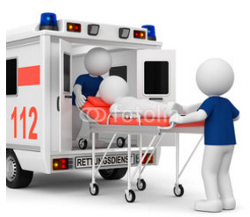
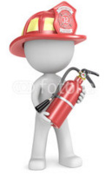
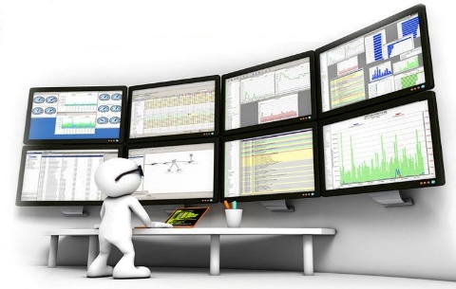
Proposal Introduction
System Architecture
Guide search/rescue units
Mobile and web applications
Network management/monitoring
Anomaly detection algorithms
Alarm management
Location tracking
Health monitoring
Data
Analysis
Feature extraction
Adaptive/machine learning
Dynamic 3-D modeling
Wearable sensors
Energy efficient design
Underground wireless comm.
Scalable and robust
Caner Aksoy, Technical Coordinator, caksoy@netas.com.tr

Slide 5
Proposal Introduction
Pre-accident use cases:
Health monitoring
Remote sensing of threats
e.g. Methane, dust explosions, flood
Early warning alarms to prevent disasters
Robust underground communication
Dynamic 3-D mapping
Location tracking
Post-accident use cases:
Uninterrupted service after explosions or mine falls
Communication with miners
Precise location detection
Guiding search and rescue teams in case of emergency
Caner Aksoy, Technical Coordinator, caksoy@netas.com.tr

Slide 6
Proposal Introduction
Work Packages
WP1: Management
Project coordination and administration
Technical management
WP2: Requirements
Business model
System requirements and specifications
Design and architecture
Definition validation use cases
Standardization issues
WP3: Wearable sensor networks
Wearable sensor hardware design
Sensor mesh network
Sensing of mine environment
Location tracking
Sensing of health status of miners
WP4: Wireless underground communication
Utilizing frequency bands
Antenna design
Communication protocols
Interoperability with rescue unit systems
WP5: Data analytics and monitoring system
Iot gateway design
Platform development
Data analytics, anomaly detection
3D mapping
Software applications
WP 6: Testing and integration
Testbed
System integration and testing
System performance testing
WP 7: Disseminations and exploitations
Disseminations
Standardizations
Training and public awareness
Publications
Exploitations
Business model
New markets
Caner Aksoy, Technical Coordinator, caksoy@netas.com.tr

Slide 7
Partners
Current Partners
Prospective Partners
Turkey
All WPs
Czech Republic
WP1, WP2, WP3, WP4, WP6, WP7
Canada
NETAŞ
İmbat Mining
Nesta
Korgün Software
Istanbul Technical University
Boğaziçi University
Bahçeşehir University
VUB Co
GiTy
Masaryk University (MUNI)
Technical University of Liberec (TUL)
NRC
CEMI
Newtrax
Vandrico, Priwen Systems
Accutron Instruments
6Harmonics
Sensorup
International Leader
Romania
All WPs
BEIA Consult International
Portugal
Eurico Ferreira (PROEF group)
Centi
LIPOR
Caner Aksoy, Technical Coordinator, caksoy@netas.com.tr

Slide 8
Partners
Are you interested in joining?
Please let us know about the WPs
that you would like to be involved!
Caner Aksoy, Technical Coordinator, caksoy@netas.com.tr

Slide 9
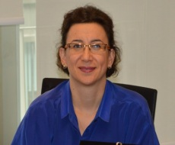
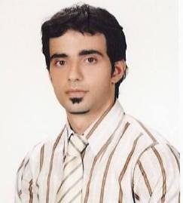
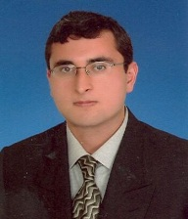
Contact Info
A.Belma Kaya
R&D Director
belmas@netas.com.tr
Ersin Bayramoglu
Project Coordinator
ersin@netas.com.tr
Caner Aksoy
Technical Coordinator
caksoy@netas.com.tr
Necip Gozuacik
Technical Leader
gozuacik@netas.com.tr
Caner Aksoy, Technical Coordinator, caksoy@netas.com.tr

