Slide 1
Celtic-Plus Event 28-29 April 2016, Stockholm
Pitch of the Project Proposal <AirVision Cloud>
<Vytautas Taujanskas, COO>
<vytautas@magma.lt>
<Your Logo>

Slide 2
Teaser: What we do
We provide intelligence & forecasting from above.
Instantly.
AirVision is complete vision processing system with ultra-high quality sensors, long range datalinks and advanced software capabilities.

Slide 3
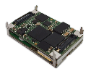
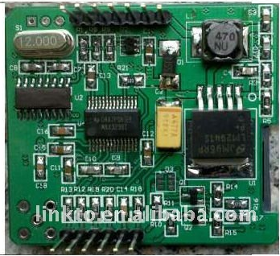
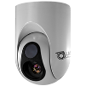
Teaser: how we do it?
NVidia Tegra X1 based onboard avionics 1024 GFLOPS processing power, supercomputer on module 15W max energy consumption (1W idle) Credit card size (50x87mm)
Sony industrial block camera
Digita Datalink Integration
Imaging data integration from different sources, image stabilization, enhancement
FLIR thermal imaging camera
GPRS modem
GPRS modem for long range telemetry
Gimbal control
Automatic gimbal positioning, GPS position following, object tracking
Designed to withstand all flight conditions All ruggedized latching connectors -20 /- +85 temp. range
Hardware interfaces and sensors SD-card, 2x USB3, 2x USB2, 3x UART, HDMI, 8x GPIO, miniPCIe, CSI. I2C 3d accelerometer, 3d gyro, 3d compass, barometer, trusted platform module

Slide 4
Teaser: the result

Slide 5
Proposal
Crop fields are monitored using manual visual inspection or manual inspection tools. We are offering to do that without manual inspection.

Slide 6
Solution: AirVision platform
Air component
Sensor integration
High-performance vision processing
Autonomous navigation
Object detection, tracking, classification
Data exchange protocols
Satellite component
Data from Sentinel-1 / Sentinel -2 ESA satellites
NDVI processing
Ground component (ground control / cloud)
3D model creating from flight images
2D model creation from flight images
Object recognition

Slide 7
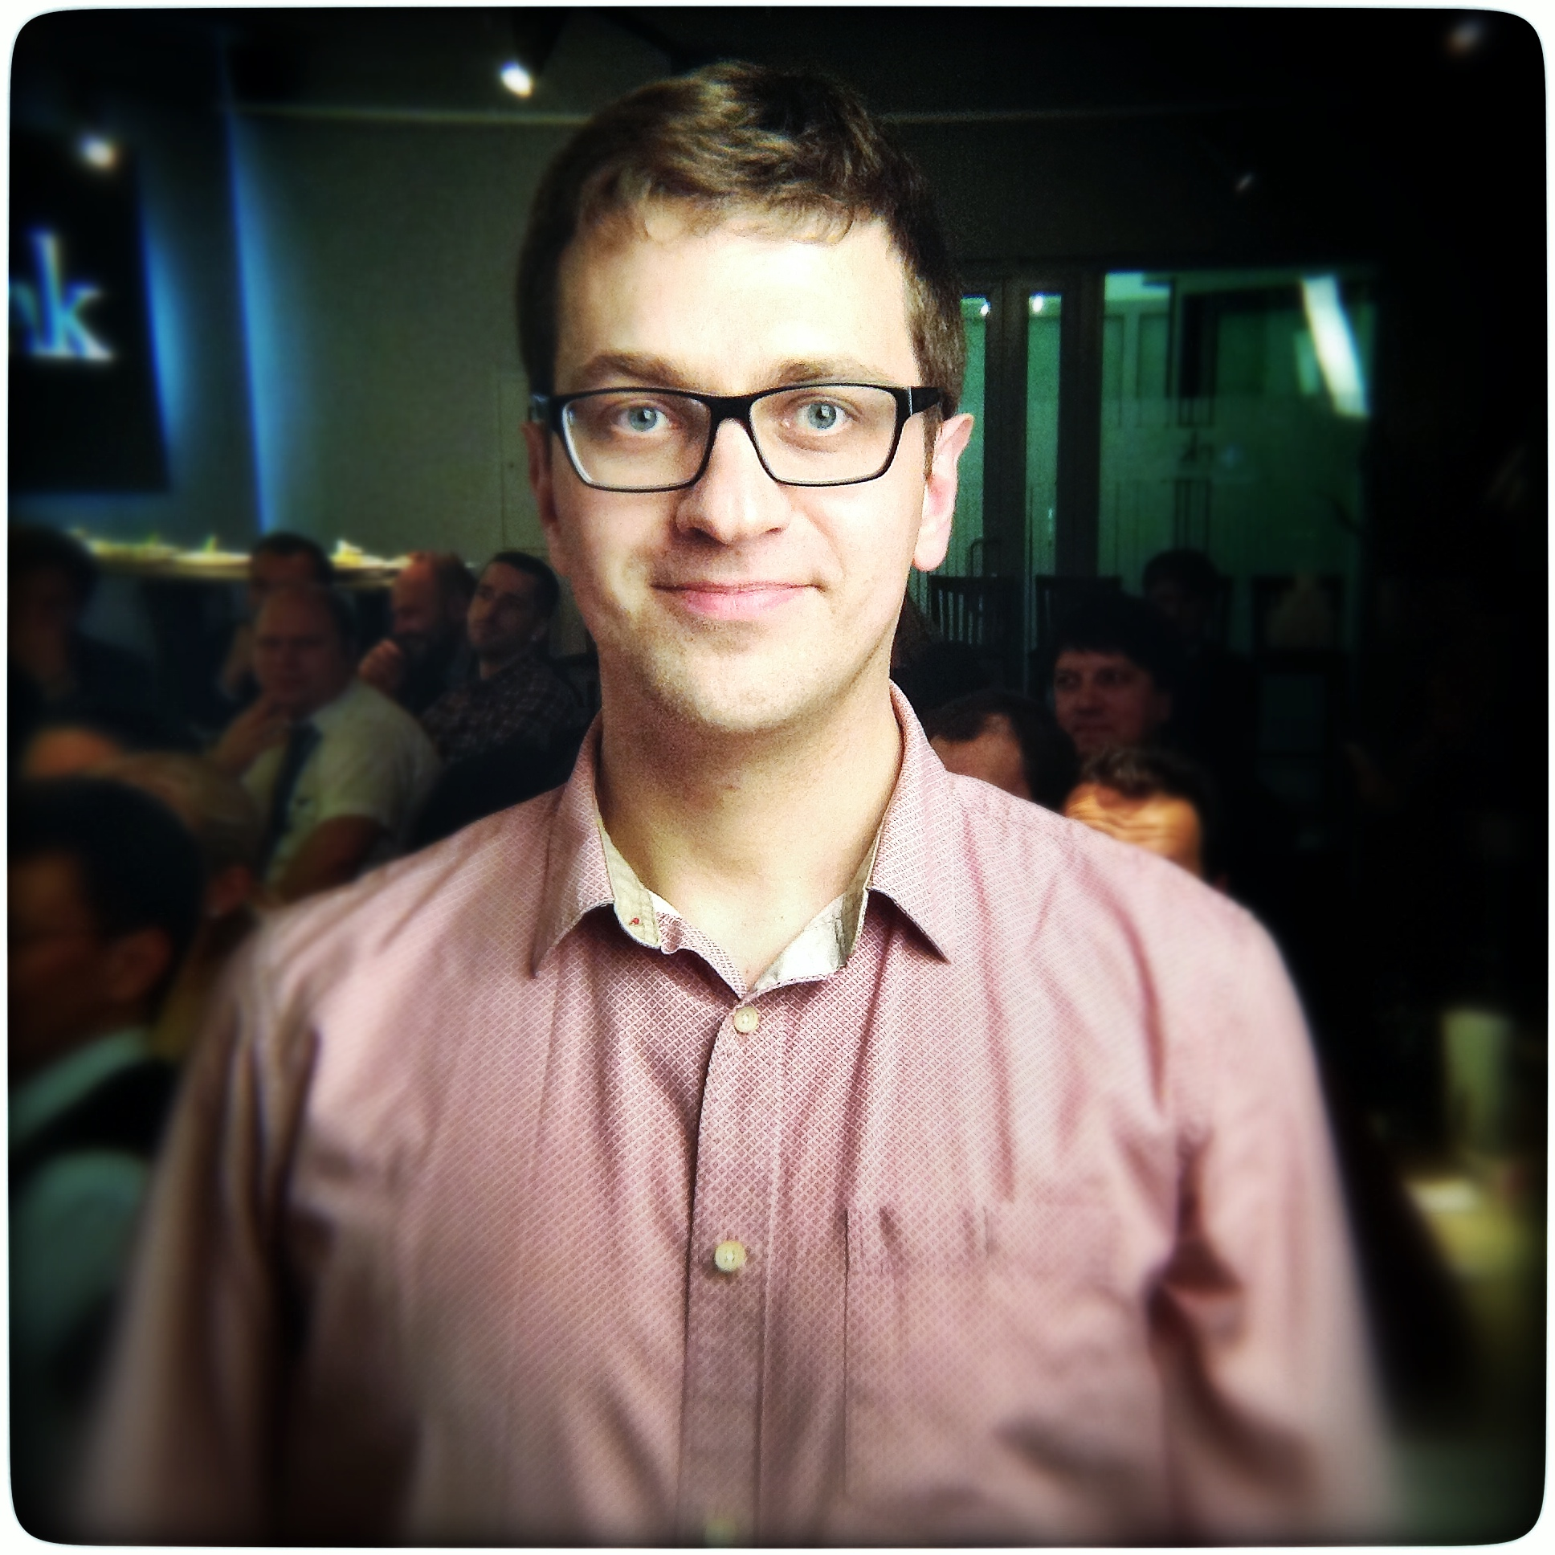
Contact info
We are looking for a partners who are working in UAV / drone / image processing fields.
Vytautas Taujanskas, COO
vytautas@magma.lt
+370 612 613 10
www.airvision.io

