Slide 1
Celtic-Plus Event 28-29 April 2016, Stockholm
Personal Air Quality Monitors
MSc. Leonardo Santiago | ATEKNEA SOLUTIONS
Leonardo.Santiago@Ateknea.com

Slide 2
Teaser
What is the main benefit of the idea/proposal?
By making these sensors small we could make a citizen scientists of us all, significantly increasing the amount and precision of environmental data through crowdsourcing.
This new wave of personal environmental sensors has the potential to really change the way that data is gathered, analysed and consumed
What makes the added value?
Over 3 year of research to develop 2 versions of the personal sensor and make sense of the data. The 3rd version is already under development. We need to test it!
*Daily exposure to gases has consequences-
CO- “the silent killer”. Poor combustion leads to high CO concentrations. We cannot smell or see CO
H2S and mercaptans are the most common odorants. Also used to monitor bad breath
NO2 and O3 are the most dangerous air pollutants, attacking our lungs, aggravating asthmatics and at risk persons
Why should I participate in the project?
There is a big deal of research in the field of Air Quality at a Institution level and also the new Citizen Scientists builing their IoT networks with several sensors
*John Saffell Technical Director Alphasense Ltd.
MSc. Leonardo Santiago | leonardo.santiago@ateknea.com

Slide 3
Organisation Profile
Specialisation in R&D and Innovation;
Innovation Project Management;
Innovative Engineering Solutions;
15+ years of experience.
We are the SME with the highest number of SME-targeted projects funded in the Seventh Framework Programme (FP7).
170+ projects
600+ SMEs involved
25+ European countries represented
100+ Engineers
30+ PhDs
MSc. Leonardo Santiago | leonardo.santiago@ateknea.com

Slide 4
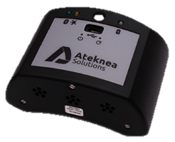
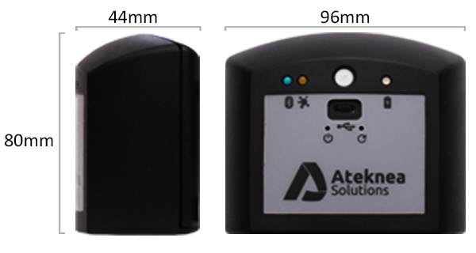
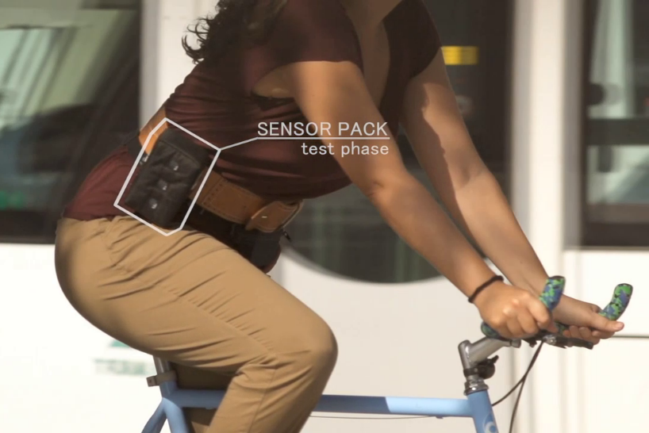
Proposal Introduction
Types of Air Quality Networks
Fixed site: 50 to 5,000 nodes per city- best calibration options
Mobile: trams, buses, special cars- no power problems, but a moving platform
Personal: rapid mapping of the city, citizens make local pollution maps- hardest to validate
Wearable: a bitfit that measures gases, particulates a technology challenge
The next generation of Air Quality Networks are cloud-based
MSc. Leonardo Santiago | leonardo.santiago@ateknea.com

Slide 5
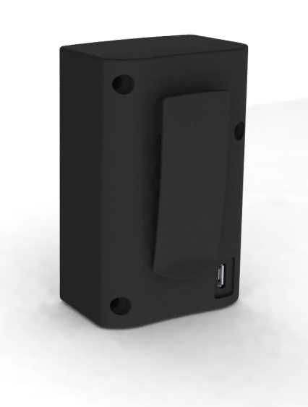
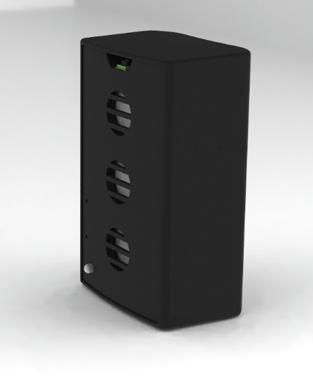
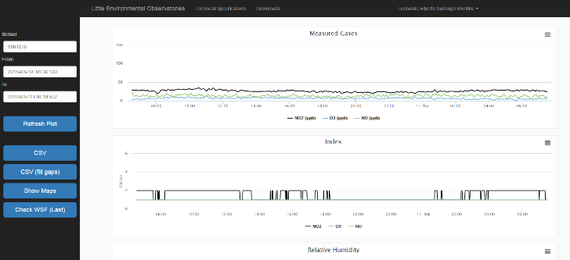
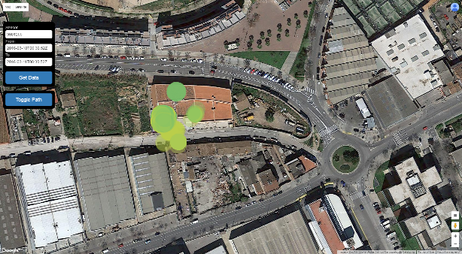
Proposal Introduction
12 to 18 months to:
Finalize the 3rd Version of the Little Environmental Observatory (LEO)
Electrochemical Sensors for NO2, O3, CO (or NO) (ppb)
Temperature (°C)
Relative Humidity (%)
Bluetooth 4.0
GPS and accelerometer information from smartphone
Cloud to and online processing tools for data processing
Activity Index Calculation for exposure to pollution
Carry out Intensive Validation test
More validation for the gas measurements are required for users to trust the devices.
MSc. Leonardo Santiago | leonardo.santiago@ateknea.com

Slide 6
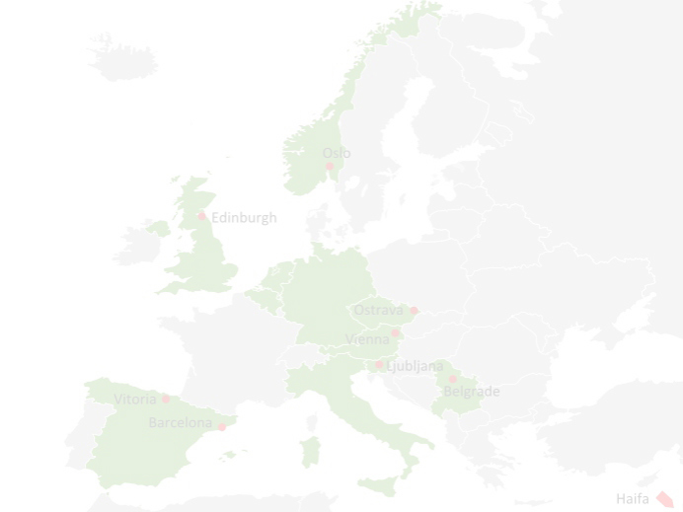
Partners
Looking for profiles and expertise
Manufacture several hundreds of units
Human resources: to test the sensors with volunteers
Air Quality Experts: to validate sensor measurements
GIS Analysis. Data analysis to create high resolution air quality maps
MSc. Leonardo Santiago | leonardo.santiago@ateknea.com

Slide 7
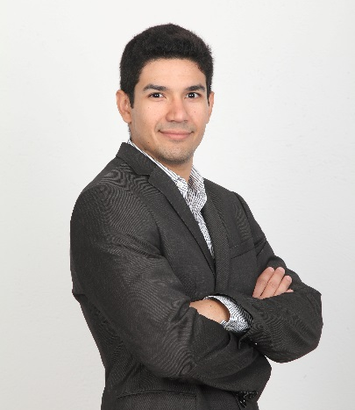
Contact Info
For more information and for interest to participate please contact:
MSc. Leonardo SANTIAGO
Leonardo.santiago@Ateknea.com
+34 932049922 (517)
C/Victor Pradera 45
Cornella de Llobregat
Spain
www.ateknea.com
For sensor information:
http://citisense.ateknea.com/sensors/technicalspecifications
MSc. Leonardo Santiago | leonardo.santiago@ateknea.com

