Slide 1
Celtic-Plus Event 28-29 April 2016, Stockholm
Understanding of IoT Devices Events
<YoungBae Seo. SEJONG Creative>
<yb.seo@sjcreative.co.kr>

Slide 2
Teaser
<Now or Near Future>
Google / Apple …
Controlled
IoT Data
IoT Data
Controlled
IoT Data
Controlled
Where is your Privacy?
YoungBae Seo / SEJONG Creative / yb.seo@sjcreative.co.kr

Slide 3
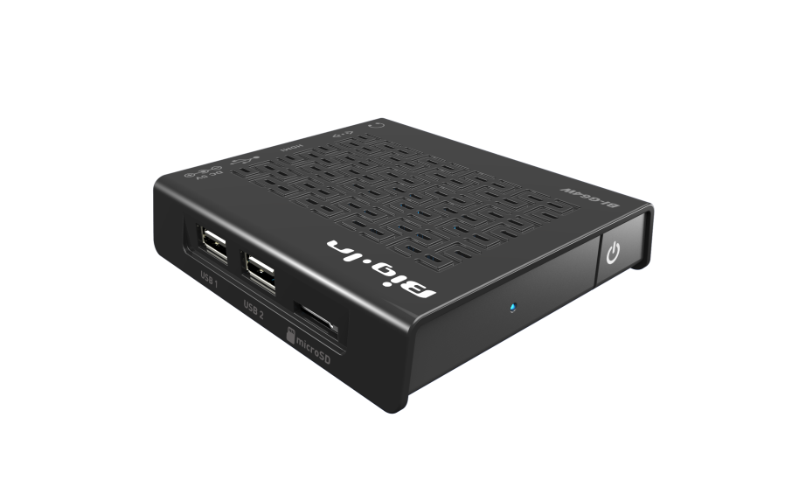
Organisation Profile
Founded in Aug. 2014.
(Helped By NIPA-National IT Industry Promotion Agency)
SEJONG Creative is deeply interested of
IoT Gateway H/W & S/W
Low Energy Small IoT G/W made by SEJONG Creative
YoungBae Seo / SEJONG Creative / yb.seo@sjcreative.co.kr

Slide 4
Proposal Introduction
The events of IoT devices must be chained
another IoT devices.
If we are deeply understanding it,
we can prevent, protect and save from the hidden dangers in your home.
Also IoT can provide convenient environments
for you
YoungBae Seo / SEJONG Creative / yb.seo@sjcreative.co.kr

Slide 5
Partners
We are willing to find R&D Partners Which can analyse IoT events data and get related funds in Eureka Day
SEJONG is looking for Big Data, Machine Learning and Security(Privacy) company(or R&D Institute)
YoungBae Seo / SEJONG Creative / yb.seo@sjcreative.co.kr

Slide 6
Contact Info
For more information and for interest to participate please contact:
YoungBae Seo / SEJONG Creative
yb.seo@sjcreative.co.kr
+82-10-2265-0212
#9069 Nuritkum Square R&D Bldg.
396, World Cup Buk-ro, Mapo-gu,
Seoul, Korea
Your
Photo
YoungBae Seo / SEJONG Creative / yb.seo@sjcreative.co.kr

