Slide 1



CELTIC-NEXT
Proposers Day
7th of September 2022, Online via WebEx
MEC over NTN
“Multimedia Edge computing over NTN”
Peretz Shekalim, PenteNetworks
peretz@pentenetworks.com

Slide 2


Teaser – the main idea
Our project is related to operation of 5G & Beyond over NTN (Focused on Satellite communications). Either DU, CU or 5G Core network functions are operated dynamically over Satellite/HAPS when and where required as a function of time, coverage area, Service type, and Network Slicing characteristics. It’s based on dynamic MEC (Multimedia/Mobile Edge Cloud) platform enable NTN as a communication services to extend SaaS paradigms in space as Private/Public Edge for 5G mutual host and RAN sharing.
The system expected to enable direct connectivity with standard smartphones or devices globally and economically, without need of terrestrial infrastructures.
When the terrestrial coverage is available, the system automatically select the optimal networks (either NTN or Terrestrial) per device, or per subscriber service according the predefined criteria's and AI models (Air interface conditions, Cost, roaming, device types, …).
MEC over NTN, Peretz shekalim, PenteNetworks, Peretz@pentenetworks.com

Slide 3
Teaser – the main benefits
  To increase the efficiency of the Satellite MEC resources, enable dynamic configuration and sharing the virtualized NTN infrastructure as a neutral host platform, to reduce significant amount for capital and operational costs.
  Enable global converge and IoT services economically
  Decrease of E2E Latency up to 50% or more (depends traffic types and customer needs)
  Enable autonomous operation of NTN when required, increase resilience and security
  Decrease the required Feeder link BW
MEC over NTN, Peretz shekalim, PenteNetworks, Peretz@pentenetworks.com

Slide 4
Organisation
Profile
We develop LTE/5G/5G-advanced solutions for Enterprises and MNOs, include private networks, IoT solutions, 5G Core, E2E orchestrator and management system, and network/services analytic tools.
Originated with R&D centre in Israel, with seasoned Team – very R&D oriented, experienced from telecom and IT industries, build networks for dozens of enterprises and mobile operators abroad.
Partner with leading service providers and system integrators
See: https://pentenetworks.com/
MEC over NTN, Peretz shekalim, PenteNetworks, Peretz@pentenetworks.com

Slide 5
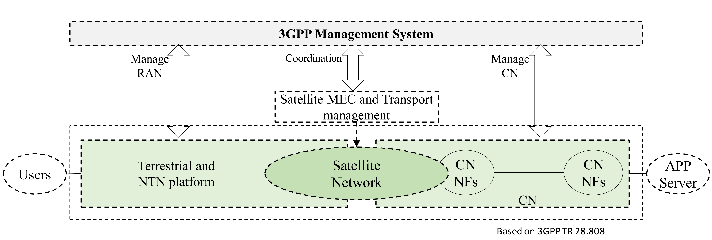
Proposal Introduction (1/2)
A dynamic 5G & beyond system architecture and operation of services optimized for unification of NTN and Terrestrial networks, use a dynamic MEC over satellite to extend SaaS paradigms, for private/public cloud services.
MEC over NTN, Peretz shekalim, PenteNetworks, Peretz@pentenetworks.com

Slide 6
Proposal Introduction (2/2)
Research and development of:
  Intelligent Edge Computing application layer based on dynamic configuration of 5G/6G RAN and Core for provisioning of Real-time services, solutions for smart industry systems and autonomous operation of 5G/6G over satellites.
  Intelligent RRM and Network Slicing allocation as a function of Time, coverage area, air interface conditions, eMTC/IoT services and devices/thing.
Optimization of Physical and protocol layers (PHY, L2/L3), RRM and DU/CU for NTN in order to:
    Reduce E2E Delay, up to 30-50%,
    Reduce FH and BH required BW,
    Increase of system resiliency,
    Decrease cost and maintain QoS and SLA.
Based on 3GPP TR 28.808
MEC over NTN, Peretz shekalim, PenteNetworks, Peretz@pentenetworks.com

Slide 7
Partners
We welcome companies and researcher in:
  Telecom industry,
  5G operators or service providers,
  5G RAN developers, MEC, Orchestrator, OSS/BSS providers
  NTN industry or system integrators
  Researchers with expertise in one or more related areas such as:
    AI/ML,
    IoT services, 5G Cellular systems, 5G RRM (Radio resource Management),
    MEC application layer, MEC orchestrator,
    satellite or NTN technologies.
MEC over NTN, Peretz shekalim, PenteNetworks, Peretz@pentenetworks.com

Slide 8
Consortium
Building
Session
From 8th-14th of September we will schedule follow-up sessions for your new project idea. Please fill in your availability as soon as possible but at the latest by 1st of September.
This session will be announced at the Proposers Day to the audience for you.
https://polls.eurescom.eu/September-CB/
MEC over NTN, Peretz shekalim, PenteNetworks, Peretz@pentenetworks.com

Slide 9


Contact Info
For more information and for interest to participate please contact:
Peretz Shekalim
Peretz@Pentenetworks.com
parwizsh@gmail.com
Tel: +972 54 3108448
Web: https://pentenetworks.com/
                Presentation available via:
Your
Photo
13 Sep. 10 CET
https://bscw.celticnext.eu/pub/bscw.cgi/d114329/MEC%20over%20NTN,%2013%20Sep%201000%20CEST.ics

