Slide 1
Celtic-Plus Proposers Day 22 September 2016, İstanbul
Virtual Reality to
Overcome Exam Anxiety
Özlem ALBAYRAK, MEBİTECH Bilişim A.Ş.
ozlem.albayrak@mebitech.com
<Your Logo>

Slide 2
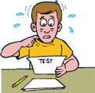
Exam Fear? No longer…
Taking exams is a
nightmare for some
Virtual Reality to Overcome Exam
helps such students to
overcome their exam anxiety
Participate because
- it is a global and common problem
- requires multidisiplinary studies
- involves state of the art technology
Özlem Albayrak, MEBİTECH, ozlem.albayrak@mebitech.com
Notes:
1 slide:
What is the main benefit of the idea/proposal?
What makes the added value?
Why should I participate in the project?

Slide 3
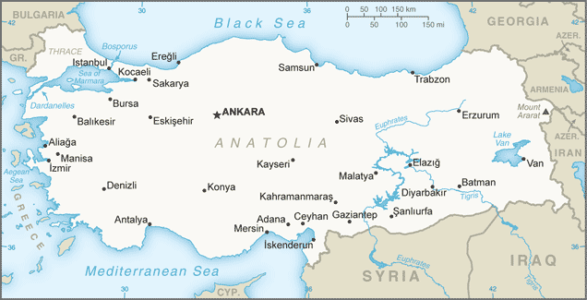
MEBİTECH Profile
Located in 3 cities
Around 80
software engineers
Selected projects:
MEBİS (Information System) (TOBB)
E-Zabıta (Konya Municipality)
TÜMAS (Meteorology General Directorate)
E- Dönüşüm (Ministry of Finance) (60 firma)
B2B Integration (Ministry of Customs)
E-Commerce Portal (İstanbul)
Law Automation and Monitoring Software
Environment, Health and Work Safety
Estimation Analysis Software
Data Quality Arrangement Software
Özlem Albayrak, MEBİTECH, ozlem.albayrak@mebitech.com
Notes:
Very short info about the profile of your organisation

Slide 4
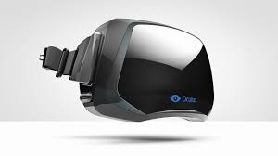
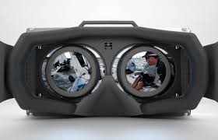
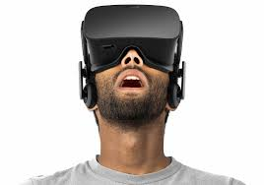
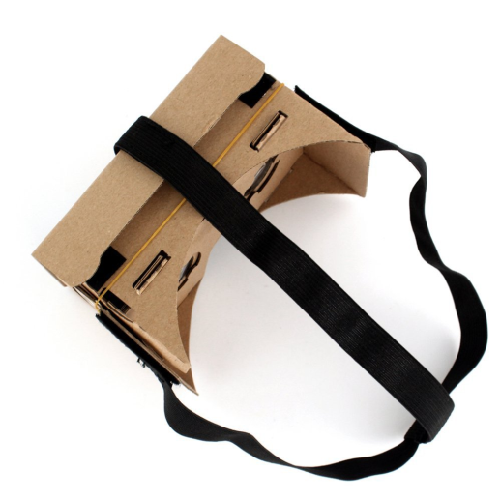
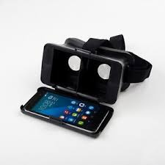
Virtual Scenarios with Glasses
Students will use
GLASSES
to be in
VIRTUAL EXAM ENVIRONMENTS
In Virtual Environments
Students will train themselves to
overcome their anxiety
Özlem Albayrak, MEBİTECH, ozlem.albayrak@mebitech.com
Notes:
Short info what the idea/proposal is about (vision, motivation, content)

Slide 5
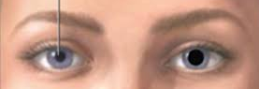
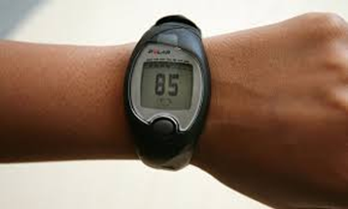
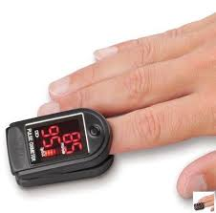
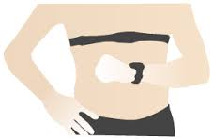
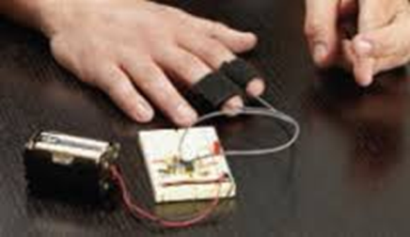
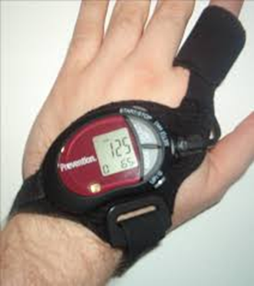
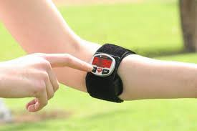
Indicators & Bio feedback
Different bio-feedback measurements will be collected
Blood pressure
Sweating level
Özlem Albayrak, MEBİTECH, ozlem.albayrak@mebitech.com
Notes:
Short info on expected outcome, impacts, schedule

Slide 6
Partners
Existing consortium, involved countries.
MEBİTECH (Turkey)
Middle East Technical University (Turkey)
Başkent University (Turkey)
Looking for:
Technology developers in Virtual Reality from any country
Özlem Albayrak, MEBİTECH, ozlem.albayrak@mebitech.com
Notes:
Existing consortium, involved countries.
Expertise, profiles and types of partners you are looking for.

Slide 7
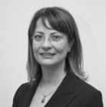
Contact Info
For more information and for interest to participate please contact:
Dr. Özlem ALBAYRAK
ozlem.albayrak@mebitech.com
+90(549) 800 5158
Uzay Çağı Cad. 1308 Sok., No:6/17
ODTÜ OSTİM Teknokent
06170 Yenimahalle ANKARA
Özlem Albayrak, MEBİTECH, ozlem.albayrak@mebitech.com

