Slide 1
Celtic-Plus Proposers Day 22 September 2016, Istanbul
IoT/M2M for smart farming using renewable energy
George Suciu – BEIA Consult
George.Suciu@BEIA.ro
www.beiaro.eu

Slide 2
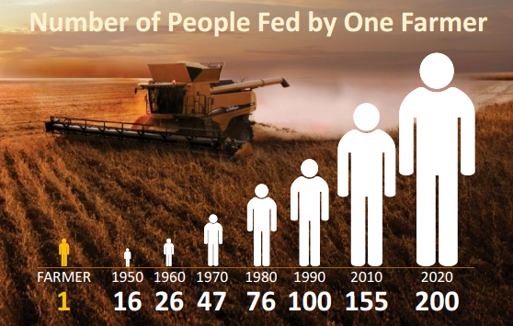
Teaser
What is the main benefit of the idea/proposal?
The project will develop a telemetry system with self-diagnosis and auto-configuration functionalities for smart farming using renewable energy sources for powering the system
What makes the added value?
The proposal aims to advance the technology for IoT / M2M communications, especially where no GSM coverage is available and to improve the energy efficiency for telemetry with low-power sensors in remote locations by using only a small size solar panel.
Why should I participate in the project?
Agriculture to feed 9 billion
Farmers and big data companies invest in precision agriculture, using sensors, drones, satellites and GPS tracking systems
farmers using only one type of precision technologies increased their yield by 16% and cut down water use by 50%.
rapid payback using these technologies
a 15% savings on seed, fertilizer, and chemicals
George.Suciu@BEIA.ro

Slide 3
Organisation Profile
Company Name | Beia Consult International SRL
General Manager | George SUCIU Sr. (george.suciu@beia.ro)
Business Field | Trading and distribution of IT & telecommunications equipment National and EU R&D Projects Telecommunications, Telemetry & IT turn-key projects
Team | Total of 40 employees: 20 engineers, 13 R&D employees (2 Ph.Ds, 1 Ph.D candidate, 5 senior researchers, and 5 junior researchers), 7 management personnel
Headquarters | 12, Poiana Narciselor st., sect.1, Bucharest
Tel / Fax | Tel: +40 21 332 3005 Fax: +40 21 332 3006
Home Page | www.beia.ro, www.beiaro.eu
Certification | ISO 9002/2000; ISO 14001;ISO27000
Established | 1991, family owned (George Suciu Sr. Founder, Jr. Co-owner)
George.Suciu@BEIA.ro

Slide 4
Proposal Introduction (1)
Motivation
Agricultural plants are extremely sensitive to climate change, because higher temperatures and changes in precipitation patterns increase the likelihood of diseases, which can lead to crop failures and irreversible damage to plants.
Current advancements in the Internet of Things (IoT) and Cloud Computing paradigms led to the development of new applications based on highly innovative and scalable service platforms, including in viticulture.
IoT solutions have a great potential in ensuring the quality and safety of agriculture products.
Objectives:
to develop a tele-monitoring system that can operate in severe condition (radiation, corrosive, humidity, extreme climate, floods, underground, underwater)
to advance the technology for M2M communications in water-environments, especially where no GSM coverage is available
to improve the energy efficiency for telemetry with low-power sensors in remote locations by using only a small size solar panel
George.Suciu@BEIA.ro

Slide 5
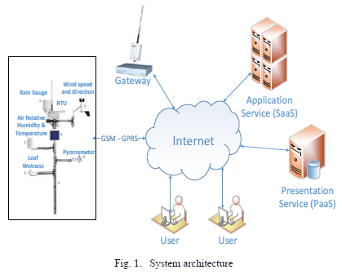
Proposal Introduction (2)
Expected outcome
Telemetry system with secure self-diagnosis and auto-configuration functionalities
Green energy operation in remote locations and harsh environmental conditions (perturbations and corrosion)
Impacts
Reduced costs and risks through automation
Integration of existing systems
George.Suciu@BEIA.ro

Slide 6
Partners
Partners involved
BEIA Consult International / SME / Romania / Development, integration and proof-of-concept prototyping work
UPB (University Politehnica of Bucharest) / UNI / Romania / Development and research of models and techniques for communication components
ICPE-CA (National Institute for R&D in Electrical Engineering) / RES / Romania / Development and research of materials for energy efficient structures
Missing partners / expertise
Under-water/ground communication expertise / IND, RES, UNI, SME / ANY country / Design and development of ultra-low power protocols for wireless under-water communication
Sensors expertise / IND, RES, UNI, SME / ANY country / Design and development of micro- and miniaturized sensor systems
George.Suciu@BEIA.ro

Slide 7
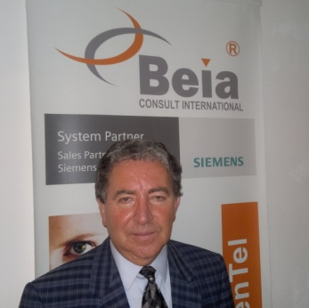
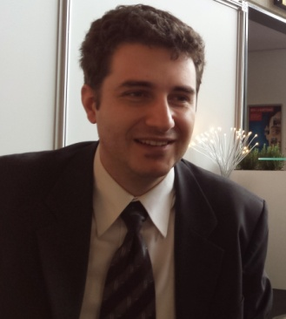
Contact Info
For more information and for interest to participate please contact:
George Suciu Sr.
+40744517799
george.suciu@beia.ro
George Suciu Jr.
+40744914798
george@beia.ro
+40-21-3323006
Str. Peroni Nr. 16
www.beiaro.eu
George.Suciu@BEIA.ro

