Slide 1
Celtic-Plus Proposers Day September 2016, Istanbul
Cost Effective Packet Analyzer for 5G
PAC-MEC Proposal
Mehmet Şimşek, Hakan Noyan, Başak Gencer Ünalsever
NETAS Telecommunications
bgencer, hnoyan, msimsek@netas.com.tr
<Your Logo>

Slide 2
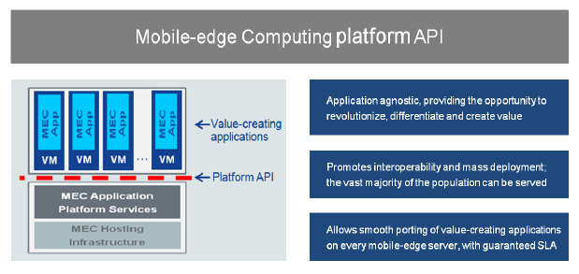
Teaser
Our motivation is to make a 5G Packet Analyzer with highly scalable, low purchasing and operating cost. And provide that as a green solution to ISPs.
Analysis of data including the application layer.
Generate statistical data and reports to help ISPs develop new Value Added Services (VAS) and or generate/activate current services quicker.
Income of ISPs will be increased via new VAS.
Better and efficient usage of network infrastructure.
Increase end users’ total Quality of Experience (QoE) in terms of speed, quality, and new services.
Mehmet Şimşek, Netaş, ysimsek@netas.com.tr

Slide 3
Organisation Profile
Netaş Telecommunications
Netas provides innovative end-to-end value added systems integration and technology services in the fields of information and communications technologies (ICT). Its customers range from telco providers to public and private enterprises in domestic and international markets. Netas’s constant increase in productivity is based on its next generation competencies around technology skillset and expertise. The company holds a track-record of 49 years and continues its foray in the field of information technologies, supported by with its experienced, best of breed research and development department. Netas also plays an important role in the modernization of the Turkish Armed Forces defense communication networks.
Mehmet Şimşek, NETAŞ, ysimsek@netas.com.tr

Slide 4
Proposal Introduction (1)
Vision
The vision is to make a scalable, cost-effective network packet analyzer designed for 5G networks.
Motivation
To improve the 5G network performance.
To improve end-user experience.
Content
5G MEC protocol, RFC compliancy research and implementation.
Parallel programming to get high computing performance from multi core/thread environments
Research on standardized statistical output data and reports to let MEC server generate VAS automatically.
Mehmet Şimşek, NETAŞ, ysimsek@netas.com.tr

Slide 5
Proposal Introduction (2)
Outcome
5G traffic analyzer solution, including cost effective flexible HW + SW
1) 5G Quality of Experience (QoE) of end users will significantly increase 2) New potential high- Value Added Services(VAS) for ISPs
Schedule
The project is planned to be finished in 2.5 years.
Impacts
Mehmet Şimşek, NETAŞ, ysimsek@netas.com.tr

Slide 6
Partners
NETAS
Core competency to coordinate this project and actively embed the researches.
SBC cluster back bone laboratory
Proven relations with mobile operators within the region
Knowledge on high-volume message processing via succession networks
Partners Needed!
With 5G research on protocols, RFCs and standardization
With SBC and parallel computing experience
With VAS infrastructure
Mehmet Şimşek, NETAŞ, ysimsek@netas.com.tr

Slide 7
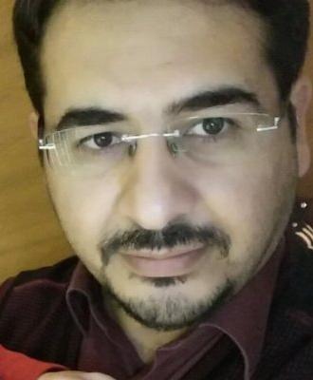
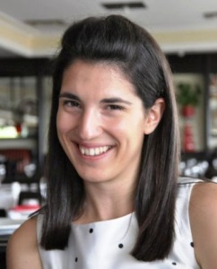
Contacts Info
For more information and for interest to participate please contact:
Mehmet Yoldas SIMSEK
msimsek@netas.com.tr
Hakan NOYAN
hnoyan@netas.com.tr
Basak GENCER UNSALVER
bgencer@netas.com.tr
Mehmet Şimşek, NETAŞ, ysimsek@netas.com.tr

