Slide 1
Celtic-Plus Event 22 September 2016, Istanbul
VAR²:
VR/AR for Physical Rehabilitation
Dr. İsmail UZUN, INOSENS
İsmail.uzun@inosens.com.tr

Slide 2
Teaser
What is the main benefit of the proposal?
VAR² allows Virtual and Augmented Reality based rehabilitation for patients (active video games) (especially for home patients through e-Health platform and motion sensors)
What brings the added value?
VR/AR based applications provide many advantages such as ease of use, repeatableness, and instantaneous measurable feedback for patients who need physical therapy.
Why should you participate in my proposal?
Convergence of VR/AR ecosystem with motion sensor and e-Health market

Slide 3
INOSENS
INOSENS
Founded in 2014
Expert on Virtual/Augmented Reality, e-Health, Data Analytics, Machine Learning
Expert on Product Development Cycles
Founder has 30+ EUREKA/TEYDEB projects experience

Slide 4
Proposal Introduction (1)
VAR² is a VR/AR based active video games for physical therapy and rehabilitaiton with e-Heatlh capability
Vision
To create global AVG and eHealth platform for Physical Therapy and Rehab.
Motivation
To design and develop VBG’s for the patinets diagnosed with JIA, CP, OBPI, etc. by using motion sensors. AVG’s will be designed to be easy to use and motivating for the patients and automatically lead the patients to correct exercises while providing mechanisms for online performance measurements.
Content
Motion Sensors, Active Video Games, e-Health, Healthcare Data Analytics

Slide 5
Proposal Introduction (2)
Outcome
VR/AR based active video games (AVG) for physical therapy and rehabilitation will be produced by using motion sensors
Impact
To enable e-Health to jump-start VR/AR
Schedule
~30 mo. (Interface Definition, Active Video Games and eHealth Platform Dev., Integration, ClinicalTests, Dissem.)

Slide 6
Partners
Current Status
INOSENS
Expected Partner Profile:
Motion sensor experts (SME/Ind)
e-Health experts (SME/Uni)
Clinics for field applications (SME)
Mobile Operators (Ind/Pub)

Slide 7
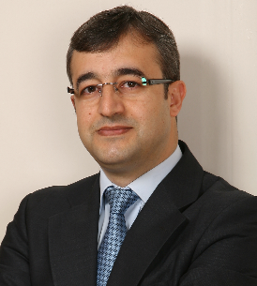
Contact
For more information and for interest to participate please contact:
Dr. İsmail UZUN
INOSENS
ismail.uzun@inosens.com.tr
www.inosens.com.tr

