Slide 1



Celtic-Plus Proposers Day
20th June 2017, Helsinki
Maths at your fingertips
Josep Tarres jtarrest@gmail.com
Timo Tiihonen timo.tiihonen@jyu.fi

Slide 2
Actionable relationships
Imagine having a set of mathematical relationships on your touch screen
  ROE= Net Income/Equity; Net Income = Pre Tax Profit*Tax Burden; etc
How to make them actionable
  To exchange inputs and outputs by a swipe
  To fix/release values by a touch
  To make all conceivable what ifs without typing/rewriting/doing the maths
How to count with your fingers in the mobile era!
Josep Tarres, jtarrest@gmail.com. Timo Tiihonen timo.tiihonen@jyu.fi

Slide 3
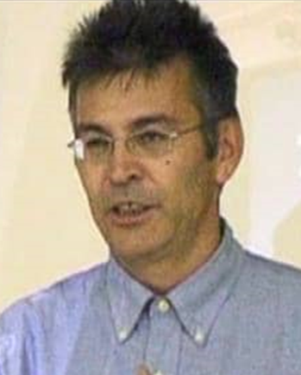
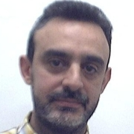
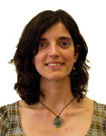
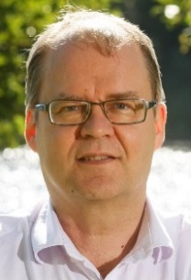
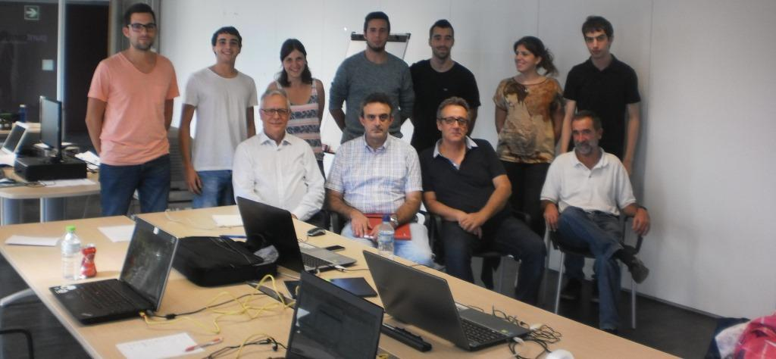
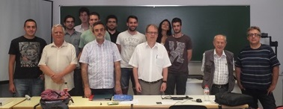
BREDEG Organisation Profile
BREDEG is a collaborative organization with
University professors:
Manuel Moreno, Universitat Politecnica de Catalunya
Joan Josep Sunyol, Fabiola Vilaseca, University of Girona
Timo Tiihonen, University of Jyvaskyla
as well as different private companies
coordinated by
Josep Tarrés
Name, affiliation & e-mail of presenter

Slide 4
Introduction to MNT
MNT complements the present knowledge and use of numerical relations
With MNT you learn and use mathematical relations with “true” mobile technology.
MNT: Intuitive, graphical, fast and reliable for
Learning (touch screen native preschoolers)
Process control (IoT GUIs etc)
Teaching (tools to support system level understanding (science, economics, etc)
MNT
Has global potential (no severe language dependencies)
Widens the possibilities, increases problem solving, simplifies calculations of present methods, shortens learning process
Josep Tarres, jtarrest@gmail.com. Timo Tiihonen timo.tiihonen@jyu.fi

Slide 5
A disruptive technology with high impact.
The vision
New ways to deal current methods trough mobile devices
Motivation
Improvement of Education and derived industrial applications
Expected outcome
A new way to complement the knowledge and use of numerical relations
Impact
It broadens user base. High market impact whenever a standard is achieved
Schedule
2018 Pilots
2019 Edu
2019 Industry
Josep Tarres, jtarrest@gmail.com. Timo Tiihonen timo.tiihonen@jyu.fi

Slide 6
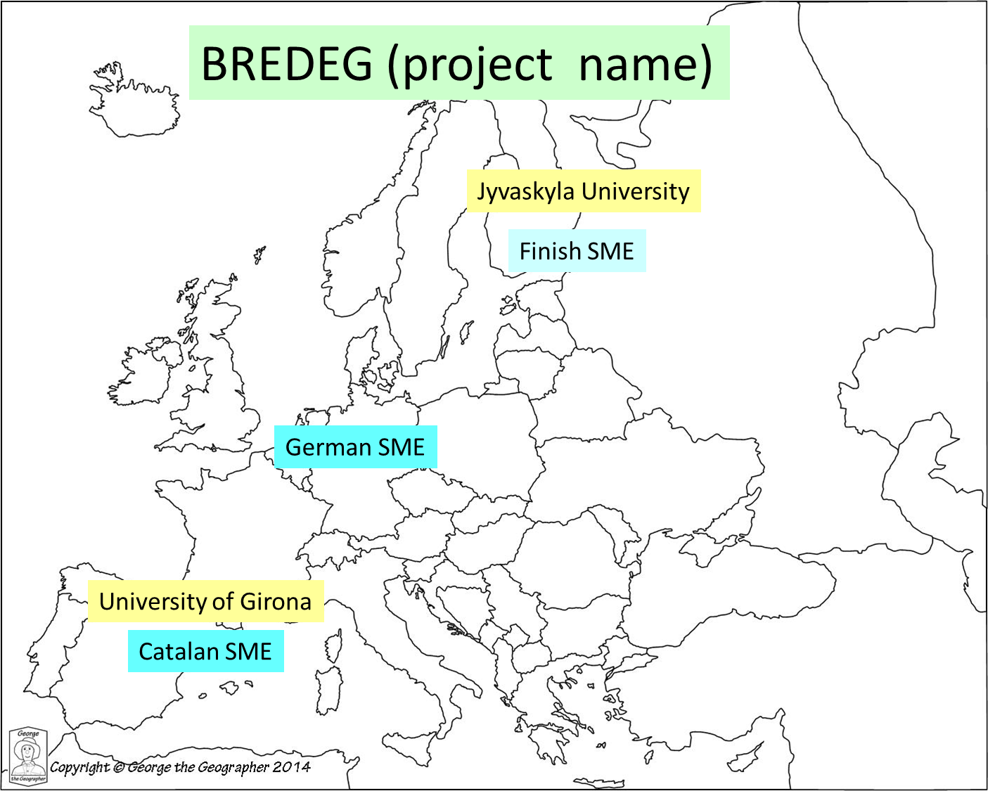
MNT Mobile Numbers technology
A REWARDING INITIATIVE with high ROI
Further development would benefit from contributions by
Software/game designers (to develop attractive and usable tools)
Learning/cognition researchers (to study, validate and justify the approach)
Josep Tarres, jtarrest@gmail.com. Timo Tiihonen timo.tiihonen@jyu.fi

Slide 7
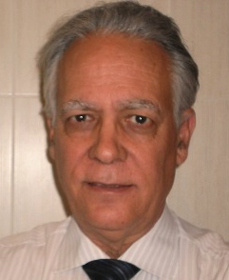
Contact Info
For more information and for interest to participate please contact:
Josep Tarrés, MNT project manager
BREDEG
jtarrest@gmail.com
+(34)606006024
Timo Tiihonen
University of Jyvaskyla
timo.tiihonen@jyu.fi
Fabiola Vilaseca
Universitat de Girona
fabiola.vilaseca@udg.edu
Josep Tarres, jtarrest@gmail.com. Timo Tiihonen timo.tiihonen@jyu.fi

