Slide 1
Celtic-Plus Proposers Day 20th June 2017, Helsinki
Safe and Secure
Vehicular Communication Systems
Ali Balador, Senior Researcher
Hossein Fotouhi, Senior Researcher

Slide 2
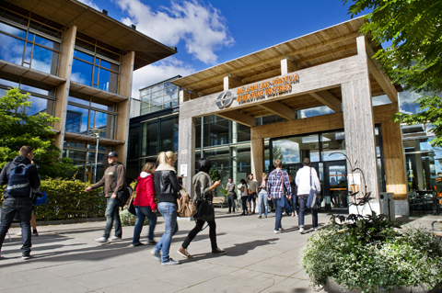
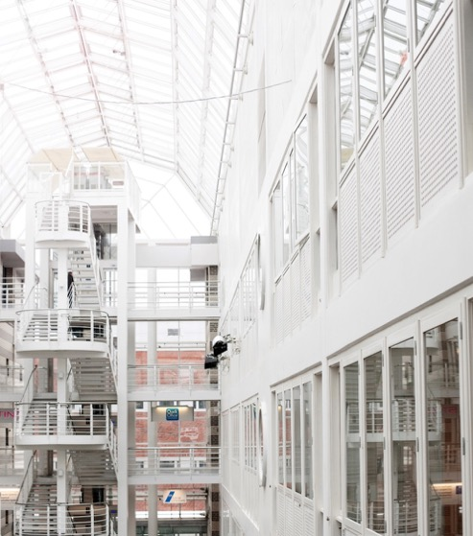
Organisation Profile
Mälardalen University (MDH) is located in Västerås and Eskilstuna, Sweden, founded in 1977.
MDH has 14,000 students and 900 employees with 71 professors.
Embedded systems is among the most prioritized research areas at MDH, where it has internationally leading competence.
RISE SICS is a leading research institute for applied information and communication technology in Sweden, founded in 1985.
202 Staff (76 Ph.D., 32 Professors)
Application areas, such as Internet of Things, Industrial Automation and Maintenance, Automotive and Rail, Telecom, Digital Health, Decision support and business intelligence, Data Centers.
Ali Balador, RISE SICS Västerås, ali.balador@ri.se

Slide 3
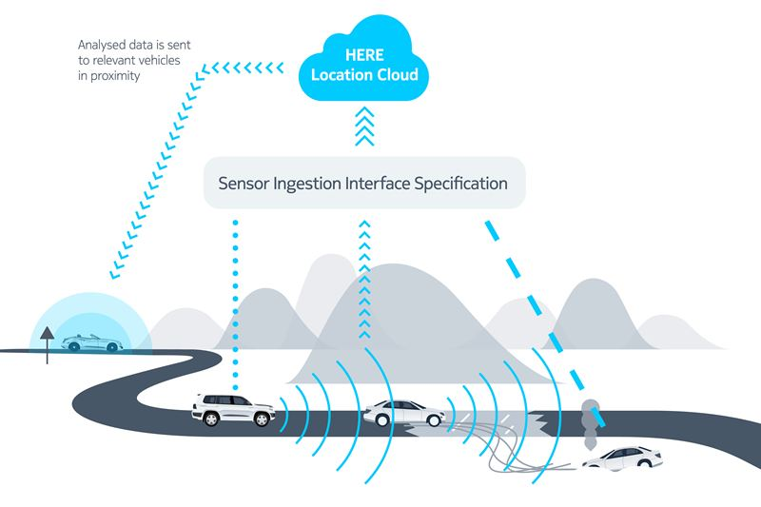
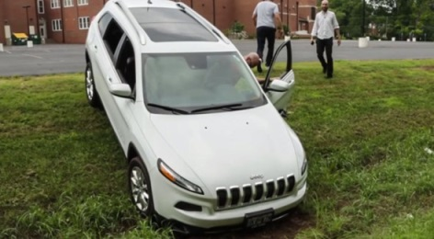
Proposal Introduction (1)
Communication Technologies
Mobile edge computing
LTE/5G
WiFi/Bluetooth
ITSG5 (DSRC)
LTE/5G
Unwanted access must be denied
WiFi/VLC/ Radar
Safety & Security
HACKED!
Ali Balador, RISE SICS Västerås, ali.balador@ri.se

Slide 4
Big Data & Connected Vehicles
Volume:
25 GB
of data per hour
generated from
a Plug-in hybrid
vehicle
Variety:
80%
of data is
unstructured –
traffic, weather,
docs
Data generated by connected vehicles compared to data usage of online activities (per hour)
Velocity:
38
microsecond
response to
millions of
events per
second
Veracity:
3% - 5%
of warranty
claims are
fraudulent
Source: AT&T, McKinsey, Verizon
Ali Balador, RISE SICS Västerås, ali.balador@ri.se

Slide 5
Proposal Introduction (2)
Expected Outcomes:
Safe and secure vehicular communication system
New services and efficient operation based on analyzing connected car data
Impacts:
Reduction of pollution (air pollution, noise, ..)
Reduction of congestion
Increased safety
Reduction of transfer cost and Increased transfer speed
More services and infotainments
Schedule:
Target for October 2017 call
Ali Balador, RISE SICS Västerås, ali.balador@ri.se

Slide 6
Partners
Sweden:
MDH,SICS
AstaZero
NEVS
Volvo
Alten
TELE2IoT
Cybercom
Germany:
Fraunhofer IIS
Qosmotech
Turkey:
Ericsson
Koc University
Enforma
France:
Telecom-sudparis
NagraVision
South Korea:
Katech
Looking for partners:
OEMs
Telecom industries, network operator
Universities and research institutes
Ali Balador, RISE SICS Västerås, ali.balador@ri.se

Slide 7
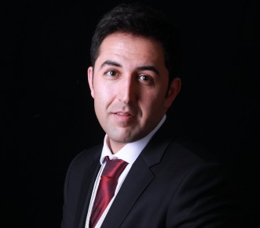
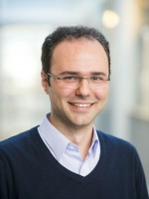
Contact Info
For more information and for interest to participate please contact:
Ali Balador
Senior Researcher
RISE SICS Västerås
ali.balador@ri.se
+46 73 053 21 33
Kopparbergsvägen 10, 722 13 Västerås, Sweden
www.sics.se/groups/rise-sics-vasteras
Hossein Fotouhi
Senior Researcher
Mälardalens högskola
hossein.fotouhi@mdh.se
+46 73 960 73 23
Högskoleplan 1, 721 23
Västerås Sweden
www.es.mdh.se/staff/2992-Hossein_Fotouhi
Ali Balador, RISE SICS Västerås, ali.balador@ri.se

