Slide 1

Celtic-Plus Proposers Day
23 November - IMEC - Leuven (Belgium)
Pitch of the Project Proposal
<< IPG4U >>
Roger Roberts
roger.roberts904@gmail.com

Slide 2
Teaser
80 %
“I invite each of you to sit down in front of your television set when your station goes on the air and stay there, for a day, without a book, without a magazine, without a newspaper, without a profit and loss sheet or a rating book to distract you. Keep your eyes glued to that set until the station signs off. I can assure you that what you will observe is a vast wasteland.”
FCC Chairman Newton Minow in 1961
Roger Roberts – roger.roberts904@gmail.com

Slide 3
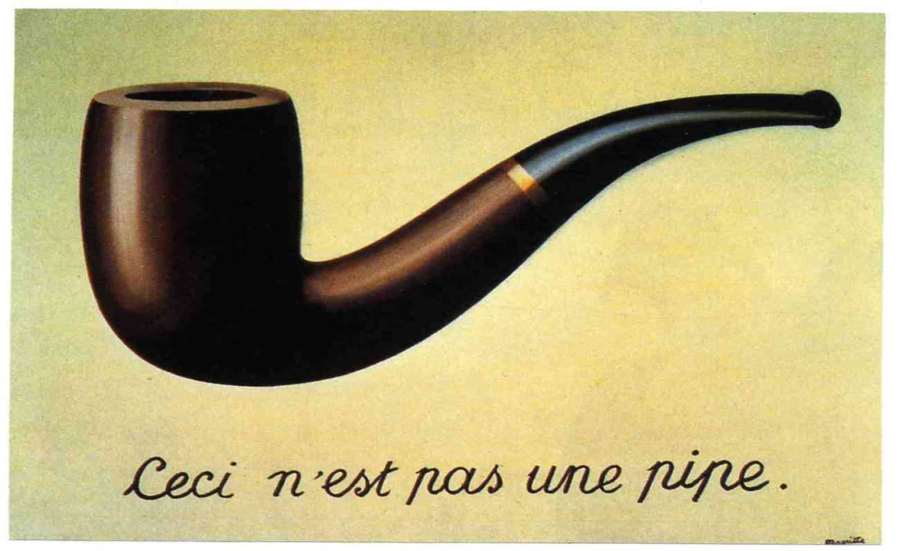

Organisation Profile
TITAN is a Think Tank that works on migration capacity, exchange and persistence of Media in a Digital and Semantic Universe!
The object is not
the representation
The representation is not
the meaning
Roger Roberts – roger.roberts904@gmail.com

Slide 4
Modeling of a signs system:
September 11
attacks
Connotation
Signified
Denotation
Month/Day/ Year
Signifier
Representation
09/11/2001
Roger Roberts – roger.roberts904@gmail.com

Slide 5

Modeling of a digital sign system:
September 11
attacks
Connotation
?
Denotation
Month/Day/ Year
?
Representation
09/11/2001
09/11/2001
00110000 00111001 00101111 00110001 00110001 00101111 00110010 00110000 00110000 00110001
Digitalization
Roger Roberts – roger.roberts904@gmail.com

Slide 6
Proposal Introduction (1)
IPG4U intends to extend the actual EPG (Electronic Program Guide) into an Interactive Program Guide as a means of finding and ordering media content on any TV or mobile platform: Linear TV and radio, video and audio content on demand, OTT offering, web and mobile specific contents..
Based on semantic Web 3.0 technologies, IPG4U will make it possible for users to select content in a complete new navigation experience based on various content qualification, analytics and user preferences. It will also use the LOD (Linked Open Data) network to enrich content indexing, and will open new smart navigation opportunities: a discovery guide.
As part of the recommendation processes, IPG4U will as well experiment new methods of auto-promotion for TV or radio programmes, using social media networks, selecting opinion leaders and key topics thanks to some social media analytics tools.
As such, the modelling and technology developed by IPG4U could be a key element for the further adoption of 360-degree publishing strategies by telecommunication operators against the diverse cultural and linguistic backdrop that Europe has to offer!
Roger Roberts – roger.roberts904@gmail.com

Slide 7








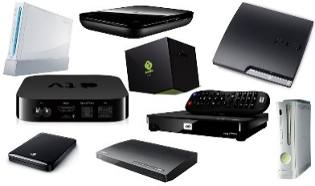
The “IPG4U” project: Meta#data flow proposed architecture
Pre-Prod.
MAM
CMS
Social media review
Opinion leaders
Key topics
Communities
Communities
Meta#data
documentation
Live PGM
VOD
Web Portal
EPG
scan
data
data
data
Meta#data
control
Automation
middleware
Knowledge
Base
Time coded tags
Broadcast Front End
IP Front End
NETWORKS
Connected
TV
VOOGLE
Video Object Ontology Global Linking Egine
Set-up box
PCs
web
Tablets
IOW: Interoperability wicket
Live Broadacast & Data Synchronization

Slide 8
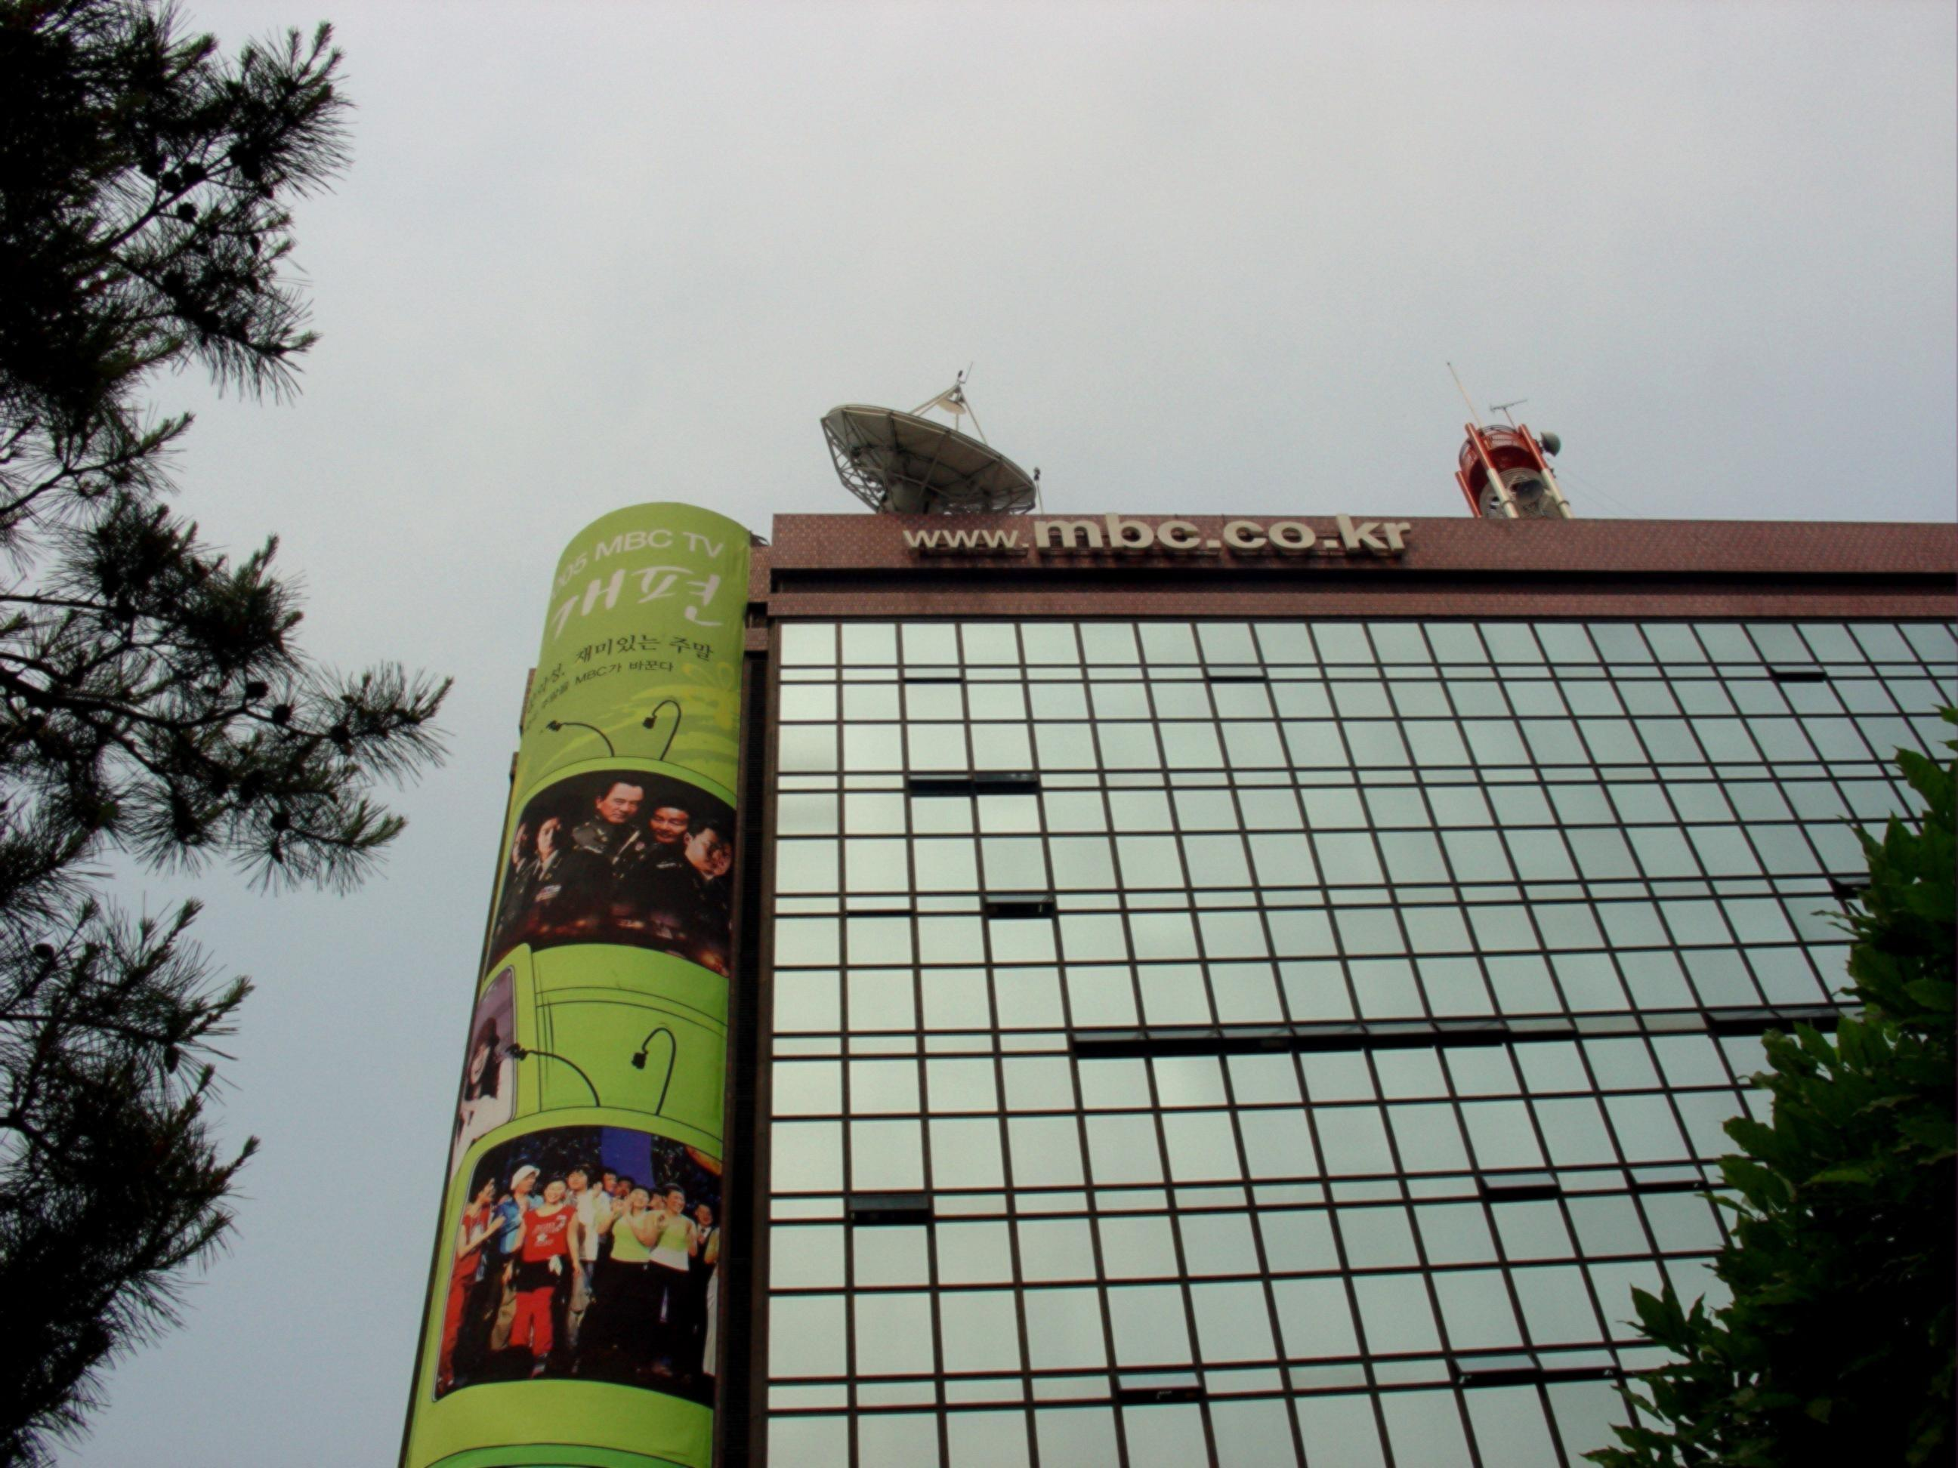
The “IPG4U” project: work packages
. B2C usages
. B2B usages
. Validate Rights ontology choice (MPEG21-RAI) and Norms to be used (Mix of Web-3 and HTML5, DVB) as well as programmes identification issues
. Building a semantic AV Lake using semantic middleware,
. Creating an IPG database on the Internet, and enriching it with Linked Open Data
. Pushing semantic tag and information to Front End
. Create interoperability wickets to integrate information from Agilience and from broadcaster salehouse (contextual advertisement)
WP1. Project management
WP2. Usages specification
WP3. Enhanced MAM & automation
WP4. Semantic A/V Lake
A. Create workflows to gather information and transfer to and back from the Semantic Lake
B. Transfer secondary events to set-up boxes for linear or for on demand TV using automation or for streaming on the web
TV distribution networks
WP5. Augmented Front End
. Creating a tool which allows synchronized display of information and content visualization as well as cache distribution for comfortable navigation
- Prototype publishing Testing and demonstrating new services on
.. A. Web
.. B. Tablet/smartphone & Set-up boxes
. Recommendation using semantic lake to determine what and Agilience for to whom recommendations are made
WP6. Dissemination
. Norms adaptation (TV anytime, DVB)
. Publishing breakthrough

Slide 9
The “IPG4U”: new usages
Semantic query<<<<<<<<<<<<<<
. Receiving contextual info during program watching
. Large choice of language subtitles
. Social media trailers
. Accessing to audio-description
. Smart semantic navigation
. Rich media program guide
. Community services for sport fans or series fans
. Content recommendation based on social media/semantic analysis categories
. Content alert based on user preferences
. Zapping to my favorite producer content (live or VOD or Internet content)
. Large memory of programs for radio and TV (incl. linear, VOD and Internet)
. User generated content registration…
. B2C usages
WP2. Usages specification
. B2B usages
. Rights availability and owners identification
. Smart navigation in program knowledge base before content acquisition
. New content or version registration
. Afterwards rights clearance and declaration
. Smart indexation and additional cataloging, …

Slide 10



The “IPG 4 U” project : partners (1)
The actual consortium (French and Belgian companies):
    Perfect Memory adapting its semantic technology and middleware extractor to build the future semantic platform and IPG database
    SGT, the French automation system provider, used by “broadcasters” as automation system for their broadcast operations, therefore provide MAM and automation platform as well as workflow engine to build all exchanges of information and media with sources and Perfect Memory semantic data base
    Agilience, a French start-up able to identify and address opinion leaders of viewers communities through social media (communities such as BeTV subscribers who are fans of football or documentaries) thanks to smart custom algorithms technology
Plurimedia leaders of EPG data market in France and in Belgium, to develop new B2B services for content distributors, enabling them to access to a richer information for commercialization, providing currently EPG info and keywords to qualify content
Roger Roberts – roger.roberts904@gmail.com

Slide 11





The “IPG 4 U” project : partners (2)
    Belgavox, as documentary producer as well as archive rights owner, will help to specify and to test the rights management design and distributors new usages
    VOO as Belgian Pay TV operator experimenting a new platform of services and in capability of offering a real panel of viewers/subscribers for testing these new services
    Its subsidiary pay-TV broadcaster Be TV (bouquet of 43 TV-channels including 7 “owned and operated”) to elaborate relevant new 2nd screen usages and services for its viewers and delivering internal programme information for enriching future IPG database
    Meanwhile Kane, specialist of benchmark studies and business intelligence will manage the project with the help of TITAN association, especially in charge of dissemination. Titan will as well be active in the specification of the standardization, the modelling, structuring of objects & wrapper issues.
Roger Roberts – roger.roberts904@gmail.com

Slide 12




The “IPG 4 U” project: possible partners (3)
The following possible partners have not yet agreed on partnering:
    FranceTélévisions laboratory has implemented a semantic base (collecting all metadata in the early phase of production that could be used as test and field trial for building the Data Lake and specify certain usages in the project
    Eltrona : a cable operator in Luxemburg offering technology for Broadcasting and Security
    Fraunhofer IDMT (Institute for Digital Media Technology - Ilmenau) : Business Unit Media Management and Delivery.The Media Management and Delivery business unit offers solutions for automatic annotation, search and quality control of audiovisual content as well as for management, processing and interactive usage of A/V content.
    The EBU (European Broadcasting Union) will be present as associate partner to make the liaison between the project and the various normalization authorities especially regarding the “TVAnytime” EPG standard.
    - YOU !!!!!!!!!!!!!!!!!!!!!!!!!! -
Roger Roberts – roger.roberts904@gmail.com

Slide 13
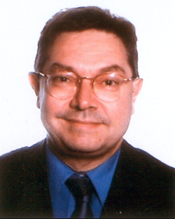
Contact Info
For more information and for interest to participate please contact:
Charles Bebert
<charles.bebert@gmail.com>
Tel : +33143295305
Kane, 47 rue Vavin, 75006 Paris - France
Join a consortium of European companies, a panel of operators and broadcasters to imagine and test new AV usages using the actual infrastructures!
Roger Roberts – roger.roberts904@gmail.com

