Slide 1
Celtic-Plus Proposers Day
Thomas Kallstenius
Program director security & privacy

Slide 2
imec’s mission
Imec is the world-leading R&D and innovation hub in nanoelectronics and digital technology.
Notes:
Imec’s Mission (1)
Imec is the world-leading R&D and innovation hub in nano-electronics and digital technology.

Slide 3

Notes:
Our uniqueness, our unique fingerprint is our combination of …

Slide 4

Notes:
… most advanced microchip technologies and …

Slide 5

Notes:
… profound software and data management skills …

Slide 6

Notes:
with specific emphasis on digital privacy and security.

Slide 7

iMinds
World-leading digital innovation in Internet of Things, Data science and Security/Privacy
Delivering industry relevant solutions serving ICT, Media, Manufacturing, Healthcare, Energy and Smart Cities markets
850+ researchers
100+ new demand driven projects/year
7 European Research Council Grants
90+ start-ups
#4 incubator world-wide
HQ – LEUVEN, BELGIUM

Slide 8
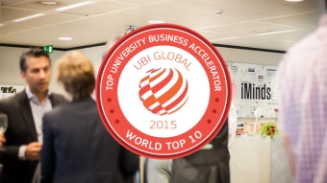
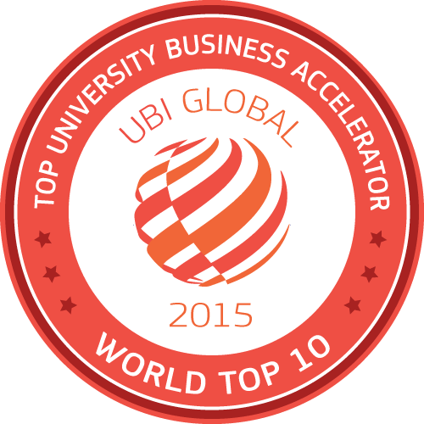
#4 university incubator in the world
90+ start-ups
20 new companies/year
#2 in Europe*
#4 worldwide*
(*) http://ubi-global.com/research/ranking/rankings-2015/#globaluba2015
Notes:
The µPnP technology was demonstrated at the IPSO challenge in a smart building scenario, where the team was awarded third place.

Slide 9
Luc Van den hove
President & CEO
Veronique Wijns
exec. support office
Filip Merckx
CFO
Inge Neven
Chief of staff & PMO
Katrien Marent
corporate&Marketing Communication & outreach
HUBERT DENEVE
lisbeth decneut as of 1.1.17
human resources
Jo De Boeck
CTO
ludo deferm
risk & compliance
Hans Lebon
CORPORATE SUPPORT & INfrastructure
An Steegen
Silicon Technologies & systems
(incl Fab operations)
Rudi Cartuyvels
smart electronics &
business development
Danny goderis
smart applications &
innovation services flanders
max mirgoli
world-wide
account management
eXECUTIVE
Board

Slide 10

close to 3,500 highly skilled researchers
Notes:
Worldwide – and especially in Flanders, Belgium – we employ close to 3.500 highly skilled researchers from over 70 nationalities who deliver industry relevant and life enhancing solutions.

Slide 11
revenue
2016: >500M€

Slide 12
74 different nationalities

Slide 13





















































































Notes:
we work together with key industrial partners and academia from all over the world across a variety of industries such as healthcare, smart cities and mobility, logistics and manufacturing, and energy. We stimulate entrepreneurship and kick-start technology start-ups.

Slide 14
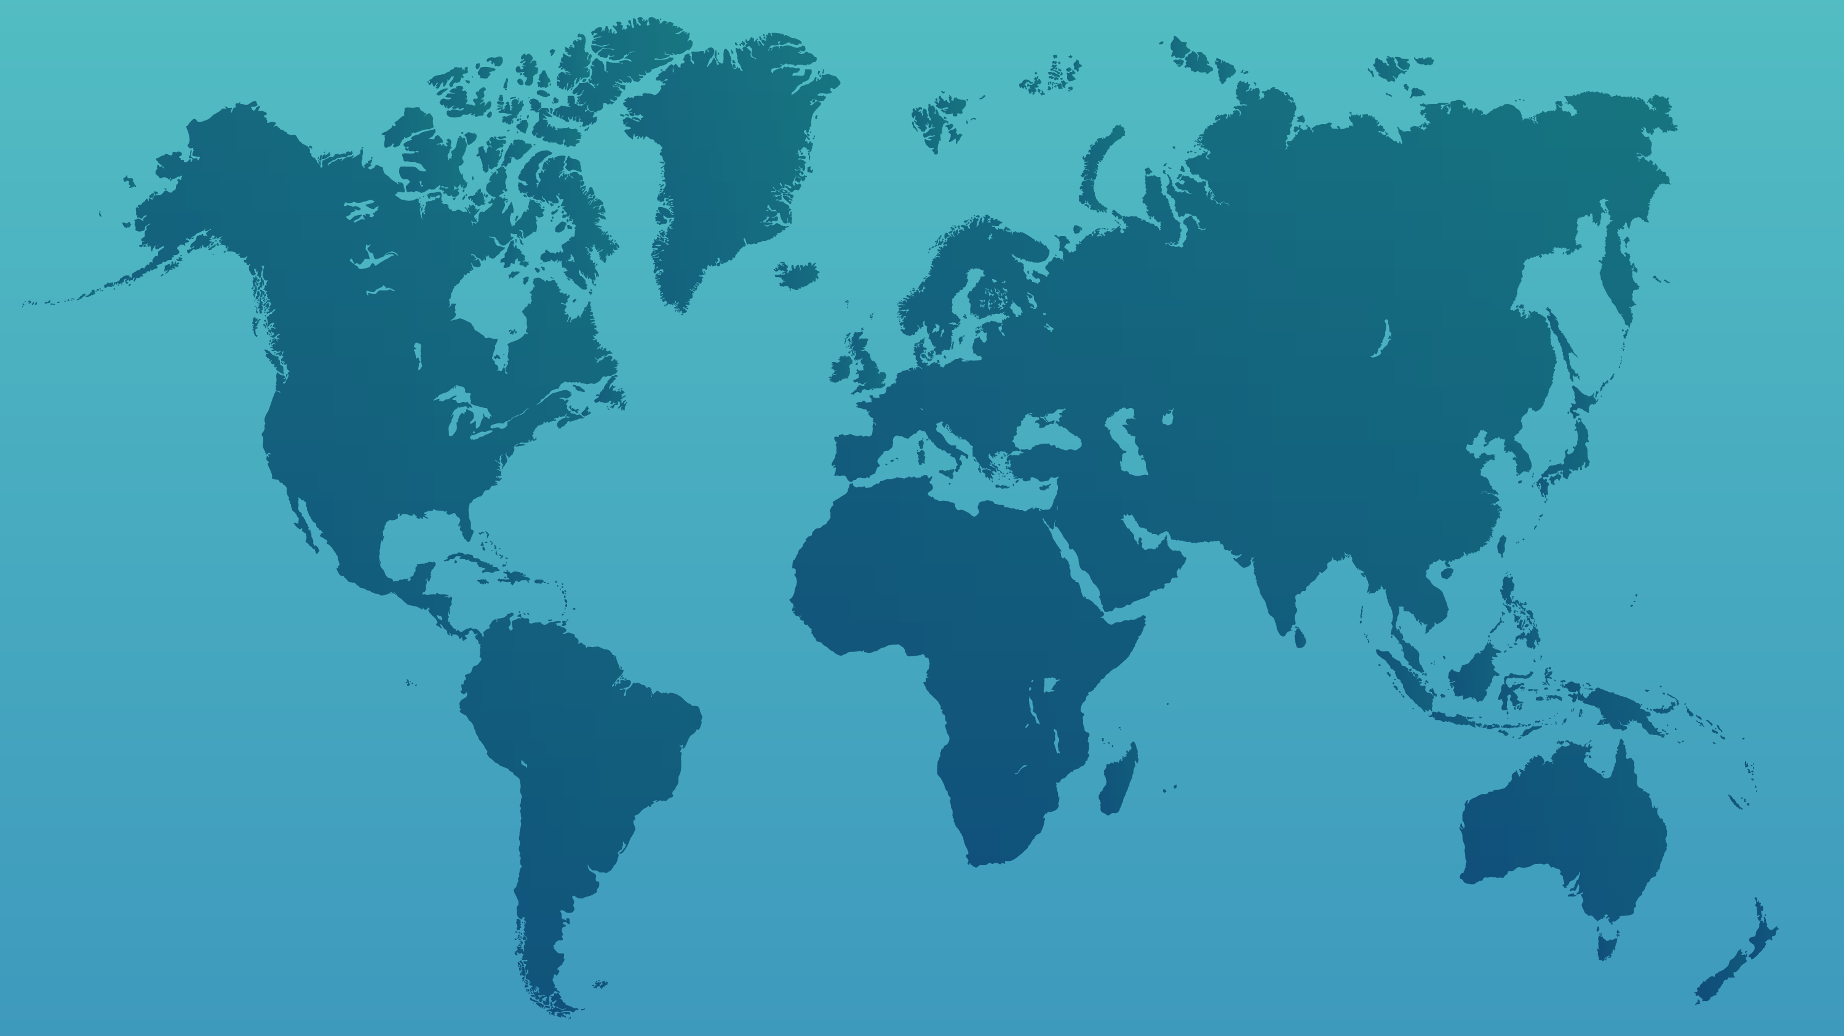

BELGIUM
THE NETHERLANDS
LEUVEN HQ - GHENT
EINDHOVEN
JAPAN
JAPAN
OSAKA
TOKYO
USA
SAN FRANCISCO
CHINA
USA
SHANGHAI
ORLANDO
TAIWAN
INDIA
HSINCHU
BANGALORE
Notes:
offices spread across the world.

Slide 15





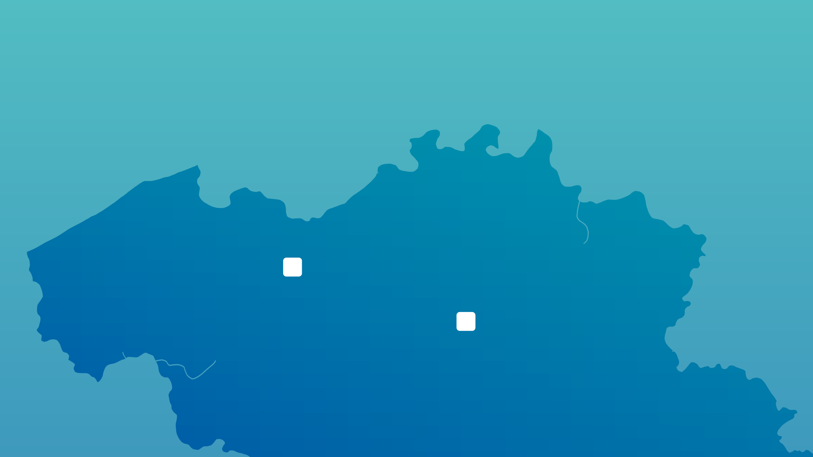

LEUVEN
HEADQUARTERS
GHENT
SMART APPLICATIONS
Notes:
We thereby make use of world-class infrastructure, including 12,000 square meters of clean room capacity containing the most advanced collection of microchip processing tools in the world, and state-of-the-art (bio, wireless, imaging, …) labs.
We also have labs in all flemish universities; and…

Slide 16





Notes:
we use these skills in order to create groundbreaking innovation in application domains such as healthcare, mobility and smart cities, logistics and manufacturing and energy.

Slide 17
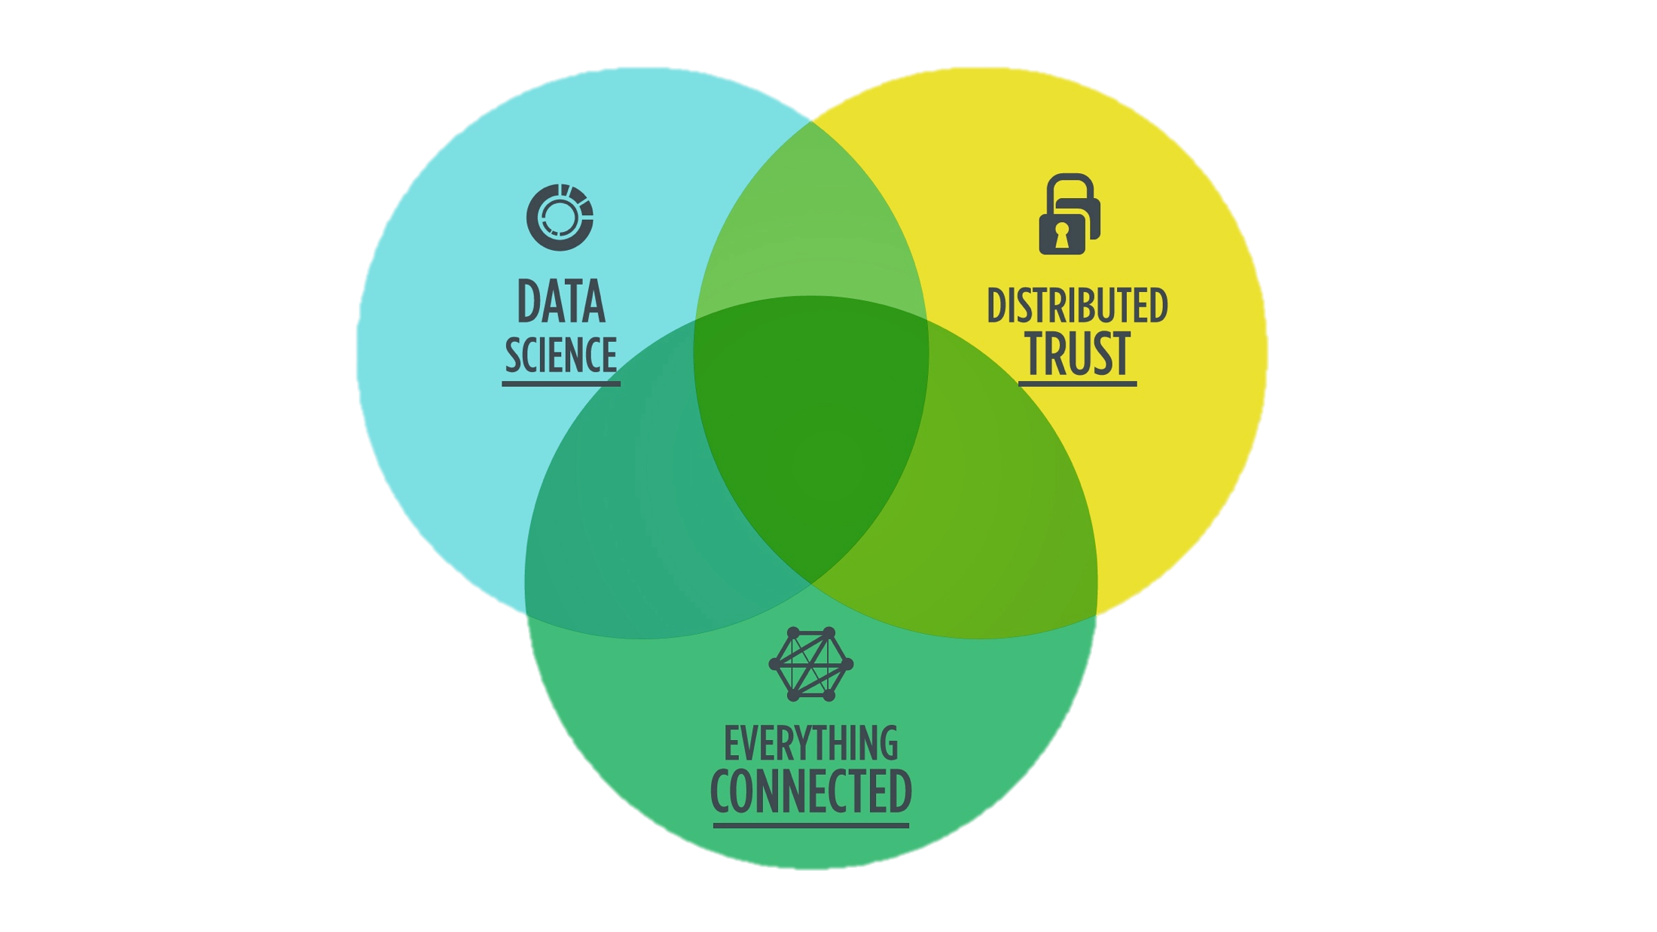
Notes:
we use these skills in order to create groundbreaking innovation in application domains such as healthcare, mobility and smart cities, logistics and manufacturing and energy.

Slide 19
Data Quality
Provenance
Deep Learning
Semantics
Data Visualization
Cloud Security
IoT Security
Data Protection
& Privacy
Deterministic Connectivity
Guaranteed Delivery
Reasoning and actuation
Notes:
we use these skills in order to create groundbreaking innovation in application domains such as healthcare, mobility and smart cities, logistics and manufacturing and energy.

Slide 20
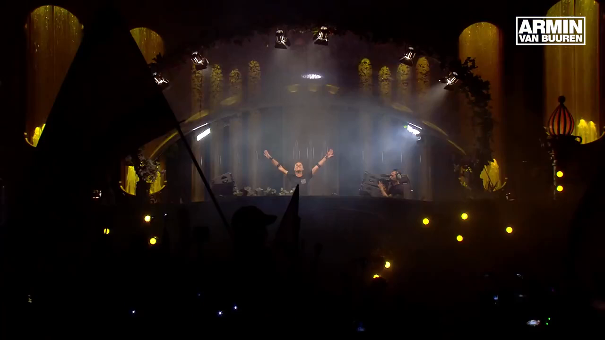
80 000
festival bracelets
massive
interference
80 000
smartphones
1000
wireless routers
Notes:
One of the most challenging environment is a large music festival.
Tomorrowland one of the biggest electronic music festivals in the world. In Boom, 16km south of Antwerp.

Slide 21
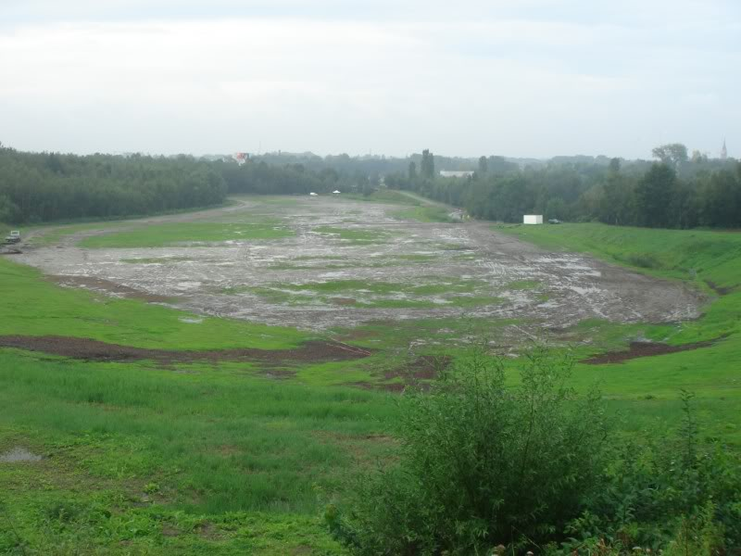

Slide 22
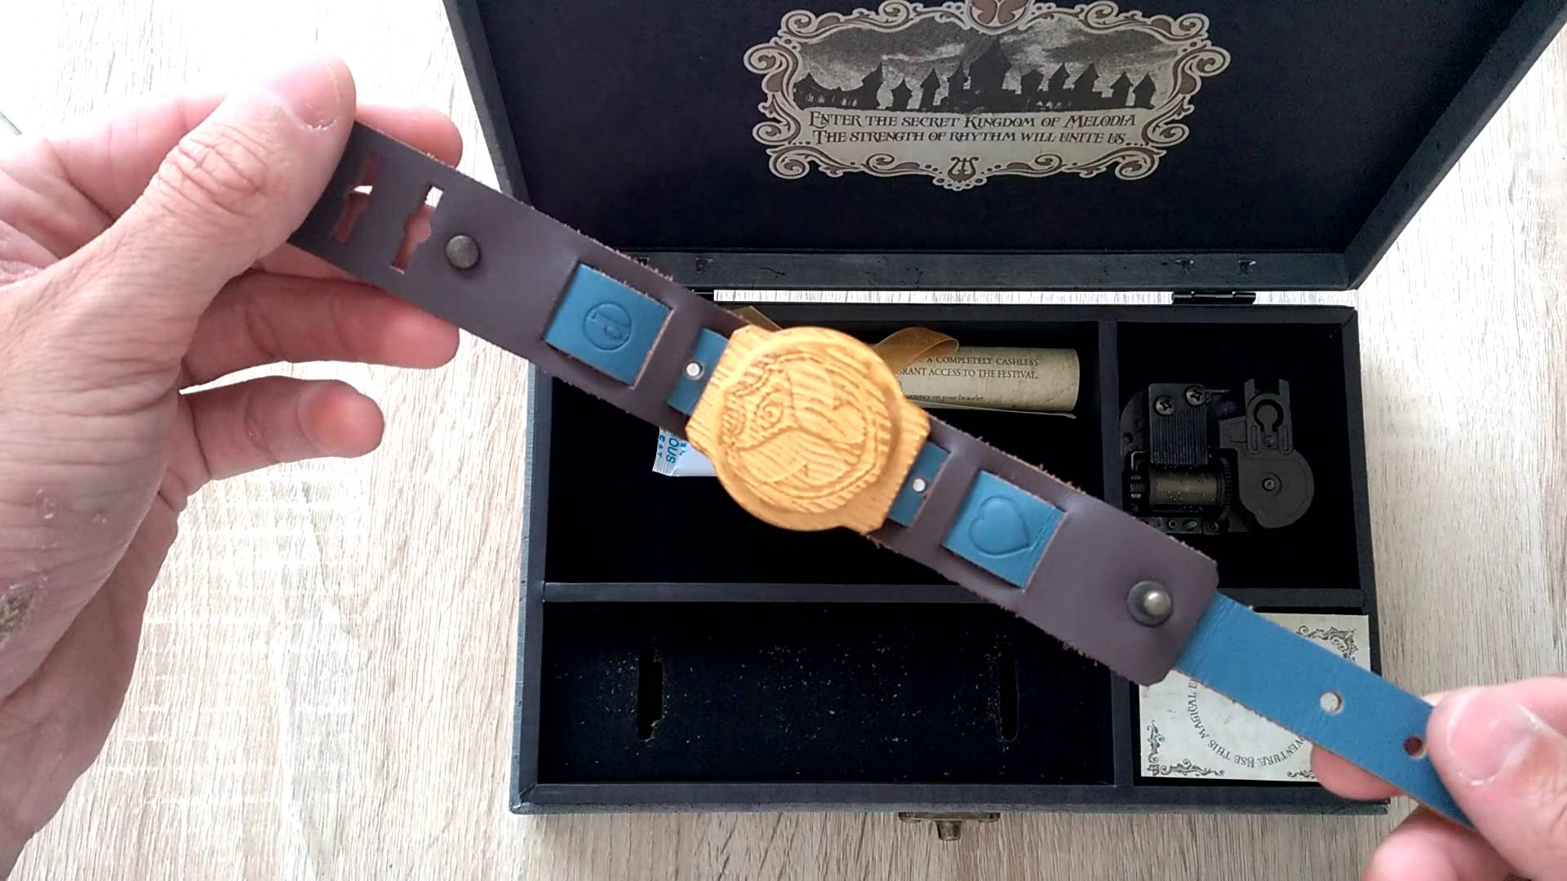
Notes:
Tomorrowland asked us to help them with the design of their bracelet.
One specific feature: Synchronize the LEDs to the music.

Slide 23
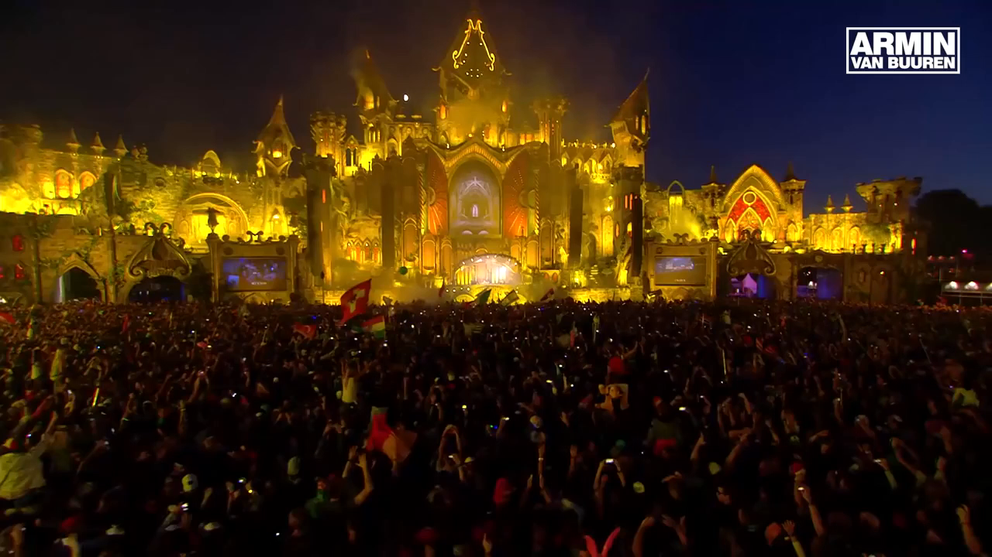


Scalable communication for 80 000 bracelets
Continuous stream of data, latency optimized
WiFi broadband hotspot of 100+ access points
Adaptive protocols that cope with the interference

Slide 24
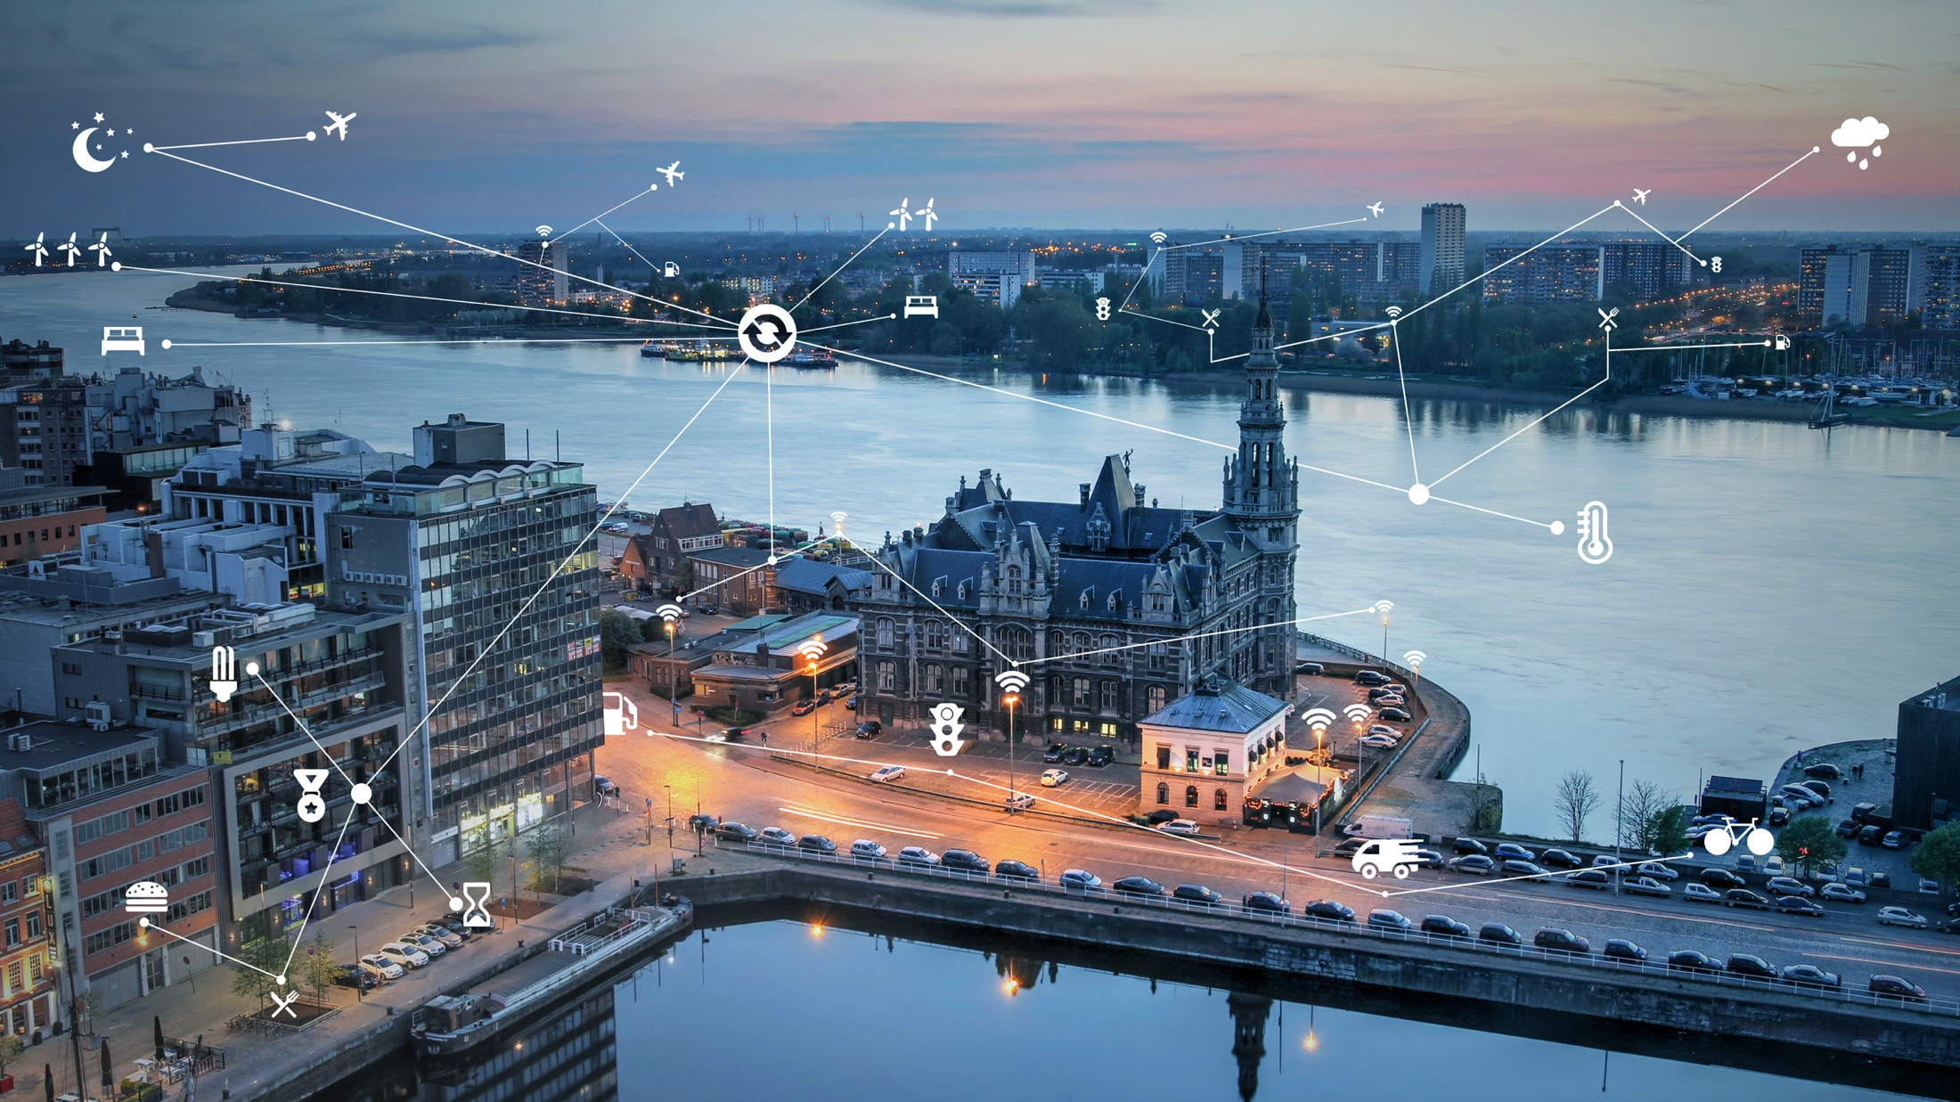
City of Things
Notes:
Further to the north, we have Antwerp.
iMinds, imec and a number of industry partners
One of the largest living labs for IoT in Europe.
But before there was the City of Things, there was the City of Strawberries

Slide 25

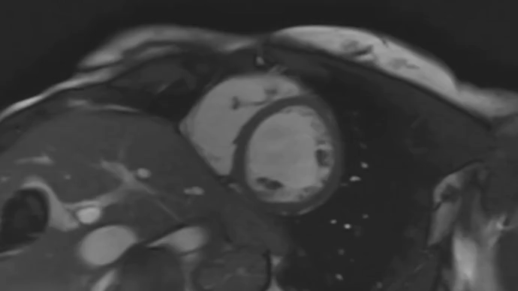
Diagnosing Heart Disease using Deep Learning
Notes:
http://irakorshunova.github.io/2016/03/15/heart.html
In 2016, The Data Science Lab team came up second in Kaggle’s “National Data Science Bowl" competition, in what was generally considered to be a highly challenging datasets. This time, the aim was to predict the minimal and maximal volumes of the left ventricle (heart chamber) from a set of MRI video sequences. Initially, the model had to be developed based on labeled examples from only 500 patients and once more, our group’s solution was based on the combination of a large number of deep learning models. That was quite challenging, because usually deep learning datasets are much larger. In addition, the amount of information and the precise location in the body in which each video was recorded varied a lot between patients. We had to focus on making our top-level model combiner robust against missing data. It also needed to know how confident each model was in order to come up with a final prediction."

Slide 26

Diagnosing Heart Disease using Deep Learning
Notes:
http://irakorshunova.github.io/2016/03/15/heart.html
In 2016, The Data Science Lab team came up second in Kaggle’s “National Data Science Bowl" competition, in what was generally considered to be a highly challenging datasets. This time, the aim was to predict the minimal and maximal volumes of the left ventricle (heart chamber) from a set of MRI video sequences. Initially, the model had to be developed based on labeled examples from only 500 patients and once more, our group’s solution was based on the combination of a large number of deep learning models. That was quite challenging, because usually deep learning datasets are much larger. In addition, the amount of information and the precise location in the body in which each video was recorded varied a lot between patients. We had to focus on making our top-level model combiner robust against missing data. It also needed to know how confident each model was in order to come up with a final prediction."

Slide 27
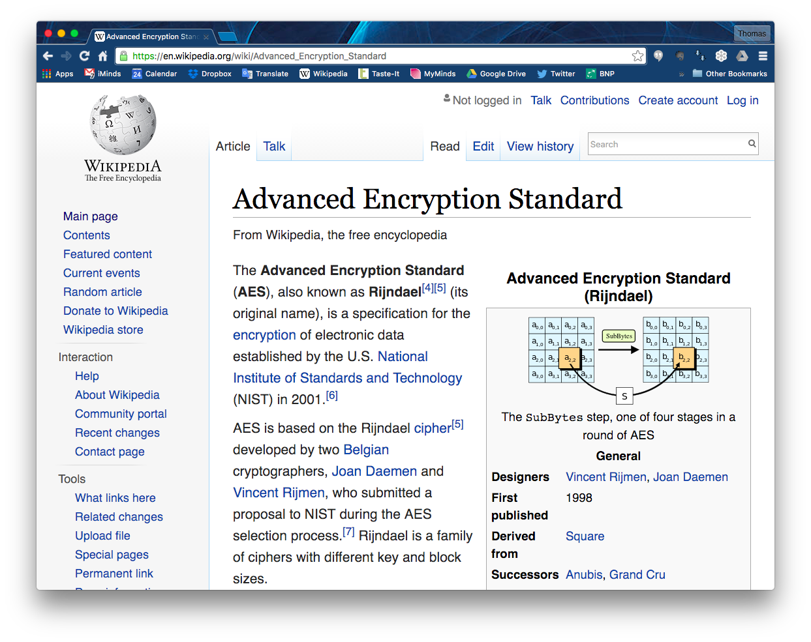
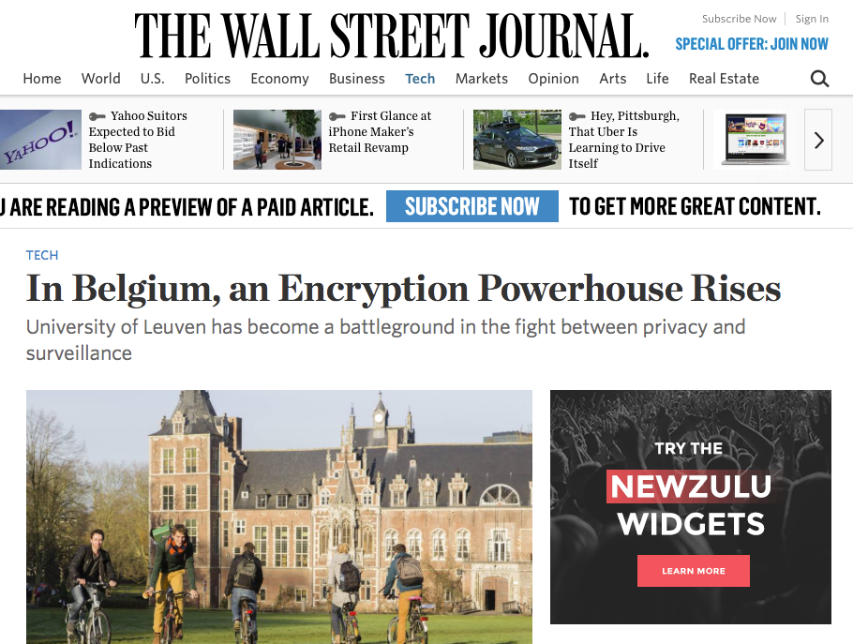
Advanced Encryption Standard
(AES)
Notes:
The worlds most popular algorithm used in symmetric key cryptography
The first (and only) publicly accessible cipher approved by the National Security Agency (NSA)

Slide 28
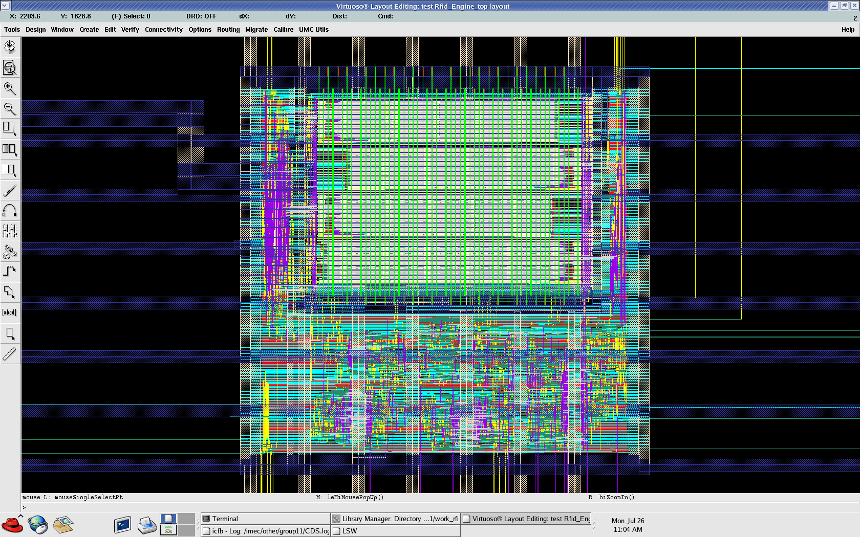
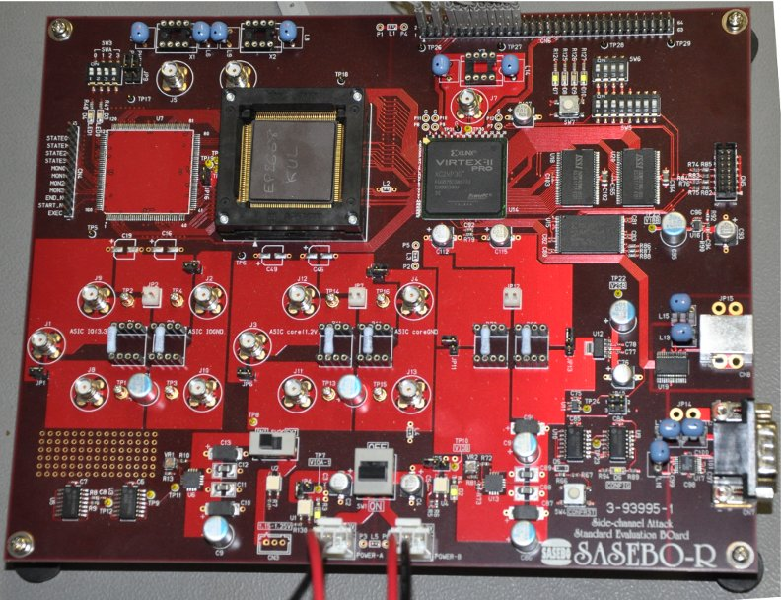
Cryptography
for IoT
Elliptic curve cryptography
  one point multiplication <5µJ
Based on optimized HW and SW co-design
Notes:
Hi Thomas,
Yes, the low power ECC is very suitable for IoT.
1. This work was first published in the context of an invited
presentation at the DAC (Design Automation Conference) in 2013.
This is a link to the paper:
https://securewww.esat.kuleuven.be/cosic/publications/article-2338.pdf
1b. At this moment we are finishing an extended journal paper,
which we plan to submit by the end of this month.
The almost final version is available from the following link:
https://securehomes.esat.kuleuven.be/~oreparaz/tmp/ecc_chip.pdf
2. Yes, it is unique.
There are multiple ECC implementations, some low power,
but ours focuses on low energy as is required for
battery operated devices.
These low numbers can only be obtained when optimizing at
ALL design steps. It is an example of collaboration within
COSIC. The protocol people (Jens and Roel) design protocols,
the HW people developed a programmable co-processor to
support these new protocols.
We typically illustrate this multiple level optimization with
our 'design pyramid'. See Figure 1. in the DAC paper.
4. Yes 5 microJoule for one point multiplication is a low number.
But because it is public key it is still a few orders of magnitude
larger than symmetric key. Our goal with the chip was to proof
that public key is feasible within the power budget of a passive
RFID tag. I have slides to compare it with AES, and HASH functions.
5. Pacemakers need to run for 6 to 12 years. They carry a non-rechargeble
battery. I don't know the details of their specific battery.
Dave Singele and his student should know more.
6. Yes you can use it as an example. I don't have a problem with that.
Although the funding for the research and processing for this project
did not come from IMINDS, we always mention IMINDS in the affiliation.
7. We have started a real collaboration with IMEC on January 1.
I have a joint PhD student with the reliability group: we want
to look at process variations to derive unique fingerprints of chips,
the so-called physical unclonable functions or PUFs.
Regards and success,
Ingrid

Slide 29
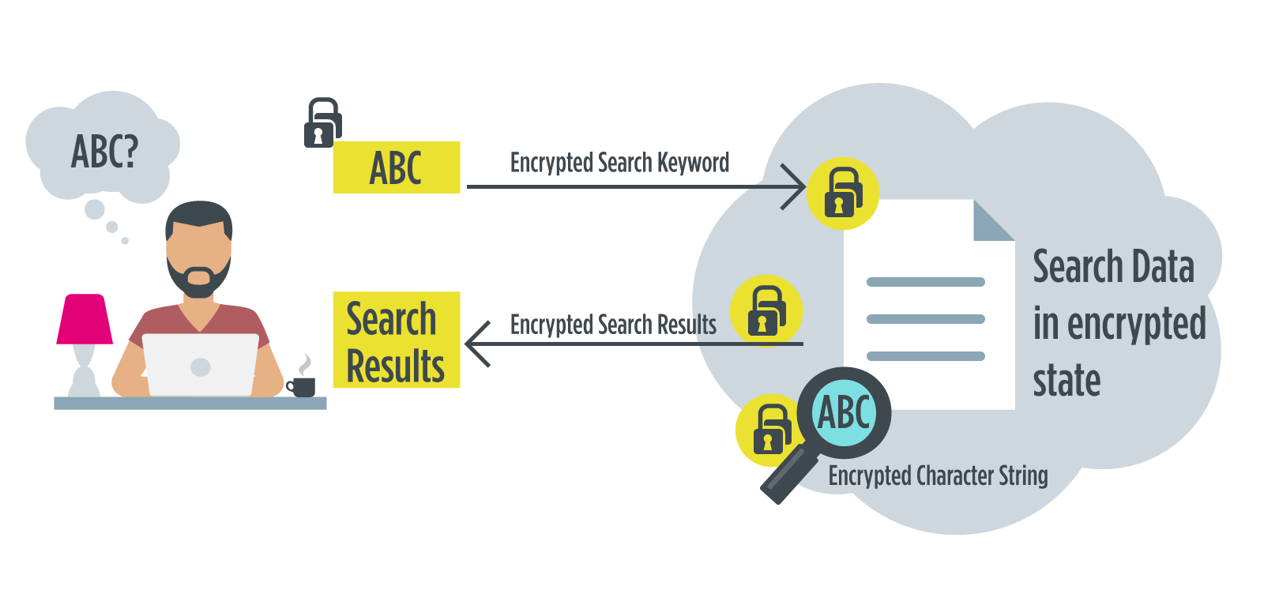
Homomorphic Encryption
for Trusted Cloud Solutions
Notes:
3-year H2020 project called HEAT with a.o. Thales and NXP

