Slide 1

Celtic-Plus Proposers Day
23rd November 2016, Leuven
Behavior Measurement and Intention Prediction (in Traffic)
Geert Vanstraelen, Macq
geert.vanstraelen@macq.eu

Slide 2

What if traffic lights could read your mind?
There are more and more senors that tell us a lot about traffic participants.
Their size, speed, location, license plate,
are they braking, is it raining, ...
But we don’t know how they are behaving and what their intentions are!
What if traffic lights could read your mind?
Would they be more friendly?

Slide 3

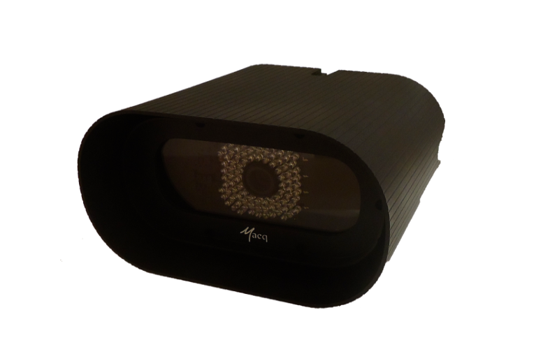
Organisation Profile
Macq, is a Brussels based SME founded in 1923 with around 70 employees. About 30% is R&D of hard- and software.
Products:
Embedded camera system for Vehicle classification, Incident detection and License Plate Recognition.
Software for traffic and mobility centers, automation of tunnels, bridges and locks (water transport).
Own PLC and SCADA product line for automation in traffic and industrial applications
We program and maintain crossroad
traffic controllers.

Slide 4
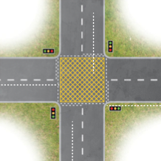
Proposal Introduction (1)
In the past a lot of research has been done to coordinate the traffic based on the detection of presence and speed but this has reached its limits.
There are a lot of new applications if we can interpret the behaviour of traffic participants and observe their intentions:
Road situation safety is measured by counting the number of accidents but this has a large dark number and has few data. With the detection of near accidents we can faster and better evaluate the safety conditions of traffic situations.
Vehicles blocking a crossroad:
    Give green light if we see that the intention is to turn right and this would not block the crossroad. Info coming from car “turn right indicator” (visual or V2I) or app GPS destination.
    Verbalize vehicles that block the crossroad in a way that could be foreseen.

Slide 5

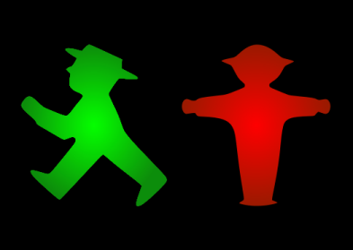
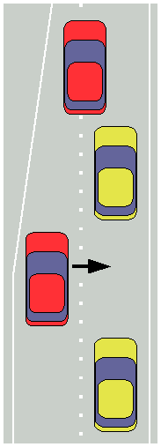
Proposal Introduction (2)
Faster green for vulnerable road users: can be done if we know there intention before they push a button. Detected by a sensor or if they use an app.
Road works: detection of problems in the flow by a misplaced signalisation cone.
Pedestrian green light: Detect all vehicles
stand still and it is save to give faster green to
pedestrians without the 3 seconds grace period
Zipper method (late merge): a smiley or warning when a car applies it correctly or not.
Our roadmap:
2017 will be used to further develop the sensors and management software.
Hope to have the opportunity to start this project in 2018.

Slide 6
Partners
Behavior Measurement and Intention Prediction
We are starting to communicate this idea in our partner network and take the opportunity to pitch it here. We are looking for expertise in:
Image analysis
Behavior analysis
Sensors
V2I: Vehicle to infrastructure communication
Floating car data
Other domains than traffic are possible.
Example: operator in a plant that receives instructions or robot help in function of what he is doing.

Slide 7
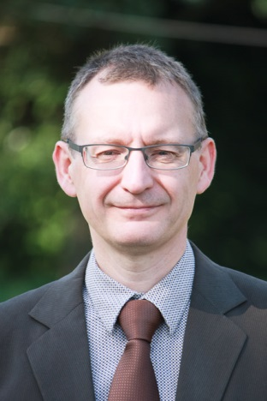
Contact Info
For more information and for interest to participate please contact:
Geert Vanstraelen, Macq
geert.vanstraelen@macq.eu
+32 (0) 2 610 15 80
Luchtschipstraat 2, 1140 Brussels
www.macq.eu

