Slide 1
Celtic-Plus Proposers Day
23 November 2016, imec, Leuven
Scalable 5G baseband processing platform (SCABA)
Tapio Rautio, Senior Scientist
Martti Forsell, Principal Scientist
Jussi Roivainen, Senior Scientist
first.last@vtt.fi

Slide 2
Trends in HW
• Evolving performance/power requirements can be addressed only by increasing parallelism/heterogeneity
• Application-specific accelerators are being replaced with more programmable solutions based on optimized multicore/hybrid processors
• Software development for increasingly parallel/heterogeneous platforms is difficult and getting even worse
5G
The cure
••• Hybrid multicore architecture combining the best parts of vector and general purpose processing
••• This core baseband solution enables partners to better penetrate to highly competitive 5G markets
Baseband HW challenges
• Extreme computational complexity due to capacity increase and new functionalities
• Huge amount of simultaneous connections (IoT, M2M)
• Scalability (different products) and reconfigurability (multiple RAT’s)
Tapio Rautio (VTT), tapio.rautio@vtt.fi

Slide 3

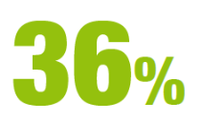

Organisation Profile
VTT Technical Research Centre of Finland Ltd is the leading research and technology company in the Nordic countries. We provide expert services for our domestic and international customers and partners, and for both private and public sectors. We use 4,000,000 hours of brainpower a year to develop new technological solutions.
We develop new smart technologies, profitable solutions and innovative services. We cooperate with our customers to produce technology for business and build success and well-being for the benefit of society.
VTT is a non-profit organisation and a crucial part of Finland's innovation eco-system. VTT operates under the mandate of the Ministry of Employment and the Economy.
OF FINNISH INNOVATIONS
include VTT
expertise. (*
Turnover 277 M€
(VTT Group 2014), personnel 2,600 (VTT Group 1.1.2015 )
Unique research and testing infrastructure
Wide national and international cooperation network
*) Source: Roles, effectiveness, and impact
of VTT, VTT & Technopolis Group, 2013.
Tapio Rautio (VTT), tapio.rautio@vtt.fi

Slide 4
Proposal Introduction (1)
Vision and motivation
Optimized hybrid multicore architecture can address the performance/energy and programmability/flexibility challenges of introduced by 5G baseband processing and new demanding use cases
The proposed technology raises the level of abstraction of parallel programming making implementation more manageable, easier to debug and migrate to new HW.
Content
Requirement specifications for the architecture
Architecture and methodology optimization
Architecture modelling (and FPGA implementation) & PoC prototype building
Implementation of target functionalities on PoC
Evaluation of the architecture (performance, energy efficiency, flexibility)
Supportive actions (marketing, exploitation)
Tapio Rautio (VTT), tapio.rautio@vtt.fi

Slide 5
Proposal Introduction (2)
Outcome
Optimized baseband architecture for the selected use cases
PoC, related methodology
Architecture evaluation (performance, energy eff., flexibility)
Impact
The core building block/architecture for scalable and flexible baseband for 5G enforcing partners’ penetration to highly competitive emerging markets
Higher quality communication solutions for EU citizens via better support for IoT, M2M and crowded communication schemes
Schedule
December 2016 Core consortium/partner seeking
January 2017 - Proposal writing
Spring 2017 Submission
Summer 2017 CELTIC Plus label
Late 2017 Project start, duration 3 years
Tapio Rautio (VTT), tapio.rautio@vtt.fi

Slide 6
Partners
Architecture developer/provider VTT, Finland
We are looking for:
Telecom infrastructure/handset providers
Telecom operator
Processor/computing platform manufacturer
System software infrastructure provider
Research partners on 5G
  Architectural implementation issues
  Low-power computing experts
Tapio Rautio (VTT), tapio.rautio@vtt.fi

Slide 7

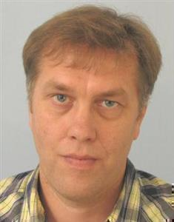
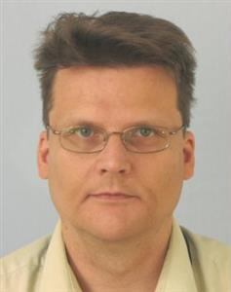
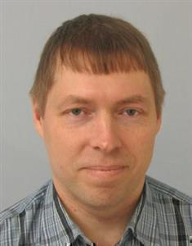
Contact Info
For more information and for interest to participate please contact:
Tapio Rautio
tapio.rautio@vtt.fi
+358 40 734 5058
Martti Forsell
martti.forsell.vtt.fi
+358 40 581 0249
Your
Photo
Jussi Roivainen
jussi.roivainen@vtt.fi
+358 40 861 5096
Tapio Rautio (VTT), tapio.rautio@vtt.fi

