Slide 1

How to set up a successful Celtic-Plus project
Celtic-Plus Proposers Day, Leuven, 23 November 2016
Christiane Reinsch
Celtic Programme Coordinator
#CelticPropDay

Slide 2

CELTIC – Organisational Structure
Chair
3 V- Chairs
CELTIC Core Group
CELTIC Support Group
Director
CELTIC Office
Public Authorities

Slide 3















Celtic Office situation
National Authorities
Celtic-Plus
Core
Group
Management Team
Chairman: Jacques Magen
Vice-Chair:
Valerie Blavette, Orange
Vice-Chair:
Jari Lehmousvori,Nokia
Vice-Chair:
Riza Durucasugil, NETAS
Celtic Office Director
Peter Herrmann
CELTIC-PLUS OFFICE
Programme
support team
Technical IT
support team
Office admin
support team
PR & Marketing
support team
Finance
support team

Slide 4
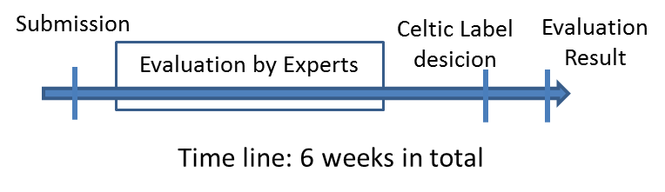
4 Steps towards the Celtic Label
Proposal submission
Evaluation
Label decision
Evaluation Results to the Submitters
In Parallel: Contact your national authorities: https://www.celticplus.eu/public-authorities/

Slide 5
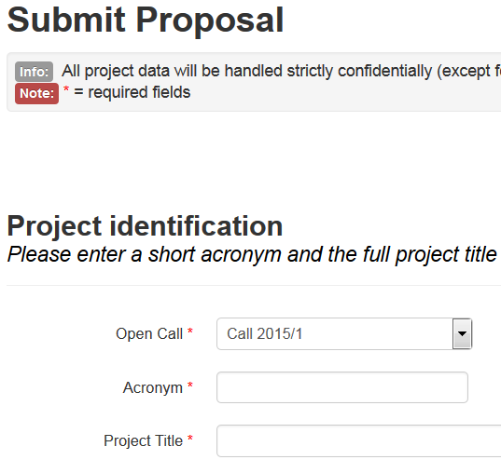
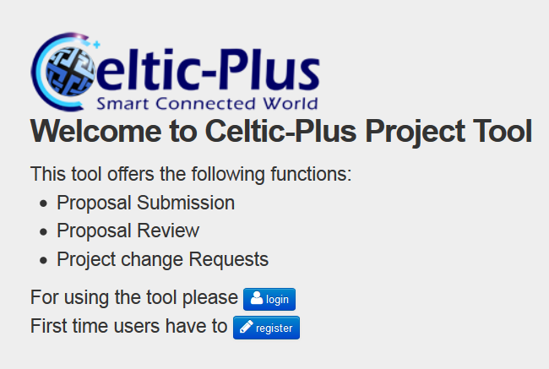
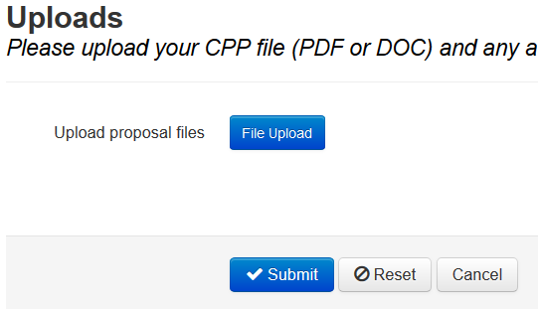
Step 1: Submission of your Proposal
CPP (Celtic Call Proposal) template available on Celtic-Plus Web

Slide 6
Step 2: Evaluation of your Proposal
Evaluation by the Group of Experts (GoE)
List of Evaluation Criteria:
1. Excellence and technological innovation
2. Strategic relevance and impact
3. Potentials for exploitation of the results and for future business
4. Quality and efficiency of the implementation of the project proposal
5. Quality of the proposed consortium
Example of a typical outcome of GoE Evaluations
S = Suitable for Labelling
M = Modifications required
N = Not suitable for Labelling

Slide 7
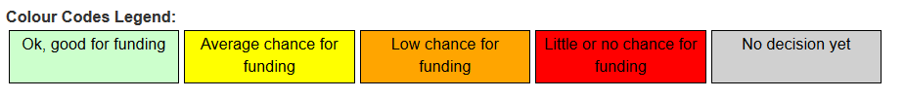
Step 2 Evaluation
2. Evaluation by Public Authorities
Possible statements for PA evaluations
Example of a typical outcome of PA Evaluations:

Slide 8
Step 3: Label Decision
GoE
Evaluation
Results
Celtic
Core
Group
Celtic
Label
PAs
The decision on the label of proposals is taken in a common meeting of the Public Authorities and the Celtic Core Group.
In addition to technical quality and business relevance national priorities can also be a criterion.

Slide 9

Step 4: Evaluation Result
Label Decision is communicated to proposers within 2 month after submission.
Labelled Projects are informed by the Celtic Office about the Set up Process.
Rejected Proposals receive feedback how they could be improved.

Slide 10
Alternative: Join a Labelled Project
- Projects Overviews at Celtic-Plus website, with status classification of “set-up” or “running”:
https://www.celticplus.eu/running-projects/
In case of interest directly contact the Coordinator
For information on funding contact the Public Authorities
For information on the Programme contact the Celtic-Plus Office

Slide 11
Project Live Cycle
The Celtic-Office supports with tools, templates and advice
Project Preparation
Project Active
Project Idea
Project Proposal
Celtic-Plus Label
Project Kick-Off
Mid-Term Review
Final Review
Exploitation
of Results
Submission to Celtic-Plus
Cooperation Agreement
Get funding in part. countries

Slide 12

Project Set Up Process
The Set Up process starts with labelling of the Celtic Project
In EUREKA projects the funding is granted by ministries of the participating countries.
Projects usually start when mandatory partners have green light for funding.
The Celtic Office organises monthly phone contacts to help projects to conclude this critical phase.
In the last years a success rate for running projects between 60 and 70 % has been achieved.

Slide 13
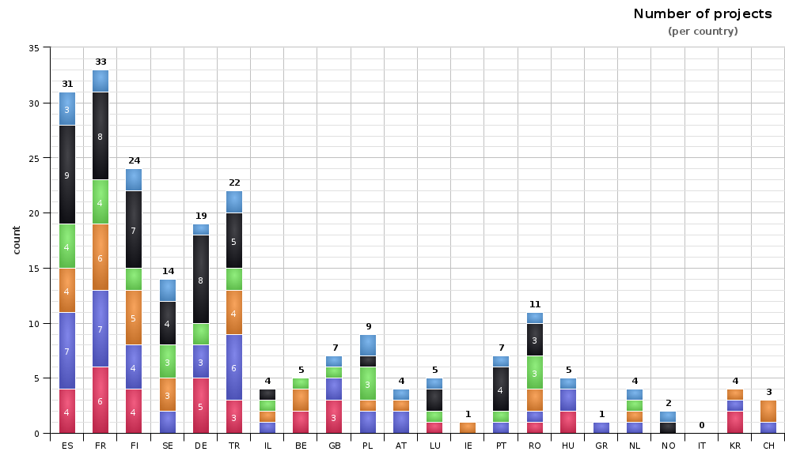

Country Participation

Slide 14
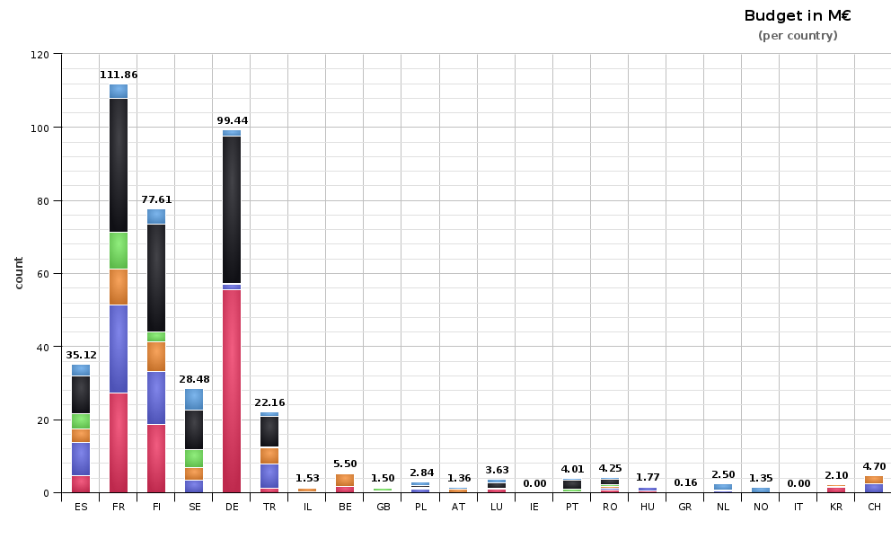
Country Participation

Slide 15

Join our next Proposers Day
21st of February 2017 in Berlin, at Deutsche Telekom
Registration will open in January 2017
https://www.celticplus.eu/latest-proposers-day/
This Event will kindly be hosted by:
Deutsche Telekom,

Slide 16
Contact:
Christiane Reinsch
Celtic Programme Coordinator
reinsch@celticplus.eu

