Slide 1
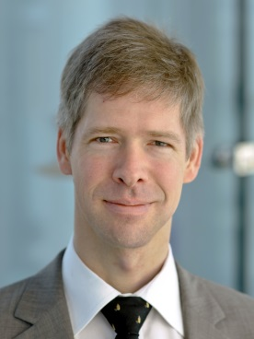
Proposers Day 20 February 2017, Berlin
Experiences of Submitting a
Celtic-Plus Proposal
Frank Burkhardt, Fraunhofer IIS
frank.burkhardt@iis.fraunhofer.de

Slide 2
Background
ReICOvAir - Reliable Industrial Communication Over the Air
An industry 4.0 project
Developing a method for qualification of different wireless transmission standards for industrial applications
Providing the means to test existing devices and to simulate the behaviour of emerging waveforms
Bring the results to the European standardization bodies
Project facts
12 funded project partners from 3 countries (Finland, Germany, Spain), 3 external advisors
Planned budget of ~3.3 million Euros
Planned effort of ~28 person years
Project start 1/2016
Project duration 33 months
Frank Burkhardt, Fraunhofer IIS, frank.burkhardt@iis.fraunhofer.de

Slide 3
Background
Industrial Partners
Scientific Partners
Advisory Partners
Frank Burkhardt, Fraunhofer IIS, frank.burkhardt@iis.fraunhofer.de

Slide 4
Background
ReICOvAir is funded by:
Webpages:
https://www.celticplus.eu/project-reicovair/ https://www.iis.fraunhofer.de/en/ff/kom/proj/reicovair.html
Frank Burkhardt, Fraunhofer IIS, frank.burkhardt@iis.fraunhofer.de

Slide 5
Project Setup Timeline
Time | Action
March 2014 | Idea
May 2014 | 1st Contact with Celtic office
August 2014 | 1st Contact with PA
Until April 2015 | Initial search for partners
June 2015 | Submission to Celtic
June 2015 | Approval by Celtic
Summer 2015 | Submission of national proposals (Finland/Germany)
November 2015 | German and Finnish funding decisions
January 2016 | Start of project work
June 2016 | Submission of Spanish national proposal
October 2016 | Spanish funding decision
February 2017 | Joining of Spanish project partners
Frank Burkhardt, Fraunhofer IIS, frank.burkhardt@iis.fraunhofer.de

Slide 6
Celtic Plus Office
They help you with
Is your idea is compatible with Celtic Plus
What are the funding conditions
Which countries are likely to provide funding for the project
This changes over time
Take care that most countries do not provide a dedicated budget for Celtic projects(!)
Provide contacts to the Public Authorities
Can provide contacts to potential partners
Provide forums where you can try to find partners
Frank Burkhardt, Fraunhofer IIS, frank.burkhardt@iis.fraunhofer.de

Slide 7
Public Authorities
They help you with
Is there a chance for funding based on:
The topic
Availability of budget
What are the funding conditions
In the scope of which national programme you should submit the proposal
When should you submit the proposal
Believe your PA. If your PA states that there is no budget available then there is very high chance that the effort you spend for the propsal will be in vain (in regard of getting funding).
Ask the PA as soon as possible with a certain degree of concreteness (e.g. 3 pages Memo describing the project idea).
Frank Burkhardt, Fraunhofer IIS, frank.burkhardt@iis.fraunhofer.de

Slide 8
Lessons Learned
Celtic Phase (language = english)
CPP Celtic Plus Proposal
Check before writing the CPP that the PD and CPP follow the same template
CLD Confirmation Letter and Declaration of acceptance
PA Phase (language = mostly national language!)
National Project Description (all national partners)
National Individual Project description (each partner)
High chance of double work!
Startup Phase
PD - Celtic Plus Project Description (Celtic)
An update (called PCC of the CPP which includes all changes from CPP)
National cooperation agreement (PA)
PCA - Celtic-Plus Project Cooperation Agreement (Celtic)
Frank Burkhardt, Fraunhofer IIS, frank.burkhardt@iis.fraunhofer.de

Slide 9
Lessons Learned
Design your project over the countries with a separation of concerns
For each country clearly seperate results can be obtained
Maybe even the order of writing the proposals can be changed
1st national proposal
2nd celtic proposal (as a summary of the national proposals)
If partners are not funded then the national results are still not affected
You never know when or if partners from different countries will be funded
Have a good fallback plan (e.g. reductino of project goal)
Be prepared to search for further partners even if the project is already running
Frank Burkhardt, Fraunhofer IIS, frank.burkhardt@iis.fraunhofer.de

Slide 10
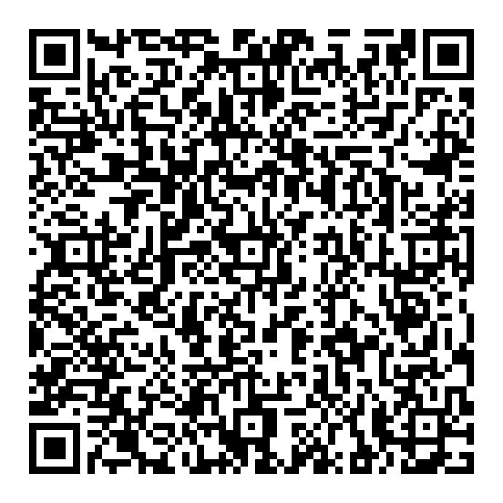
Contact Info
For more information please contact:
Frank Burkhardt
Tel: +49 9131-776-6312
frank.burkhardt@iis.fraunhofer.de
Thomas Heyn
Tel. +49 160-5840 473
Thomas.heyn@iis.fraunhofer.de
Fraunhofer-Institut für Integrierte Schaltungen IIS
Am Wolfsmantel 33
91058 Erlangen
Web: http://www.iis.fraunhofer.de
Frank Burkhardt, Fraunhofer IIS, frank.burkhardt@iis.fraunhofer.de

