Slide 1


Celtic-Plus
Proposers Day
13th December 2017, Luxembourg
Pitch of the Project Proposal
HomePlus
Mustafa Kemal Kar, Turkcell Technology
kemal.kar@turkcell.com.tr

Slide 2

Teaser
Home Plus aims at putting together IoT services such as smart home and voice assistant, on top of legacy wireless router and (VoIP) hub functionalities in a single all-in-one gateway.
This gateway will support well-known wireless technologies and directly communicate with each smart peripheral device based on star topology.
The gateway will be able to run Android OS applications offering TV, music, messaging services with voice assistant capability and drive large displays.
www.celticplus.eu HomePlus, Mustafa Kemal Kar, kemal.kar@turkcell.com.tr

Slide 3
Organisation Profile
Converged communication and digital services player
  Mobile: 51K sites, 1 Gbps DL speeds, VoLTE support
  Fixed: 39 km total fiber, 3M houses with fiber support (up to 1 Gbps)
  Digital Services:
    BiP (Digital Communication Platform)
    Turkcell TV+
    Fizy (Music Platform)
    Lifebox (Smart Storage)
Operating in 9 countries with 50.4M subscribers, 36M Turkish mobile subscribers
~1000 R&D personnel
Listed both on NYSE & Borsa Istanbul with a $7.3B market cap
www.celticplus.eu HomePlus, Mustafa Kemal Kar, kemal.kar@turkcell.com.tr

Slide 4

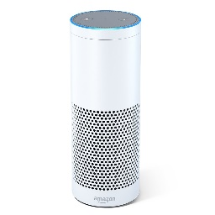
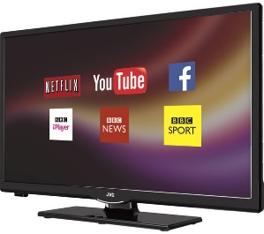
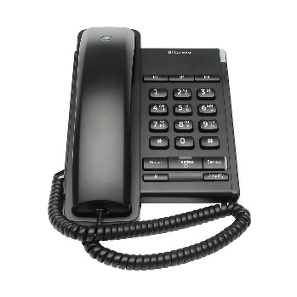

HomePlus in Detail
Existing solutions:
Homeplus enhance the experience by;
Smart home with detectors & sensors
Voice Assistance to conrol home
www.celticplus.eu HomePlus, Mustafa Kemal Kar, kemal.kar@turkcell.com.tr

Slide 5
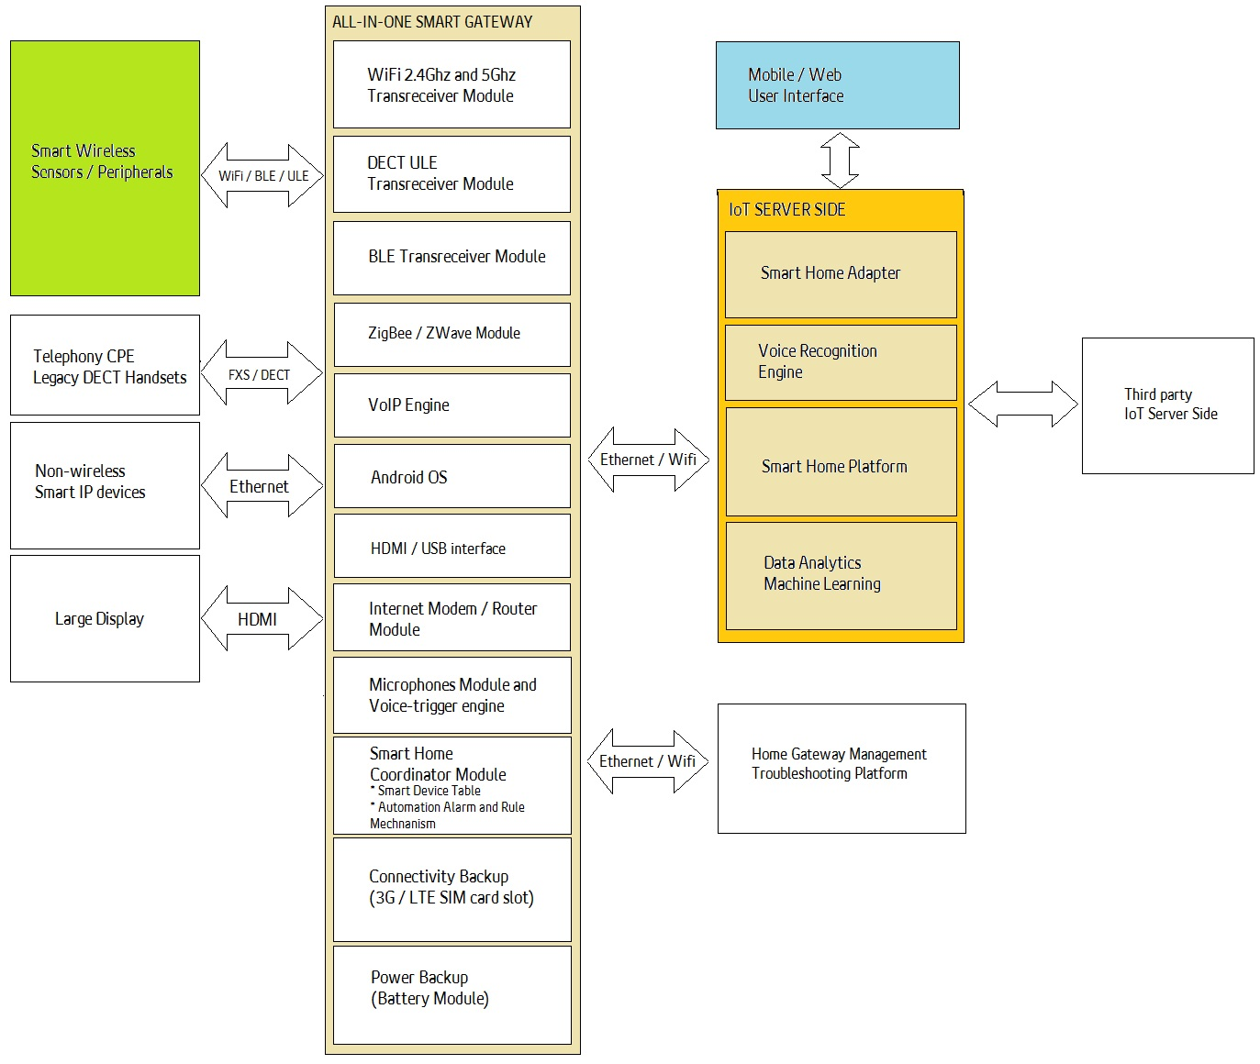
HomePlus in Detail
www.celticplus.eu HomePlus, Mustafa Kemal Kar, kemal.kar@turkcell.com.tr

Slide 6
HomePlus - Innovation
Support multiple proven smart home wireless technologies
Support voice-assistantship and user interaction via smart microphone/speaker
Support Android OS applications and drive large display.
Eliminate need for multiple gateways in IoT consumer premises
Eliminate multiple smart gateways and complex wireless mesh networks, so ease of installation and remote troubleshooting
With regard to consumer’s usage behaviors and accumulated historical data, develop advanced machine learning and analytics techniques on server side; and thereby offer additional new values in a contextual manner.
www.celticplus.eu HomePlus, Mustafa Kemal Kar, kemal.kar@turkcell.com.tr

Slide 7
HomePlus – Business Impact
Reduce total cost of ownership to IoT consumer
Lower total cost of ownership by eliminating multiple gateway devices and wireless repeaters/ extenders.
Reduce installation time and troubleshooting efforts
Offer truly comprehensive IoT services via a single smart gateway by service providers
www.celticplus.eu HomePlus, Mustafa Kemal Kar, kemal.kar@turkcell.com.tr

Slide 8
Partners
Country | Company
BELGIUM | Barco
 | IMEC
 | Televic Healthcare
CANADA | National Research Council Canada
CZECH REP. | Masaryk University
FRANCE | University La Rochelle
 | Orange
 | Institut-Mines Telecom
 | NXP France
 | Soft@Home
TURKEY | Turkcell Technology
 | Vestel
PORTUGAL | Gecad
Looking for Partners / Expertise
  Electronics hardware manufacturers
  Embedded software design companies
  System integrators
www.celticplus.eu HomePlus, Mustafa Kemal Kar, kemal.kar@turkcell.com.tr

Slide 9
Contact Info
For more information and for interest to participate please contact:
Mustafa Kemal Kar
Turkcell Technology R& D
kemal.kar@turkcell.com.tr
+90 532 210 38 43
Rahmi Cem Cevikbas
Turkcell Technology R& D
cem.cevikbas@turkcell.com.tr
+90 532 210 10 65

