Slide 1



Celtic-Plus
Proposers Day
13th December 2017, Luxembourg
Pitch of the Project Proposal
RESETCOM
(Reliable, Secure, Trustable Communication system for Automated Driving)
Ali Balador, Senior Researcher
Hossein Fotouhi, Senior Researcher

Slide 2

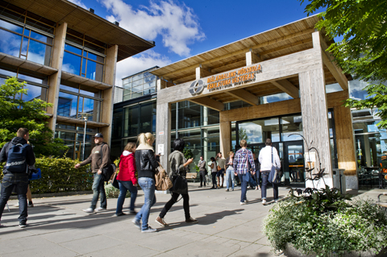

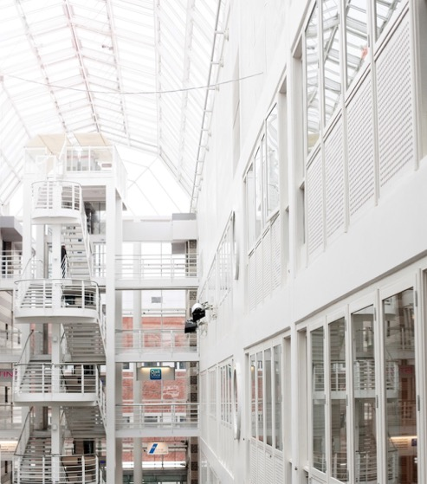

Organisation Profile
Mälardalen University (MDH) is located in Västerås and Eskilstuna, Sweden, founded in 1977.
MDH has 14,000 students and 900 employees with 71 professors.
Embedded systems is among the most prioritized research areas at MDH, where it has internationally leading competence.
RISE SICS is a leading research institute for applied information and communication technology in Sweden, founded in 1985.
202 Staff (76 Ph.D., 32 Professors)
Application areas, such as Internet of Things, Industrial Automation and Maintenance, Automotive and Rail, Telecom, Digital Health, Decision support and business intelligence, Data Centers.
www.celticplus.eu RESETCOM, Ali Balador, RISE SICS Västerås & ali.balador@ri.se

Slide 3
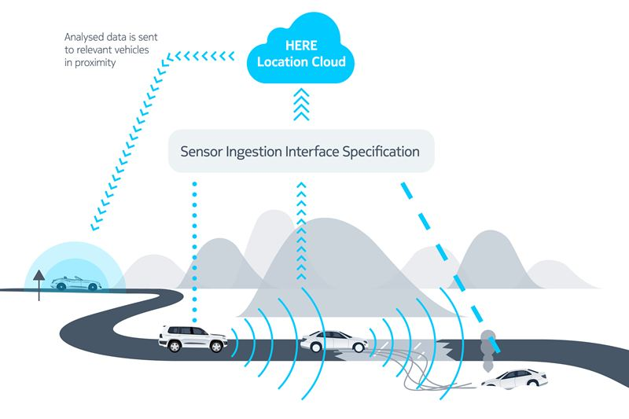


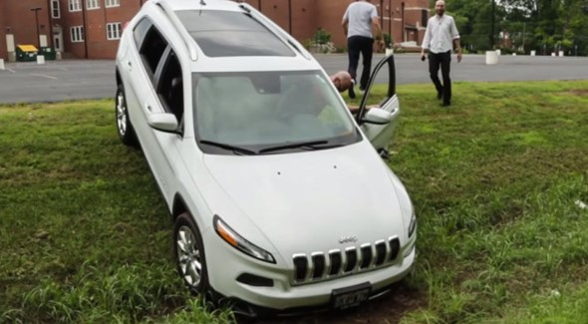
Proposal Introduction (1)
Communication Technologies
LTE/5G
Mobile edge computing
WiFi/Bluetooth
Trustability
Unwanted access must be denied
ITSG5 (DSRC)
LTE/5G
Security & Privacy
HACKED!
www.celticplus.eu RESETCOM, Ali Balador, RISE SICS Västerås & ali.balador@ri.se

Slide 4
Proposal Introduction (2)
Objectives: RESETCOM will pave the way of securing the transportation system by considering a number of use cases empowered by wireless vehicular communication. Designing systems using COTS wireless technologies while providing security requirements is a need for future use cases to be practical. This project considers some of the common use cases in vehicular communications, such as (i) Cooperative Adaptive Cruise Control (CACC), (ii) truck platooning, and (iii) road safety service via Infrastructure. The project vision is to devise safe and secure heterogeneous wireless networks, focusing on wireless protocols/standards, network management, Cloud/Fog Computing, and data analytics.
www.celticplus.eu RESETCOM, Ali Balador, RISE SICS Västerås & ali.balador@ri.se

Slide 5
Proposal Introduction (3)
Expected Outcomes: The outcome of this project will be providing security as a service for vehicular communication use cases, where the project will deliver through some demonstrations. This project will devise interoperability solution to integrate various technologies. It will also provide privacy strategies to demonstrate compliance with the GDPR.
Impacts:
  Reduction of pollution (air pollution, noise, ..)
  Reduction of congestion
  Increased safety
  Reduction of transfer cost and Increased transfer speed
  More services and infotainments
Schedule:
  23 April 2018
www.celticplus.eu RESETCOM, Ali Balador, RISE SICS Västerås & ali.balador@ri.se

Slide 6
Partners
Sweden: RISE SICS, MDH, CEVT, Tele2IoT, Alten, Alkit, AstaZero, Trafikverket
Finland: VTT, Oulu University, Esju, Verkotan, Bittium, Ericsson
Germany: Fraunhofer, Qosmotech
France: Telecom-sudparis, NagraVision
Turkey: Ericsson, Enforma, Turkcell, Koc university
Looking for partners:
  OEMs
  Telecom industries, network operator, software and hardware providers
  Universities and research institutes
www.celticplus.eu RESETCOM, Ali Balador, RISE SICS Västerås & ali.balador@ri.se

Slide 7
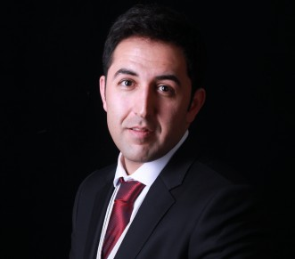
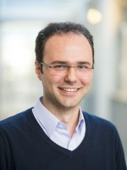
Contact Info
For more information and for interest to participate please contact:
Ali Balador
Senior Researcher
RISE SICS Västerås
ali.balador@ri.se
+46 73 662 15 83
Kopparbergsvägen 10, 722 13 Västerås, Sweden
www.sics.se/groups/rise-sics-vasteras
Hossein Fotouhi
Senior Researcher
Mälardalens högskola
hossein.fotouhi@mdh.se
+46 73 960 73 23
Högskoleplan 1, 721 23
Västerås Sweden
www.es.mdh.se/staff/2992-Hossein_Fotouhi

