Slide 1
Celtic-Plus Proposers Day
13th December 2017, Luxembourg
End-to-end KYC in mins
Digital Customer Onboarding
Olivier Picavet
Business Development Manager
o.picavet@snapswap.vc

Slide 2
Teaser
Telecoms must identify their customers (KYC regulatory requirements):
Support both digital and physical channels for onboarding and activate services in the fastest possible time
Time consuming
Need agents and people
Expensive
Bad user experience
www.celticplus.eu Digital Customer Onboarding, Olivier Picavet - Business Development Manager, o.picavet@snapswap.vc

Slide 3
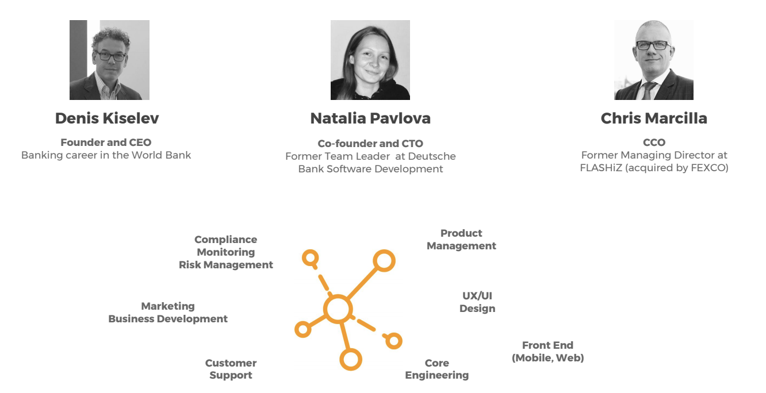
Organisation Profile
Headquartered in Luxembourg, supervised by the CSSF
First Blockchain Electronic Money Institution in Europe
Passported to allow services in all 28 EU member states
Team: 16; HQ - Luxembourg; Dev Center - Kaluga (Russia)
www.celticplus.eu Digital Customer Onboarding, Olivier Picavet - Business Development Manager, o.picavet@snapswap.vc

Slide 4
SNAPROVE - Complete onboarding solution
1
2
BASIC PERSONAL INFO
PHONE NUMBER VERIFICATION AND RISK SCORING
3
5
DOCUMENT VERIFICATION
6 min
4
ADDITIONAL INFORMATION
6
IDENTITY VERIFICATION
ADDITIONAL DOCUMENTS
7
8
9
CONGRATULATIONS!
SANCTION LISTS CHECK PEP CHECK
DIGITAL SIGNATURE
www.celticplus.eu Digital Customer Onboarding, Olivier Picavet - Business Development Manager, o.picavet@snapswap.vc

Slide 5
How we create value
SHORT TIME TO MARKET
AUTOMATED PROCESS
MORE RELIABLE VERIFICATION
4 weeks
24/7
No manual processing
CUSTOMER RETENTION
COST SAVING
LEGAL COMPLIANCE
Up to 85%
8 times cheaper
AMLD 4 - MiFID II - GDPR
www.celticplus.eu Digital Customer Onboarding, Olivier Picavet - Business Development Manager, o.picavet@snapswap.vc

Slide 6
Europe: +100 Million KYC verifications/year by 2020
TELCOS
Life, Health, Car
Home
BANKS
INSURANCE COMPANIES
INVESTMENT FUNDS
WEALTH MANAGEMENT
CONSUMER LOAN COMPANIES

Slide 7
Partners
Recognitions
Winner
Lisbon, Portugal
www.celticplus.eu Digital Customer Onboarding, Olivier Picavet - Business Development Manager, o.picavet@snapswap.vc
Notes:
1 slide:
Existing consortium, involved countries.
Expertise, profiles and types of partners you are looking for.

Slide 8
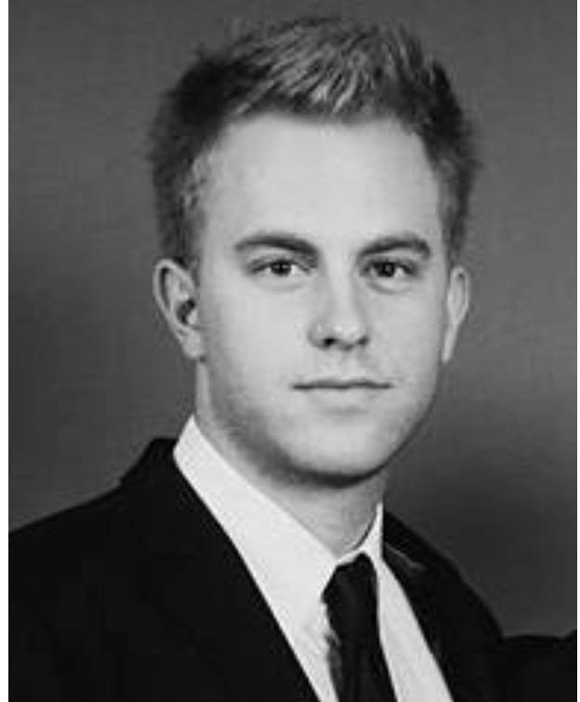
Contact Info
For more information and for interest to participate please contact:
Olivier Picavet (Bus. Development Manager)
O.Picavet@snapswap.vc
+32 474 68 33 46
Boulevard Royal, 59
www.snapswap.eu

