Slide 1
CELTIC Proposers Brokerage Day
- Business Impact Session -

Slide 2
Business Impact of CELTIC Projects
Moderator:
Mr Richard Foggie, Innovate UK Business Connect, Knowledge Transfer Manager – Digital
Economy and Internet of Things
Pannelists:
F4iTECH: Mr Ismail Uzun from Inosens (TR)
AI4GREEN: Mr Orhun Ergul from Piworks (UK)
IEoT: Mr Pedro Lousa from Beyond Vision (PT)
SENDATE & AI-NET: Mr Reijo Savola Reij from University of Jyväskylä (FI)

Slide 3

CELTIC Proposers Brokerage Day
-Business Impact Session-
Federated AI Platform for Industrial Technologies
Dr. İsmail Uzun
CEO @INOSENS

Slide 4
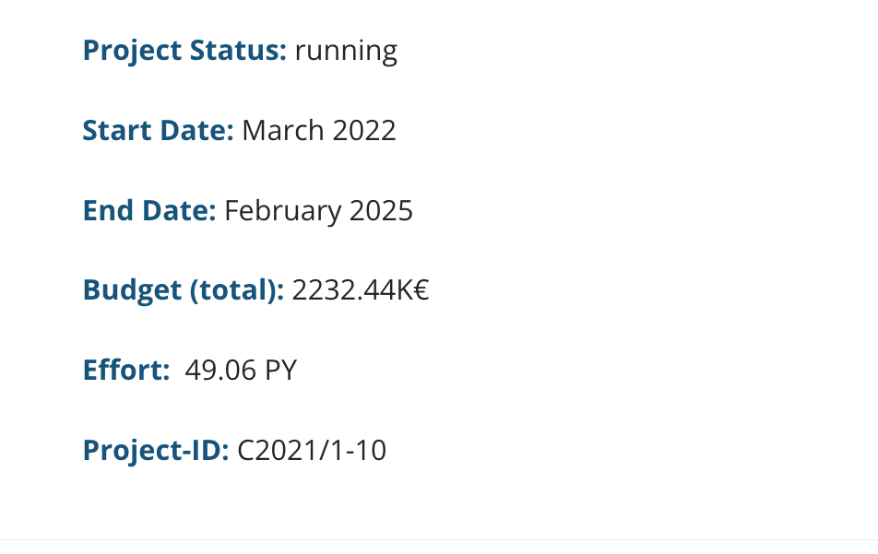
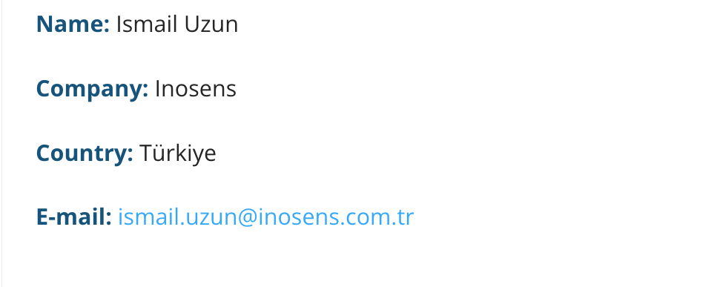
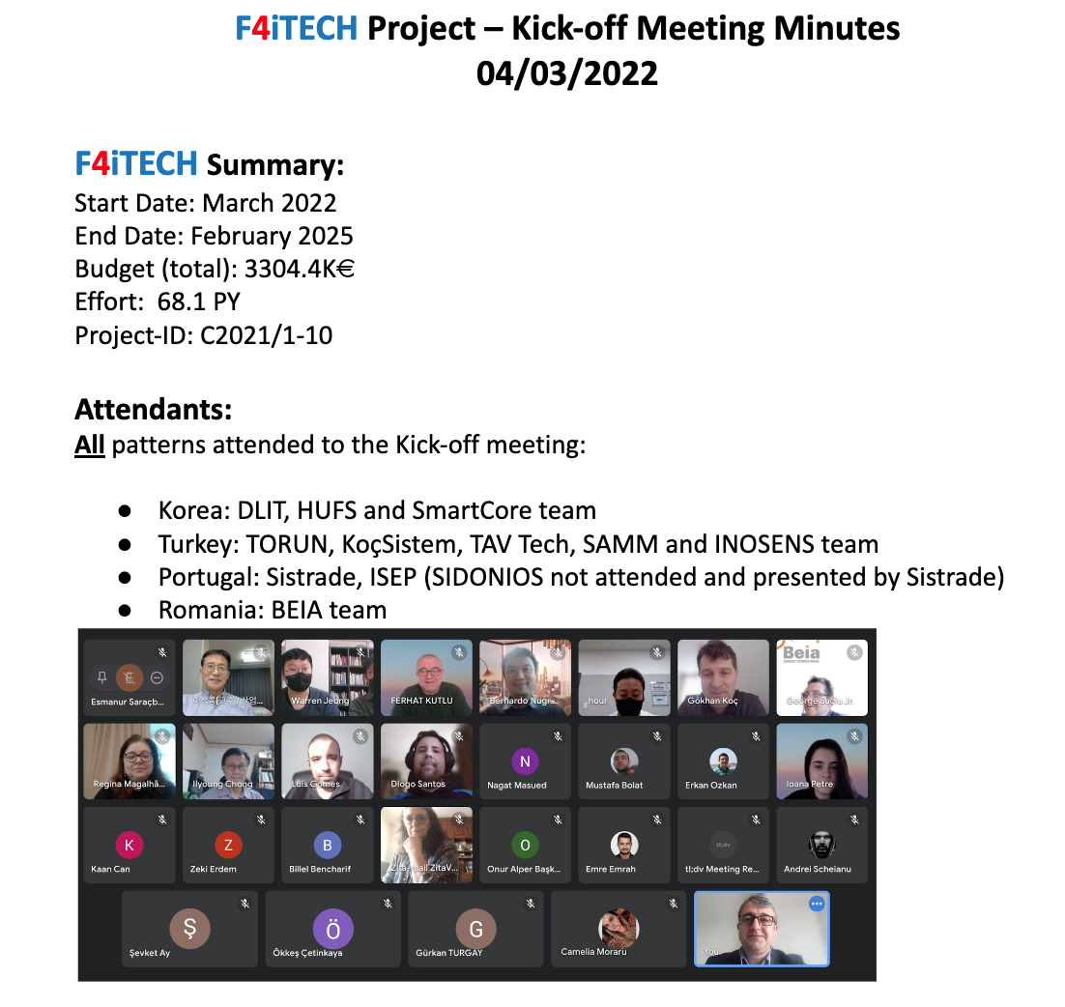
Summary
Key Info
Coordinator

Slide 5
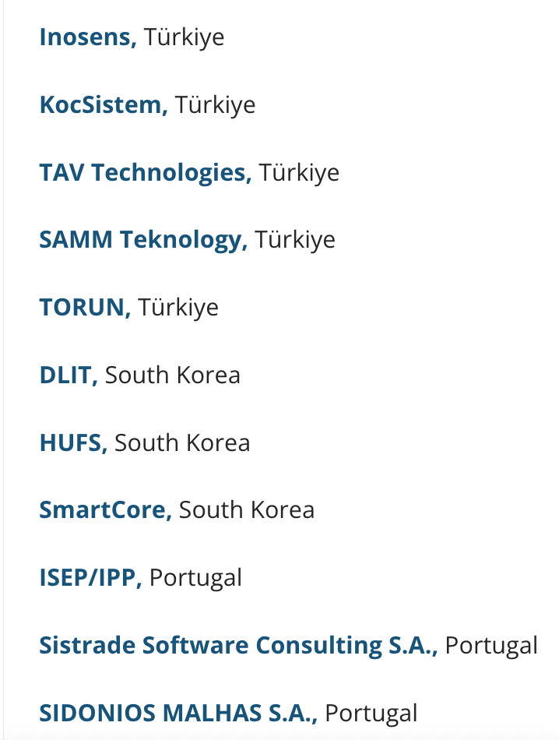
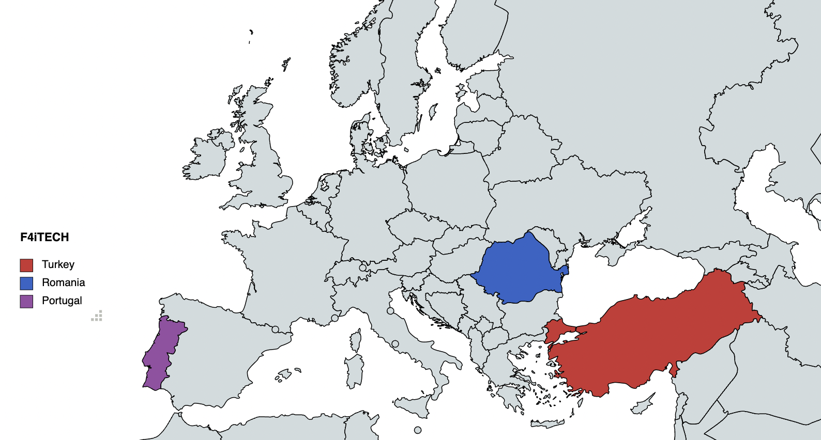
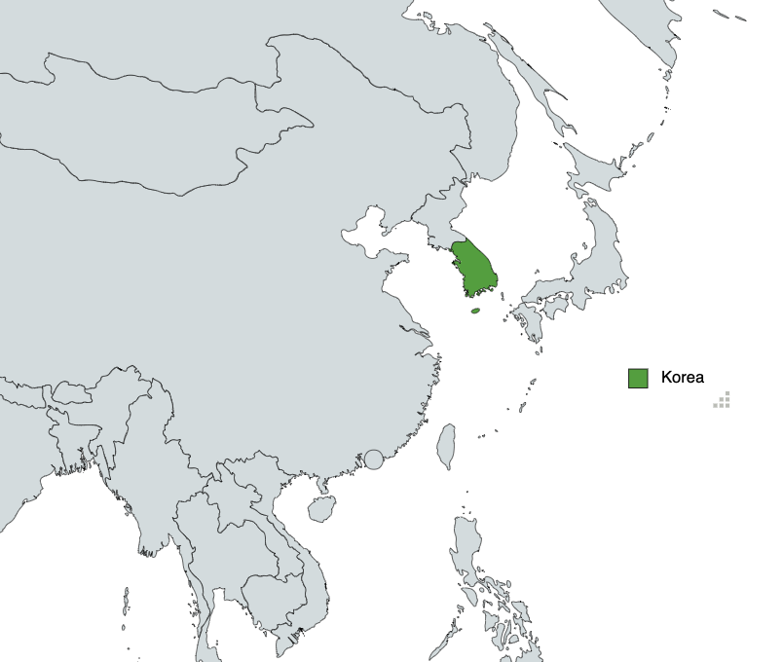
Consortium
4 Countries,
12 organizations
2 Universities,
3 Industrial Partners
7 SMEs
* 1 University in Turkey is Subcontractor

Slide 6
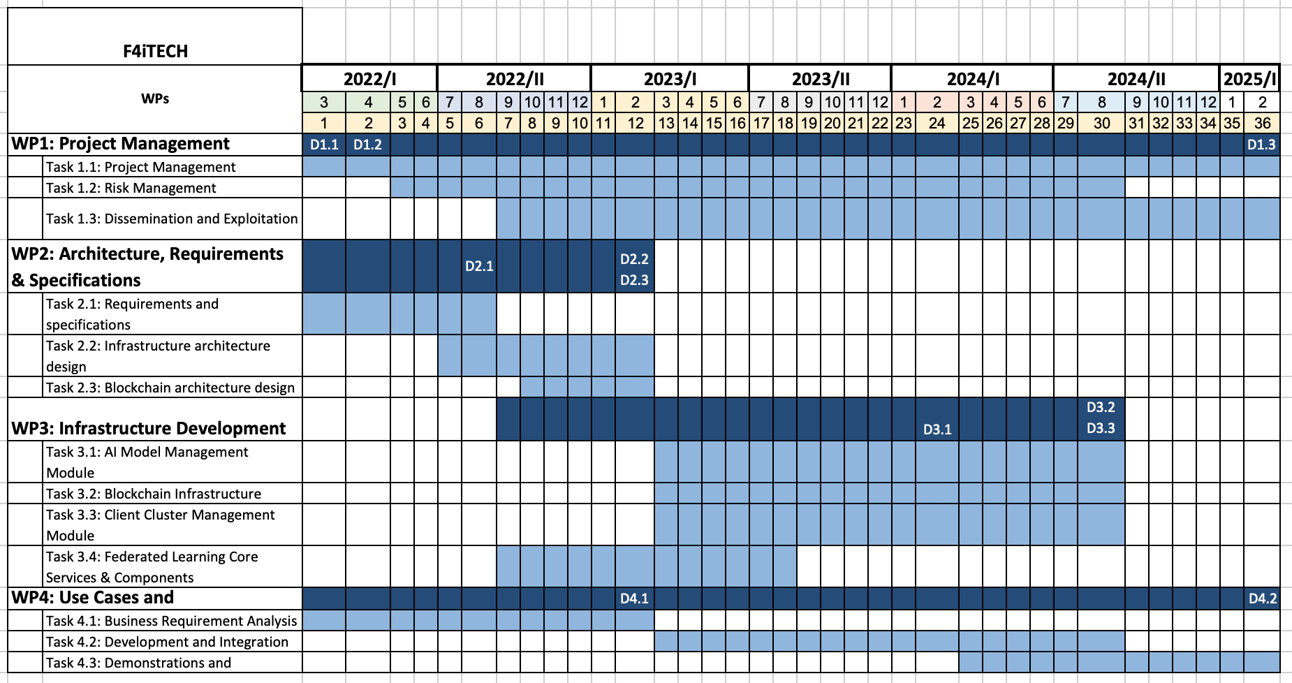
Timeline

Slide 7
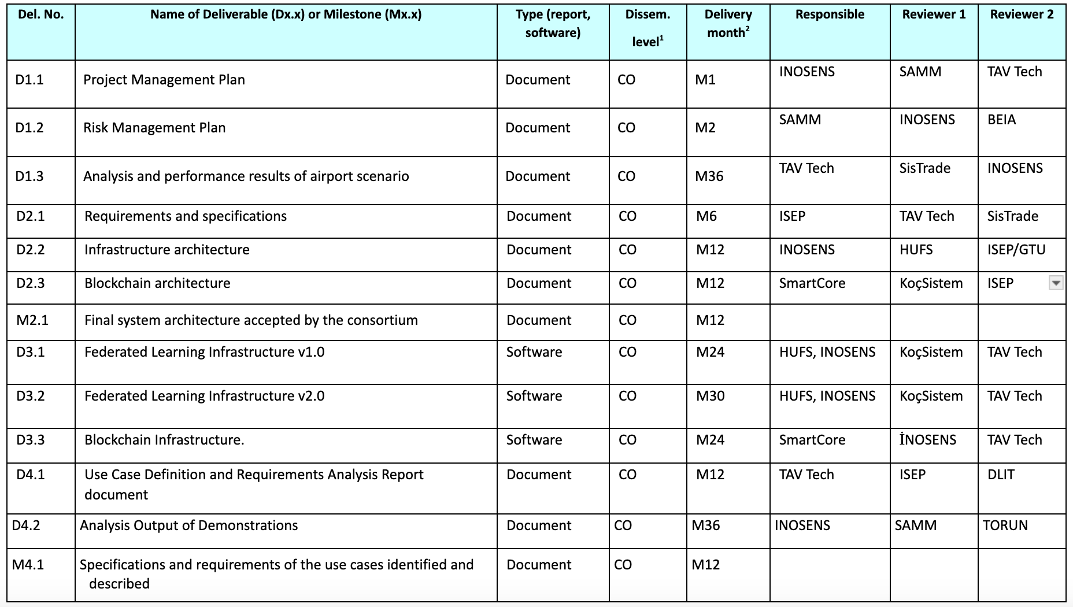
Deliverables

Slide 8
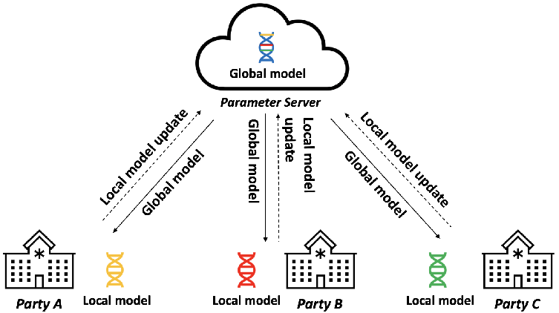
Federated Learning
(FL)
FL is a decentralized machine learning technique that enables multiple parties to collaboratively train ML models while keeping their data securely stored on their local devices.

Slide 9
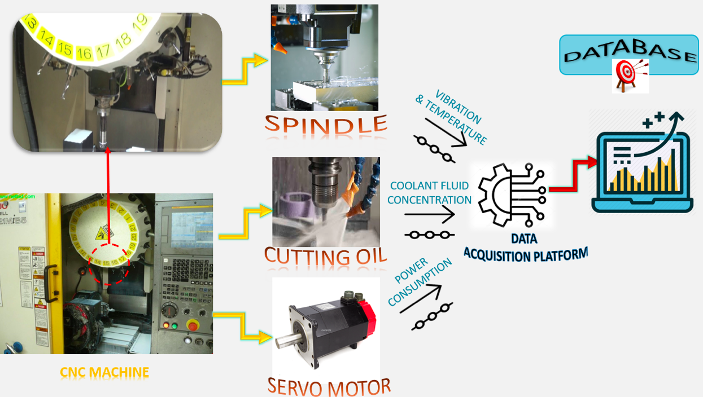
Idea of F4iTECH
Current AI-based industrial applications follow a linear, sequential approach to data collection, processing, and model deployment, often leading to centralized data collection challenges and potential quality issues.
To address this, F4iTECH aimed to develop a federated learning platform tailored for industrial automation.

Slide 10
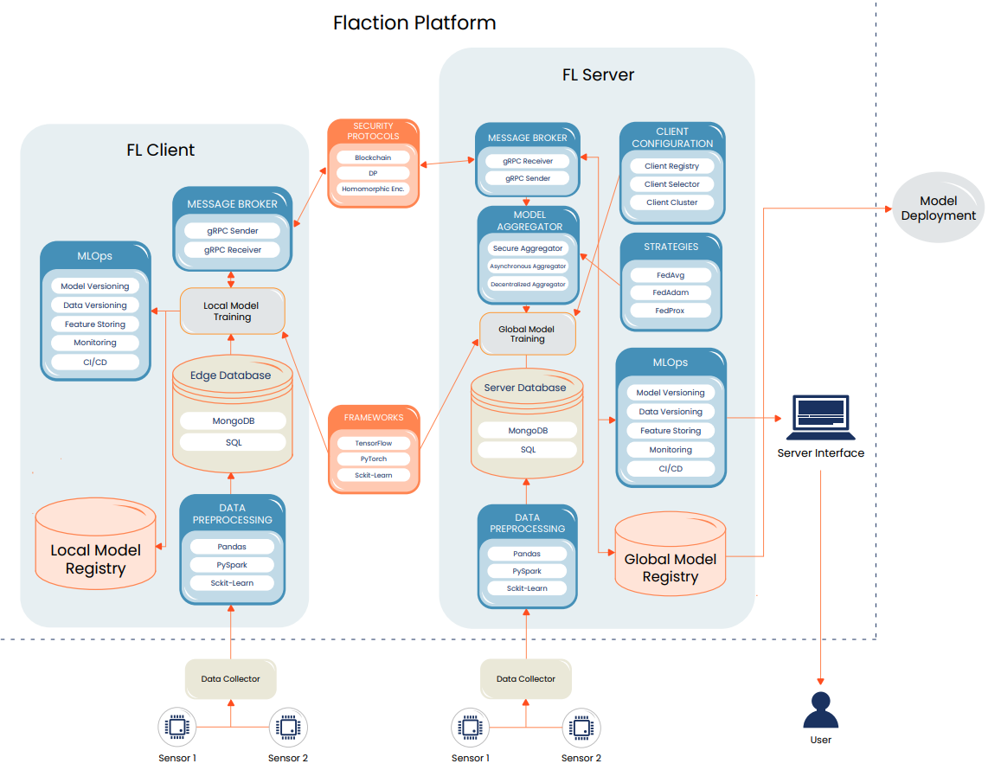
FLaction
A Federated Learning (FL) platform for industrial automation that offers solutions by building AI models on decentralized data and may use blockchain approach to disseminate data allowing accuracy and privacy.
.

Slide 11
Use Cases
03
04
YOUR TITLE
4. Textile
YOUR TITLE
2. Smart Factories
Private equity has successfully attracted the best and brightest in corporate America.
Private equity has successfully attracted the best and brightest in corporate America.
6. Supply Chain
Manufacturing Process
Remaining Useful Lifetime
Blockchain Based Management
1. Aviation
5. DAS
3. Retail
Anomaly Detection by Distributed Acoustics Sensing
Airport Passenger Operations
Customer Emotion Detection
Notes:
1: FL-based AI models (in smart factories) fed by distributed sensing system data will detect anomalies such as excessive heating and Remaining Useful Lifetime (RUL) of CNC machines.
2: Pax Analyzer (for aviation) is a cutting-edge tool designed to provide customers with real-time dashboards including many airport passenger operations.
3: FL-based AI models (industrial application) fed with data collected from kiosk sensors in retail stores will be analysed and used to determine customer mood satisfaction.
4: Blockchain-enabled FL in Collaborative Supply Chain (Industrial application) fed with data collected from supply chain model in which multiple industries collaborate will be analysed to prove a blockchain function and to provide intelligent applications in supply chain model with collaborative manufacturing.
5: Cyber-physical system (in textile sector) based on IoT, AI, Federated Learning, and Blockchain technologies, to enable real-time monitoring of manufacturing processes and equipment, predictive maintenance, anomaly detection, and tracking of materials.
6: FL-based AI models (sensor analytics/industrial application) fed with data collected from the fibre optic DAS system, solutions that can make AI-based alarm systems by detecting anomalies and classifying event types for critical areas will be developed.

Slide 12
Business Impact
Enhanced Data Privacy and Security
1
Cost Reduction and Efficiency Gains
2
Customization and Flexibility
3
4
Operational Resilience
Sustainability and Resource Optimization
5
Notes:
Enhanced Data Privacy and Security
Data decentralization ensures that sensitive business data stays local while still contributing to AI model development, reducing the risk of data breaches and complying with strict privacy regulations (e.g., GDPR).
Blockchain integration provides additional security layers, ensuring data integrity and traceability, which is crucial in highly regulated industries.
Cost Reduction and Efficiency Gains
Improved machine utilization and energy optimization through smart manufacturing and operational management systems directly contribute to cost savings.
Real-time, decentralized data processing enables quicker decision-making, reducing downtime, and eliminating inefficiencies in production lines or supply chains.
Customization and Flexibility
Federated AI empowers industries to create customized AI models that cater to specific operational needs while maintaining alignment with global business goals.
This leads to better product customization and more responsive production, meeting the increasingly personalized demands of consumers.
Faster Innovation and Adaptation
By leveraging decentralized AI model learning, industries can accelerate innovation cycles by integrating learnings from multiple sources and reacting swiftly to operational changes.
The collaborative model development enables continuous improvement without significant disruptions to business operations, driving faster time-to-market for new products or services.
Operational Resilience
Decentralized data processing reduces dependency on central servers and minimizes the risk of single points of failure, making the system more resilient to cyberattacks, technical failures, or other disruptions.
Sustainability and Resource Optimization
Federated AI enables better resource management, reducing waste and energy consumption. By continuously learning from operational data, it can recommend actions to reduce carbon footprints and improve sustainability efforts.

Slide 13
Business Impact
6
New Products
7
Technological Leadership
Partnership and Strategic Collaboration
8
9
Understand New Markets and Cultures
Industry Collaboration (SME-Uni-I)
10

Slide 14
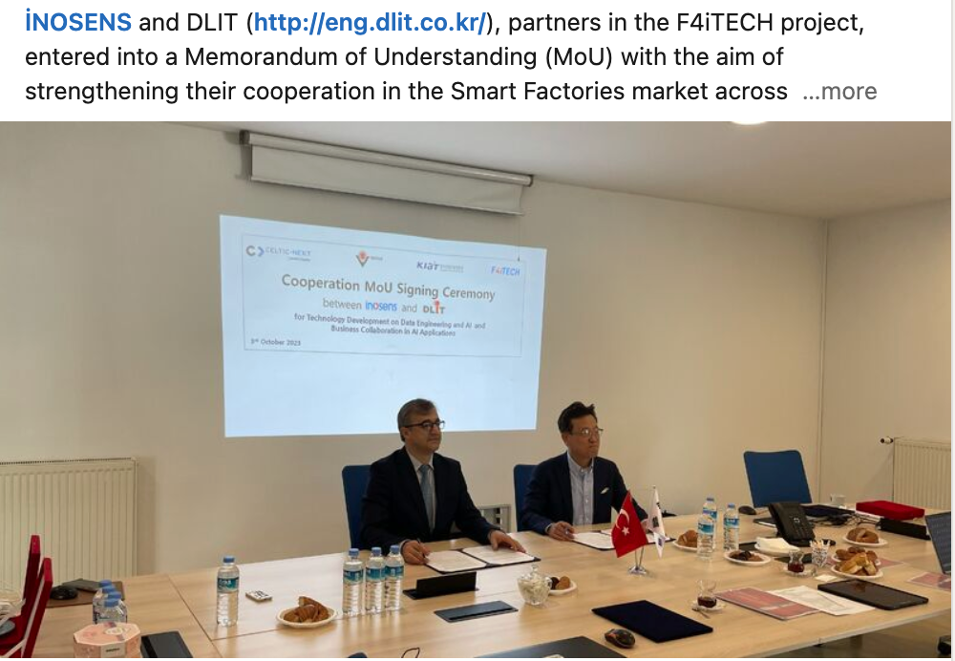
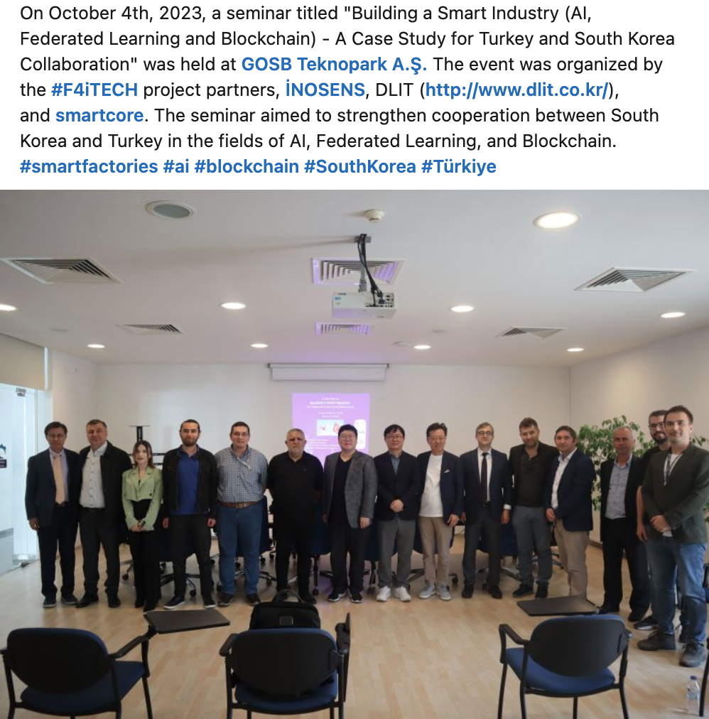
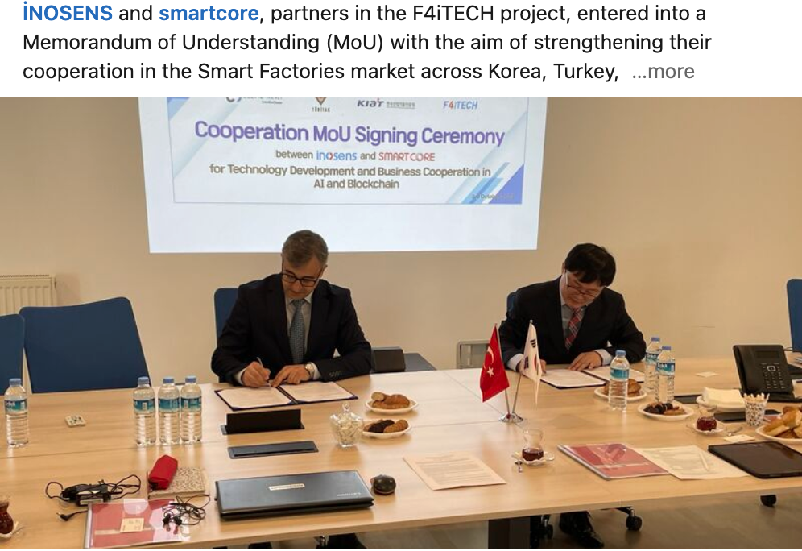
Business Impact

Slide 15
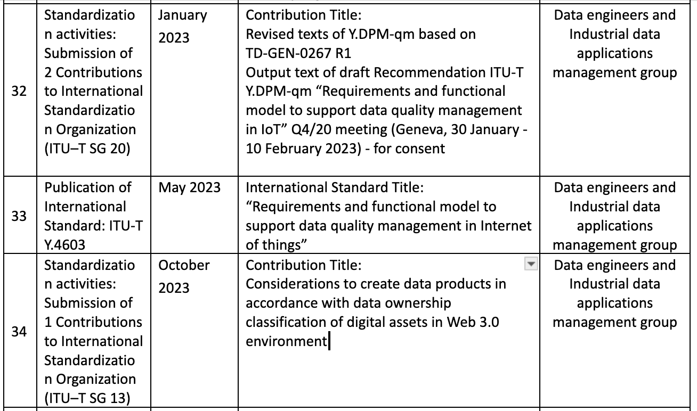
Business Impact
45 Dissemination activity (publication, seminar etc.)
+
Contributions to ITU-T Standards

Slide 16
Federated AI Platform for Future Industry

Slide 17

CELTIC Proposers Brokerage Day
-Business Impact Session-
Project:

Slide 18
IEoT – Intelligent Edge of Things
A three-tier Edge-IoT data service architecture

Slide 19
Introduction
Main focus on AI to achieve
  Real-time performance
  High level of security and privacy
  Resource and energy efficiency
  Scalability and manageability
Services placement depends on
  Need for computational capacity
  Availability
  Responsiveness
  Context-awareness
  Energy criticality

Slide 20
Consortium
Portugal
  Beyond Vision (leader)
  PDMFC
  Inst. Telecom. Aveiro
Austria
  TUW
  AVL
Turkey
  Gohm
  Vestel

Slide 21
Architecture
Tier 1 (Beyond Skyline)
  Cloud server platform
  Group info from Local Edge Servers
  Perform long-term tasks (e.g. drone behavior fine-tuning)
Tier 2 (beXStream)
  Local edge platforms
  Group info from edge nodes
  Perform short-term tasks (e.g. drone routes planning)
Tier 3 (drones, wearables, etc.)
  Edge node sensors and drones
  Retrieve environment info
  Perform real-time tasks (e.g. collision avoidance)

Slide 22
Grand-demo (scenario)

Slide 23
Grand-demo (physical implementation)

Slide 24
Developed use-cases
(port)
Outcome: in a partnership with Vodafone, demos done at the Port of Leixões (one of the biggest ports in Portugal)

Slide 25
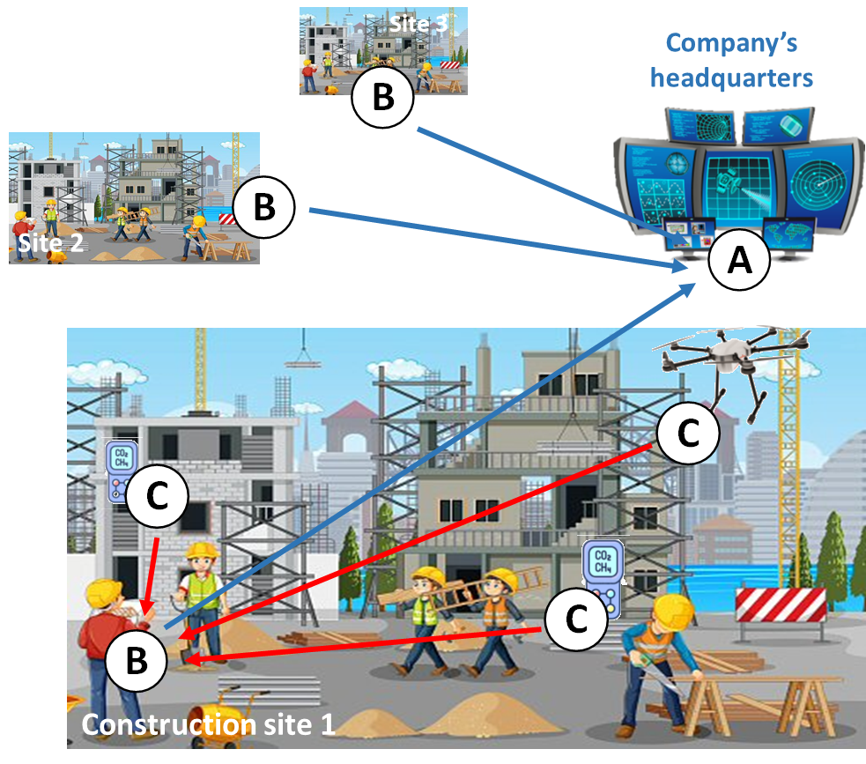
Developed use-cases
(construction)
Outcome: several contacts being held at this moment in the Middle East!

Slide 26
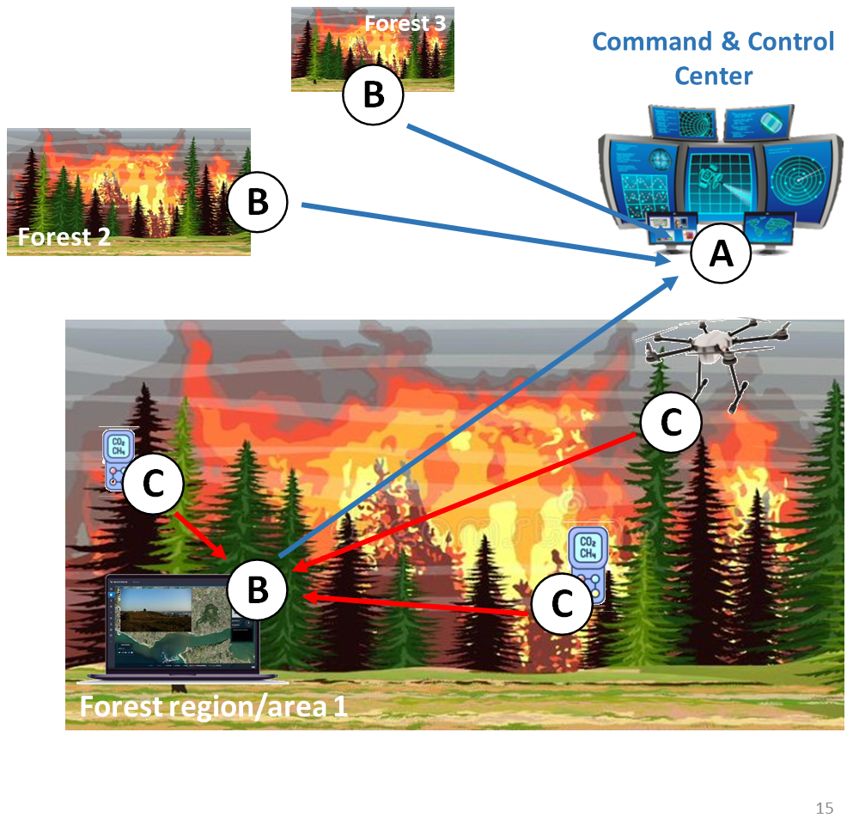
Developed use-cases
(hazardous)
Outcome: partnership with the biggest company dealing with fires in Portugal!

Slide 27
Developed use-cases
(wildfires)
Outcome: PoC done near Riyadh for pipeline inspection!

Slide 28
Business Impact
(coarse numbers)
New products: Beyond Skyline, LoRa sensors
Improved products: UAVs, beXStream
New projects: at least two
Revenues: expected 6M€ in 2024 (compared with 1.5M€ in 2023)
Round of investment under way

Slide 29
Pedro Lousã
Beyond Vision, S.A.
pedro.lousa@beyond-vision.com
https://beyond-vision.com/

Slide 30

CELTIC Proposers Brokerage Day
-Business Impact Session-
AI4GREEN
Orhun Ergul
Technical Delivery Lead, P.I.Works

Slide 31




























82
58
10M+
1.7B+
Operators
Countries
Cell Count
Subscribers
19 Years of Experience
References
Global Recognition
Winner.
GSMA Foundry Excellence Award with Know It All
Winner.
Managed Services Innovation
Winner.
Successful Automation Deployment
Network Sustainability Award
Recognition.
Network AI and Automation
Joint-initiatives with operators to drive innovation

Slide 32





Independent Network Automation Provider for Mobile Operators
Deliver performance & cost efficiency
Optimization
Network Automation
Customer Experience
Operations
Performance
Maximize Efficiency
Cost Reduction
Planning

Slide 33
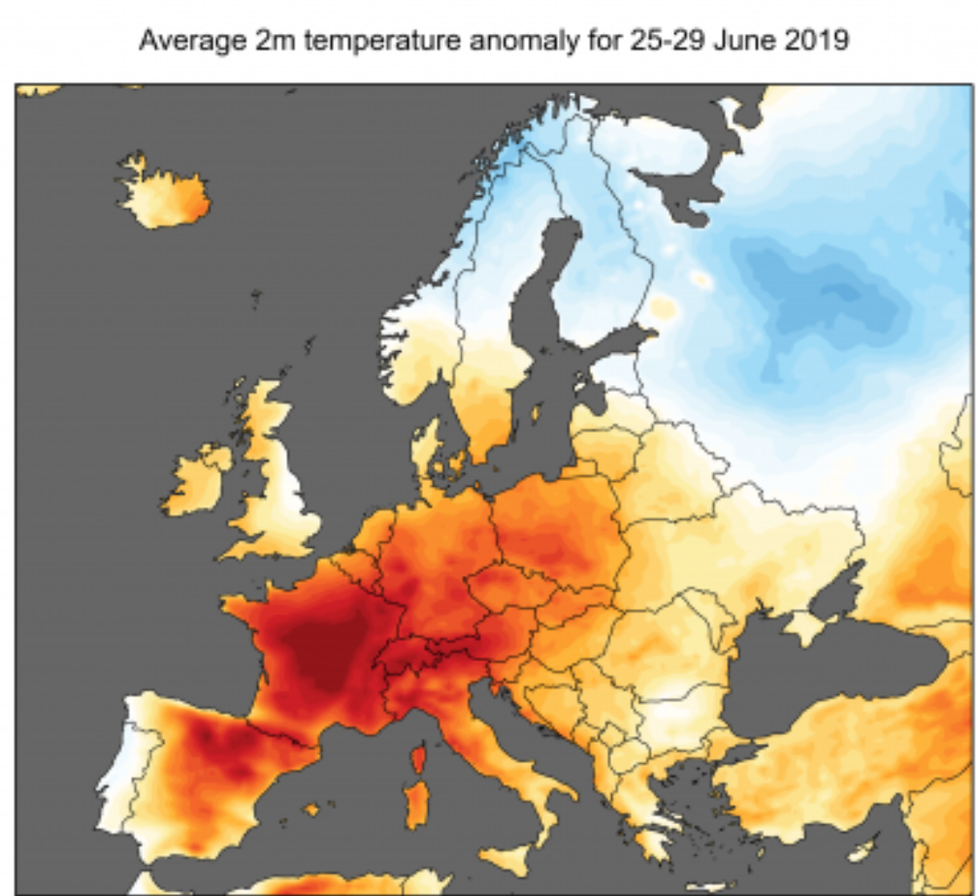


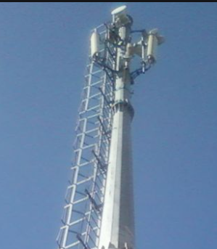



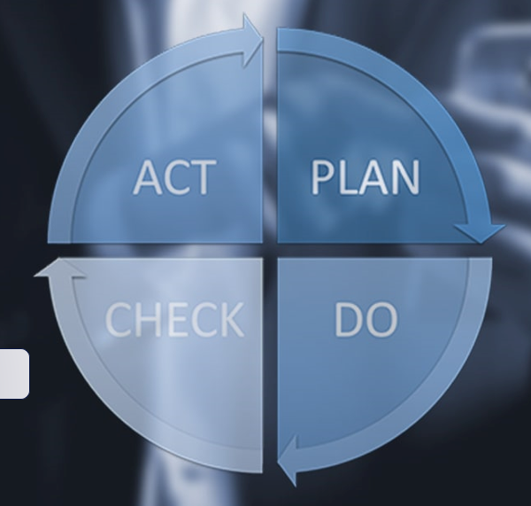


















Partners & Motivation
Started: Oct 2019
Completed: Dec 2022
Project leader
functions
17 partners
  3 telcos
  6 universities/research institutes
  8 private companies
  Goal:
  The main goal of this project is to achieve an improvement of about 30-40% of the end-to-end energy efficiency compared to current networks.
Notes:
AI4Green Consortium is consists of 17 Partners from 5 Countries: Sweden, Portugal, France, Finland and Turkey and we have together worked towards the goal to achieve 30-40% energy savings in mobile networks with the use of Artificial Intelligent. The project started in dec 2019 and is ending now in November

Slide 34


AI-Assisted Risk-Aware Energy Saving on Live Network
Energy Saving
I - PREDICTIVE CARRIER
SHUTDOWN ALGORITHM
Best in Class
Predictions
Improved
Saving Methods
II - PREDICTIVE SECTOR
SHUTDOWN ALGORITHM
- Benchmark of 8 algorithms
92% Prediction Accuracy on decisions
18% more shutdown vs reactive approach
Identifying sectors during underutilized periods
Awareness of coverage gaps & QoS Constraints
10% More saving on RAN vs vendor features
Risk-Awareness
III - CROWD MOVEMENT
ANALYTICS ENGINE
Geo-Spatial
Awareness
Knowing the Unexpected
IV- SOCIAL MEDIA
ANALYTICS ENGINE
ML based geolocated call traces
GNN based prediction
86% Accuracy on saving actions
52% Energy saving opportunity during events
Minimization of capacity risks
Disaster awareness by Social Media feeds i.e. X, Google News, etc.
SON orchestration
3 Minutes response time to unplanned events

Slide 35
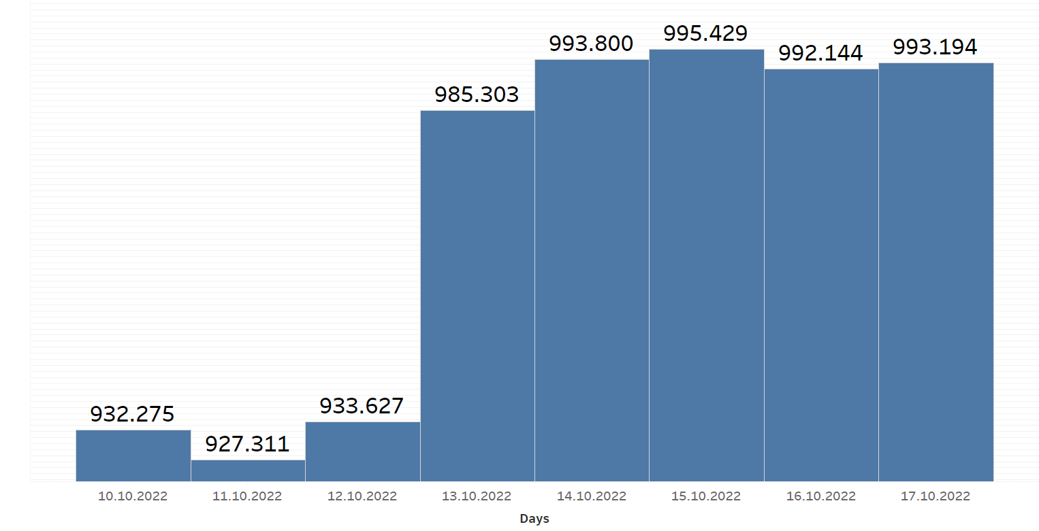
Sector Shutdown Results
 | Energy consumption (W) | Energy Saving (W) | Saving Percentage | Annual Saving (GWh) | Estimated Whole Network Annual Saving (GWh)
Only Vendor Features | 932,942 | 58,728 | 5.90% | 0.0214 | 6.18
Vendor Features + Sector Shutdown | 927,305 | 64,635 | 6.50% | 0.0235 | 6.78
No energy saving | 991,671 | - | - | - | -
  Energy consumption between 2 AM - 6 AM of 104 sites.
The estimation for Turkcell's annual countrywide overall network energy saving using this method is about 6.78 GWh
Notes:
This Graph shows the daily energy consumption of the whole 104 sites. On 11 Oct and 13 Oct, only the vendor feature is activated. When we compare the results, there is clear energy-saving by using vendor features. Our improved model is slightly better than the vendor feature. On the day that we ran our model (11 Oct.), the energy consumption is the lowest.
In Table, the overall energy saving of the vendor feature is about 5.9%. Our improved model increased that amount by about 10%. The best energy saving is achieved by using our improved model using with vendor features, which is about 6.5%. The vendor energy saving of vendor feature and improved model is 58728 W and 64635 W, respectively. For the testing field, the estimated annual saving is about 23 MWh when our improved model is used. The whole network's energy-saving is estimated at about 6.78 GWh, corresponding to an annual saving of 1.63 M€ (considering 0.24 €/kWh) if we used this model on the whole network

Slide 36
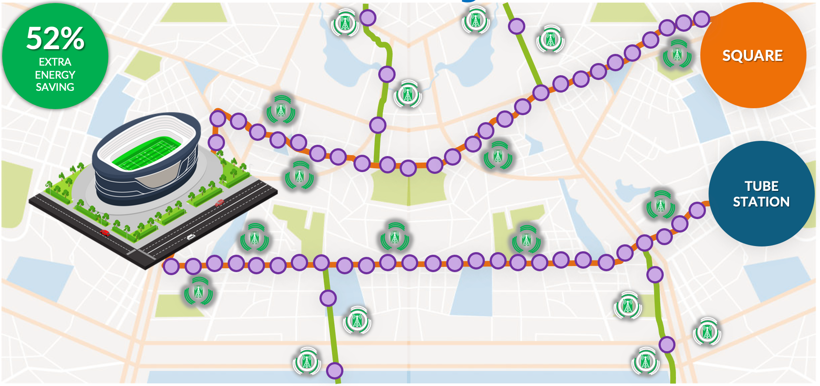
Crowd Movement
Modelling Results
Using the exclusion list (network load expectations on each cell), it is possible to determine when the energy saving algorithms are allowed to take/stop action on the network.
There is room for 52.5% of energy saving even on special event days around event venues when crowd movements are modelled with machine learning.
The energy saving algorithms save ~14682 Watts per hour on a normal day in Kadıköy region.*
Energy Saving (Estimates) | Per Hour Saving* | 5 Hours Saving* | Percentage (5 Hours)*
Regular Day (no match) with ES | 14682 Watt-Hour | 73410 Wh | 6%
Match Day with no risk (off ES) | 0 Wh (No Saving) | 0 Wh | 0 %
Match Day with CMM assisted ES | 7635 Wh | 38173 Wh | 3.2 %
52.5% saving
* Based on the values in “Live Network Results” section of this presentation.

Slide 37


Business Impact
Dissemination Summary
Awards
New Products: 6
Improved Products: 11
Expected ROI : 1-50x
New Employees 12-14
Patents & Trademarks: 2
Prototypes & Fields trials: 7
Contributions to standards: 2
Open-source Software: 3
Techno economics: 1
Conferences papers: 10
Journal Papers: 16
Thesis:9
Notes:
And the partners contributing in the project also see great business impact from the project. Among them are new and improved products within diffrent areas. Some examples uf new products developed is:
Turkgen has developed a social media analysis software product that enables understanding public or natural events to trigger actions over network
Allbesmart - AI based software tool to forecast QoS KPIs of LTE and 5G networks
Turkcell and PI works have developed sector-based shut-down algorithms that use sample data collection from Geolocation Engine and feature extraction
We will soon hear more about these deliveries. And if you are interested to know more detaila around this summery the can be found in the impact table

Slide 39
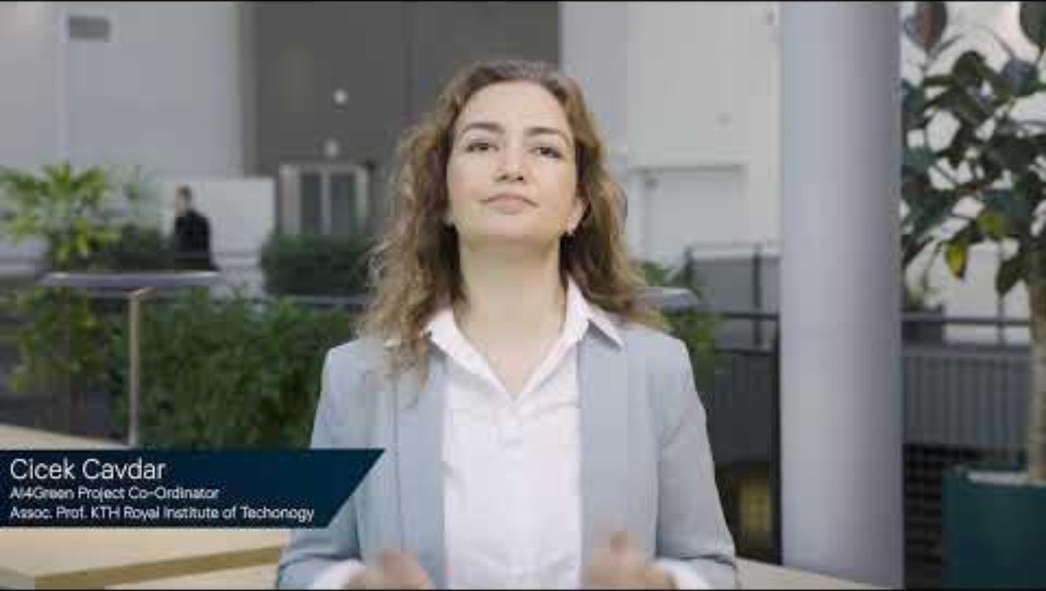
AI4GREEN: (PT)
SENDATE & AI-NET: Mr Reijo Savola Reij from University of Jyväskylä (FI)

Slide 40
CELTIC Proposers Brokerage Day
-Business Impact Session-
CELTIC-FLAGSHIP Projects success of
SENDATE and AI-NET
Mr Reijo Savola, University of Jyväskylä (FI)

Slide 41

SEcure Networking for a DATa center cloud in Europe
Notes:
This Graph shows the daily energy consumption of the whole 104 sites. On 11 Oct and 13 Oct, only the vendor feature is activated. When we compare the results, there is clear energy-saving by using vendor features. Our improved model is slightly better than the vendor feature. On the day that we ran our model (11 Oct.), the energy consumption is the lowest.
In Table, the overall energy saving of the vendor feature is about 5.9%. Our improved model increased that amount by about 10%. The best energy saving is achieved by using our improved model using with vendor features, which is about 6.5%. The vendor energy saving of vendor feature and improved model is 58728 W and 64635 W, respectively. For the testing field, the estimated annual saving is about 23 MWh when our improved model is used. The whole network's energy-saving is estimated at about 6.78 GWh, corresponding to an annual saving of 1.63 M€ (considering 0.24 €/kWh) if we used this model on the whole network

Slide 42

Business Impact of CELTIC Projects
SENDATE & AI-NET: Mr Reijo Savola Reij from University of Jyväskylä (FI)

Slide 43
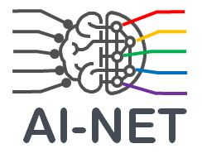
Accellerating digital transformation in Europe by Intelligent NETwork automation
Notes:
This Graph shows the daily energy consumption of the whole 104 sites. On 11 Oct and 13 Oct, only the vendor feature is activated. When we compare the results, there is clear energy-saving by using vendor features. Our improved model is slightly better than the vendor feature. On the day that we ran our model (11 Oct.), the energy consumption is the lowest.
In Table, the overall energy saving of the vendor feature is about 5.9%. Our improved model increased that amount by about 10%. The best energy saving is achieved by using our improved model using with vendor features, which is about 6.5%. The vendor energy saving of vendor feature and improved model is 58728 W and 64635 W, respectively. For the testing field, the estimated annual saving is about 23 MWh when our improved model is used. The whole network's energy-saving is estimated at about 6.78 GWh, corresponding to an annual saving of 1.63 M€ (considering 0.24 €/kWh) if we used this model on the whole network

Slide 44
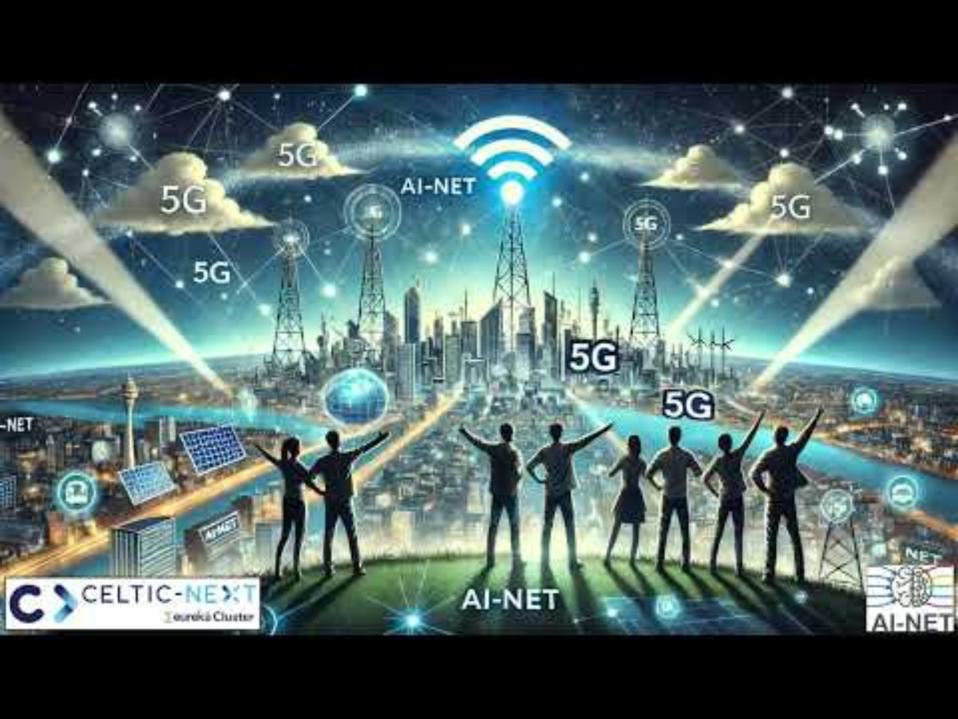
Business Impact of CELTIC Projects
CELTIC FLAGSHIP:
AI-NET

Slide 45
Mr Reijo Savola
University of JyväskyläSavola
Email:reijo.m.savola@jyu.fi

Slide 46
Business Impact of CELTIC Projects
Moderator:
Mr Richard Foggie, , Innovate UK Business Connect, Knowledge Transfer Manager – Digital
Economy and Internet of Things
Pannelists:
F4iTECH: Mr Ismail Uzun from Inosens (TR)
AI4GREEN: Mr Orhun Ergul from Piworks (UK)
IEoT: Mr Pedro Lousa from Beyond Vision (PT)
SENDATE & AI-NET: Mr Reijo Savola from University of Jyväskylä (FI)

