Slide 1
CELTIC Proposers Brokerage Day
- Pitching Session -

Slide 2


Welcome
Project Idea
Pitching Session
Christiane Reinsch, CELTIC Programme Coordinator
reinsch@celticnext.eu

Slide 3

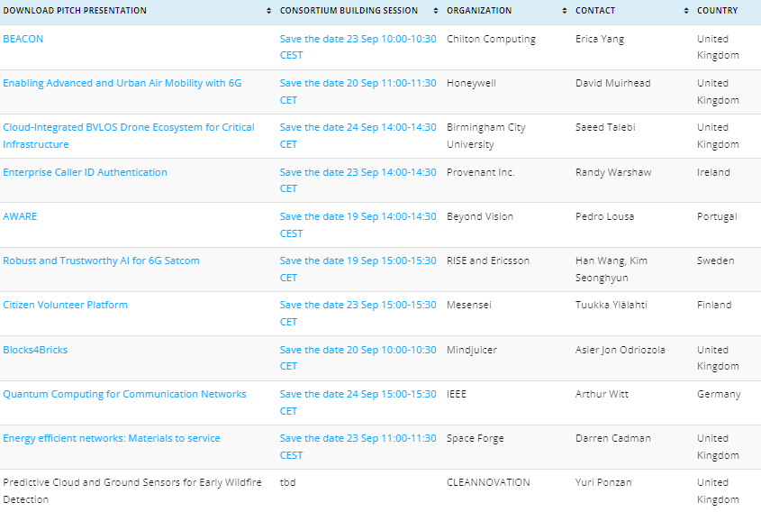
Pitch Overview
Moderator: Christiane Reinsch, CELTIC Programme Coordinator

Slide 4



Find the pitches Online
celticnext.eu/new-ideas
www.celticnext.eu office@celticnext.eu

Slide 5
CELTIC-NEXT
Consortium Building SessionsDay
19 -24th September
Consortium Building and information about international funding
celticnext.eu/latest-event
Stay informed about CELTIC
https://www.celticnext.eu/news-subscription/

Slide 6
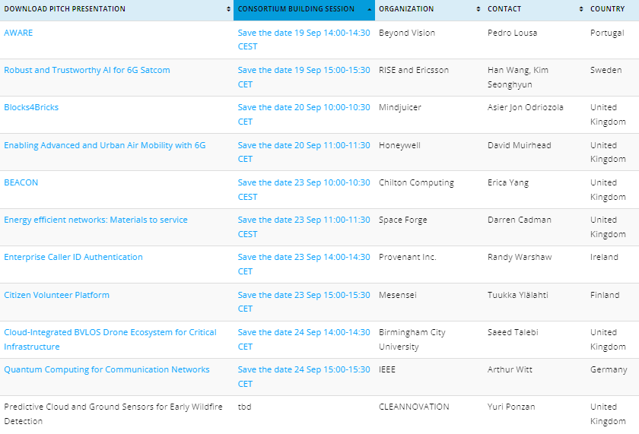
CSB Overview
19-24th of September

Slide 7


CELTIC-NEXT
AUTUMN CALL 2024
Open until 24th October
https://www.celticnext.eu/

Slide 8





CELTIC-NEXT
Pitch of
the Project Proposal
18th April 2024, London
BEACON: Network-Assisted Highly Interactive Spatial Computing Technology for Healthcare
Dr Erica Yang, Head of Research, Chilton Computing Ltd, UK
info@chiltoncomputing.co.uk
@Copyright protected

Slide 9

Teaser
Purpose: Making spatial computing work for highly interactive digital healthcare applications
Main benefit: allowing interactive and real-time responses that are capable to support complex care needs for people with long-term health conditions remotely
What makes the added value? – (ultimately) it is about demonstrating the feasibility of spatial computing for supporting complex collaborations betweeen carers, patients, remote healthcare professionals, through leveraging
Advanced network assistance, such as on-demand high-throughput streaming, and
Its integration with AI and AR technologies in the real-world context
Why should I participate in the project? – part of a pioneering team developing next-gen spatial tech foundation for real-world digital healthcare applications
BEACON: Network-Assisted Highly Interactive Spatial Computing Technology for Healthcare
Erica Yang, Chilton Computing Ltd, info@chiltoncomputing.co.uk
@Copyright protected

Slide 10









Organisation
Profile
Staff track record (UK and international)
  Coordinator of an ongoing CELTIC-Next project (€4.6 million)
  Experts in what we do! Highly experienced in collaborative R&D projects: key roles in numerous European and national projects
  Deep tech expertise across domains, AI & technology, next-gen networks
  Extensive long careers with Oxford University, UK National Lab …
Expert project management – supported by professional project managers, with proven ability to deliver large-scale collaborative R&D
Great healthcare ecosystem – you will be working with a strong network of UK and European HealthTech partners
Emphasis on commercialisation - with a clear value proposition for eHealth stakeholders
A great company to work with!
Personal experience:
Expert evaluator for the EC Horizon2020
Expert speaker for UKRI Brussels
Expert panel member for UKRI
Expert group member, UK automotive council
Erica Yang, Chilton Computing Ltd info@chiltoncomputing.co.uk
@Copyright protected

Slide 11






Proposal
Introduction
on-screen, goggles - real time and interactive visual and voice guidance
Real-time joint-up medical information delivery
Motivation: the current remote healthcare support is basic, limited primarily to remote video consultation. Many patients struggle to contextualise what needs to be done on a day-to-day basis, resulting in, unfortunately, avoidable, hospital admissions. Changing this demands technology breakthroughs brought by spatial computing.
Vision: every carer and patient can enjoy personalised and quality healthcare support anywhere in the world, powered by network-assisted AI-powered spatial computing technology, that can provide real-time, meaningful, and ease-to-interpret feedback critical to the health management of a patient, regardless of where they are.
On-premise Edge Compute Box
Remote
Healthcare
Professionals
Privacy respecting deployment
Patient and Carers/Workers
BEACON: Network-Assisted Highly Interactive Spatial Computing Technology for Healthcare
Erica Yang, Chilton Computing Ltd, info@chiltoncomputing.co.uk
@Copyright protected
Notes:
Current technology, such as centralised cloud services and AI on smart phone, often require expensive client hardware or intense data movements between clients/servers.

Slide 12

Proposal
Introduction
Expected outputs/outcomes:
WP1 – requirement and architecture: network-assisted content-aware spatial computing architecture
WP2 & WP3 - Technology stacks: network APIs and spatial computing tech development
WP4 – PoC demonstrators: A range of validated digital health PoC demonstrators, typically one per nation, and one international joint-up application for cross-border use case
WP5 – CDE: A CDE framework to maximising the impact, commercially, technologically, and partnerships
WP6 – Project management: aiming for a successful delivery nationally and internationally
Impacts (post-project)
  Contributions to spatial computing related global standards/initiatives
  Commercial European/Global value chain partnerships, including eHealth, AI and AR community
BEACON: Network-Assisted Highly Interactive Spatial Computing Technology for Healthcare
Erica Yang, Chilton Computing Ltd, info@chiltoncomputing.co.uk
@Copyright protected
Notes:
1 slide:
Short info on expected outcome, impacts, schedule typical project duration 36 month

Slide 13
Partners
Existing consortium, involved countries: UK, Turkey
Expertise, profiles and types of partners we are looking for:
1
Hospitals, clinics and care providers who have existing capability to trial the PoC tech, developing clinical/medical relevant use cases and requirements and contributing to evaluation
AI + AR application developers in digital health with existing commercial tractions in remote healthcare monitoring
IoT developers and digital health app developers with innovative tech for remote patient and health monitoring applications
2
3
BEACON: Network-Assisted Highly Interactive Spatial Computing Technology for Healthcare
Erica Yang, Chilton Computing Ltd, info@chiltoncomputing.co.uk
@Copyright protected
Notes:
1 slide:
Existing consortium, involved countries.
Expertise, profiles and types of partners you are looking for.

Slide 14
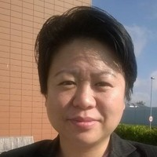
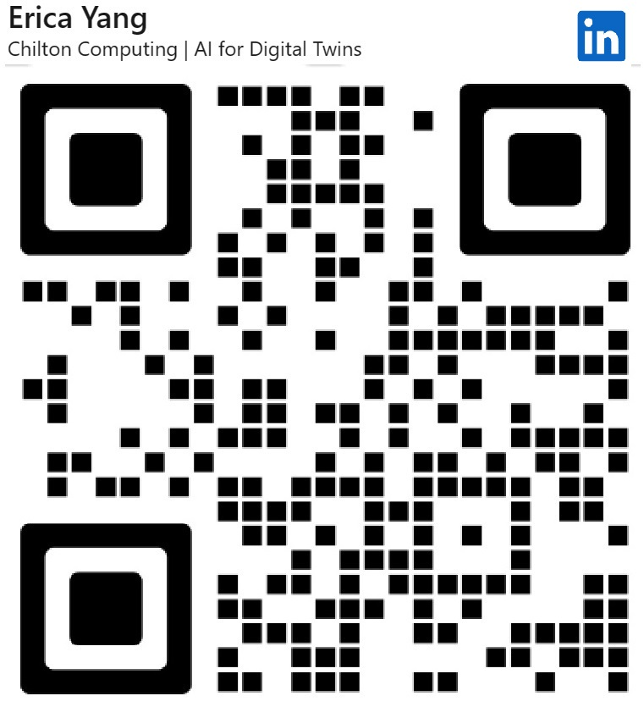

Contact me!
For more information and an expression of interest
Dr Erica Yang, Chilton Computing Ltd
info@chiltoncomputing.co.uk
Wood Centre for Innovation,
Quarry Rd,
Oxford OX3 8SB,
UK
Presentation available at:
@Copyright protected

Slide 15



Join the Consortium Building Session
Monday 23rd at 10 CET
Join meeting
Join by meeting number
Meeting number (access code): 2744 998 1092
Meeting password: Jv37DkFpv4Y
www.celticnext.eu office@celticnext.eu

Slide 16

CELTIC-NEXT
Proposers Brokerage Day
18th September 2024, London
Pitch of the Project Proposal
Enabling Advanced and Urban Air Mobility with 6G
David Muirhead, Honeywell, Sr. Director Engineering
dave.muirhead@honeywell.com

Slide 17
Teaser
What is the main benefit of the idea/proposal?
Development of 6G connectivity technology for Advanced Air and Urban Mobility (AAM/UAM)
That unlocks new and sustainable autonomous and semi-autonomous modes of transport for people and goods
Enabling a multitude of industrial and social use cases such as asset inspection and remote health care.
What makes the added value?
World class technology consortium bridging the gap between the satellite and cellular industries. Honewell‘s aerospace herritage in airborne connectivty for civil aviation and substantial investment in other AAM/UAM enabling technologies gives us significant credence, leverage and channel to market.
Why should I participate in the project?
AAM is a burgeoning market that will be enabled by new connectivity technologues such as 3GPP NTN
AAM connectivity is a largely and untapped space for innovation and growth.
www.celticnext.eu David Muirhead, Honeywell, dave.muirhead@honeywell.com

Slide 18

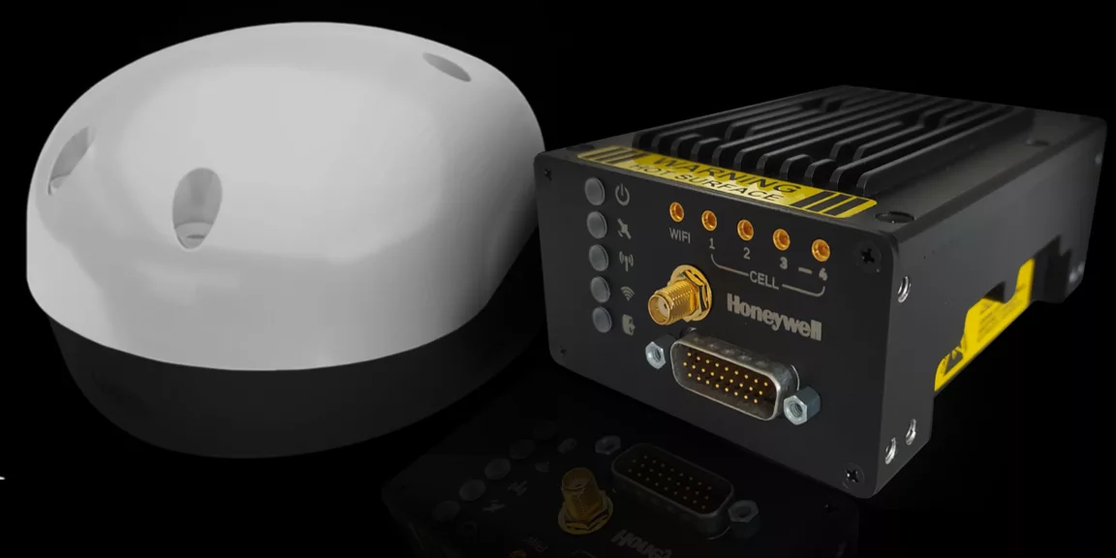
Organisation Profile
Honeywell Service and Connectivity is part of Honeywell Aerospace.
Engineering teams in: UK, Czech Rep., Canada
Design and develop connectivity solutions for Air Transport, Business Jets, General Aviation
  Satellite Communications
  Connectivity Enablers
  Airtime Reseller
Strategic focus on Advanced Air Mobility - Urban Air Mobility
  Satellite Communications
  Cellular Communications: 5G
  Non-Terrestrial Networks: 5G, 6G
www.celticnext.eu David Muirhead, Honeywell, dave.muirhead@honeywell.com

Slide 19
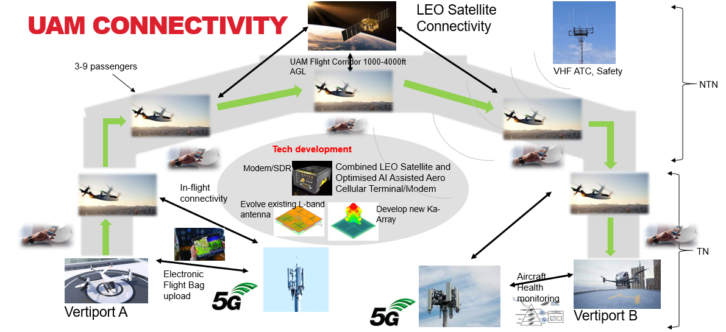
Proposal Introduction
Development of a highly optimized, low SWaP, resilient and mission critical connectivity terminal.
3GPP NTN Sub 6GHz and Ka-band capable of LEO constellation connection
Optimized PHY for airborne connectivity and seamless link switching between satellite and cellular
Enabling vehicle command and control, health monitoring, video services, passenger connectivity through resilient narrowband and broadband
links.
www.celticnext.eu David Muirhead, Honeywell, dave.muirhead@honeywell.com

Slide 20

Proposal Introduction (2)
Expected Outcomes:
The world’s first high reliability NTN/TN based connectivity terminal for AAM, capable of worldwide adoption
Program Duration: 4 yrs; 2025-2028
Covering the following activities:
Service and platform requirements incl airspace management and security
Overall system architecture design
Antenna and RF subsystem design and test
6G NTN subsystem protocol stack development
Software radio subsystem development
Avionics terminal development and integration
6G NTN/TN Network integration and end-end testing
Security and network architecture design, development and testing
Airborne platform integration, verification and pre-flight testing
Flight trial planning and demonstrations
Industrialization and commercialization planning
www.celticnext.eu David Muirhead, Honeywell, dave.muirhead@honeywell.com

Slide 21
Partners
.
Honeywell - (Canada, UK, Cz)
UE Protocol Stacks - Software Radio Systems (Ireland/Spain)
5G/6G NTN Test Network – Lasting/ Fraunhofer IIS? SAC? (Ro/ De/ UK)
NTN services – Inmarsat/ Viasat, Telesat (UK / Canada)
Ka-band Antenna – Ensilica (TBC) (UK)
Advanced antennas techniques - Swansea University (UK)
Test facility - flight trial – Cranfield, Saab (UK, Sweden)
Cyber, AI optimisation – Livewire, Bradford University (UK)
Test houses – RF subsystems, Channel sim – SAC/ SquarePeg? (UK/Ca)
www.celticnext.eu David Muirhead, Honeywell, dave.muirhead@honeywell.com

Slide 22
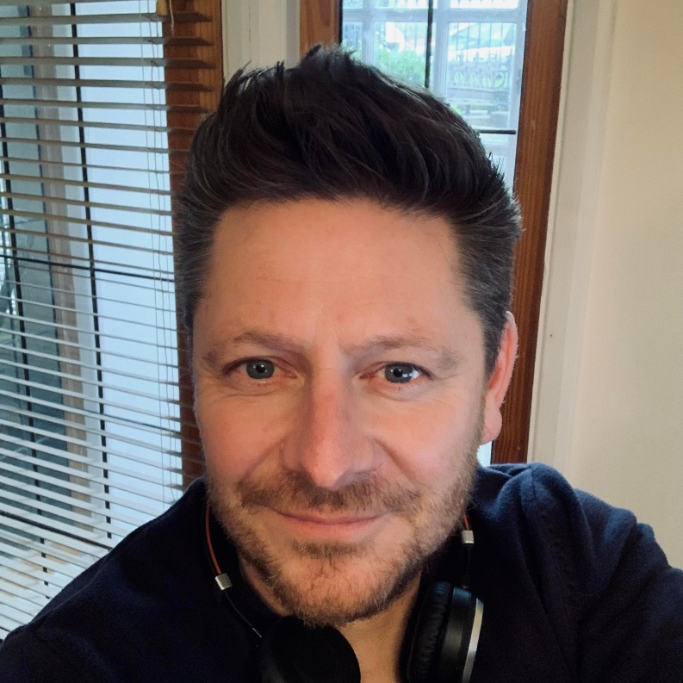
Contact Info
For more information and for interest to participate please contact:
David Muirhead,
Honeywell Aerospace Technologies
dave.muirhead@honeywell.com
+44 (0)7976 790087
Newtown Trading Est, Green Ln,
Tewkesbury GL20 8HD
Web https://aerospace.honeywell.com/
                Presentation is available via:

Slide 23
Join the Consortium Building Session
Friday 20th at 11 CEST
Join meeting
Join by meeting number
Meeting number (access code): 2740 214 9520
Meeting password: gvMKAV2Pm95
www.celticnext.eu office@celticnext.eu

Slide 24

CELTIC-NEXT
Proposers Brokerage Day
18th September 2024, London
Pitch of the Project Proposal
Cloud-Integrated BVLOS Drone Ecosystem for Critical Infrastructure
Dr Saeed Talebi, Associate Professor
Martin Weston, Head of Strategic Partnership
Birmingham City University
Saeed.Talebi@bcu.ac.uk, Martin.Weston@bcu.ac.uk

Slide 25
Teaser
Main benefit: Revolutionises infrastructure monitoring with a cloud-based, cellular-controlled drone system for national-scale BVLOS operations.
Added value: 5G/6G integration enables cost-effective, scalable drone management.
Centralised cloud Ground Control Station (GCS) increases reliability and reduces infrastructure costs.
Why Participate?
Collaborate with leading industry partners like Network Rail, and DroneCloud.
Shape the future of 5G/6G-enabled drone technology across critical infrastructure.
www.celticnext.eu Cloud-Integrated BVLOS Drone Ecosystem for Critical Infrastructure

Slide 26
Organisation Profile
Birmingham City University (BCU) is renowned for its multidisciplinary approach, combining science, technology, engineering, and arts (STEAM) to foster innovation in research and industry collaboration.
BCU is actively involved in AI/ML and digital infrastructure inspection, contributing to cutting-edge technologies through its strong partnerships with industry and participation in EU-led projects.
With a focus on practical industry applications, BCU’s research centres blend academic rigour with real-world impact, positioning the university as a leader in technology and engineering education.
www.celticnext.eu Cloud-Integrated BVLOS Drone Ecosystem for Critical Infrastructure

Slide 27
Proposal Introduction (1)
Vision: Create a cloud-based, cellular-controlled drone ecosystem for national-scale BVLOS operations, transforming the way critical infrastructure (rail, highways, utilities) is monitored and maintained.
Motivation: Current radio-based C2 systems are expensive and limited in range. By leveraging 5G/6G networks and cloud-based control, we aim to enhance scalability, reliability, and cost efficiency in drone operations.
Content: Cloud-based Ground Control Station (GCS) for real-time drone management.
Dual C2 architecture: Combining radio and cellular networks for seamless, long-distance drone control.
Real-time data collection for predictive maintenance and reduced human risk.)
www.celticnext.eu Cloud-Integrated BVLOS Drone Ecosystem for Critical Infrastructure

Slide 28
Proposal Introduction (2)
Expected outcomes:
Cloud-based BVLOS drone system integrated with 5G/6G networks for infrastructure monitoring.
Prototype of drones controlled via a cloud-based Ground Control Station (GCS) over cellular and radio networks.
Impacts:
Economic: Significant cost savings for infrastructure maintenance through automated drone inspections.
Environmental: Reduced carbon footprint by replacing traditional methods with drones.
Schedule (36 months):
Phase 1 (0-12 months): System design, regulatory approvals, and initial development.
Phase 2 (12-24 months): Prototype development, field testing, and validation.
Phase 3 (24-36 months): Full-scale deployment, trials, and commercial readiness.
www.celticnext.eu Cloud-Integrated BVLOS Drone Ecosystem for Critical Infrastructure

Slide 29
Partners
DroneCloud (UK): It is a SaaS platform providing end-to-end management for drone operations and Uncrewed Traffic Management (UTM).
Birmingham City University (UK): Pioneering RTO active in AI and software engineering
Network Rail (UK): Largest infrastructure owner and operator in the UK
HERO (Austria): It is a certified drone service provider specialising in automated, BVLOS drone operations for infrastructure monitoring, using advanced drones-as-a-service models.
www.celticnext.eu Cloud-Integrated BVLOS Drone Ecosystem for Critical Infrastructure

Slide 30
Contact Info
For more information and for interest to participate please contact:
Name and affiliation: Saeed Talebi (Associate Professor)
and Martin Weston (Head of Strategic Partnership)
E-Mail: Saeed.Talebi@bcu.ac.uk and Martin.Weston@bcu.ac.uk
                Presentation is available via:

Slide 31
Join the Consortium Building Session
Tuesday 24th at 15 CEST
Join meeting
Join by meeting number
Meeting number (access code): 2742 901 0111
Meeting password: hWb48AGAyN3
www.celticnext.eu office@celticnext.eu

Slide 32

CELTIC-NEXT
Proposers Brokerage Day
18th September 2024, London
Enterprise Caller ID Authentication
Randy Warshaw (CEO, Provenant Inc.)
randy@provenant.net

Slide 33
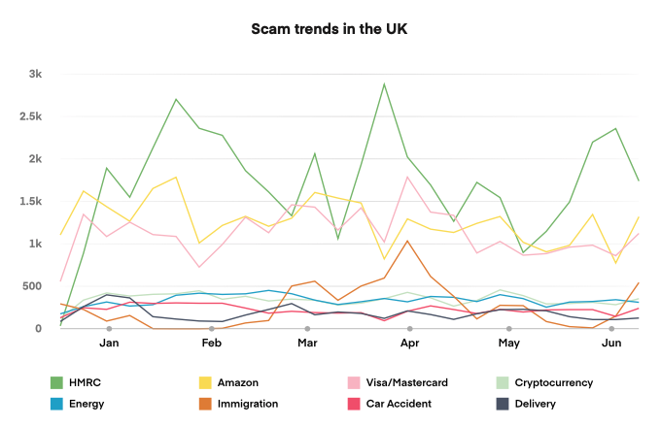
Financial Loss and Emotional Distress from Scam Calls
The Communications Fraud Control Association estimates fraud in the telecom industry reached almost $39 billion in 2023 (+12%); equivalent to 2.5% of telecommunications revenue!
UK leads Europe in scam calls
In 2023, 45 million people received scam text or calls
In the UK, each year at least 1 million people in the UK risk financial loss and emotional distress (Ofcom, March 2023). £750 million lost between 2022-23 (HMRC)
Fraud has eroded consumer trust: fewer people answer calls from unknown or suspicious numbers, making it harder for legitimate businesses to connect with their customers.
A variety of digital trust technologies and governance approaches (STIR/SHAKEN, Call Labels, SIP analytics, RCD…) have not solved the problem.
Source: HIYA Global Call Threat Report - 2024
www.celticnext.eu Enterprise Caller ID Authentication | Randy Warshaw | Provenant Inc | randy@provenant.net

Slide 34
Provenant Inc.
Provenant is a pioneering company at the forefront of globally verifiable and secure telephony. Founded in 2020 by industry veterans, Provenant addresses one of the telecom industry's most pressing challenges: distinguishing legitimate calls and texts from fraudulent ones. The company's innovative solutions provide proof of a communication's source and authenticity across any channel or jurisdiction. Built on non-proprietary, open global standards, Provenant's technology is fully decentralized and free from platform or vendor lock-in. As they prepare to launch multi-party trials in the EU and US, Provenant is poised to revolutionize how we verify and authenticate identity in the digital world, particularly for voice and text communications
www.celticnext.eu Enterprise Caller ID Authentication | Randy Warshaw | Provenant Inc | randy@provenant.net

Slide 35
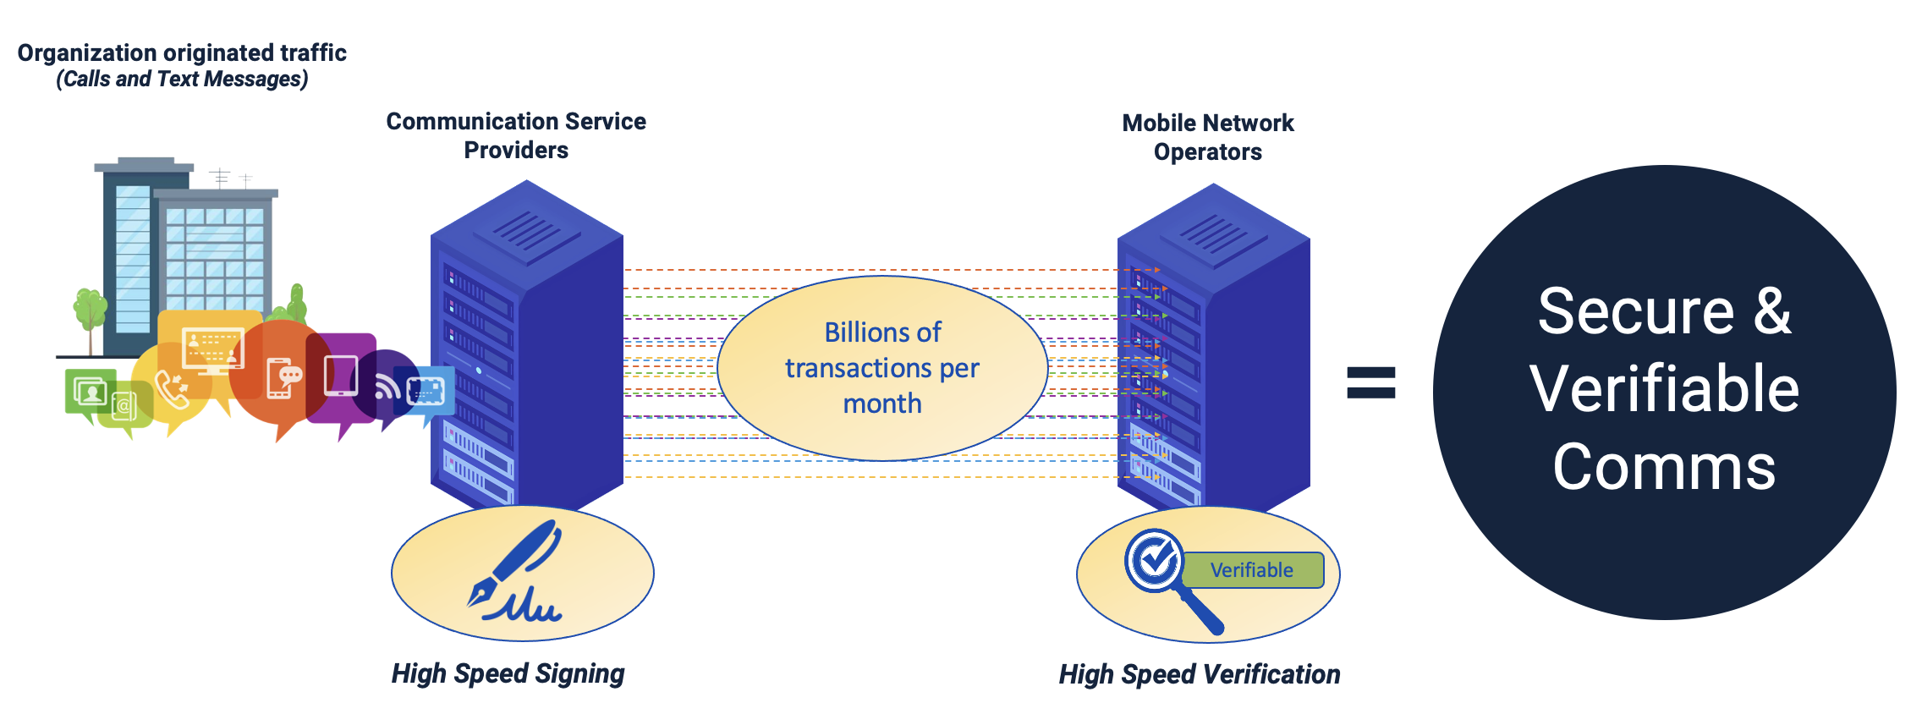
Provenant’s Secure and Authentic Telecommunications Technology
Security: cryptographic methods to prevent spoofing and ensure the authenticity of the enterprise calling party’s identity.
Global Applicability: allows for consistent enterprise caller ID authentication practices across different countries and regions.
Interoperability: interoperability between different types of networks (IP-based, circuit-switched) and between different countries’ telecom systems. Works seamlessly with existing caller ID authentication systems like STIR/SHAKEN and ETSI STIR.
Flexibility: accommodates the varying regulatory environments and technical capabilities of different countries.
www.celticnext.eu Enterprise Caller ID Authentication | Randy Warshaw | Provenant Inc | randy@provenant.net

Slide 36
Project Details
Duration: 36 months
Outcomes:
  Explore the use of cryptographic protocols for issuing and verifying enterprise identifiers (GLEIF/vLEIs)
  High speed call origin signing and verification at call termination
  Testing on OpenRAN testbed (Digital Catapult’s SONIC Lab is a joint programme between Digital Catapult and Ofcom, funded by UK Government Department for Science, Innovation & Technology )
  Limited piloting on MNO infrastructure
www.celticnext.eu Enterprise Caller ID Authentication | Randy Warshaw | Provenant Inc | randy@provenant.net

Slide 37




Partners
  Provenant Inc. (Ireland)
  Digital Catapult (UK)
  Accelerate-Swiss (Switzerland)
  We are looking for MNOs to pilot the solution in a real-world setting
www.celticnext.eu Enterprise Caller ID Authentication | Randy Warshaw | Provenant Inc | randy@provenant.net

Slide 38
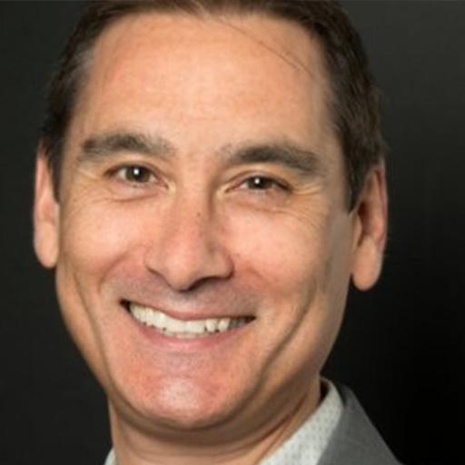
Contact Info
For more information and for interest to participate please contact:
Randy Warshaw, CEO - Provenant Inc.
randy@provenant.net
https://provenant.net/
Presentation is available via:

Slide 39
Join the Consortium Building Session
Monday 23rd at 14 CEST
Join meeting
Join by meeting number
Meeting number (access code): 2743 521 5641
Meeting password: GhAAN3wZb22
www.celticnext.eu office@celticnext.eu

Slide 40

CELTIC-NEXT
Proposers Brokerage Day
18th September 2024, London
Pitch of the Project Proposal
AWARE: Advanced Wireless AI and Robotics for Enhanced Cognitive Communication Continuum
Pedro Lousã, Beyond Vision
Pedro.lousa@beyond-vision.com

Slide 41
Teaser
Main Benefit:
  Revolutionizes user interaction with environments through advanced 6G networks
Added Value:
  Enables resilient connectivity for robotics and smart services, enhancing situational awareness
Participation Incentives:
  Engage in cutting-edge technology development
  Collaborate with leading experts and organizations
  Access to new markets and applications in 6G and robotics
www.celticnext.eu 6G Aware, Pedro Lousã, Beyond Vision, S.A., pedro.lousa@beyond-vision.com
Notes:
1 slide:
What is the main benefit of the idea/proposal?
What makes the added value?
Why should I participate in the project?

Slide 42
Organisation Profile
Organization Name: Beyond Vision
Overview:
  Expertise in Electronics, Mechanics, AI, SW, Robotics
  Experience in developing innovative solutions
  Strong focus on research
Key Achievements:
  Several National and European projects
  Manufacturer of UAVs for industrial applications
www.celticnext.eu 6G Aware, Pedro Lousã, Beyond Vision, S.A., pedro.lousa@beyond-vision.com
Notes:
1 slide:
Very short info about the profile of your organisation

Slide 43
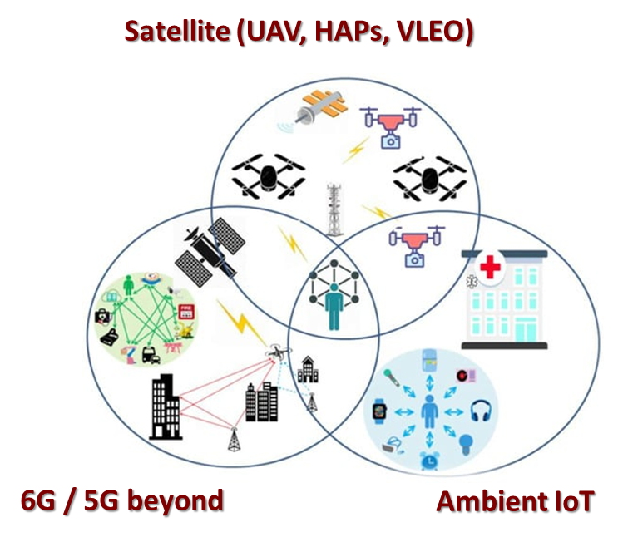
Proposal Introduction (1)
Vision: To create a unified 6G network that enhances user awareness and supports advanced robotics
Motivation: to enhance 5G network architecture and connectivity through the use of satellites for resilient coverage, particularly in emergency communication scenarios within dynamic environments
Content:
Development of 3D networking for robust communication and sensing capabilities.
Integration of Cognitive Communication Continuum (CCC) for intelligent network adaptation.
www.celticnext.eu 6G Aware, Pedro Lousã, Beyond Vision, S.A., pedro.lousa@beyond-vision.com
Notes:
1 slide:
Short info what the idea/proposal is about
(vision, motivation, content,
please include a picture describing your idea)

Slide 44
Proposal Introduction (2)
Expected Outcomes
Development of a Robust 6G Architecture: Creation of an end-to-end AI/ML-based framework for integrated sensing, communication, cognition, and positioning.
Enhanced 3D Networking Capabilities: Facilitation of precise positioning and navigation services, supporting applications such as UAVs and AMRs.
Intelligent Context-Aware Services: Deployment of services that adapt to user needs and environmental conditions, particularly in emergency scenarios.
Impacts
Improved Emergency Response: Enhanced communication reliability in dynamic environments, enabling faster and more effective emergency management.
Expansion of Smart Services: New applications and services that enhance user awareness and interaction with their surroundings.
Advancements in Robotics: Strengthened capabilities for safe autonomous systems operating in complex environments.
Project Schedule [Duration: 36 months] Year 1: Research and Development/ Year 2: Prototyping and Testing (Months 13-24)/ Year 3: Deployment and Evaluation (Months 25-36)
www.celticnext.eu 6G Aware, Pedro Lousã, Beyond Vision, S.A., pedro.lousa@beyond-vision.com
Notes:
1 slide:
Short info on expected outcome, impacts, schedule typical project duration 36 month

Slide 45
Partners
Countries Involved:
  Portugal:
    oneSource: Emergency response platform provider, focusing on developing integrative components and multi-modal devices.
    University of Lusofona: Academic partner specializing in indoor localization/navigation for UGVs/AMRs.
    Beyond Vision: Specialists in drone manufacturing, enhancing advanced sensing and perception capabilities, and facilitating 5G and LEO connectivity over drones.
  Germany:
    Huawei: Experts in 6G network architecture for robotics and automation, contributing to the integration of 6G-enabled sensing and communication in robotic systems.
Expertise and Profiles Needed
Organisations with expertise in: AI/ML, Robotics and Autonomous Systems, Mobile Network Operation, Network Architecture and Stanardisation, Emergency Response Solutions, Sensing and Positioning Technologies
Types of Partners Sought
Academic institutions for testbed set up and research collaboration
Industry partners with related innovative technologies and interest in sustainable end-to-end service development
Stakeholders in emergency management and response systems
www.celticnext.eu 6G Aware, Pedro Lousã, Beyond Vision, S.A., pedro.lousa@beyond-vision.com
Notes:
1 slide:
Existing consortium, involved countries.
Expertise, profiles and types of partners you are looking for.

Slide 46

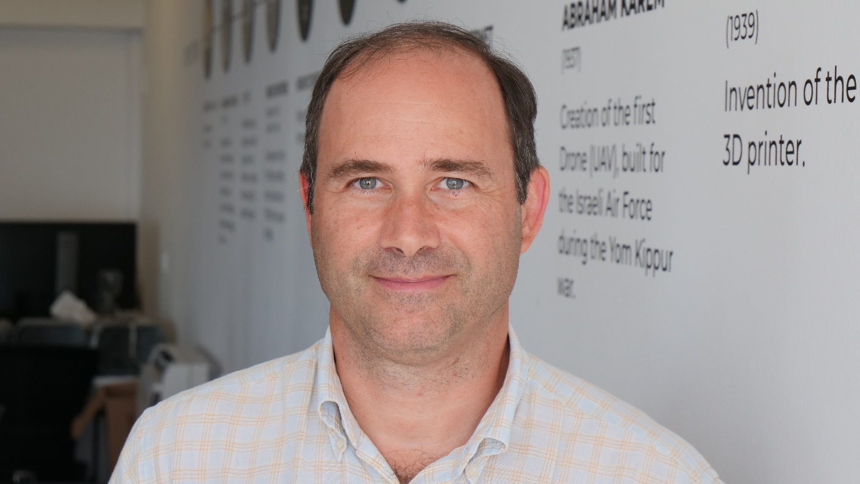
Contact Info
For more information and for interest to participate please contact:
Pedro Lousã
pedro.lousa@beyond-vision.com
+351 911890642
Beyond Vision, SA
Av. Quinta Grande, 28B
2610-161 Amadora
https://beyond-vision.com/

Slide 47
Join the Consortium Building Session
Thursday 19th at 14 CEST
Join meeting
Join by meeting number
Meeting number (access code): 2742 698 2597
Meeting password: gJKm9rRyU27
www.celticnext.eu office@celticnext.eu

Slide 48


CELTIC-NEXT
Proposers Brokerage Day
18th September 2024, London
Pitch of the Project Proposal
Robust and Trustworthy AI for 6G Satcom
Han Wang, Shahid Raza, RISE Sweden, han.wang@ri.se
Kim Seonghyun, Ericsson Sweden, kim.seonghyun@ericsson.com

Slide 49
Teaser
Making AI robust and trustworthy when deployed in future 6G Satellite communication
www.celticnext.eu Han.Wang@ri.se

Slide 50

Organisation Profile
RISE, Cybersecurity Unit
RISE has the most comprehensive cybersecurity research and innovation expertise in Sweden. We have coordinated and participated in dozens of cybersecurity projects on national and international levels. RISE also owns a cyber range that is a state-of-the-art cybersecurity test and demonstration facility in Kista, Stockholm.
Care of expertise:
IoT Security
Cloud Security
Software Security
5G Security
AI security
Cybersecurity Certification
Ericsson Research Security
Our mission is to provide security expertise, develop innovative solutions, and deliver proof of concept to support various divisions within Ericsson.
We are committed to advancing technical research, driving standardization efforts, and fostering academic collaboration.
5G/6G and IoT security
Identify Management
Platform and Software Security
Monitoring and Auditing
Privacy
Cryptography
www.celticnext.eu Han.Wang@ri.se

Slide 51



Proposal Introduction (1)
Robust AI for 6G: AI systems are vulnerable to security attacks. 6G satellite communication is being treated as critical infrastructure and requires robust AI solutions.
For example, adversarial manipulation could misguide positioning systems or disable critical surveillance functions.
Future telecom, especially 6G, will be managed by AI and attackers could interrupt connectivity, intercept sensitive data, or cripple emergency response systems.
We aim to focus on 6G (including Edge) as a target domain
www.celticnext.eu Han.Wang@ri.se

Slide 52




Proposal Introduction (2)
Potential adversarial attacks on ML-based systems:
  Data poisoning attack
  Model evasion attack
  Inference attack
  …
Solutions (e.g.):
  Design privacy-preserving ML-based systems
    by adding differential privacy
    by data synthetization
  Using decentralized training, such as federated learning
Securing (distributed) AI supply chain will also be a focus
Related projects:
  H2020 CONCORDIA, ARCADIAN-IoT
  Horizon Europe HARPOCRATES, INTEND
www.celticnext.eu Han.Wang@ri.se
Notes:
Scenario: Red and Blue team
Data leakage attack
Auditing: Is it safe to release the model
Vertical federated learning: multiple parties with different features about the same users/ samples
Previous projects some reference papers

Slide 53
Partners
Sweden: RISE, Ericsson, a telecom operator (to be confirmed), and an SME(s)
Looking for an EU consortium. We can coordinate the Swedish application.
www.celticnext.eu Han.Wang@ri.se

Slide 54
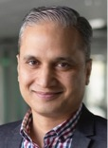

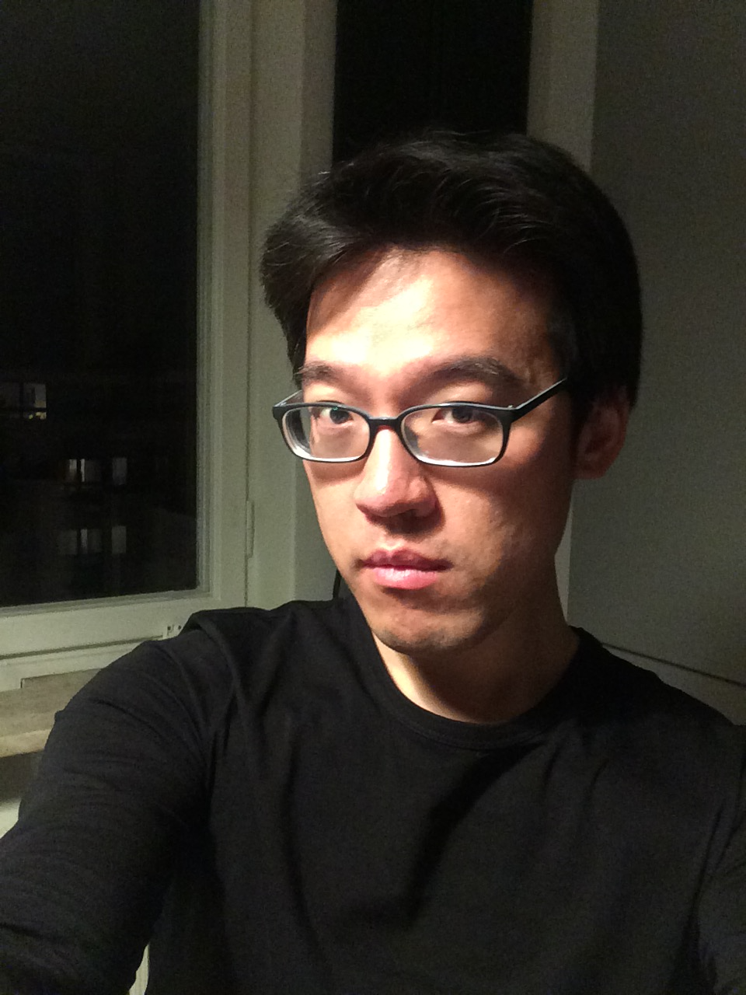
Contact Info
For more information and for interest to participate please contact:
Shahid Raza
Research Director, RISE Cybersecurity
shahid.raza@ri.se
+46 76 883 17 97
Isafjordsgatan 22
16440 Kista
Sweden
Han Wang,
Researcher, RISE Cybersecurity
han.wang@ri.se
+46 73 089 55 12
Isafjordsgatan 22
16440 Kista
Sweden
Kim Seonghyun, Ericsson Research
kim.seonghyun@ericsson.com
+46 70 986 55 32
Torshamnsgatan 23, 164 83,
Stockholm,
Sweden

Slide 55
Join the Consortium Building Session
Thursday 19th at 15 CEST
Join meeting
Join by meeting number
Meeting number (access code): 2743 729 0349
Meeting password: 3CwQyv7HJC2
www.celticnext.eu office@celticnext.eu

Slide 56

CELTIC-NEXT
Proposers Brokerage Day
18th September 2024, London
Pitch of the Project Proposal
Citizen Disaster Volunteer Platform
Tuukka Ylälahti, CEO, Mesensei Oy
tuukka@mesensei.com

Slide 57
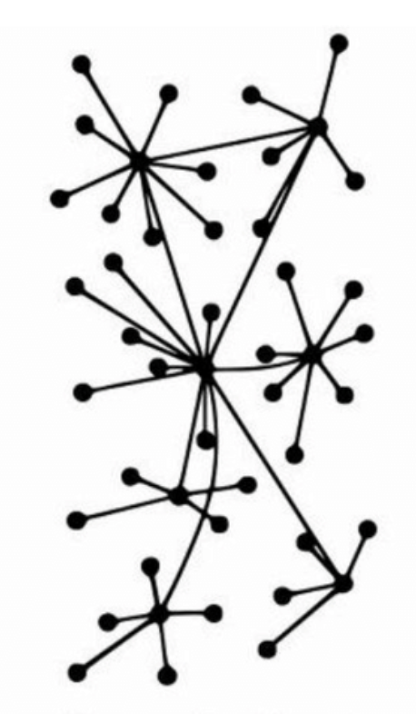
Teaser
  Modern societies are complex and networked. Collaboration of government agencies, businesses, NGOs, and citizens is increasingly vital in public safety.
  Establishing effective, multi-directional communication flows between them is a significant interoperability challenge legally and technologically.
  The proposed solution is a combined training and coordination platform for public authority - citizen volunteer collaboration.
  The value proposition is to address multi-organizational coordination and interoperability challenges to reinforce public safety at the European, regional, and local levels.
www.celticnext.eu Public Authority - Citizen Volunteer Platform, Tuukka Ylälahti, CEO, Mesensei Oy, tuukka@mesensei.com

Slide 58
Organisation Profile
  The concept is based on mobile platform as a service (m-PaaS) technology developed by Mesensei Oy. Since 2018, Mesensei has invested 1.5 million in product development in revenue and investments.
  Mesensei m-PaaS is currently used by universities, municipalities, NGO’s and corporates for building privacy and data protection sensitive digital services.
www.celticnext.eu Public Authority - Citizen Volunteer Platform, Tuukka Ylälahti, CEO, Mesensei Oy, tuukka@mesensei.com

Slide 59
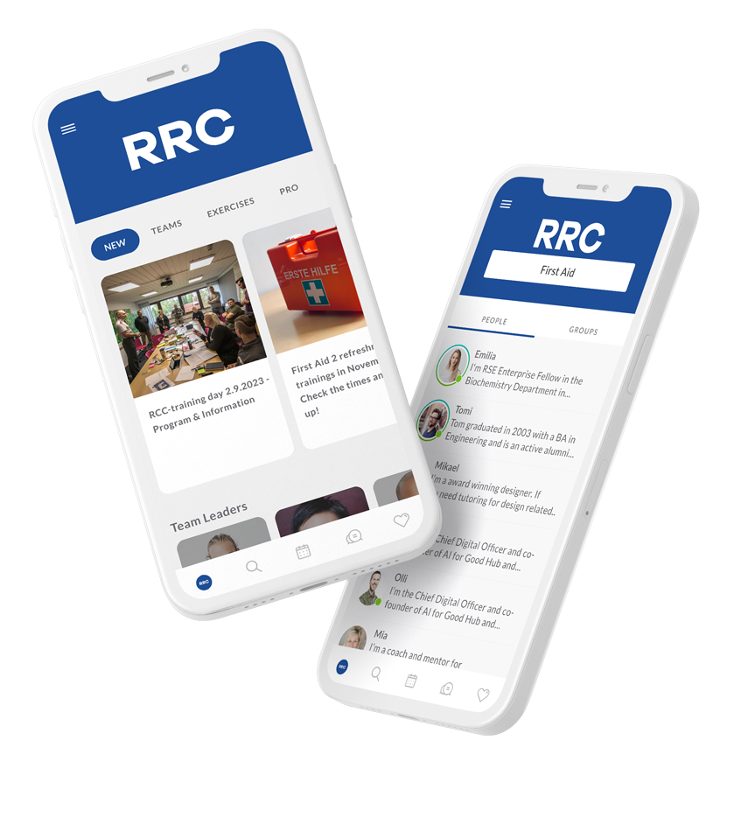
Proposal Introduction
  We propose an European platform dedicated to public authority - volunteer citizen collaboration.
  The platform sets out to replace ad-hoc tools currently used, such as WhatsApp, and fragmented range of siloed education and training tools with compliance, cybersecurity and trust issues.
  The platform serves as guiding technology for establishing legally compliant and secure way of working, which can be trusted by authorities and citizens alike.
  The business requirements for the platform are affordable cost and ease of use comparable to the popular everyday tools.
www.celticnext.eu Public Authority - Citizen Volunteer Platform, Tuukka Ylälahti, CEO, Mesensei Oy, tuukka@mesensei.com

Slide 60
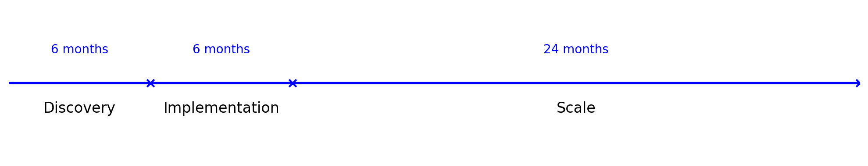
European Public Safety Collaboration Platform
  Expected Outcome: A dedicated platform to facilitate collaboration between European public authorities and citizen volunteers, enhancing public safety efforts across diverse use cases.
  Key Impacts:
    Improved Public Safety: multi-directional communication between citizens and public authorities.
    Increased Community Engagement: Empower citizens to participate actively in safety initiatives.
    Scalable Solution: Adaptable for various European regions and safety contexts.
www.celticnext.eu Public Authority - Citizen Volunteer Platform, Tuukka Ylälahti, CEO, Mesensei Oy, tuukka@mesensei.com

Slide 61
Partners
  Mesensei has partnered up with Laurea University of Applied Sciences, Municipality of Nurmijärvi and Helsinki Rescue Association. It is a cluster representing the best in class knowhow in Finland.
  For End-User Need evaluation and Co-creation we are looking for public authorities and regional developers and NGO's interested in themes of public safety, public authority - citizen collaboration and training & mobilisation of large scale volunteer networks.
  For technology and commercialisation we are looking for distribution partners, such as service solution providers and technology integrators to form international consortium.
  For research and conceptual development we are looking for research and special expertise of partners with vested interest in public safety issues, e.g natural disaster response, mitigation of extreme climate effects, resiliency, preparedness, response and recovery.
www.celticnext.eu Public Authority - Citizen Volunteer Platform, Tuukka Ylälahti, CEO, Mesensei Oy, tuukka@mesensei.com

Slide 62
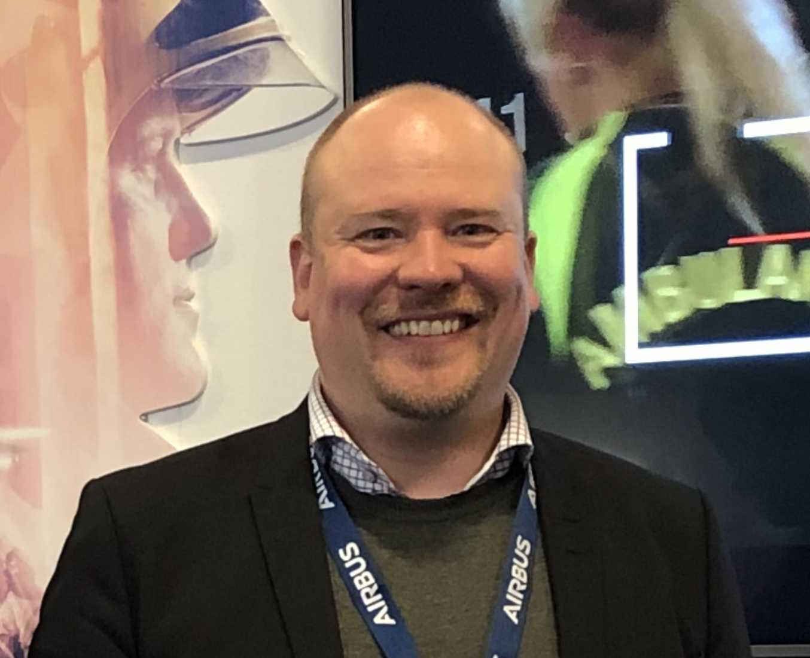
Contact Info
For more information and for interest to participate please contact:
Tuukka Ylälahti, CEO, Mesensei Oy
tuukka@mesensei.com
+358400410315
Otakaari 5, 02150, Espoo, Finland
www.mesensei.com
                Presentation is available via:

Slide 63
Join the Consortium Building Session
Monday 23rd at 15 CEST
Join meeting
Join by meeting number
Meeting number (access code): 2742 480 1335
Meeting password: mG9HJS2UP7P
www.celticnext.eu office@celticnext.eu

Slide 64

CELTIC-NEXT
Proposers Brokerage Day
18th September 2024, London
Pitch of the Project Proposal
Blocks4Bricks
Asier Jon Odriozola, Mindjuicer Director
asier.o@mindjuicer.com

Slide 65
Teaser
Let’s use Minecraft to virtually rebuild Ukraine, and raise funds to rebuild it for real.
Blocks4Bricks (B4B‘s) lets you sponsor virtual blocks to raise funds for real 'bricks‘,
With 100% of profits going towards reconstruction efforts.
A relatively similar project to build Denmark using Minecraft, used 4,000 billion Blocks.
Ukraine is 12 times bigger, which could mean 48,000 billion blocks.
With B4B‘s £1 sponsors1 block, and you can sponsor as many blocks as you like.
Let‘s bring the community together & harness Minecraft builders‘ power for good.
www.celticnext.eu Block4Bricks, Asier Jon Odriozola, Mindjuicer Director, asier.o@mindjuicer.com

Slide 66
Teaser
Why Participate and opportunities
Businesses & Investors: Economic growth, infrastructure development, housing rehabilitation, energy efficiency, regional stability, disaster resilience, health infrastructure, humanitarian assistance, tax benefits,
access to government and local authorities reconstruction contracts
Academia: Research opportunities, knowledge exchange, community engagement, educational opportunities
Minecraft Builders: Social impact, community engagement, personal fulfilment, skills development
Diaspora: Hope of a better future, global awareness, driving economic growth, cultural preservation
Brands: Social responsibility, Brand awareness, Brand loyalty, employee engagement, competitive advantage
Individuals: Social impact, personal fulfilment, reputation building, tax benefits and networking opportunities
www.celticnext.eu Block4Bricks, Asier Jon Odriozola, Mindjuicer Director, asier.o@mindjuicer.com

Slide 67





Teaser
Sustainable Knowledge Ecosystem Community
Building a better future starts with free, safe and global creative collaboration.
Blocks4Bricks is powered by Minecraft and welcomes gamers across platforms.
Together, we merge virtual world-building with real-world solutions to help rebuild Ukraine.
By continuously exchanging ideas, we create real and lasting impact , driving sustainable
reconstruction and resilience.
www.celticnext.eu Block4Bricks, Asier Jon Odriozola, Mindjuicer Director, asier.o@mindjuicer.com

Slide 68
Organisation Profile
At Mindjuicer we believe in Clarity of Thought for All
as a Free ‘Value Exchange’ of Ideas, to Foster
Collaboration & Engagement
We are an award-winning Strategic Communications and
Creative Organizational Engineering consultancy
based in Epping Forest, right outside London.
With more than 20 years of building brands, we help start-ups, firms, organisations and institutions to influence opinion, change behaviours
and create positive change.
www.celticnext.eu Block4Bricks, Asier Jon Odriozola, Mindjuicer Director, asier.o@mindjuicer.com

Slide 69

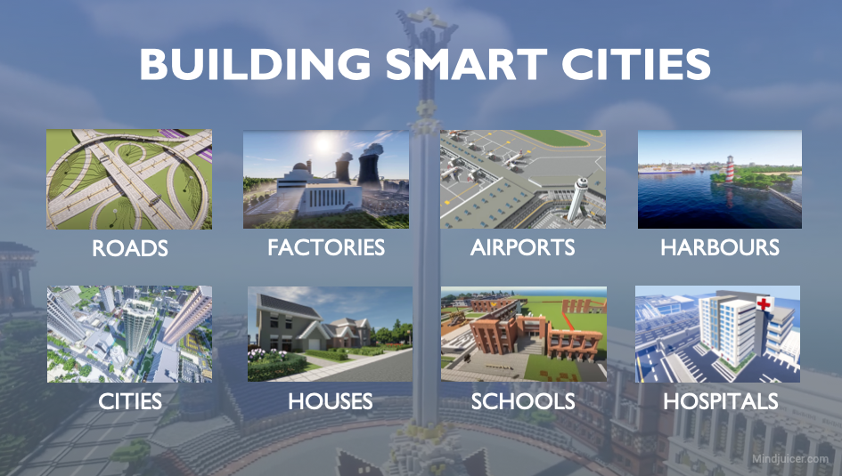
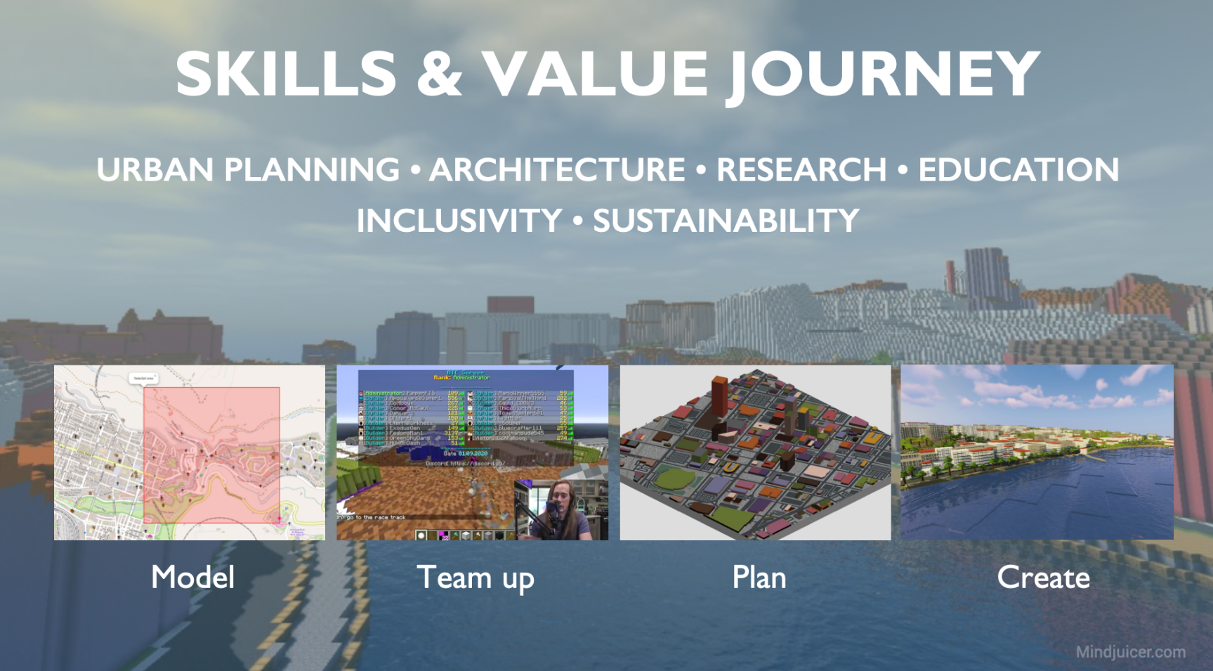
Proposal Introduction (1)
Blocks4Bricks is not about playing a game, but playing our part in history.
For more thriving communities & smart cities. For a healthier, safer, more sustainable & connected world.
Let’s build it together… one block at a time
VISION
MOTIVATION
CONTENT
www.celticnext.eu Block4Bricks, Asier Jon Odriozola, Mindjuicer Director, asier.o@mindjuicer.com

Slide 70
Proposal Introduction (2)
PHASE 1
Geographic Data Acquisition & Preparation
Key Objective: Acquire and prepare geographic data for virtual platform development. Social platforms and Community building start.
PHASE 2
Geographic Development & Community Engagement
Key Objective: Full development of the platform and further engagement with communities. Partnerships development and events.
PHASE 3
Scaling, Crowdfunding Campaign & Public Partnerships
Key Objective: Leverage public engagement and crowdfunding to drive platform growth and real-world impact projects.
PHASE 4
Public & Private Backing for Long-Term Sustainability & Growth
Key Objective: Attract large-scale public and private investments to expand real-world implementation and sustain growth.
www.celticnext.eu Block4Bricks, Asier Jon Odriozola, Mindjuicer Director, asier.o@mindjuicer.com

Slide 71
Partners
We would like to partner with a range of profiles from potential countries and Institutions
🇩🇪 🇳🇱 🇩🇰 🇬🇧🇨🇭🇺🇦 🇳🇴 🇸🇪 🇫🇮 🇱🇻 🇺🇸 🇨🇦 🇯🇵 🇰🇷 🇦🇪 🇶🇦
Technical partners (Software & Game Development, Engineering, IT security)
Construction and Infrastructure Partners (Construction, Architects, Sustainability experts)
Academic and Research Institutions (Research, Universities, Educational Institutions)
Government & Public Sector Partners (Government Agencies, Development Banks)
Private Sector Partners (Corporate Social Responsibility, Private Investors, Construction Tech Companies)
www.celticnext.eu Block4Bricks, Asier Jon Odriozola, Mindjuicer Director, asier.o@mindjuicer.com

Slide 72
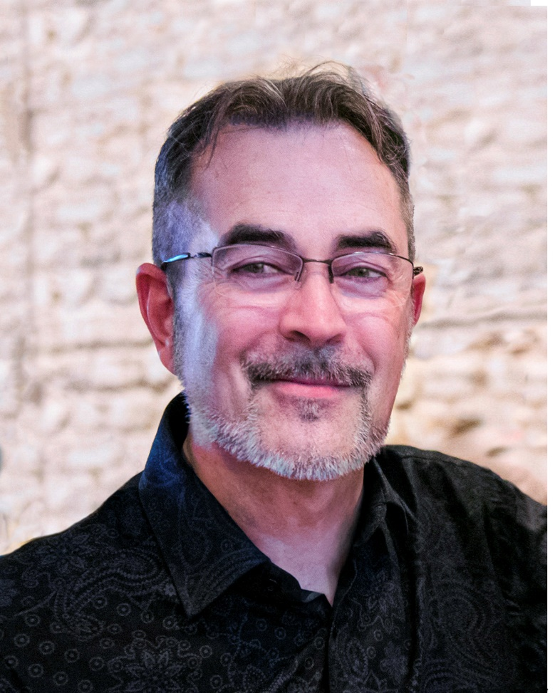
Contact Info
For more information and for interest to participate please contact:
        Asier Jon Odriozola
        asier.o@mindjuicer.com
        +44 777 337 1289
        13 Colebrook Gardens, Loughton, Essex IG10-2HS, UK
        www.mindjuicer.com
                Presentation is available via:
Blocks4Bricks - Build a Virtual City. Rebuild a Real Nation

Slide 73
Join the Consortium Building Session
Friday 20th at 10 CET
Join meeting
Join by meeting number
Meeting number (access code): 2741 299 9401
Meeting password: 3qN7rTV9UHx
www.celticnext.eu office@celticnext.eu

Slide 74

CELTIC-NEXT
Proposers Brokerage Day
18th September 2024, London
Pitch of the Project Proposal
Quantum Computing for Communication Networks (QCCN)
Arthur Witt
arthur.witt@ieee.org

Slide 75
QC in Networks. Why?
Main Benefit
Improved computation of complex and time-sensitive comp. tasks in comm. networks by quantum computing (QC).
Enables data loss reduction, network automation, better QoE, ...
Added Value
New QC algorithms for network optimization and signal processing tailored to neutral atom and photonic QC hardware.
Reasons for own Participation
Experience in QC algorithm design for resource optimization in networks and solid background in communications engineering.
www.celticnext.eu QCCN, Arthur Witt, arthur.witt@ieee.org

Slide 76

Organisation Profile
quitt: quantum information technology and telecommunications
Start-up in Pre-Seeding Phase (not yet funded)
Located in Germany
www.celticnext.eu QCCN, Arthur Witt, arthur.witt@ieee.org

Slide 77
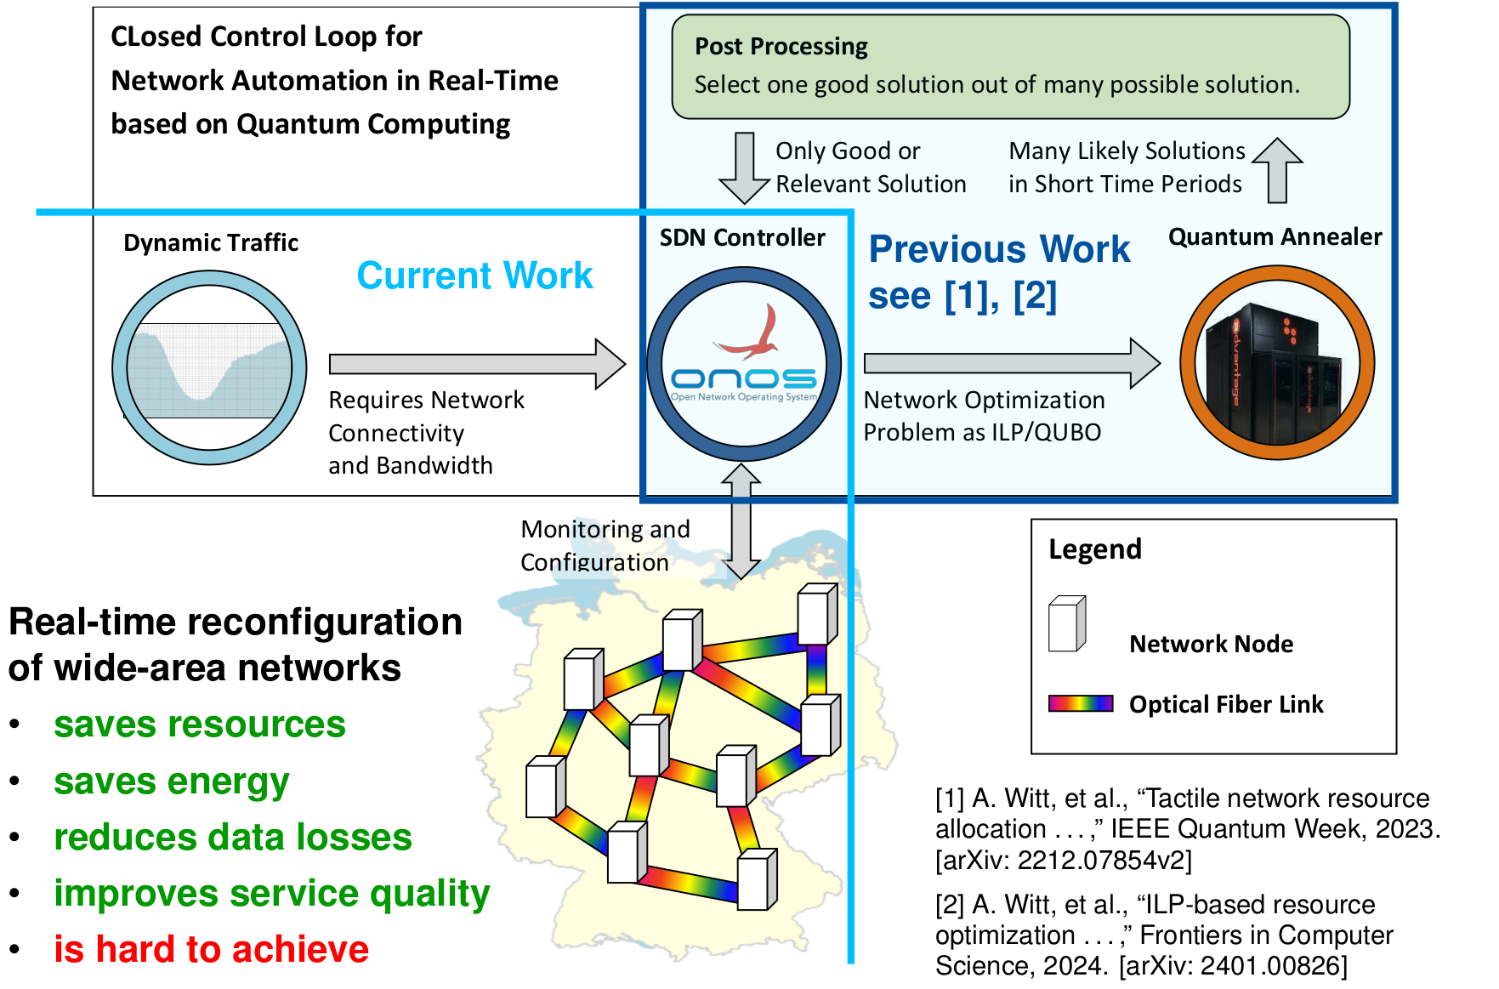
QC for Optimization
Vision
Real-time optimization of networks to obtain network automation.
Motivation
QC can solve NP-hard problems with an exponential speed-up compared to classical computing.
Presented at IEEE HPSR July, 2024.
www.celticnext.eu QCCN, Arthur Witt, arthur.witt@ieee.org

Slide 78
QC for Signal Processing
Vision
Supporting 6G/7G signal processing in
X-hauling by optical quantum computing.
Motivation
6G NR uses small cells, many antenna per CU/DU, provides BB signals for many users.
Optical QC can reduce energy consumption and seems embeddable in small-packaged, room-temperature systems in near future.
www.celticnext.eu QCCN, Arthur Witt, arthur.witt@ieee.org

Slide 79
Expectation
Outcome
Design and evaluation of QC algorithms for ILP-based optimization and signal processing in 6G X-haul.
Simulation environment, 2 Papers/year, patents.
Impact
Demonstration of real-world applications realized with QC.
Schedule
1. year: Solving network ILP on gate-based/neutral atom QC
2. year: X-haul signal processing concept with QC
3. year: Refinements and Improvements
www.celticnext.eu QCCN, Arthur Witt, arthur.witt@ieee.org

Slide 80
Partners
Consortium doesn’t exist, yet.
2 German partner from the field of theoretical quantum physics with experience in QC possibly available.
Searching: Partner with keen in
6G X-hauling, Radio-over-Fiber, Optical Transmission
www.celticnext.eu QCCN, Arthur Witt, arthur.witt@ieee.org

Slide 81
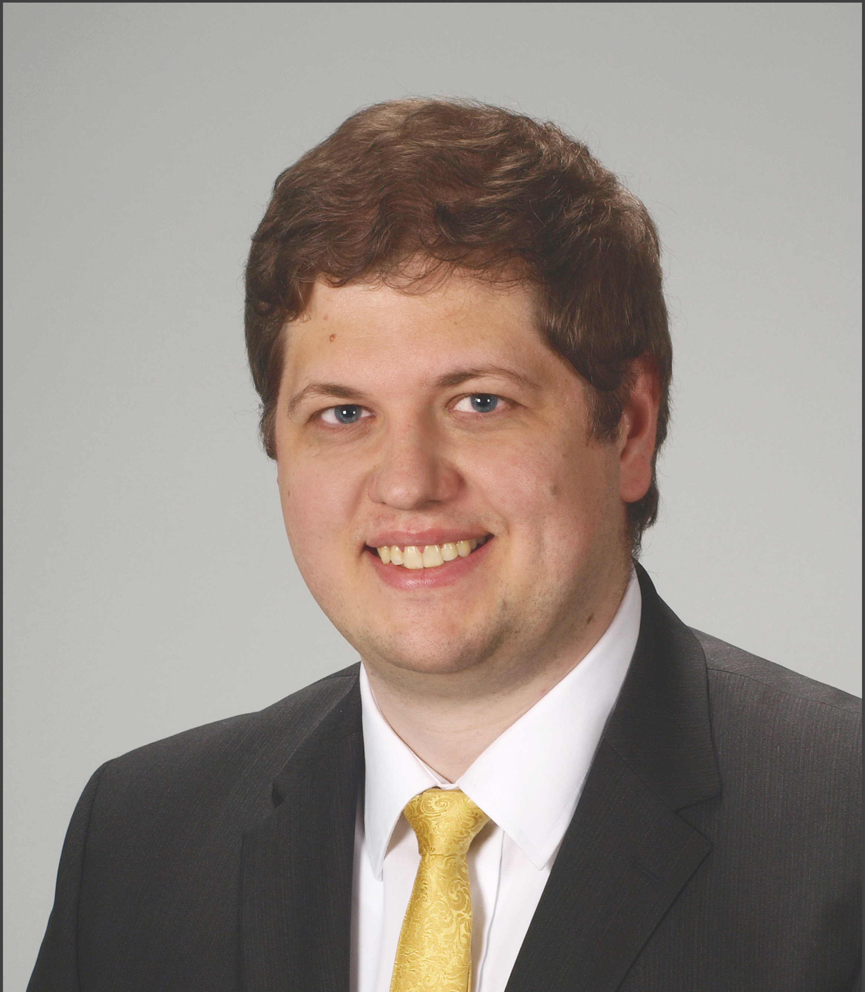
Contact Info
For more information and for interest to participate please contact:
Arthur Witt
arthur.witt@ieee.org
+49 1577 5869584
Presentation is available via:

Slide 82
Join the Consortium Building Session
Tuesday 24th at 15 CET
Join meeting
Join by meeting number
Meeting number (access code): 2744 998 1092
Meeting password: t2aGPW32y9P
www.celticnext.eu office@celticnext.eu

Slide 83

CELTIC-NEXT
Proposers Brokerage Day
18th September 2024, London
Pitch of the Project Proposal
Energy efficient networks:
Materials to service
Dr Darren Cadman, Business Development Manager, Space Forge
Darren.Cadman@spaceforge.com

Slide 84
5G FR2 roll out – how?
Energy Efficient Networks – Materials to Service
While 5G currently presents as the most energy efficient standard, there are still significant challenges in realising net zero within the telecommunications ecosystem. This becomes more pronounced as 5G in the FR2 (>24GHz) frequency range is developed. The proposed idea is to look at the challenges holistically and with a view to develop solutions by bringing the supply chains together. Focus areas could include base station architecture, thermal management, semiconductor chip design and packaging (incorporating cooling and mMIMO), modulation schemes, wave propagation in urban environments and use of metamaterials, AI of base stations while maintaining quality of service provision, cell size and area, green base stations, use cases – when and where to deploy cells versus satellite based communications, public versus private networks, FR1 v FR2 deployment, and even how is energy efficiency defined for telecommunications?
Benefit of the proposal: coordinated effort towards reaching net-zero for telecoms networks
Added value: Opportunity to bring disparate entities and expertise to pull together solutions for a highly complex challenge
There are so many opportunities and angles to approach this from, to address significant environmental and international regulatory challenges
www.celticnext.eu Energy efficient networks: materials to services – Darren Cadman – Space Forge – Darren.Cadman@spaceforge.com

Slide 85

Advanced semiconductor materials supplier
Hi tech scale up – Series A funding led by NATO Innovation Fund
  Aim: exploit microgravity environment of space to produce ultra-high quality semiconductor materials
  Terrestrial material production capability
HQ in Cardiff, Wales
Key market is telecoms
  Lead on DSIT Open Networks Ecosystem project: 5G SWaP+C with BT and CSA Catapult
www.celticnext.eu Energy efficient networks: materials to services – Darren Cadman – Space Forge – Darren.Cadman@spaceforge.com

Slide 86
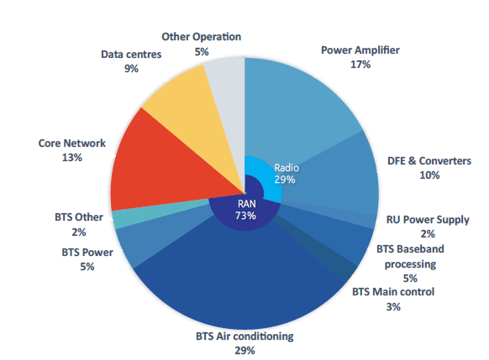
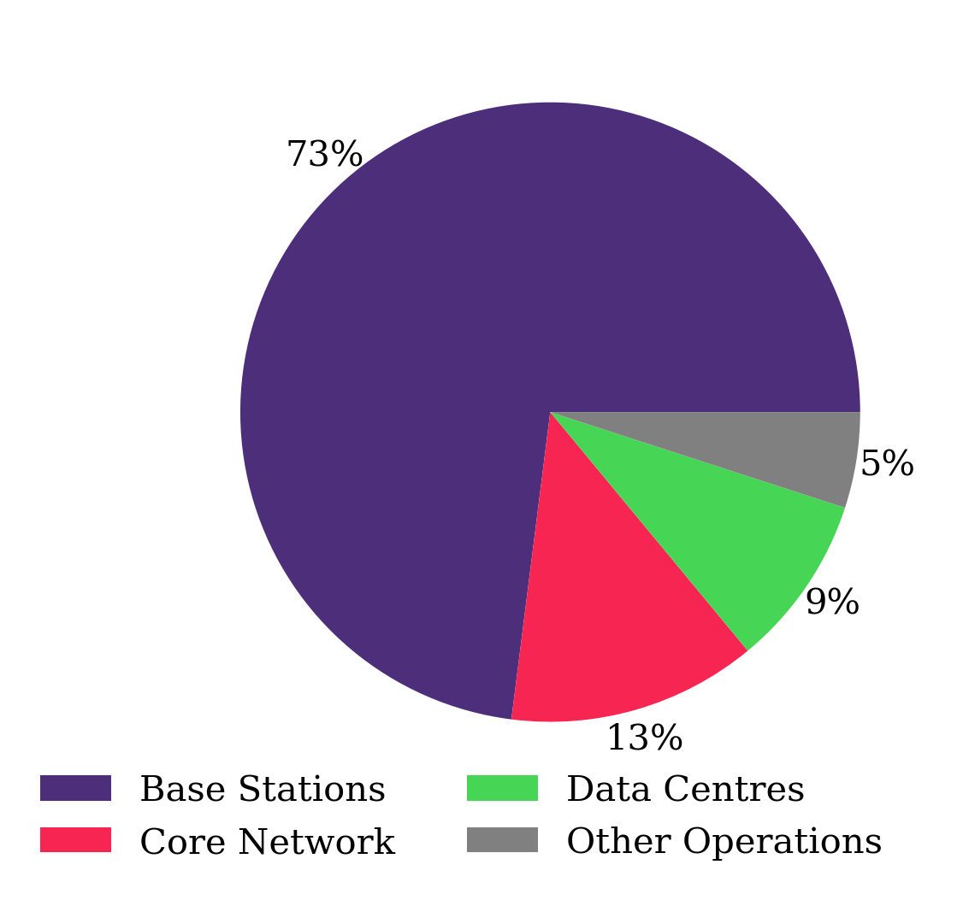
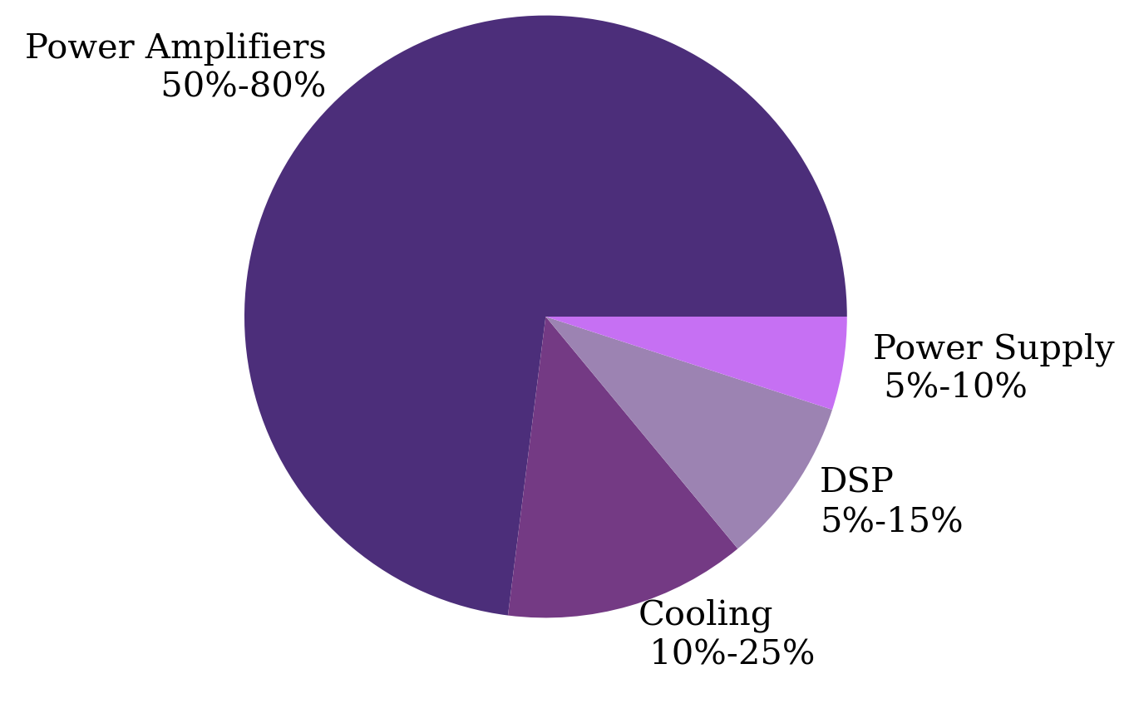
Energy efficiency: materials to services
How is “energy efficiency” defined?
Energy per bit?
Spectrum efficiency?
Power supply efficiency?
Coverage versus cell size?
Rollout and deployment?
In service maintenance, upgrades and servicing?
Efficient and/or Green?
Site level/equipment level/network level/company operations
Base materials – lead to better system performance and improved reliability
Power amplifier design
Modulation waveform design for reduced peak power
Base-station design – Green and/or efficient
Service deployment – when/where to use 5G sub 6 GHz v 5G >24 GHz v Wifi v satcom v Legacy/existing
Thermal management optimisation
www.celticnext.eu Energy efficient networks: materials to services – Darren Cadman – Space Forge – Darren.Cadman@spaceforge.com

Slide 87
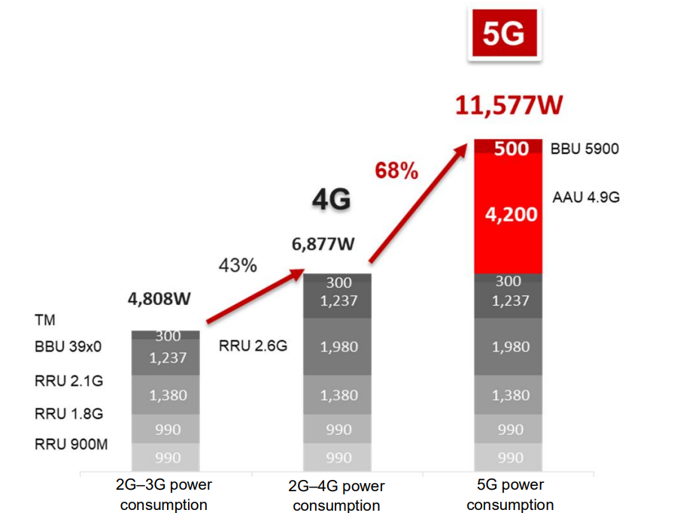
Proposal Introduction (2)
Aims:
Molecular view through to the holistic view of the network:
36 months to realise desired outcomes of:
Reduced energy consumption demonstrators
Green energy production concepts
More efficient use of energy as a resource
Resolve some of the ‘hard’ hardware issues
Cross discipline/sector/industry international collaboration
www.celticnext.eu Energy efficient networks: materials to services – Darren Cadman – Space Forge – Darren.Cadman@spaceforge.com

Slide 88
Partners
Partners to model and integrate Space Forge advanced semiconductors
Waveform research groups
Service provider inputs required
Power amplifier designers
System level integrators
Green power supply designers
Limited list – open to further discussions.
www.celticnext.eu Energy efficient networks: materials to services – Darren Cadman – Space Forge – Darren.Cadman@spaceforge.com

Slide 89
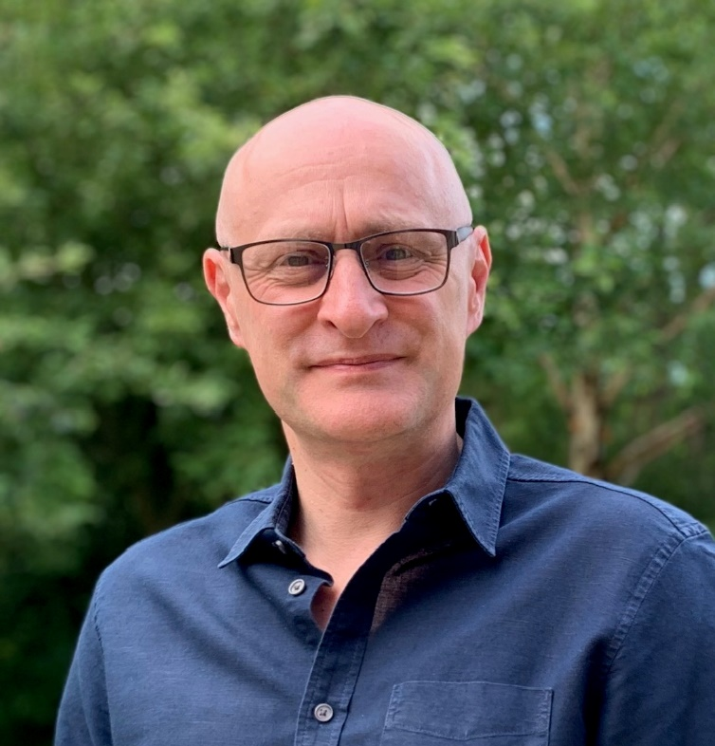
Contact Info
For more information and for interest to participate please contact:
Darren Cadman at Space Forge
Darren.Cadman@SpaceForge.com
Mobile: +44 (0)7301 060113
Unit 10 Eastgate Business Park,
Wentloog Avenue, Cardiff, Wales, CF3 2EY
https://www.spaceforge.com/in-space-manufacturing#semi-conductor
Presentation is available via:

Slide 90
Join the Consortium Building Session
Monday 23rd at 11 CEST
Join meeting
Join by meeting number
Meeting number (access code): 2744 674 5688
Meeting password: V2iVkPaNt46
www.celticnext.eu office@celticnext.eu

Slide 91

CELTIC-NEXT
Proposers Brokerage Day
18th September 2024, London
Predictive Cloud and Ground Sensors for Early Wildfire Detection
Yuri Ponzani - CLEANNOVATION

Slide 92
Teaser
The platform provides early detection of unusual patterns in forest ecosystems using satellite data, IoT sensors, and AI, allowing forest managers to prevent wildfires before they spread.
www.celticnext.eu Proposal Name, Your Name, affiliation & e-mail of presenter

Slide 93
Organisation Profile
Recycle2Trade Ltd is a UK-based SME specializing in data intelligence for environmental monitoring. Our experience includes data interoperability , UX and remote sensing for gas emissions monitoring
www.celticnext.eu Proposal Name, Your Name, affiliation & e-mail of presenter

Slide 94
Proposal Introduction (1)
The platform integrates satellite and ground sensors with AI to detect unusual patterns in forest ecosystems, providing early wildfire alerts and insights to forest managers for disaster resilience.
www.celticnext.eu Proposal Name, Your Name, affiliation & e-mail of presenter

Slide 95
Proposal Introduction (2)
Expected Outcome:
The project will deliver a cloud-based prediction platform combined with ground sensors, capable of providing early detection of wildfire risks in forest ecosystems globally.
Impacts:
Reduced damage from wildfires through early intervention
Enhanced disaster resilience for forest ecosystems
Improved decision-making for forest managers based on real-time data
Contribution to global wildfire prevention efforts and climate resilience
Schedule:
Project duration: 36 months, with pilot implementations in the UK, Spain and others countries TBC in year 2.
www.celticnext.eu Early Wildfire Predictive Detection, Yuri Ponzani, Recycle2Trade Ltd - info@recycle2trade.com

Slide 96
Partners
Existing consortium, involved countries.
RECYCLE2TRADE LTD (UK) - LEAD
SPAIN PARTNER TBC
OTHERS TBC
www.celticnext.eu Proposal Name, Your Name, affiliation & e-mail of presenter

Slide 97
Contact Info
For more information and for interest to participate please contact:
Recycle2Trade Ltd
Address: Astral Towers, Betts Way, Crawley, RH10 9XA, UK
Country: United Kingdom
Website: https://cleannovation.global/
Contact Point: Yuri Ponzani
  Email: info@recycle2trade.com
  Landline: +44(0)20 8133 6885
  Mobile: +44(0)7506323337

Slide 98
Find the pitches Online
celticnext.eu/new-ideas
www.celticnext.eu office@celticnext.eu

