Slide 1




Autumn Call 2024, Proposers’ Brokerage Day, 18 Sept 2024
Xavier Priem, CELTIC-NEXT Director
www.celticnext.eu

Slide 2
Eureka
The world’s biggest public network - over 45 countries also including Canada, Chile, Israel, Singapore, South Africa and South Korea
International RD&I collaboration enables Eureka countries to tackle global challenge and increase competitiveness
A transnational network facilitating the coordination of national priorities on innovation and providing access to national funding
More on: www.eurekanetwork.org/

Slide 3


Since 1985:
48.4+ billion euro public-private investment
7,000+ R&D projects
35,000+ organisations supported
Notes:
Eureka is the world’s biggest public network for international cooperation in R&D and innovation present in over 45 countries.
We fund R&D projects that result in innovative products, processes or services.
Since 1985, by mobilising some 48.4 BILLION euro of public-private investment, we have supported the R&D of over 7,000 groundbreaking projects that have positively impacted economic growth and changed people’s lives for the better.

Slide 4






CELTIC-NEXT in the European innovation landscape
EUREKA
National
European Community Programmes
Innovation
Programmes
following
European
Strategy
Trans-National Programmes
following
National Priorities
Develop &
Maintain
Critical Mass & Differentiation
6G Bridge - Finland
Future Network Services - Netherlands
...

Slide 5

Industry-led communities consisting of leading companies, knowledge institutes and end-user organisations
Strategic technology areas
Market-oriented, aiming to solve economic, technological and societal challenges
Clusters
Notes:
Clusters are large thematic communities that include industry experts and corporates (like Bosch, Airbus, Telefonica, Rolls-Royce and Philips).
Together, the Clusters maintain close cooperation with public authorities, meaning economic, technological and societal challenges can be addressed in join calls for projects where communities collaborate to achieve a common aim.
Cluster projects can be large and can cover a whole value chain.
To note: All Clusters have calls for projects with several participating countries ongoing.

Slide 6

Who is CELTIC-NEXT?
CELTIC-NEXT is the world industry-driven ECP* ICT** not for profit cluster involving all the major ICT** industry players, service providers, many SMEs, and research institutions & academia to enable a secured, trusted, and sustainable digital society.
*Eureka Clusters Program, launched on 17/6/2021, CELTIC-NEXT was launched earlier in 2003
*Eureka Clusters Program, launched on 17/6/2021
** Information & Communications Technologies
*** Research, Development & Innovation

Slide 7

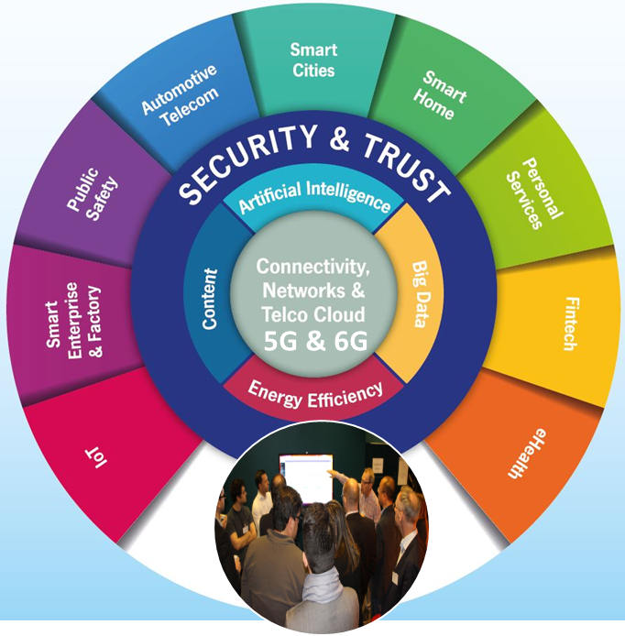
The ICT Cluster under the umbrella of EUREKA
Focused on Next-Generation Communications for the Digital Society
A flexible and agile community of over 1150 private and public organisations, among prominent industry players, small & medium-sized enterprises and academic/research institutions
The organiser of regular calls for projects, twice a year, in Spring and Autumn; and larger Flagship Calls
Financed through public and private funding through transnational RD&I cooperation
Open to any organisation willing to contribute to the industry-driven European and beyond ICT research programme

Slide 8
The mission of CELTIC-NEXT is to:
  Foster our Eureka collaborative RD&I program for the ICT community
  Accelerate the deployment and uptake of advanced ICT services
  Employ the new network concepts of 5G and beyond, and lead to the innovation ownership and implementation of 6G in Eureka countries
Because It is crucial to consolidate the position of :
  Eureka manufacturers and service providers
  Eureka countries sovereignty
The strong ambition of CELTIC-NEXT is, therefore, to:
  Assist Eureka National Authorities, Eureka Industry, and Eureka Societies
  Make them access to societal benefits, competitive advantages, commercial returns of being at the forefront of the new digital era for the society
Who is CELTIC-NEXT?
-
CELTIC-NEXT Mission & Vision
Notes:
NEW

Slide 9
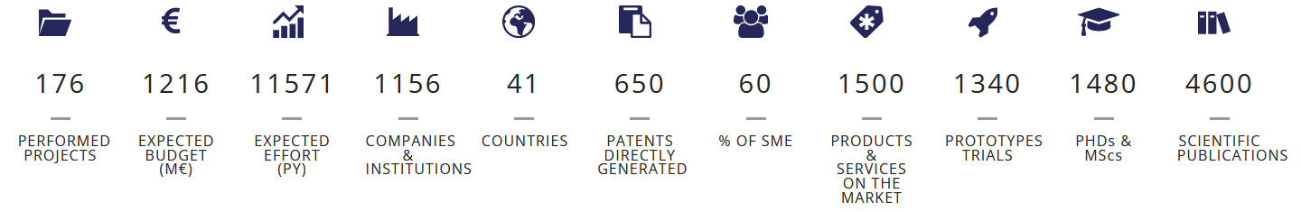
Who is CELTIC-NEXT?
Since its launch in 2003, CELTIC has achieved:
CELTIC-NEXT is open to all entities willing to align their business targets with their national public priorities, by running common RD&I*** projects to advance the development and uptake of advanced ICT solutions, thus accelerating their own Time-To-Market.
*Eureka Clusters Program, launched on 17/6/2021
** Information & Communications Technologies
*** Research, Development & Innovation
https://www.celticnext.eu/

Slide 10
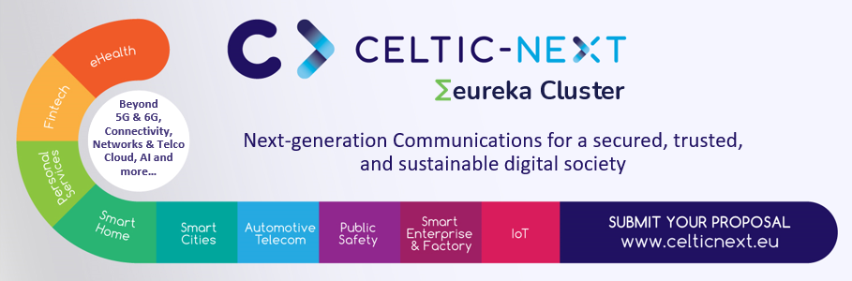



What CELTIC-NEXT does ...
CELTIC-NEXT manages an international Quality Label that enables international consortia to apply more successfully to National Funding schemes and assemble them to fund international cooperative innovation.
CELTIC Bottom-up calls
CELTIC Flagship projects & open calls
EUREKA ECP Joint Calls

Slide 11















CELTIC’s Community
CELTIC Core Group
CELTIC’s Community builds its Mission, Vision & Roadmap
with over 1150 community members across 41 countries (Europe & beyond)
https://www.celticnext.eu/celtic-next-organisation/

Slide 12
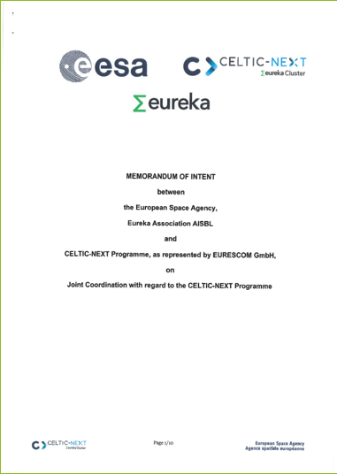
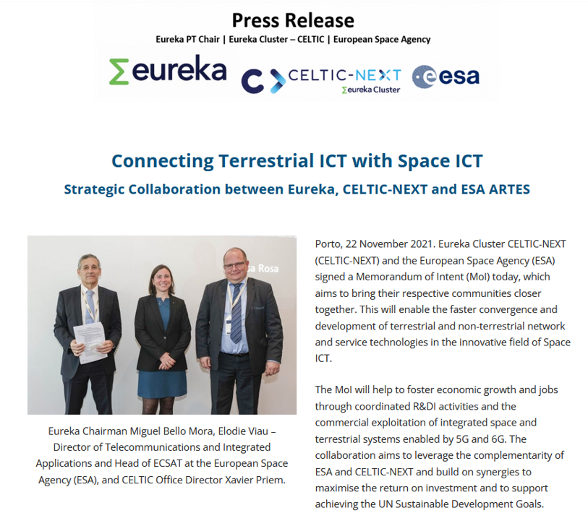
CELTIC-NEXT in the European Funding Landscape
EUREKA-CELTIC &
European Space Agency MoI Signed (Nov. 2021)
______
EUREKA-CELTIC &
6G-IA SNS
MoU Signed (Apr. 2022)
Knowledge exchange &
SRIAs cross-contributions
Leveraging funding schemes across TRLs & topics
Calls timing alignment
Easier pipelining of proposals
From Research to Market
(TRL , early adopters, testbeds...)
Offering innovative entities the full panel between top-down programs and bottom-up spaces for their collaborative projects

Slide 13






CELTIC-NEXT offers…
Opportunities to fund transnational RD&I consortia
Access to the best companies and knowledge institutes
Projects initiated by industry in line with national priorities
Global and trusted cooperation in the communities
Support of experts with an industrial viewpoint
  “Are you looking to collaborate on an international and industry-driven RD&I project that covers a whole value chain?”
Notes:
Clusters offer/value – why participating in Clusters

Slide 14

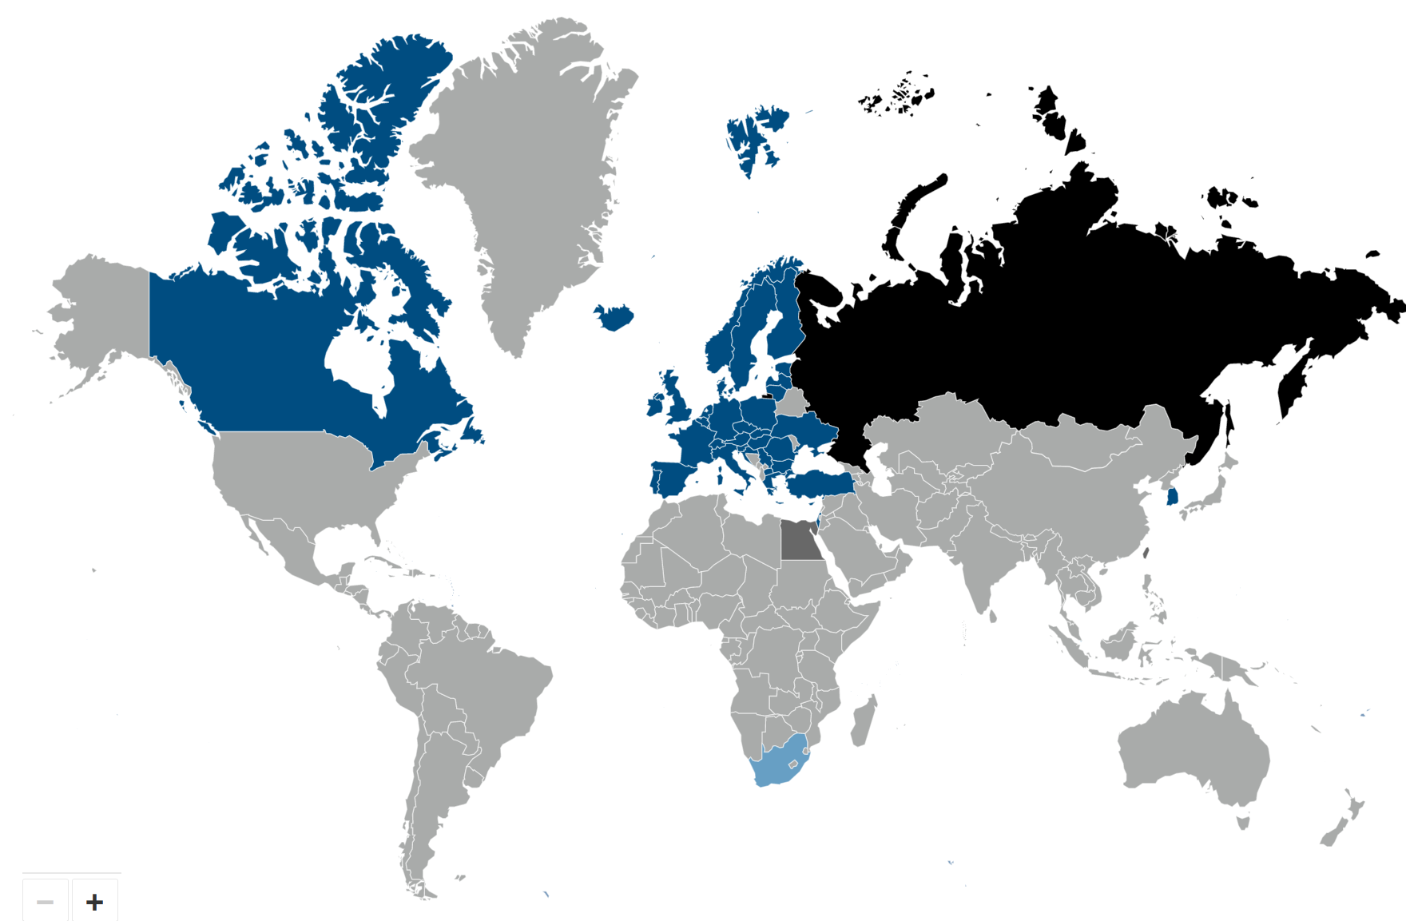

CELTIC-NEXT’s DNA
FOR YOUR SUCCESS
Bottom-up
  Proposers are free to define their project proposal according to their own research interests
By participating, you will get
Expectable benefits for you
Your opportunities are
The award of a Globally Recognized Label
Professional coaching and mentoring
Easy access for SMEs
Access to SMEs for Large industry & vice-versa
Access to partners from more than 45 countries
Access to national funding (while having international co-innovation)
Transnational RD&I cooperation
Boosting your competitiveness
Accelerating your growth
Shortening time to market
Accessing new markets
Increasing your international visibility
Exposing your know-how to the eco-system
Receiving guidance, coaching and monitoring of your project by the CELTIC Office,
flexible project coaching process where you can adapt your project plan, consortium and other aspects, in an agile way, using CELTIC’s Project Change Requests
Immerge yourself into a rich ecosystem covering the technology and business whole value chains (Large Industry, SMEs, Startups, RTOs, Academia, end-users)
Build RD&I consortia during brokerage and other events
Lead or be part of an industry lead project
Create and foster collaborative innovation
Stimulate disruptive and/or sustainable ideas
Run and manage your collaborative project with the Office’s support
Adapt to internal and external circumstances
Generate high economic impact
Grow and collaborate beyond borders
Deliver high social and economic impacts
Support U.N. SDGs
Close to the market
  So far projects have led to more than 1500 new or improved products and services
High Success Rate
  High-quality proposals have a good
  chance of receiving funding.
  Average success rate 60 %
Flexibility
  Project focus can be adjusted to new technological developments in the field

Slide 15

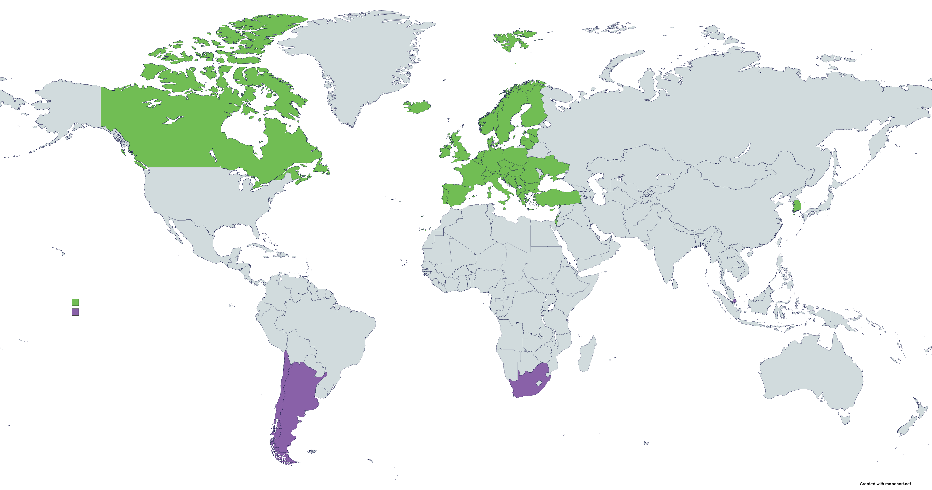






Opportunities to collaborate globally
Europe (large)
UK
Canada
Chile
South-Korea
South-Africa
Singapore
And potentially more countries in the future... like Brazil
https://www.celticnext.eu/national-public-contacts-funding-schemes/

Slide 16
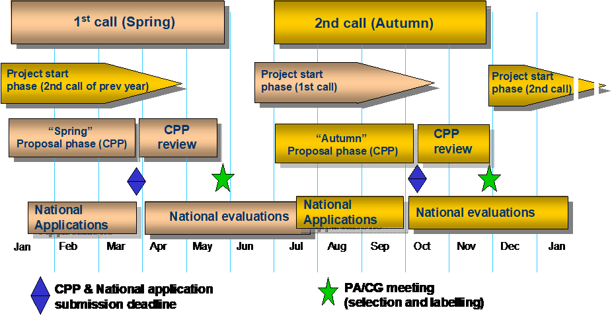
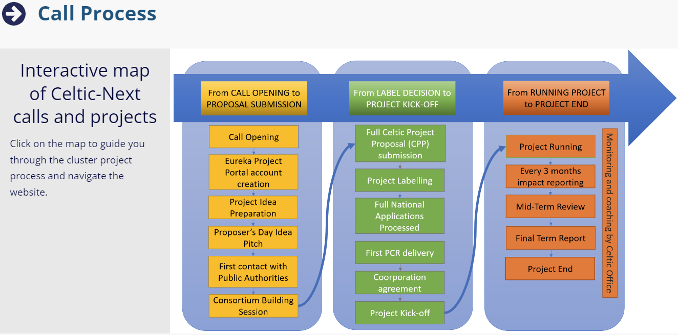
Call process and timelines
CELTIC offers 2 bottom-up calls per year and additional flagship calls
Autumn Call 2024 dates:
Opening
July 2024
Launch Event
23rd of July 2024
Proposers Brokerage Day
18th of September 2024
Deadline for proposals
21st of October 2024
Labels notification
December 2024
https://www.celticnext.eu/call-information/
https://www.celticnext.eu/proposers-days/
https://www.celticnext.eu/call-calendar/
https://www.celticnext.eu/brokerage-tool/

Slide 17
Project Submission
21st Oct, 2024
Project Evaluation & Labelling
Nov-Dec, 2024
Project Start
from Feb 2025
Call Opening
July, 2024
CELTIC-NEXT Autumn Call 2024
Important: please contact the Public Authorities before Projects submission:
https://www.celticnext.eu/national-public-contacts-funding-schemes/
Receiving their opinion early can avoid mistakes in your proposal, and will improve your chances to get the label by aligning with National Priorities and Schemes
https://www.celticnext.eu/call-information/

Slide 18
CELTIC-NEXT’s typical BOTTOM-UP call projects
Partners
Number: 4-15 (typical)
Countries
Number: 3-7 (recommended)
Market & Tech Value-Chains
Full E2E Technology Value chain to demonstrate full E2E Services
Budget & Duration
Budget (costs):
3 to 15M€ (typical)
Strictly more than 2 Eureka Countries
Full Market Value Chain representative partners onboard to demonstrate Market Impact relevance
Duration:
24-48 months, 36 typical
Type:
Large Industry players
SMEs
RTOs
Academia
Public Bodies

Slide 19
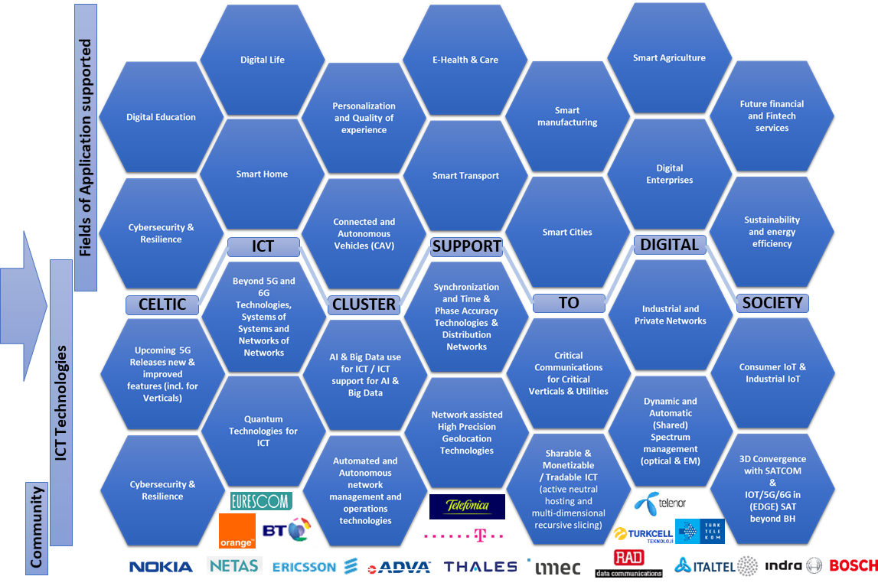


As usual, Proposals that address any of the topics of the CELTIC Strategic Roadmap in this bottom-up call are welcomed
https://www.celticnext.eu/strategic-roadmap/

Slide 20
Future needs of the end users:
High level fields of applications
Human Centred Technologies and Services, for an Augmented Life Experience
Digital divide elimination
E-Health & Care
Full industrial digitization and support of vertical industries
Digital Enterprises
Private Networks for Smart Manufacturing (Indus. 4.0)
Futuristic use cases
Holographic “Teleportation”
Smart Regions/Cities/Buildings/Homes
Smart Transportation
Smart Tourism
Sustainability & Efficiency of Smart Energy Grids
Public Safety & Crowd Control
Users in Control and Trust of offered services
Digital support for Education and Remote Education
Digital (Media, Gaming, Sports, Culture and Entertainment)
Remote working and Nomadic Working (Digital Nomads)
Smart Agriculture
Future Financial and Fin-Tech
ICT support to third party AI based applications
Smart Logistics (geolocation IOT networks)
Connectivity Grid / Telecom Infra as 4th Utility, like Energy
“World” Real-time Synchronous Digital Twin

Slide 21
Future needs of the end users:
Main technical areas of research
Ubiquity / Pervasiveness
Urban, sub-urban down to rural
Dynamic capacity following people seamless mobility
In “normality”
Automation, Reliability, Transparency: Cognitive operations
Extensive Monitoring
Big Data Analytics
Smart Regions/Cities/Buildings/Homes
Artificial Intelligence
Into the home for education and remote working
One Identity for seamless experience
In “crisis” (pandemics, major climate events)
ICT supporting large and intense Ai/ML deployment for verticals (connectivity, processing, data storage…)
Transparency or the Imperceptible latency
Protection and Trust
Holographic “transportation” & Real-time Synchronous Digital Twin
Holographic media teleport
Cyber-security
Identity management
Multi-sense networks
Time engineered applications
Highly Precise Positioning
Edge Computing
Open-RAN / vRAN
Slicing

Slide 22
Enabling technologies that have to be mastered
Beyond 5G, from 5G to 6G
Wired and Wireless Industrial ICT
Industrial features of 5G and beyond
ICT Critical Infrastructure as a Utility, The Critical Connectivity Grid
Macro/Micro Grids’ concepts related technologies adapted to ICT as it exists for Energy
Space dimension enabled 5G/B5G/6G
Distributed & Smarter Networks
Deeper “edge-ification” for Distributed, collaborative and hierarchical AI/ML
SAT enabled 5G/B5G/6G
Time Sensitive Networks
Precision Positioning
Private Networks
More Indoor techs like Terahertz, Visible Light Coms,
Non-3GPP convergence (like Wi-Fi, Industry Net Standards…)
Tera scale Internet of Things (IoT)
Moving ICT to SAT
RAN in SAT (Space-RAN?)
CORE in SAT (Space-CORE?)
MEC in SAT (Space-Edge Dc?)
MBH in SAT (Space-Mobile Backhaul?)
Value Added Services in SAT
Earth Meshed Network (including Oceans)
SAT to Ground
SAT to Sea
SAT to Air Objects & IOTs
SAT to SAT
=> SAT to All
Multimodal SATs
Combining GPS info with Network info
Combining Observation modalities with Network info
Avionics communications
Air to Ground
Air to Air
Drones / HAPS
Balloons?
More Multi-Purpose Adaptable Networks:
Universal adaptive core
Programmable network Operating System
Advanced very large-scale monitoring (for AI, ML, Dl…)
Distributed AI/ML
Consuming
Producing
Supporting
Intelligent and Automated Dynamic Spectrum Management :
Electro-magnetic Spectrum: Horizontal & Vertical Flexible Sharing CBRS, DSS, LSA, LAA, MultiFire, new enablers…
Optical spectrum: Sliceable Optics, shared lambdas
Full Slicing
Full end-to-end Slicing of physical networks and infrastructures (see Smarter Networks)
Real End-to-End leading to:
Multi-layered multi-tenancy
Full neutral hosting
Multi-Dimensions sliceable (incl. Spectrum and Time)
Thanks to: Deeper Network Programmability
Enhanced overall architectures to support needed enablers
End-to-end Horizontal and Vertical Network Convergence
AI/ML for Digital Infrastructures
End-to-end Network Automation
Autonomous Systems and Networks
Advanced QKD Networking
Connectivity as a Shared Critical Utility
Wireless and Wired Tera-Broadband technology:
Wireless (electromagnetic and visual light waves):
Larger massive MIMO systems
TeraHertz Communications
Wired optical:
Photonics
Optical smart networks
Optical spectrum: Sliceable Optics, shared lambdas
Increasing Bandwidth in Optical Network: use of additional bands, Higher modulation schemas
Quantum communications
QKD
Entanglement
Cyber-security
Quantum QKD
AI/ML & Big Data Real Time Analytics based Security
Reinforcement of Sovereignty
Cyber-attack based Disaster recovery
Trust enablers
Security
Auditability
Transparency
No “Cell” Radio Networks with distributed smart mMIMO systems

Slide 23

2024 additional topics:
In addition to the SRIA large coverage, following topics are welcomed by PAs:
Digitalization of the Economy thanks to Information & Communications Technologies
Clean Growth & Sustainability
Remote Health & Care
ICT for Industry 4.0 and Logistics
Consumer IoT, Industry IOT
ICT Technologies for METAVERSES
Private Networks (including Industrial & leisure)
Critical Coms for Emergency & Rescue Services
Non-Terrestrial-Networks and Terrestrial Networks convergence
Critical Resilient Infrastructures & Cybersecurity
Open RAN
AI for ICT & Networks (including Radio Massive MIMO, Open-RAN RICs, ...)
and 5G Advanced and 6G topics (sensing, location, ...)
As usual, Proposals that address any of the topics of the CELTIC Strategic Roadmap in this bottom-up call are welcomed

Slide 24
Conclusion
Join the CELTIC-NEXT Community and apply to trans-national funding for your next steps of development of your innovations, technologies and products & services, and:
Get a recognised international label to your innovations
Don’t be restraint to specific limit to your innovation project (bottom-up vs top-down)
Get a larger visibility for collaboration
Gain commercialisation channels (mixing Large Industry with SMEs and RTOs) in near-to-market innovation collaborations
Accelerate your Time-To-Market by increasing your TRLs in a near to market funding scheme
Collaborate easily outside of Europe (Eureka Network of Countries) with the proven EUREKA Clusters mechanism, extending again your visibility and commercialisation channels

Slide 25

MANY THANKS FOR YOUR ATTENTION.
Xavier Priem
CELTIC-NEXT – Director
c/o Eurescom GmbH
Wieblinger Weg 19/4
69123 Heidelberg, Germany
Mobile: +49 1515 796 2180
Fax: +49 6221 989 209
Email: office@celticnext.eu
Web: https://www.celticnext.eu
CELTIC-NEXT is a not for profit organisation hosted by Eurescom GmbH
CelticNextEurekaCluster
@CelticNext
CELTIC-NEXT Video Channel

