Slide 1
CELTIC-NEXT Proposers Brokerage Day
24th February 2025, Barcelona
Pitch of the Project Proposal
ARAISE
Attack Resistant AI-driven and Quantum-Safe techniques for beyond 5G and IoT
Prof. Mika Ylianttila, University of Oulu, Finland
Centre for Wireless Communications, NetSEC research group
mika.ylianttila@oulu.fi

Slide 2
Organisation Profile
NetSEC research group at the University of Oulu, Finland aims to develop essential security technologies to enable secure, trustworthy and privacy-driven 6G, and solve some of the remaining research problems in 5G and beyond, as part of the active research and industrial community, in joint research projects and programs. NetSEC seeks actively new partners in the academic and industrial community. NetSEC belongs to CWC Networks and Systems research unit and contributes to the 6G Flagship program.
https://www.6gflagship.com/
https://www.oulu.fi/en/research-groups/network-security-trust-and-privacy
www.celticnext.eu ARAISE, Mika Ylianttila, University of Oulu, mika.ylianttila@oulu.fi

Slide 3
Teaser
Vision
Towards attack-resilient machine learning that ensures secure, efficient, and sustainable AI-driven B5G networks, safeguarding against emerging threats from adversarial AI and quantum computing.
Added value and benefits
Increased relicense against adversary attacks (including powered with AI and quantum computers of the future) to companies in their products and for the society at large. Benefits include cost-savings, customer satisfaction and brand integrity, with increased assurances to the continuity of services.
www.celticnext.eu ARAISE, Mika Ylianttila, University of Oulu, mika.ylianttila@oulu.fi

Slide 4
Proposal Introduction (1)
Motivation
The urgent need to secure ML-integrated B5G networks against AI-driven and quantum-enabled adversaries, ensuring robust, privacy-preserving, and sustainable next-generation communications.
Approach
I) An AI-driven quantum-aided attack modelling framework for ML-integrated B5G, using attack graphs and information theory.
II) Quantum-aided adversarial resilient ML algorithms, to secure the B5G systems with privacy and model integrity.
III) Secured quantum-safe algorithms with efficiency and sustainability.
www.celticnext.eu ARAISE, Mika Ylianttila, University of Oulu, mika.ylianttila@oulu.fi

Slide 5
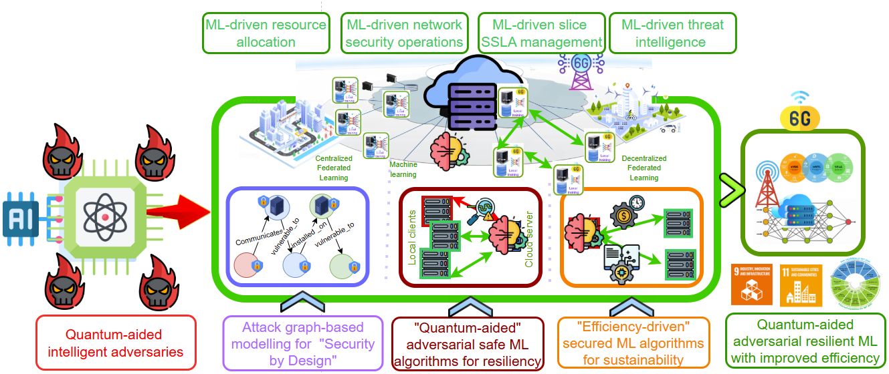
Proposal Introduction (2)
www.celticnext.eu ARAISE, Mika Ylianttila, University of Oulu, mika.ylianttila@oulu.fi

Slide 6
Proposal Introduction (3)
Expected outcomes
Futuristic AI-driven and quantum-enabled adversarial attack-safe ML-algorithms and datasets for resilient B5G systems that preserve privacy, integrity, compliance and sustainability goals
Impact
Novel AI-driven and quantum-enabled adversarial robust ML algorithms and training datasets for empowering resilient industrial and societal innovations, while achieving sustainability goals
www.celticnext.eu ARAISE, Mika Ylianttila, University of Oulu, mika.ylianttila@oulu.fi

Slide 7
Partners
Consortium to be decided (potentially to be merged with some other proposals)
Potential partners
Cloud service providers and mobile operators needing ensure quantum safety and resiliency towards AI-related and Quantum security threats
Manufacturing enterprises with ML-integrated B5G connectivity
Enterprises and organizations that need secure quantum and AI/ML safety in their products and services
www.celticnext.eu ARAISE, Mika Ylianttila, University of Oulu, mika.ylianttila@oulu.fi

Slide 8
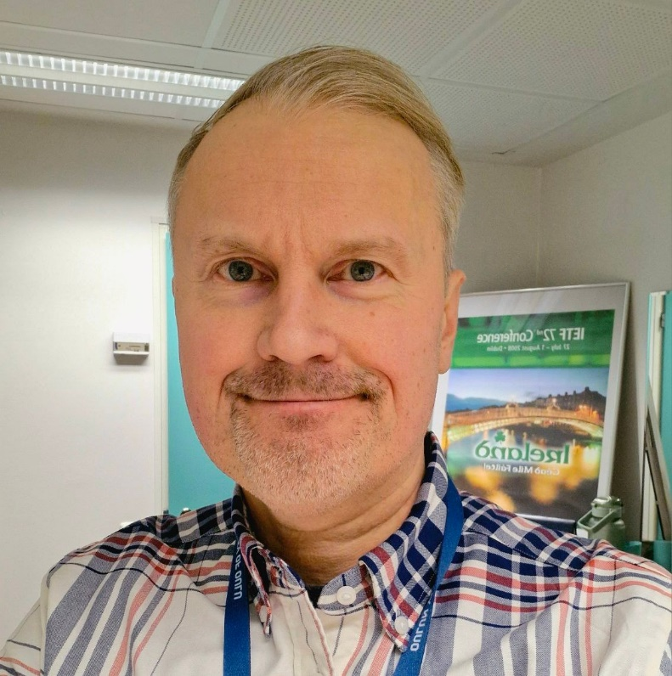
Contact Info
For more information and for interest to participate please contact:
Prof. Mika Ylianttila
mika.ylianttila@oulu.fi
+358 40 535 0505
P.O.Box 4500 FI-90014 University of Oulu Finland
https://www.oulu.fi/en/researchers/mika-ylianttila
Presentation is available via:

