Slide 1
CELTIC-NEXT Proposers Brokerage Day
24th February 2025, Barcelona
ETHICA: Digital Product Passport for ESG Transparency, Harmonized Intelligence, Compliance, and Auditability ETHICA
Suna AKBAYIR
suna@artechconsulting.net

Slide 2
Artech International
Member & Deep Integration of Tech Communities:
European Automotive Research Partners Association (EARPA)
Big Data Value Association (BDVA)
AI, Data and Robotics Association (ADRA)
FIWARE
Clean Hydrogen Alliance
HydrogenEurope
Hub Brussels
SME
Brussels, Belgium
Finalized & Ongoing National, EIT Urban Mobility & Manufacturing, Horizon Europe, Digital Europe projects.
Active DPP projects;
BASE (Horizon Europe)
5G4PHEALTH (Celtic Next) (Coordinator)
MainVerse (XECS)
www.celticnext.eu ETHICA, Suna AKBAYIR, ARTECH, suna@artechconsulting.net

Slide 3
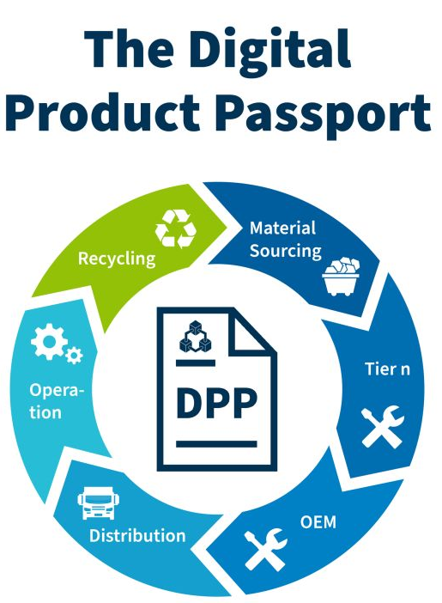
ETHICA
🔹 AI-powered, automated ESG & compliance reporting 🔹 Secured traceability 🔹 Harmonized compliance framework –complex EU regulations (ESPR, CSRD, EPR, Battery Passport, WEEE, etc.)
📌 For Industry & Manufacturers – Automate compliance tracking, reduce ESG reporting workload 📌 For Tech Providers – Innovate with AI, Blockchain, IoT & Digital Twins in ESG & Circular Economy
🔗 Digital Product Passport (DPP) is a digital identity for products, designed to provide detailed information about their entire lifecycle. DPP aims to increase transparency and accountability in product manufacturing and supply chains, promoting sustainable practices and helping consumers make informed choices.
www.celticnext.eu ETHICA, Suna AKBAYIR, ARTECH, suna@artechconsulting.net

Slide 4
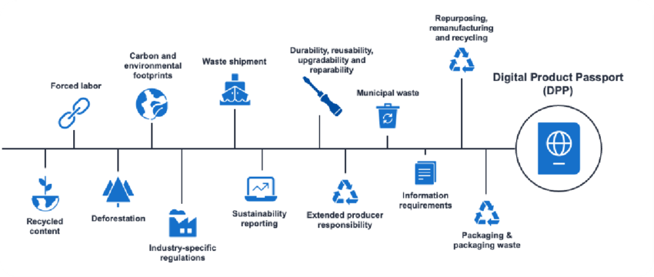
ETHICA Proposal
ETHICA envisions a trusted, AI-powered compliance ecosystem that ensures transparent, auditable, and secure ESG reporting using Digital Product Passports (DPPs). By integrating AI, Blockchain, IoT, and Digital Twins, ETHICA harmonizes compliance across complex EU regulations (ESPR, CSRD, EPR, Battery Passport, WEEE, etc.), supporting sustainability, circular economy, and responsible business practices.
www.celticnext.eu ETHICA, Suna AKBAYIR, ARTECH, suna@artechconsulting.net

Slide 5
ETHICA: DPP for ESG Transparency, Harmonized Intelligence, Compliance, and Auditability
Duration: 36 Months
Expected Outcomes: AI-driven compliance framework, Hybrid-securization, consolidated regulatory reporting, Circular economy integration.
✅ Cost-Efficient: reduction in compliance costs; automated data collection & verification ✅Market Trust: Ensures reliable & auditable sustainability claims ✅ Interoperability: Seamless integration with ERP, ESG platforms, and certification.
www.celticnext.eu ETHICA, Suna AKBAYIR, ARTECH, suna@artechconsulting.net

Slide 6
Partners
Existing consortium members & involved countries:
🔗 ongoing dicussion with different countries and profiles from
🇧🇪🇹🇷🇲🇹🇸🇪
Expertise, profiles and types of partners we are looking for;
- Compliance and Regulation Tech Experts, -OEMs and suppliers in the area of Automotive,
--OEMs and suppliers in the area of Electronics,
--Textile Manufacturers and suppliers,
--Construction companies and suppliers
www.celticnext.eu ETHICA, Suna AKBAYIR, ARTECH, suna@artechconsulting.net

Slide 7
Contact Info
For more information and for interest to participate please contact:
Ms. Suna AKBAYIR
suna@artechconsulting.net
+32470553576
Rue de la Presse 4, Brussels
Belgium
www.artechconsulting.net
Presentation is available via:

