Slide 1
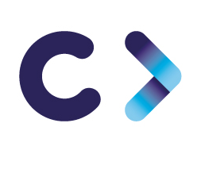
CELTIC-NEXT Proposers Brokerage Day
24th February 2025, Barcelona
Pitch of the Project Proposal
DataMind AI
Haluk Gökmen Egesys Ltd
Haluk.gokmen@egesys.net

Slide 2
Teaser
DataMind AI – Transforming Manufacturing with AI-Driven Intelligence
What is the Main Benefit of the Idea/Proposal?
AI-powered automation & decision support for manufacturing enterprises.
Reduces manual workload by optimizing workflows and automating repetitive tasks.
Enhances operational efficiency, quality control, and predictive maintenance.
Seamless integration with enterprise systems for data-driven decision-making.
Scalable & flexible AI infrastructure, continuously evolving with business needs.
www.celticnext.eu DataMind AI, Egesys Ltd. Haluk.gokmen@egesys.net

Slide 3
Teaser
DataMind AI – Transforming Manufacturing with AI-Driven Intelligence
What Makes the Added Value?
Open-source AI foundation (DeepSeek, Mistral, Llama, Falcon, PyTorch, TensorFlow).
Fine-tuned AI models trained on company-specific data for accurate insights.
Custom AI-driven modules for IT support, procurement, predictive maintenance, and quality control.
Seamless interoperability with enterprise databases, ERP, and IoT systems.
Secure & private AI implementation, ensuring compliance with company policies.
www.celticnext.eu DataMind AI, Egesys Ltd. Haluk.gokmen@egesys.net

Slide 4
Teaser
DataMind AI – Transforming Manufacturing with AI-Driven Intelligence
Why Should I Participate in the Project?
Accelerate digital transformation and gain a competitive edge.
Reduce costs & optimize resources through AI-driven efficiency.
Enhance decision-making with real-time insights and predictive analytics.
Be part of an innovation-driven ecosystem, shaping the future of AI in manufacturing.
Future-proof your business by adopting cutting-edge AI solutions.
www.celticnext.eu DataMind AI, Egesys Ltd. Haluk.gokmen@egesys.net

Slide 5
Organisation Profile
Egesys (Ege Sistem Bilişim Hizmetleri Sanayi ve Ticaret Ltd. Şti.) is an SME specializing in mentoring programs, software solutions, training, and consultancy in key areas such as R&D, Innovation, Entrepreneurship, Industry 4.0, and Digital Transformation.
www.celticnext.eu DataMind AI, Egesys Ltd. Haluk.gokmen@egesys.net

Slide 6
Proposal Introduction (1)
Vision: Leverage AI to optimize manufacturing processes, automate decision-making,
and enhance operational efficiency.
Motivation: Manual processes lead to inefficiencies, delays, and high costs. AI-driven automation and predictive analytics enable smarter workflows, reducing errors and boosting productivity.
Content
AI-powered automation for IT support, procurement, predictive maintenance, and quality control.
Open-source AI framework fine-tuned with company data for enterprise-specific solutions.
Seamless integration with manufacturing systems, ERP, and IoT platforms.
www.celticnext.eu DataMind AI, Egesys Ltd. Haluk.gokmen@egesys.net

Slide 7
Proposal Introduction (2)
Expected Outcomes:
AI-driven automation enhances operational efficiency and reduces costs.
Predictive maintenance minimizes downtime and improves machine reliability.
AI-powered procurement and quality control optimize resource utilization.
Improved decision-making through real-time data insights.
Impact:
Increases productivity by reducing manual workload and repetitive tasks.
Enhances manufacturing agility and competitiveness.
Strengthens AI capabilities for future enterprise innovation.
Schedule: Poject Duration 36 months
Phase 1 (M 1-6): AI framework selection & data collection.
Phase 2 (M 7-18): AI model training, integration, and testing.
Phase 3 (M 19-30): Deployment, optimization, and fine-tuning.
Phase 4 (M 31-36): Full-scale implementation & continuous improvement
www.celticnext.eu DataMind AI, Egesys Ltd. Haluk.gokmen@egesys.net

Slide 8
Partners
Existing Consortium & Involved Countries:
Türkiye: Egesys, NURSAN, Projesis
Country Representation: Türkiye (Turkish consortium is full).
Need for International Partners: Looking for partners from other countries.
Expertise & Profiles Sought:
AI & Machine Learning Experts: Specializing in NLP, predictive analytics, and AI-driven automation.
Manufacturing & Industrial IoT Specialists: Experience with AI-powered process optimization.
Enterprise Software Developers: Integration with ERP, MES, and manufacturing execution systems.
Academia & Research Institutions: AI model training, data security, and compliance.
Business & Innovation Consultants: AI adoption strategy and digital transformation guidance.
www.celticnext.eu DataMind AI, Egesys Ltd. Haluk.gokmen@egesys.net

Slide 9
Partners
Types of Partners:
AI R&D firms, universities, and technology providers.
Manufacturing enterprises adopting AI for process improvement.
Companies working on enterprise AI, automation, and industrial applications.
www.celticnext.eu DataMind AI, Egesys Ltd. Haluk.gokmen@egesys.net

Slide 10
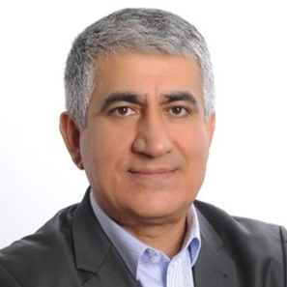
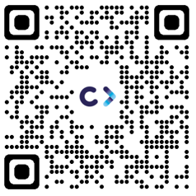
Contact Info
For more information and for interest to participate please contact:
Haluk Gökmen Egesys Ltd.
haluk.gokmen@egesys.net
+90 232 4837323
Cumhuriyet Meydani No:12/61
Konak-Izmir-Türkiye
www.egesys.net
Presentation is available via:
Your
Photo

Slide 11
Join the Consortium Building Sessions
NOTE: CELTIC organizes Consortium Building Sessions to foster the partner search for you. Please indicate your availability within the 25-28 February via
https://polls.eurescom.eu/XV0ZTgdEQg/
Login: participant
Pwd: 2402 We will update this slide for you according to the provided poll information.
Please fill in the poll with your availabilities indicating
PROPOSAL NAME, your name, your organization
Join Webex meeting
Meeting number (access code): tbd
Meeting password: tbd
Join by phone +49-6925511-4400 Germany toll Global call-in numbers Can't join the meeting?
www.celticnext.eu office@celticnext.eu

