Slide 1
CELTIC-NEXT Proposers Brokerage Day
24th February 2025, Barcelona
Pitch of the Project Proposal
“to use and protect” Privacy and safety driven Applications in the data centric world of Smart Hospitals
Tobias Pabst, ICCAS Uni-Leipzig
tobias.pabst@medizin.uni-leipzig.de

Slide 2
Teaser
The Challenge
🏥 Smart Hospitals generate vast amounts of data.
🔐 Healthcare data requires protection but holds potential for innovation.
Our Goal
🌍 pan-European concepts for utilizing healthcare data in medical and
economic applications while ensuring compliance
www.celticnext.eu Proposal Name, Your Name, affiliation & e-mail of presenter
Notes:
The Challenge
🏥 Smart Hospitals, like other smart applications, generate vast amounts of data.
🔐 Healthcare data requires strong protection but also holds high potential for innovation.
Our Goal
🌍 Develop pan-European concepts for utilizing healthcare data in medical and economic applications while ensuring full compliance with GDPR & MDR.
Our Approach
👥 User-Centric Perspective: We prioritize patients’ data protection rights while fostering innovation.
💡 Bridging Tech & Regulation: Many healthcare innovations rely on data-driven solutions. We aim to enable them ethically & securely.

Slide 3
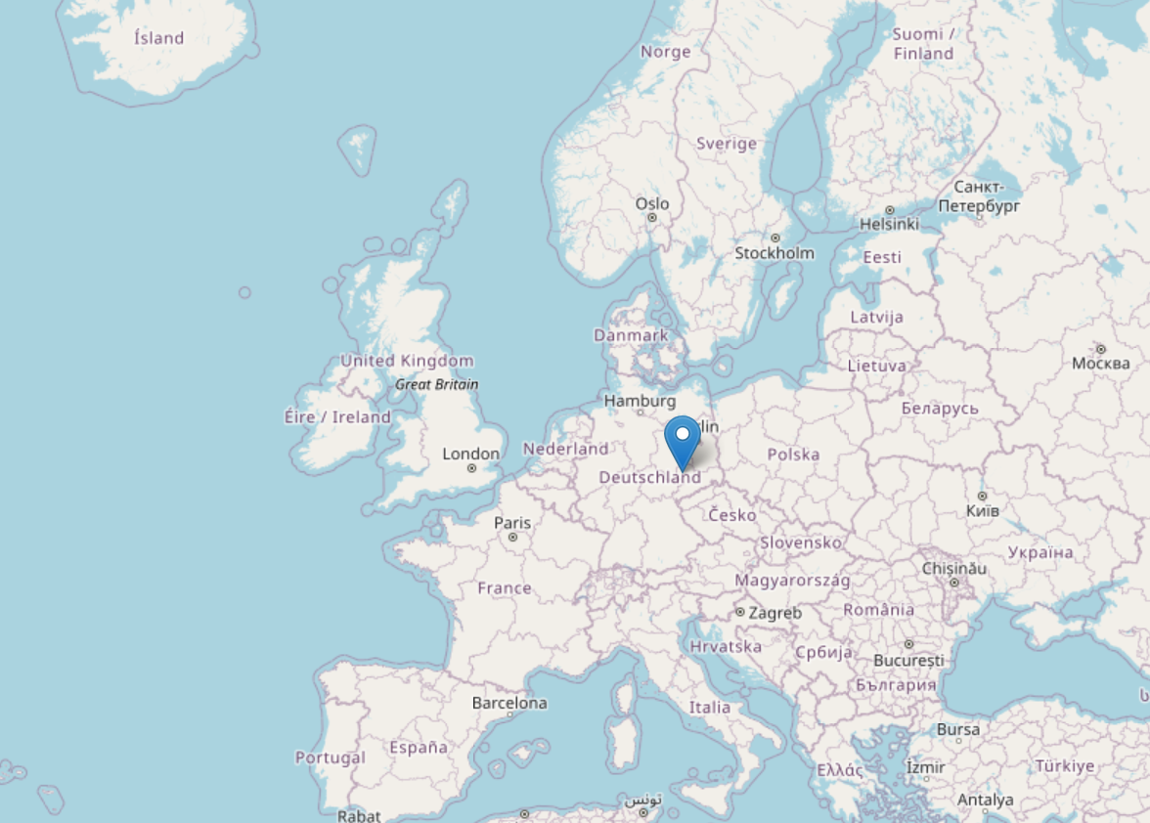
Organisation Profile
ICCAS Leipzig
Convergence of engineering, computer science and healthcare
Pre-industrial Research & Development of Digital technologies of the future medical sector
Contract research, services, TRL3-7, collaborative projects
Very close cooperation with clinics
Exclusively application-relevant projects
ISO 13485 certification
www.celticnext.eu Proposal Name, Your Name, affiliation & e-mail of presenter

Slide 4
Organisation Profile
Robotics
Models for personalised medicine
Development of Life Support
Systems (EIT, EKG,…)
Workflow modelling
5G mobile & clinical use of medical technology
Telemedicine
Clinical decision support/
Digital Twin
AI for clinical application
Interfaces (SDC) Networking of medical technologies
Intraoperative multimodal imaging / Spectral imaging
Software for disaster relief missions
Image guided focussed ultrasound
Development of AR & VR applications
MR guided interventions
www.celticnext.eu Proposal Name, Your Name, affiliation & e-mail of presenter

Slide 5
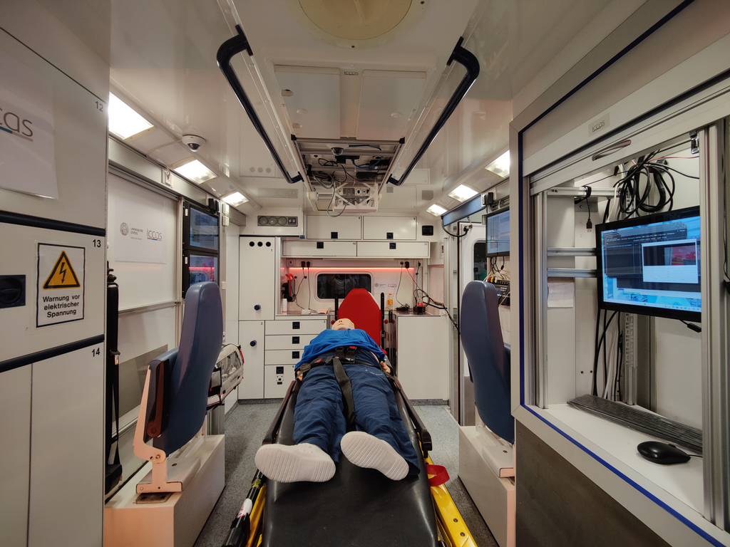
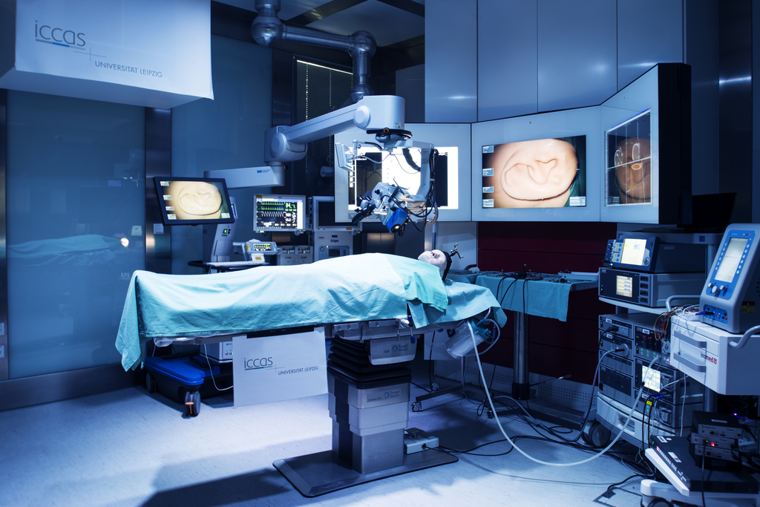
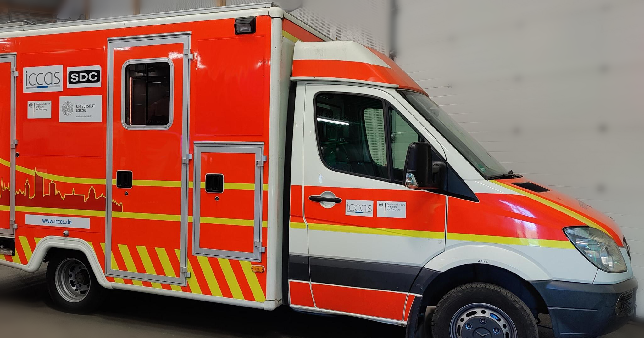
Team Communication Systems and Standardisation
www.celticnext.eu Proposal Name, Your Name, affiliation & e-mail of presenter
Notes:
> communication systems and standardization
Our group specializes in all communication technologies and applications.
We operate a 5G-enabled ambulance, an interoperable demonstration operating room, and are currently developing guidelines for the use of private 5G networks in hospitals. Additionally, we are deeply involved in smart hospital communication and sensing technologies.
Located within a medical campus, we have direct access to healthcare professionals, allowing us to evaluate devices and concepts emerging from our research in real-world clinical settings and gather valuable hands-on data.

Slide 6
Proposal Introduction (1)
Smart Hospital automates task based on real time full-sensoric data about patients, processes and objects.
Big amounts of data tend to create desires to use and misuse them.
IT-Security
Data Protection
Safety
www.celticnext.eu Proposal Name, Your Name, affiliation & e-mail of presenter
Notes:
1 slide:
Short info what the idea/proposal is about (vision, motivation, content,
please include a picture describing your idea)

Slide 7
Proposal Introduction (2)
expected outcome of a three-year project:
Record specific challenges in smart hospitals
Create concepts that ensure
smart tech respects users’ privacy
operational safety of the smart facility
economic benefits for the operators
3. Provide product-ready solutions
www.celticnext.eu Proposal Name, Your Name, affiliation & e-mail of presenter
Notes:
1 slide:
Short info on expected outcome, duration 36 month
impacts, schedule typical project

Slide 8
Partners
Idea for consortium
Existing:
ICCAS | Computer Science and Engineering
University Hospital Leipzig| Healthcare Professionals and IT-Staff
Wanted:
Experts on MDR or GDPR like regulators, authorities, NGOs
Companies that create products & services according to the concepts
www.celticnext.eu Proposal Name, Your Name, affiliation & e-mail of presenter
Notes:
1 slide:
Existing consortium, involved countries.
Expertise, profiles and types of partners you are looking for.
smart hospitals popping out everywhere in europe and this is a challange we chould not do as one country allone. the celtic plattform is well suited for this project because mayor regulations like the mdr and gdpr apply to all of us europeans.

Slide 9
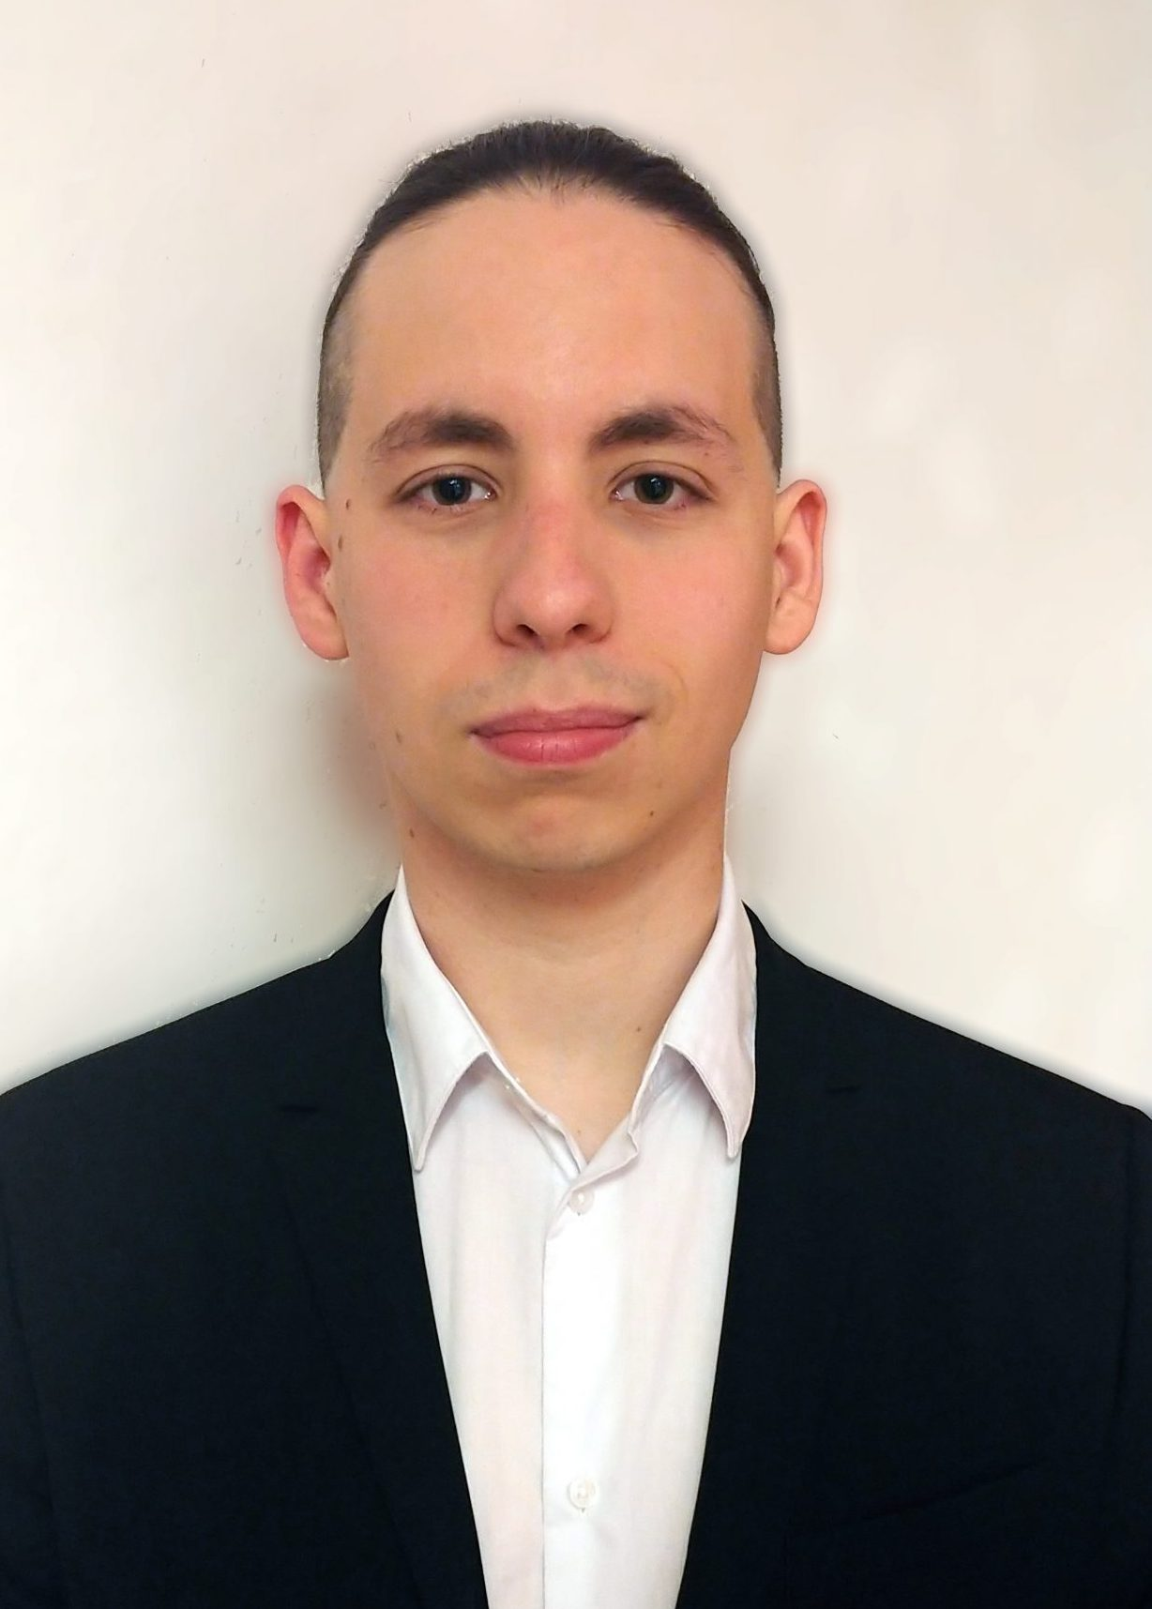
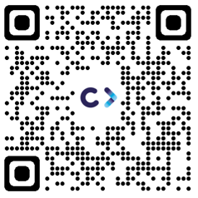
Contact Info
For more information and for interest to participate please contact:
Tobias Pabst, ICCAS
tobias.pabst [at] medizin.uni-leipzig.de
www.iccas.de
Presentation is available via:

