Slide 1
CELTIC-NEXT Proposers Brokerage Day
24th February 2025, Barcelona
Pitch of the Project Proposal
CLEAR-AI –Carbon Level Evaluation & Analytics in Real-time with AI
<Murat SAĞLAM / Alpata Technology>
<murat.saglam@alpata.com>

Slide 2
Teaser
Empowering Green Manufacturing Through Intelligent, Real-Time Insights
CLEAR-AI AI-powered, real-time solutions to monitor and analyze energy consumption and carbon emissions across product, process, and equipment levels.
• AI-Enhanced Scope 1 & Scope 2 Emissions Tracking – Real-time monitoring and predictive analytics for direct and indirect emissions.
• AI-Driven Data Analytics for Sustainability – Advanced insights to optimize processes and reduce carbon footprint.
• Automated Compliance & Transparency – AI ensures continuous alignment with GHG Protocol standards, streamlining reporting.
• Intelligent Operational Efficiency – AI detects inefficiencies, predicts energy peaks, and recommends optimizations for minimal emissions.
• Self-Learning AI Models – The system adapts to new products and machinery, enabling continuous improvement without manual recalibration.
www.celticnext.eu CLEAR-AI Murat SAĞLAM / Alpata Technology murat.saglam@alpata.com

Slide 3
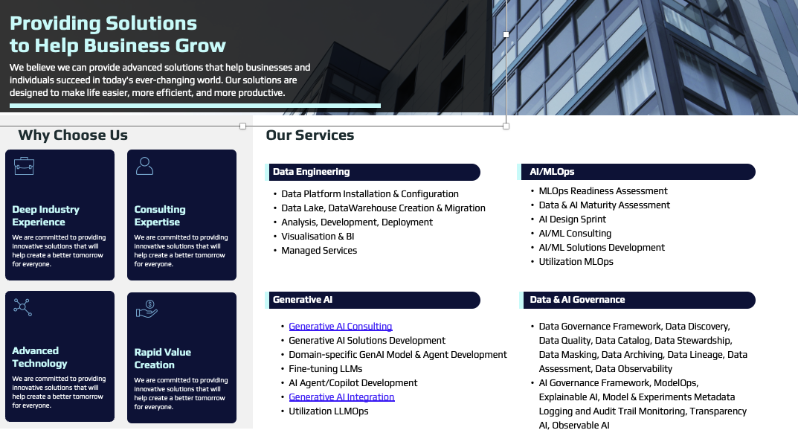
Organisation Profile
Established in 1998 in Eskisehir, Turkey; Alp Aviation is a privately owned company with absolute dedication to the aerospace industry and its highest standards. With its efficient operations, quality, design and lean manufacturing practices, Alp Aviation manufactures flight critical and rotating parts, systems and subsystems for various customers around the world.
Having 1500 highly qualified employees, Alp Aviation utilizes more than 250+ High Tech CNC Machine Parks and CMM quality control equipment, performs various tests including non-destructive tests, coatings and other special processes and has a wide range of laboratory capabilities. Alp Aviation has over 100 distinct special processes some of which can rarely be found throughout the world, and all approved by NADCAP and OEM customers.
Alp Aviation, together with its efficient supply chain demonstrate extensive experience in machining and processing of titanium, nickel, steel, stainless steel, copper alloys and super alloys. Alp Aviation manufactures Helicopter Dynamic Parts & Assemblies, Helicopter Tail Rotor Drive Shaft System (TRDS) Parts & Assemblies, Dynamic & Static Engine and APU Parts including jet engine Fan and Compressor Integrally Bladed Rotors, Landing Gear Parts & Assemblies, Structural Parts & Assemblies, Hydraulic and Fuel Systems and Tube Assemblies to the world’s aviation giants such as Lockheed Martin (Sikorsky, LM Aero), Raytheon Technologies (Pratt & Whitney, Pratt & Whitney Canada, Collins Aerospace), Honeywell, Safran, Heroux Devtek, Turkish Aerospace (TAI), Tusas Engine Industries (TEI) and Aselsan.
Today the products proudly manufactured by Alp Aviation support several rotary and fixed wing aircraft platforms such as S-76, S-92, CH53, H-160, Boeing 737, Boeing 747, Boeing 767, Boeing 777, Boeing 787, Airbus A319/NEO, Airbus A320/NEO, Airbus A321/NEO, Airbus A330, Airbus A340, Airbus A350, Airbus A380 , Embraer 550, Gulfstream G500
1 slide:
Existing consortium, involved countries.
www.celticnext.eu CLEAR-AI Murat SAĞLAM / Alpata Technology murat.saglam@alpata.com

Slide 4
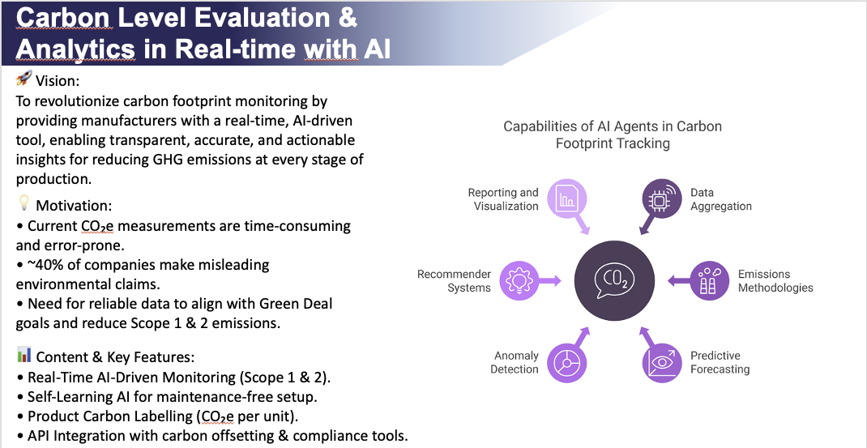
Proposal Introduction (1)
www.celticnext.eu CLEAR-AI Murat SAĞLAM / Alpata Technology murat.saglam@alpata.com

Slide 5
Proposal Introduction (2)
Impacts:
• Reduce GHG emissions across manufacturing sectors.
• Enable transparency and trust in environmental reporting.
• Support Green Deal goals by promoting sustainable production.
• Combat greenwashing with reliable, real-time data.
Expected Outcomes:
• AI-powered real-time carbon footprint monitoring system.
• Accurate Scope 1 & 2 emissions tracking at product, process, and equipment levels.
• Fully automated Product Carbon Labelling.
• API-integrated platform for carbon offsetting and compliance.
• IoT integration for machine level
Project Schedule (36 Months):
• Months 1-6: Research, requirement analysis & system design.
• Months 7-18: AI development, data integration & prototype.
• Months 19-30: Testing, optimization & pilot implementations.
• Months 31-36: Final deployment, training & dissemination.
www.celticnext.eu CLEAR-AI Murat SAĞLAM / Alpata Technology murat.saglam@alpata.com

Slide 6
Partners
Partners involved / interested
Turkey: Alpata Technology , Alp Aviation
Missing partners / expertise
Industry partners (LE/SME) with interest in real-time solutions to monitor and analyze energy consumption and carbon emissions across product, process, and equipment levels providing relevant use cases and data
Tool and technology providers with expertise in AI/ML ,5G/6G , İoT
Knowledge providers and Academic Partners
www.celticnext.eu CLEAR-AI Murat SAĞLAM / Alpata Technology murat.saglam@alpata.com

Slide 7
Contact Info
For more information and for interest to participate please contact:
Murat SAĞLAM – Alpata Technology
murat.saglam@alpata.com
Presentation is available via:

