Slide 1
CELTIC-NEXT Proposers Brokerage Day
24th February 2025, Barcelona
Pitch of the Project Proposal
Optolink
Daniel Maclure
Fraunhofer CAP
Daniel.maclure@fraunhofer.co.uk

Slide 2
Optolink Concept
Optical comms terminals for off-grid, point-to-point communication
High-speed comms for remote areas lacking infrastructure
Back-up comms for disaster relief after damage to infrastructure
Fraunhofer CAP has experience with key hardware and physical technologies for optical comms in various domains:
Terrestrial / Overcoming opstacles (non-line of sight)
Air to air / Air to ground
Underwater
Space / Space to ground
www.celticnext.eu Physical layer technologies for optical communications- Daniel Maclure, Fraunhofer CAP, daniel.maclure@fraunhofer.co.uk

Slide 3
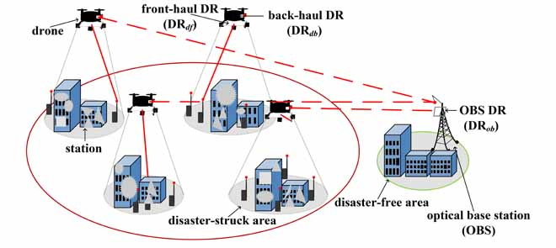
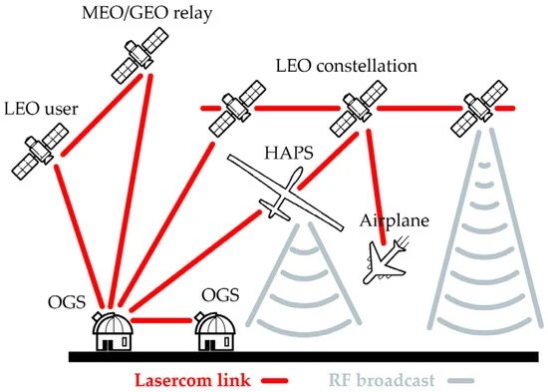
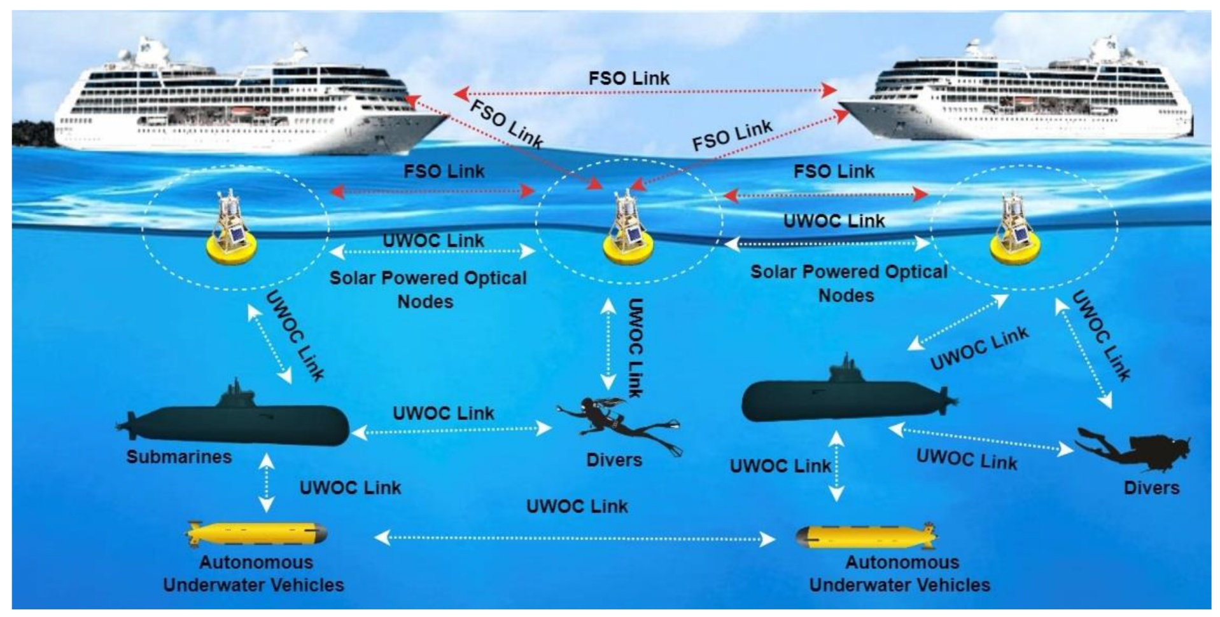
Domains and use-cases
Ground- Development of land-based communications links
Airborne- Optical communications systems (i.e. HAPS and Drones)
Underwater environment optical links for ROVs and submarines including through water/air interface
Space- optical links for space and space to ground
Open to discussing other topic areas
[1]
[2]
[3]
[1] P. K. Esubonteng and R. Rojas-Cessa, "RESTORE: Low-Energy Drone-Assisted NLoS-FSO Emergency Communications," in IEEE Access, vol. 10, pp. 115282-115294, 2022, doi: 10.1109/ACCESS.2022.3218014.
[2] Carrasco-Casado et al. , M. Miniaturized Multi-Platform Free-Space Laser-Communication Terminals for Beyond-5G Networks and Space Applications. Photonics 2024, 11, 545. https://doi.org/10.3390/photonics11060545
[3] Chaudhary, et al. A Salinity-Impact Analysis of Polarization Division Multiplexing-Based Underwater Optical Wireless Communication System with High-Speed Data Transmission. J. Sens. Actuator Netw. 2023, 12, 72. https://doi.org/10.3390/jsan12050072
www.celticnext.eu Physical layer technologies for optical communications- Daniel Maclure, Fraunhofer CAP, daniel.maclure@fraunhofer.co.uk

Slide 4
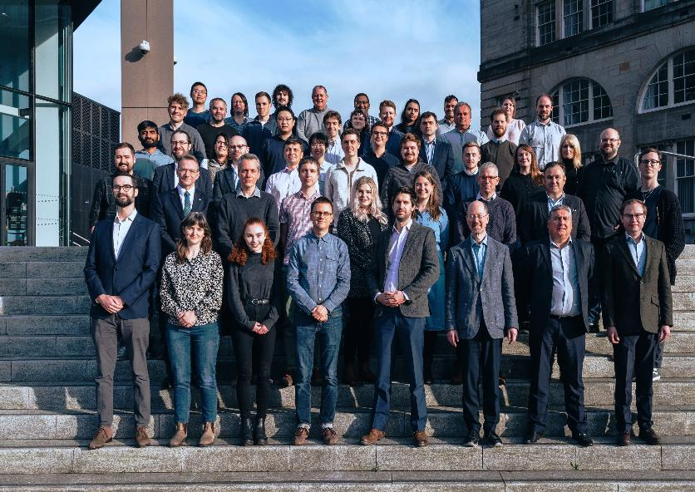
Fraunhofer CAP
Fraunhofer Centre for Applied Photonics provides professional R&D services for, and with, industry
Not for Profit UK company and legally independent affiliate of Fraunhofer Gesellschaft
Currently >80 staff and students (including 30 staff with PhDs and 28 PhD/EngD students)
Specialising in optics and photonics technologies, including Remote sensing, Free-space optical communications and Quantum technologies
To date:
>250 projects of value
>£120M total value of projects to all partners
>130 funded company partners from SMEs to multi-nationals
www.celticnext.eu Physical layer technologies for optical communications- Daniel Maclure, Fraunhofer CAP, daniel.maclure@fraunhofer.co.uk

Slide 5
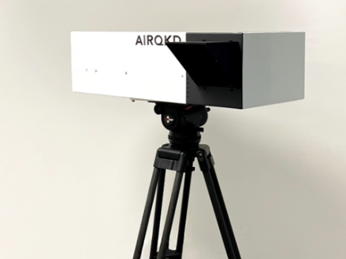
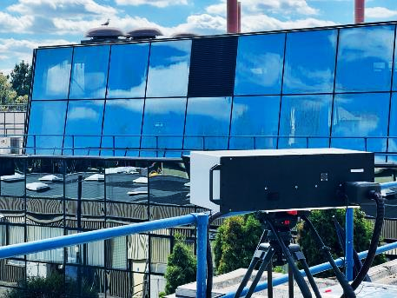
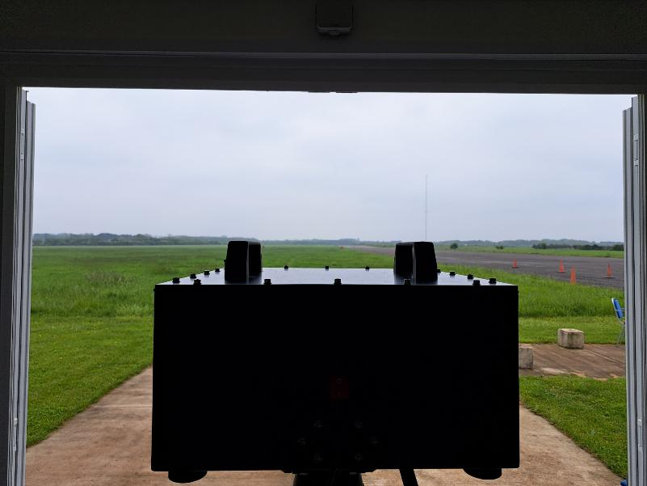
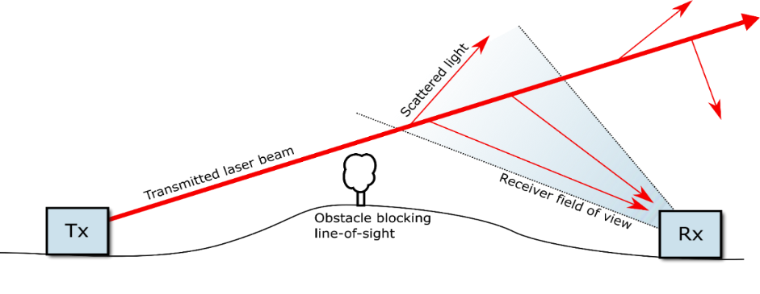
Land
Experience
Developed an outdoor communications link for QKD communications.
Development of NIR/IR sources for turbulent environments.
Development of NLOS communications at various wavelengths.
Ideas
Development of a last kilometre link for classical or quantum communications.
Developing optical NLOS links for overcoming obstacles say in an urban environment
Ground-station receivers for airborne platforms to stream secure communication data.
www.celticnext.eu Physical layer technologies for optical communications- Daniel Maclure, Fraunhofer CAP, daniel.maclure@fraunhofer.co.uk

Slide 6
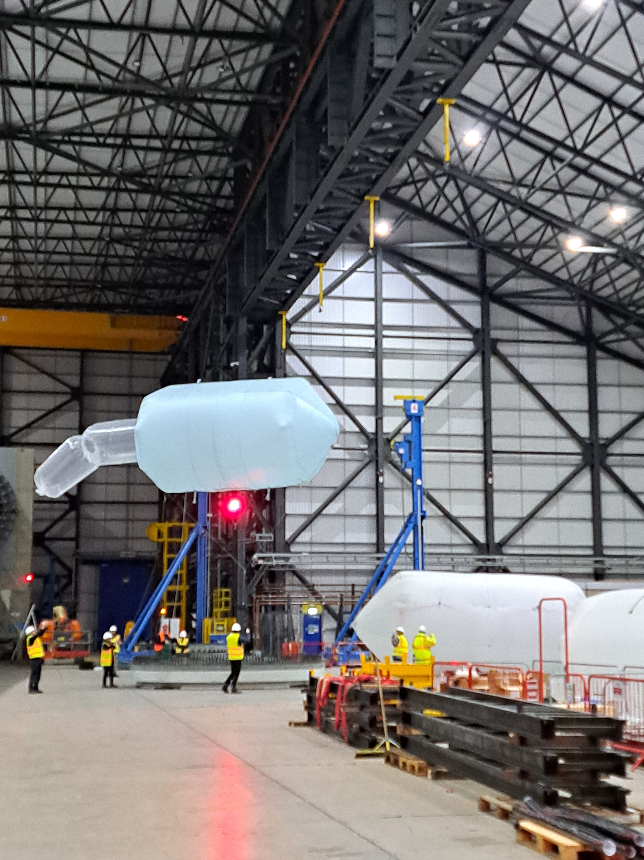
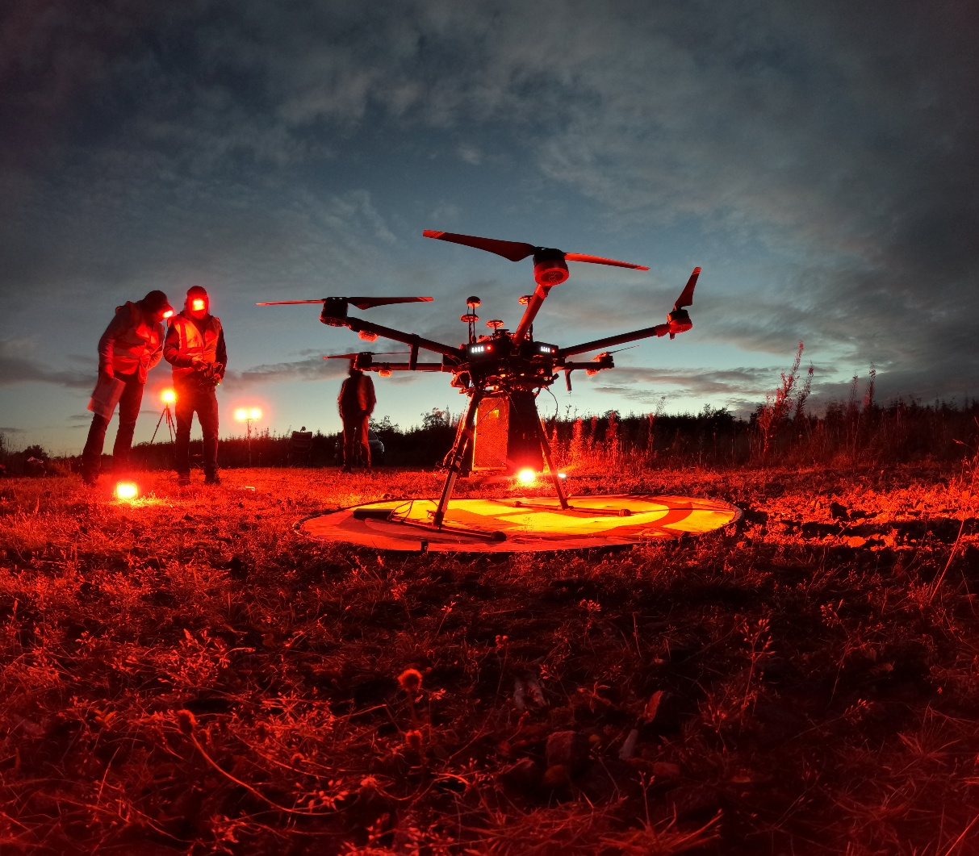
Airborne
Experience
We have worked on projects aimed at airborne communications and sensing
Drone LIDAR units
Optical comms for HAPS
Ideas
Communications for interconnecting drone networks used in monitoring (i.e. wildfire monitoring)
Air to ground systems for communication to relay information from the ground to an aerial platform (i.e. where traditional communications have been damaged)
www.celticnext.eu Physical layer technologies for optical communications- Daniel Maclure, Fraunhofer CAP, daniel.maclure@fraunhofer.co.uk

Slide 7
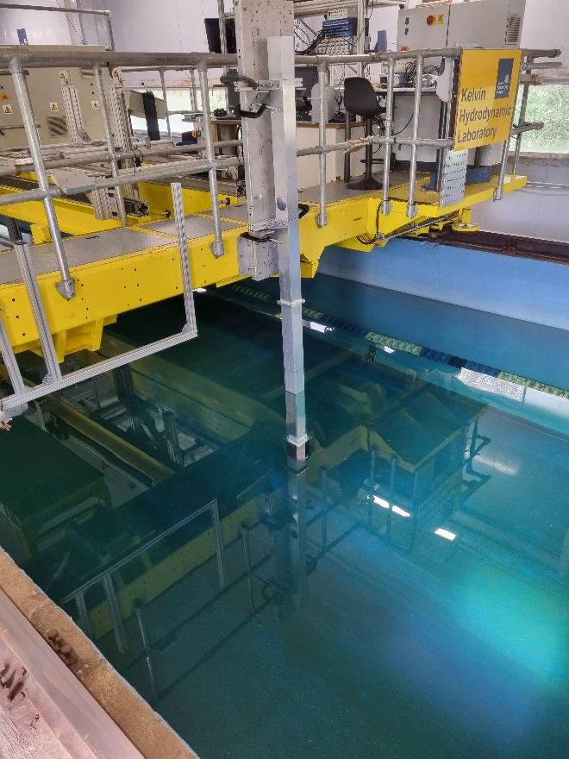
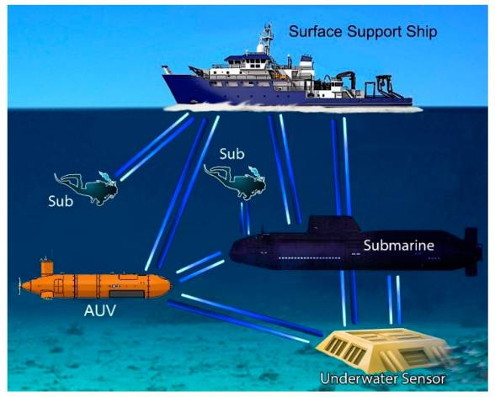
Underwater
Experience
Tested underwater links in test tanks and reservoirs
Tested side scattering fibres for underwater communications
Idea:
Pointing and tracking between ROVs (Inspecting damaged undersea cables).
ROV to base station which could be a surface vessel or arial platform surface.
Monitoring station to ROV link development
[1]
[1] Schirripa Spagnolo G, Cozzella L, Leccese F. Underwater Optical Wireless Communications: Overview. Sensors (Basel). 2020 Apr 16;20(8):2261. doi: 10.3390/s20082261.
www.celticnext.eu Physical layer technologies for optical communications- Daniel Maclure, Fraunhofer CAP, daniel.maclure@fraunhofer.co.uk
Notes:
Areas of use
ROVs for underwater inspection of cables
(monitoring pollution or possible damage to underwater structures)

Slide 8
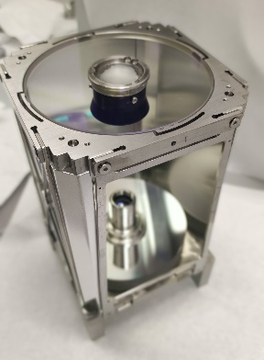
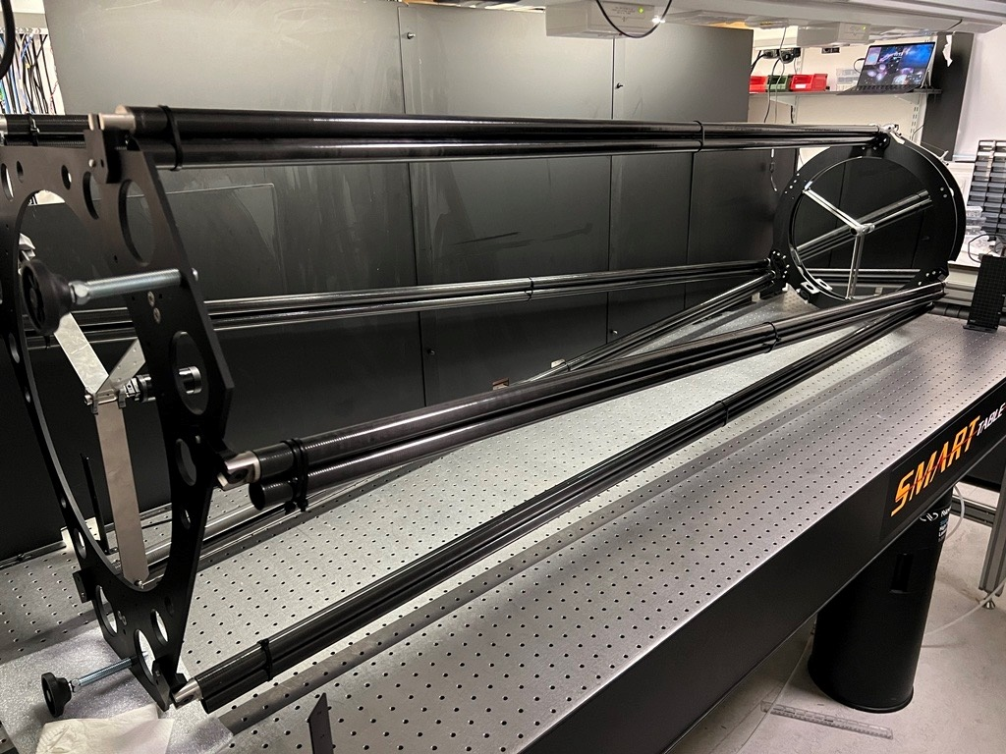
Space
Experience
We have experience in space to ground and other forms of space-based technologies
CubeSat telescope (1.5U)
Optical ground-station receiver characterisation
Atmospheric turbulence modelling
Ideas
Secure inter-satellite communications for CubeSat constellations
Space-to-ground communications
Testing units for optical ground receivers
www.celticnext.eu Physical layer technologies for optical communications- Daniel Maclure, Fraunhofer CAP, daniel.maclure@fraunhofer.co.uk

Slide 9
Potential Partners
Fraunhofer CAP works with companies across sectors, up and down supply chains, and also with universities and other Research and Technology Organisations (RTOs), use-case owners, and manufacturers and systems integrators of optical communication hardware
Our expertise lies in the physical layer
We are especially interested in partners with complimentary expertise.
e.g. working at data-link layer, network layer and higher.
www.celticnext.eu Physical layer technologies for optical communications- Daniel Maclure, Fraunhofer CAP, daniel.maclure@fraunhofer.co.uk

Slide 10
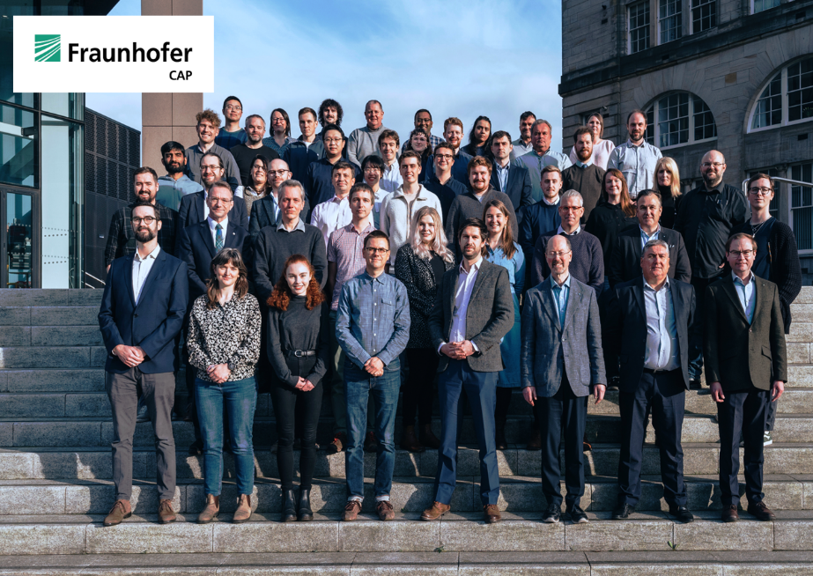
Contact Info
For more information please contact:
Daniel Maclure
Fraunhofer CAP
daniel.maclure@fraunhofer.co.uk
0141 548 4667
99 George St, Glasgow G1 1RD
https://www.fraunhofer.co.uk/en/contact.html
Presentation is available via:

