Slide 1
CELTIC-NEXT Proposers Brokerage Day
24th February 2025, Barcelona
Pitch of the Project Proposal
Smart and Fast WiFi Test Automation
Burcu ERGUN, Airties burcu.ergun@airties.com

Slide 2
Teaser
Main Benefit: Accelerates WiFi testing by up to 50%, reduces human errors, and improves test accuracy with AI-driven Automation.
Added Value:
AI & Machine Learning for adaptive, real-world test scenarios
Cloud-based automation for seamless integration
Real-time insights & anomaly detection for efficient troubleshooting
Why Participate? Join a cutting-edge initiative to revolutionize telecom testing, gain early access to innovative AI-powered tools, and boost your market competitiveness with faster, smarter WiFi performance validation!
www.celticnext.eu Smart and Fast WiFi Test Automation, Burcu ERGUN, Airties, burcu.ergun@airties.com

Slide 3
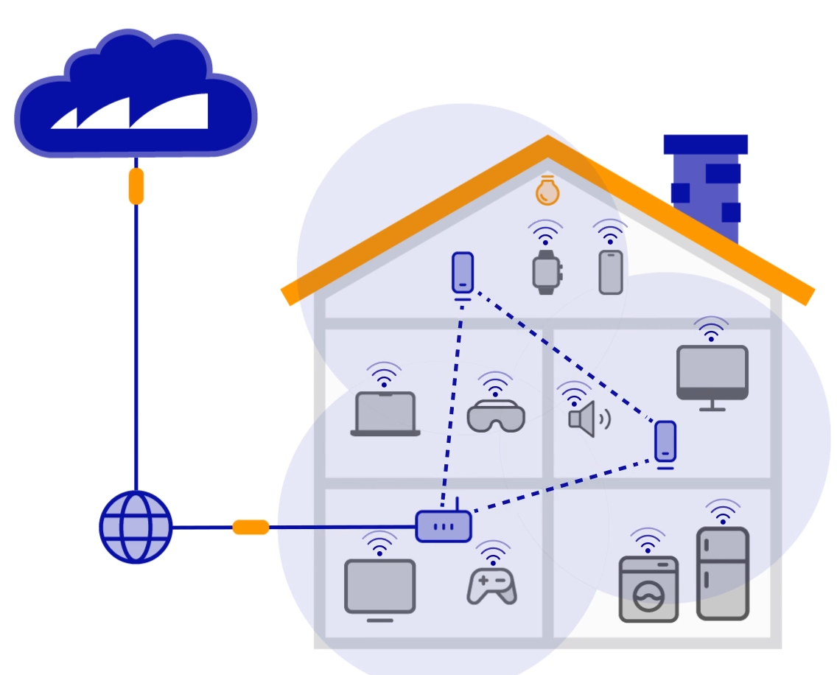
Organisation Profile
Airties provides managed Wi-Fi solutions for the Tier 1 Internet Service Providers (ISPs) across the globe.
Currently, Airties integrates into and remotely manages more than 35 million home Gateways mostly in USA and Europe.
Airties’ SW solutions optimize Wi-Fi connections and home networks, leading optimized user experience.
Airties utilizes AI-powered methods for optimization of home networks.
www.celticnext.eu Smart and Fast WiFi Test Automation, Burcu ERGUN, Airties, burcu.ergun@airties.com

Slide 4
Proposal Introduction (1)
Vision: To revolutionize WiFi testing by eliminating inefficiencies, reducing human intervention, and enhancing accuracy with AI-driven automation.
Motivation: Traditional WiFi testing is slow, costly, and prone to human error. Current methods lack adaptability to dynamic network environments. SmartWiTest introduces AI & ML to optimize test execution, ensuring faster, smarter, and more reliable testing.
Content & Key Features: AI-powered test automation for real-time optimization Machine Learning-driven test scenarios adapting to network conditions Cloud-based management for seamless remote testing Faster & more accurate WiFi performance validation
www.celticnext.eu Smart and Fast WiFi Test Automation, Burcu ERGUN, Airties, burcu.ergun@airties.com

Slide 5
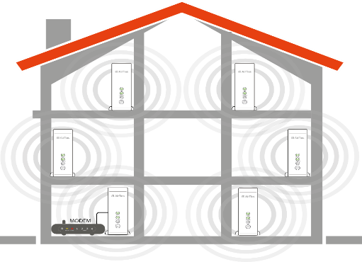
Proposal Introduction (2)
SmartWiTest = Faster, Smarter, and More Reliable WiFi Testing!
Test Scheduler
Test results/logs
Test results
Test request
Testers
TAS Portal
Test queue
LLama 3.1
Llama Agent
AI Prompts
Test Environment
www.celticnext.eu Smart and Fast WiFi Test Automation, Burcu ERGUN, Airties, burcu.ergun@airties.com

Slide 6
Proposal Introduction (3)
Expected Outcomes:
AI-driven WiFi test automation platform
50% faster testing processes with reduced human intervention
Adaptive & intelligent test scenarios using Machine Learning
Cloud-based test management for remote and scalable testing
Improved accuracy with real-time anomaly detection
Impacts:
For Telecom Operators: Faster and more reliable network validation
For IoT & Smart Device Manufacturers: Optimized device connectivity & performance
For Data Centers & Enterprises: Efficient troubleshooting and reduced downtime
www.celticnext.eu Smart and Fast WiFi Test Automation, Burcu ERGUN, Airties, burcu.ergun@airties.com

Slide 7
Proposal Introduction (4)
Project Timeline (36 Months)
Months 1-6: Requirement analysis & AI model development
Months 7-18: Core platform development & integration
Months 19-30: Testing, validation & optimization
Months 31-36: Pilot deployment & commercialization strategy
www.celticnext.eu Smart and Fast WiFi Test Automation, Burcu ERGUN, Airties, burcu.ergun@airties.com

Slide 8
Partners
Managed Wi-Fi Solutions
Existing Consortium & Partner Collaboration
TR consortium is full
Looking for partners with expertise in:
AI & Machine Learning for intelligent test automation
Telecom & Network Infrastructure for real-world validation
IoT & Smart Device Development for connectivity optimization
Cloud & Edge Computing for scalable and remote testing
Cybersecurity & Data Privacy for secure network testing
www.celticnext.eu Smart and Fast WiFi Test Automation, Burcu ERGUN, Airties, burcu.ergun@airties.com

Slide 9
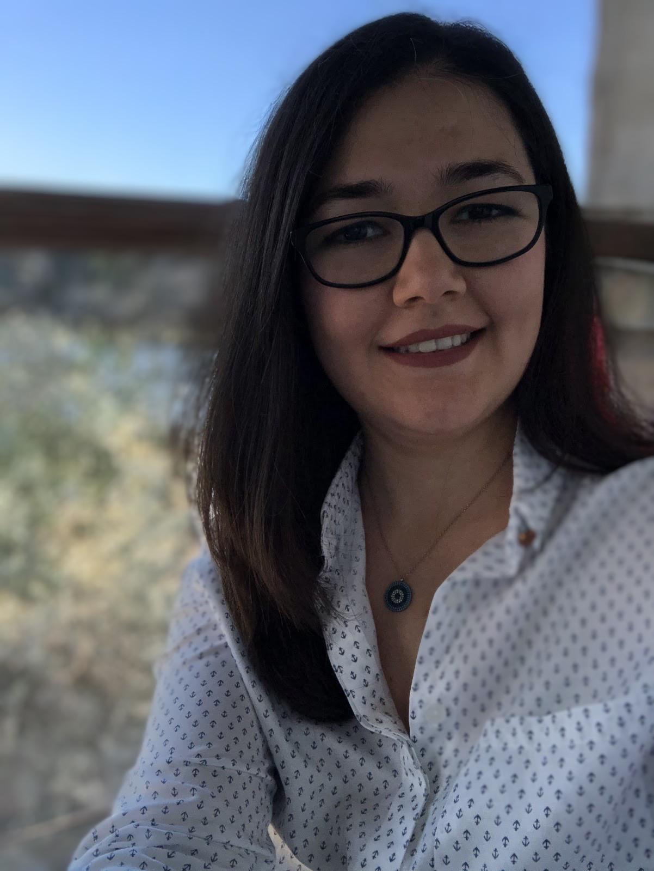
Contact Info
For more information and for interest to participate please contact:
Burcu ERGUN
burcu.ergun@airties.com
Presentation is available via:

