Slide 1

CELTIC Proposers Day in Aveiro on 11.09.25
SUCCESSFUL SME

Slide 2
Aiming at fully autonomous drones

Slide 3
The drones’ era
Drones exist for a very long time but...
Recently, the portfolio of applications „exploded“
Entertainment
Industry
Military

Slide 4
The need for autonomous operations
Industry is requiring more independent drones
The goals
Task optimization
Costs reduction
The challenges
Independent navigation
Obstacle avoidance (static / dynamic)
RT decision making
All in a small, light, „power saving package“
That can be further stretched to
GNSS denied environment
Communications jamming

Slide 5
Addressing the challenges
Flexible architecture
Edge computing
Cloud integration
On-board AI
Wide communications portfolio
Navigation sensors

Slide 6
Beyond Vision drones
CPU Board w/AI capabilities
Linux and ROS
Wi-Fi: main short-range comm
5G: main long-range comm
Twin GNSS receivers
FC w/triple redundance INS
Additional navigation sensors
beXstream cloud platform

Slide 7
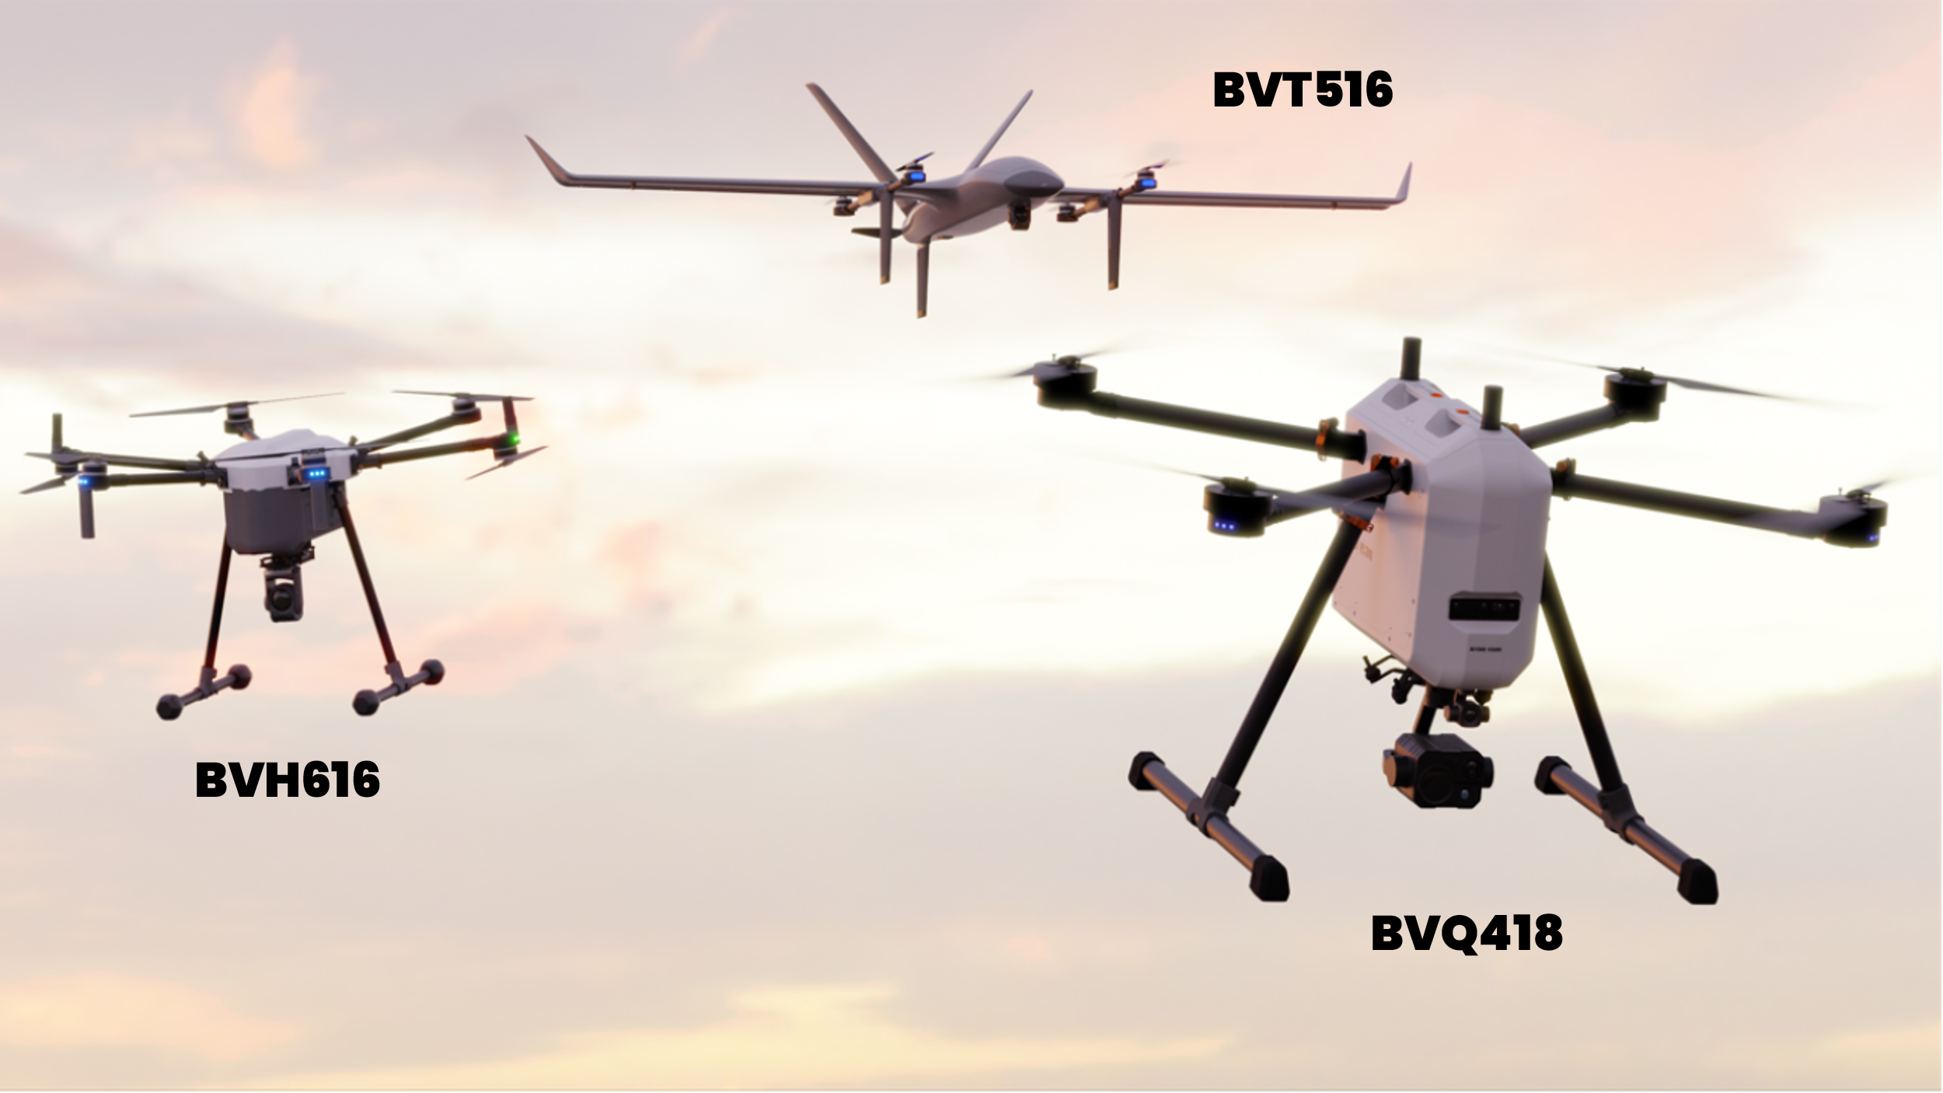
The happy family
And more to come... Stay tuned!

Slide 8
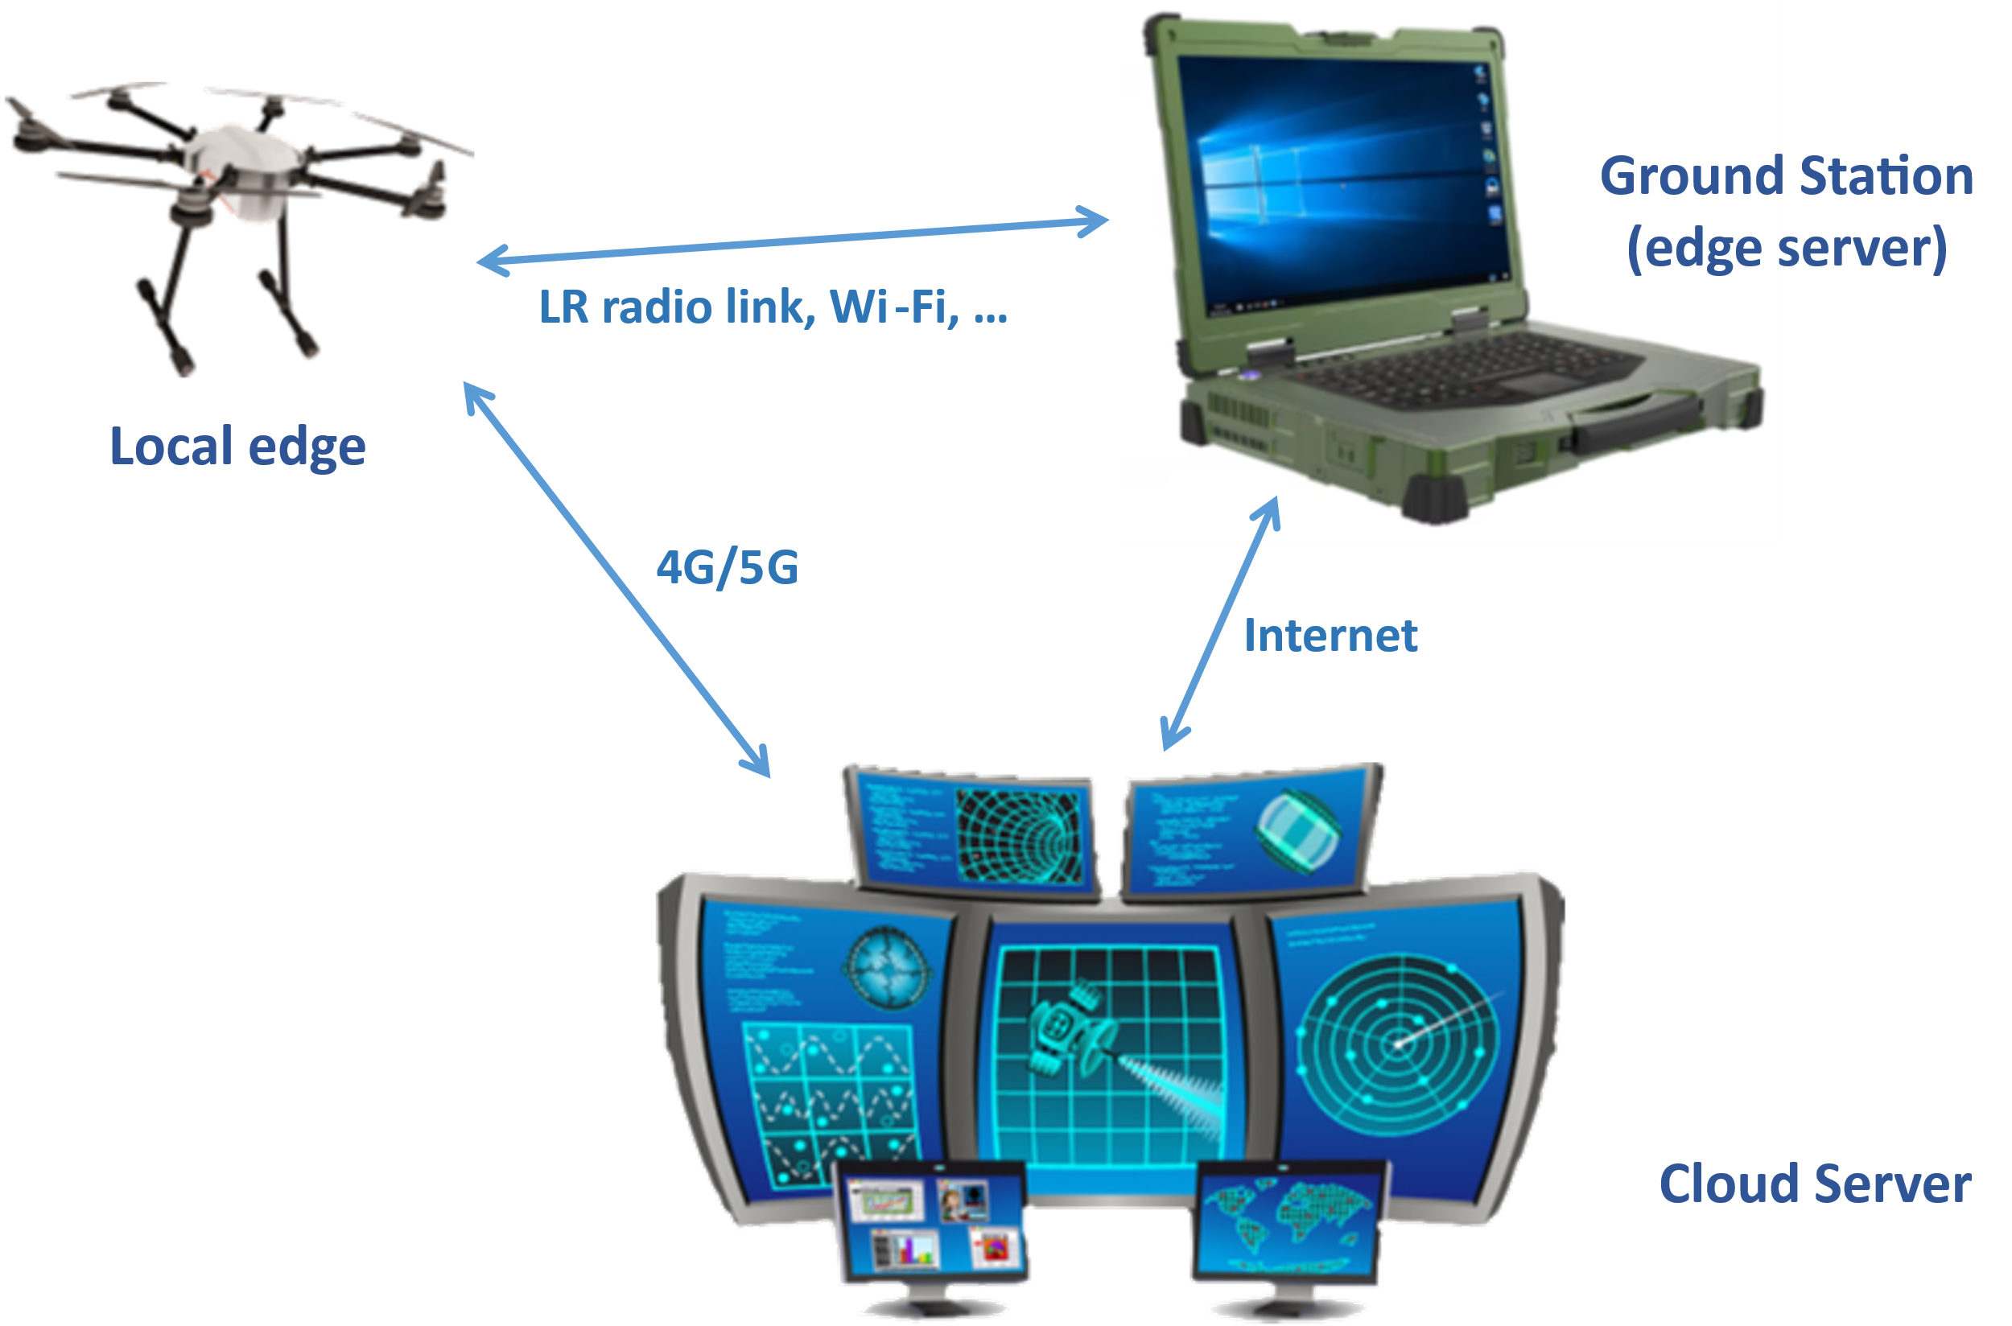

The ecosystem
Flexible 2-tier / 3-tier architecture
Local edge (drone itself)
Edge server (ground station)
Cloud server (beXstream)

Slide 9
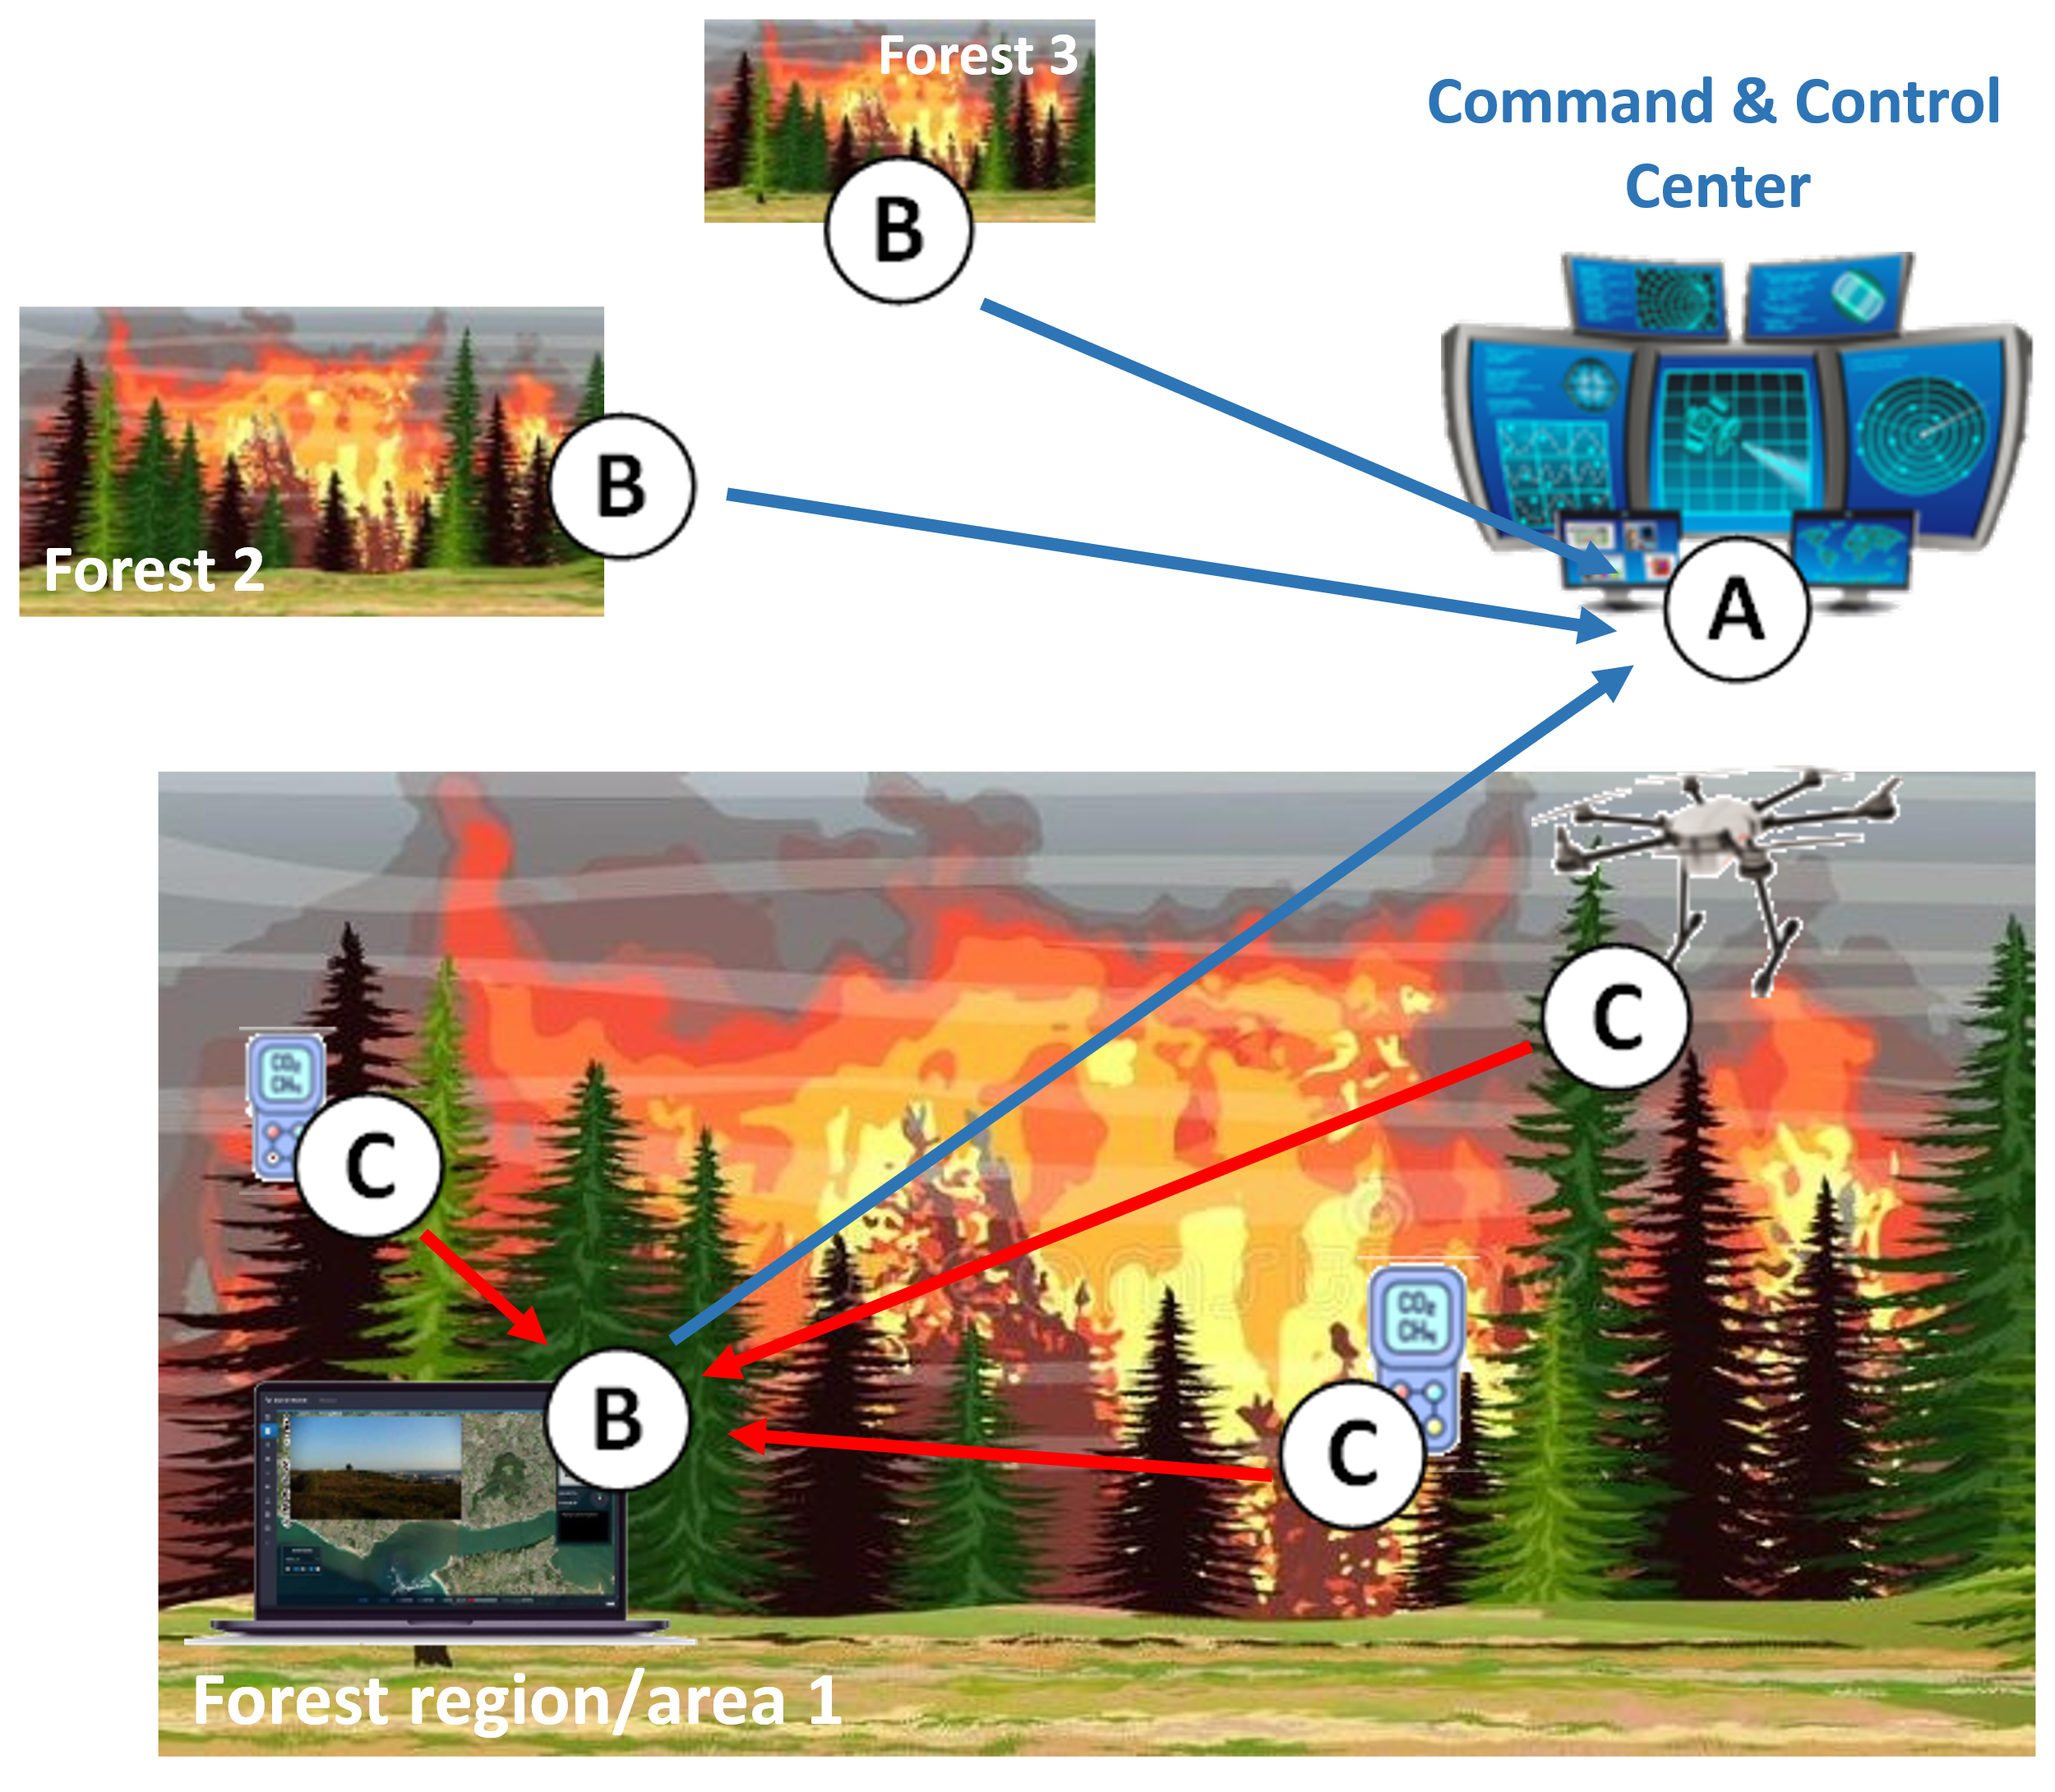
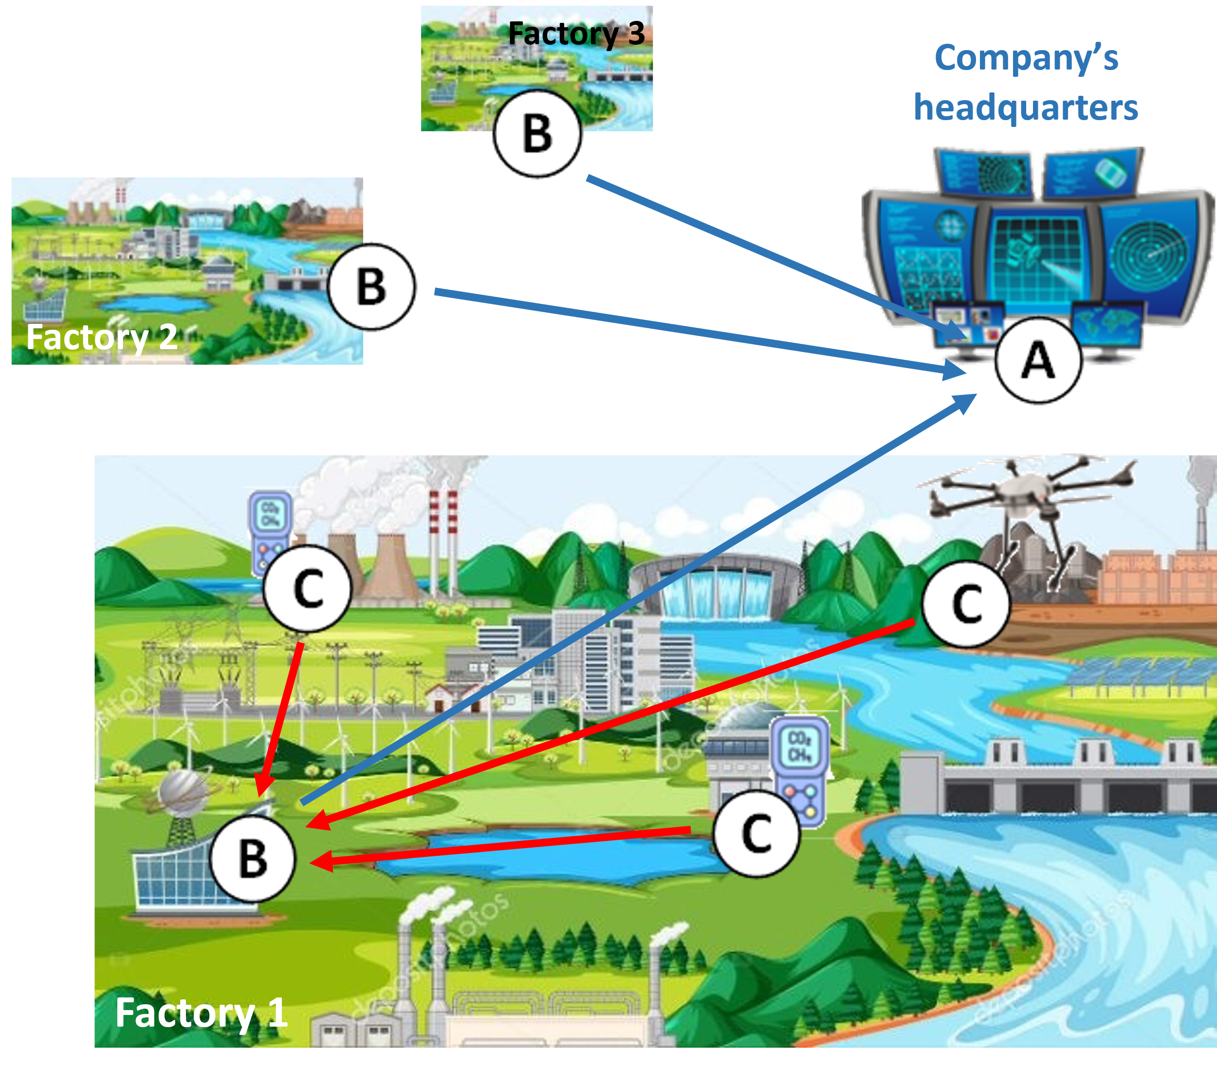
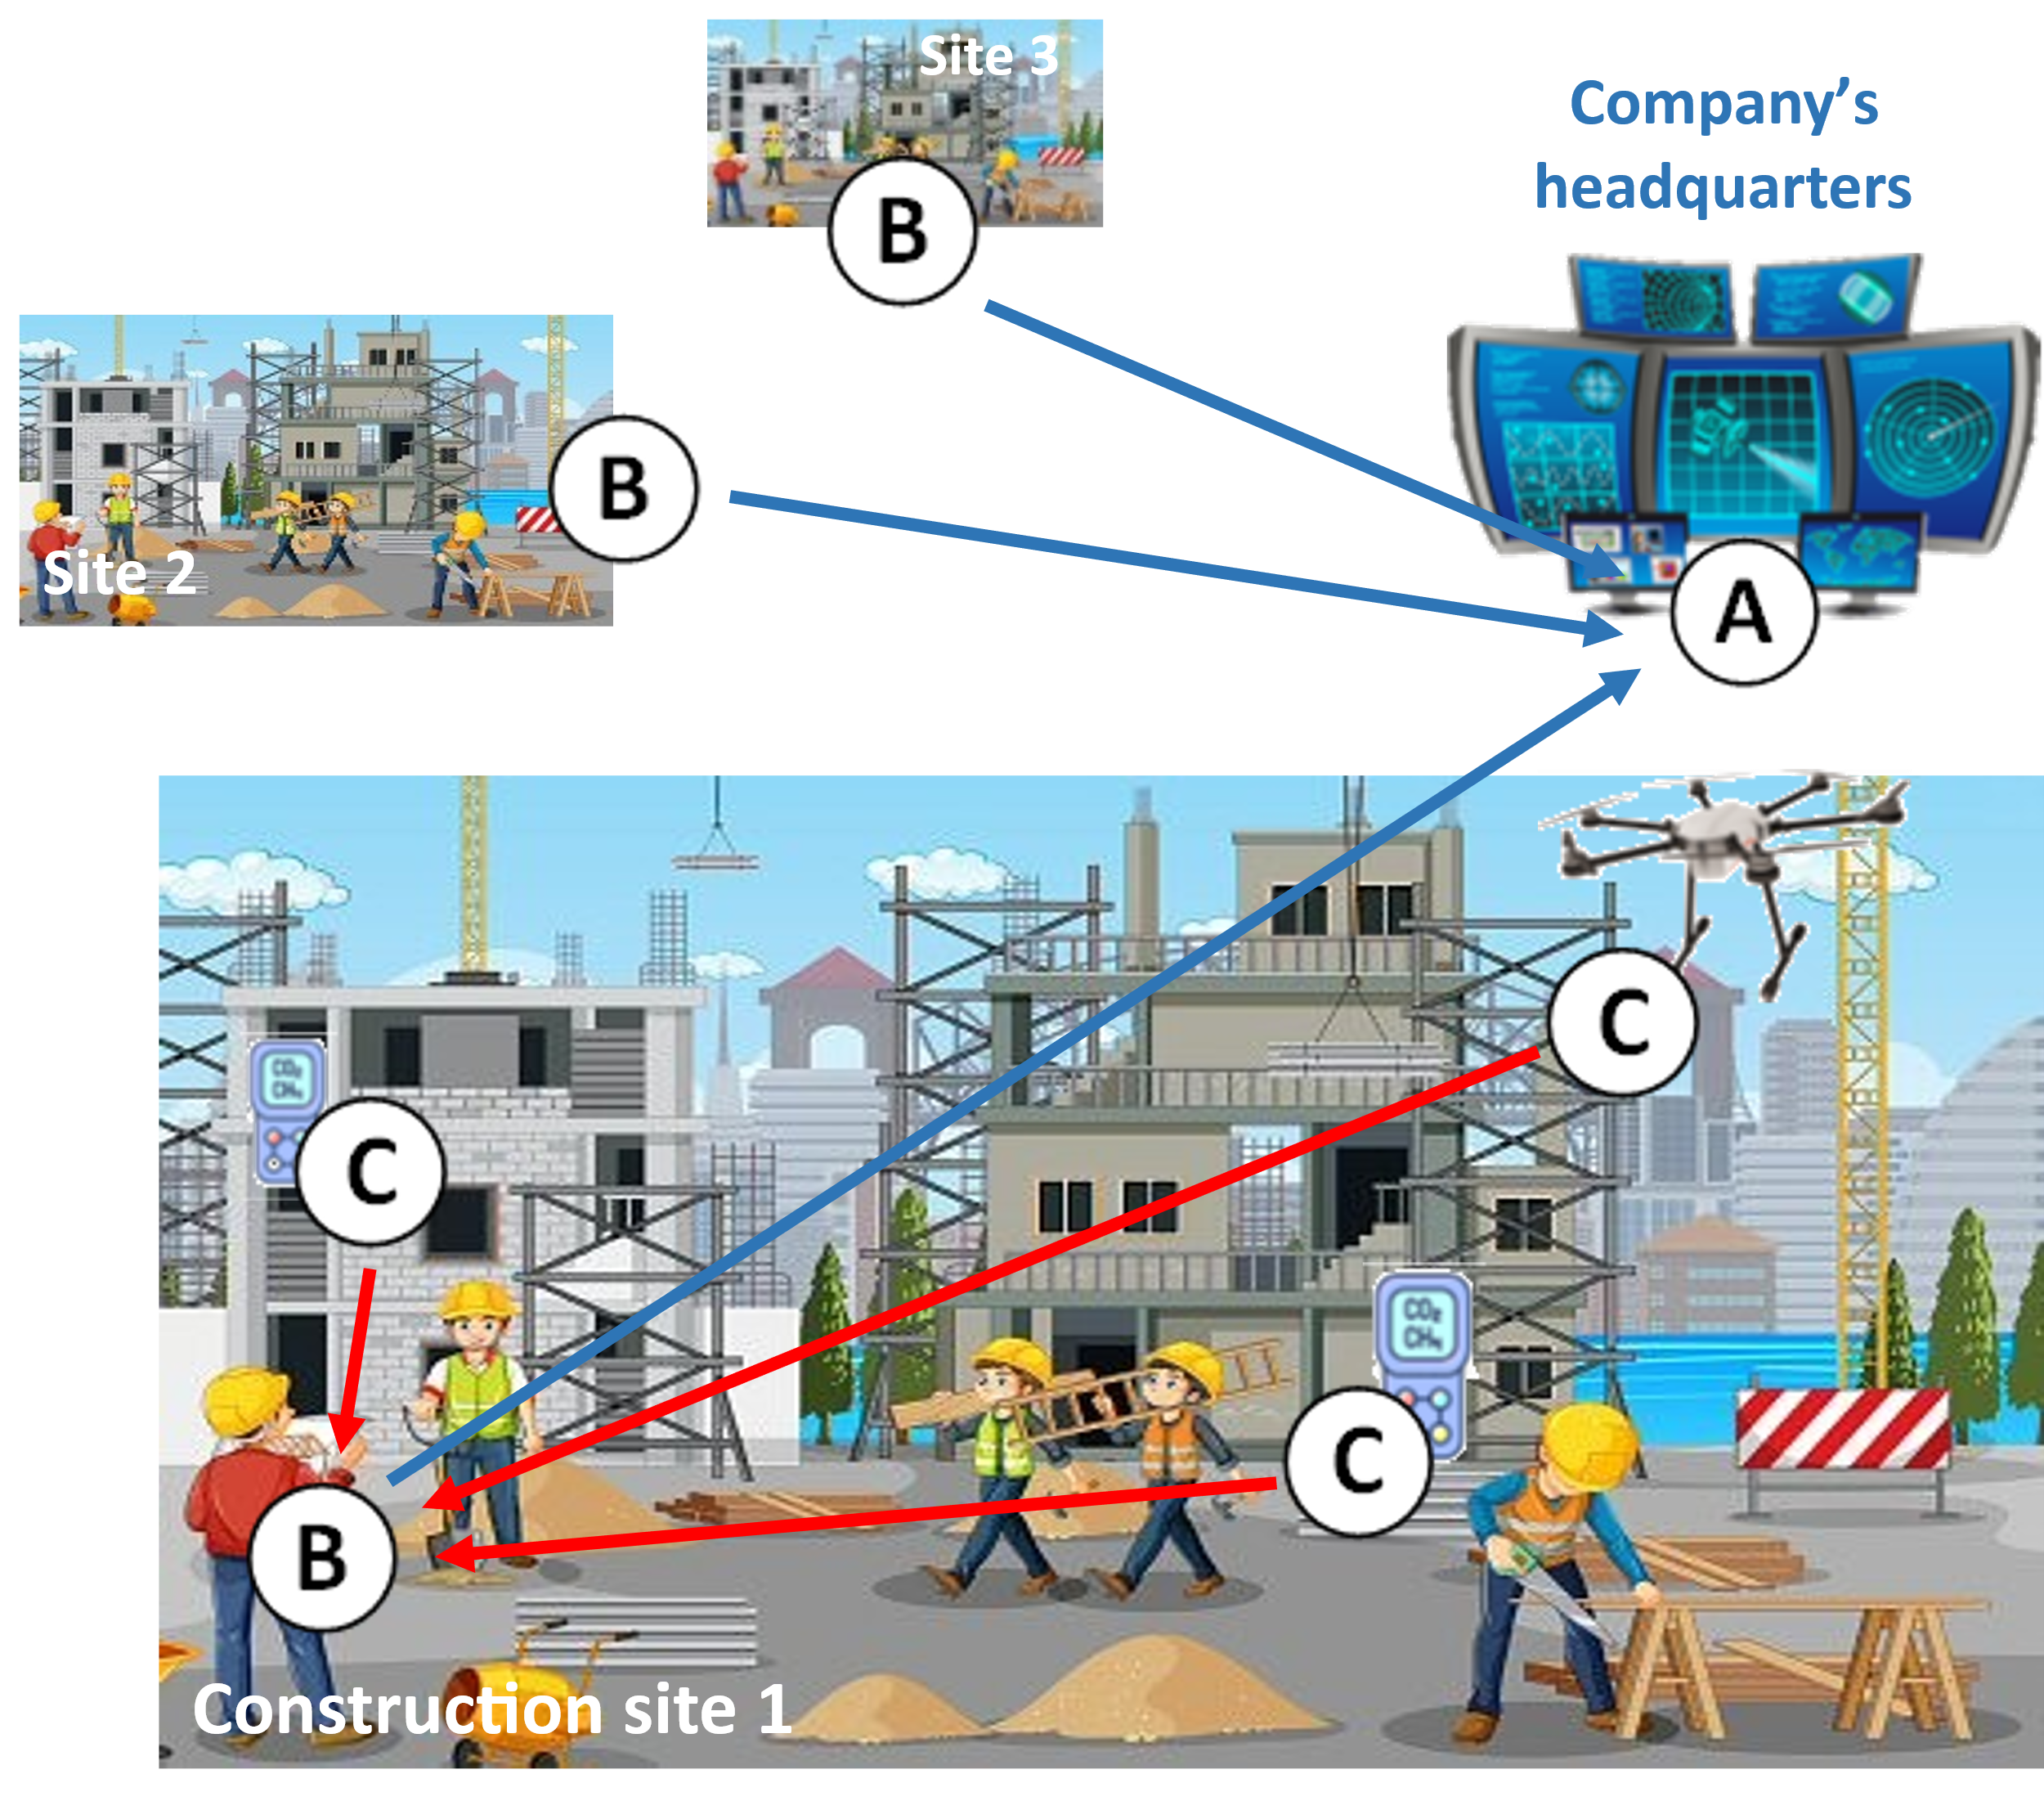
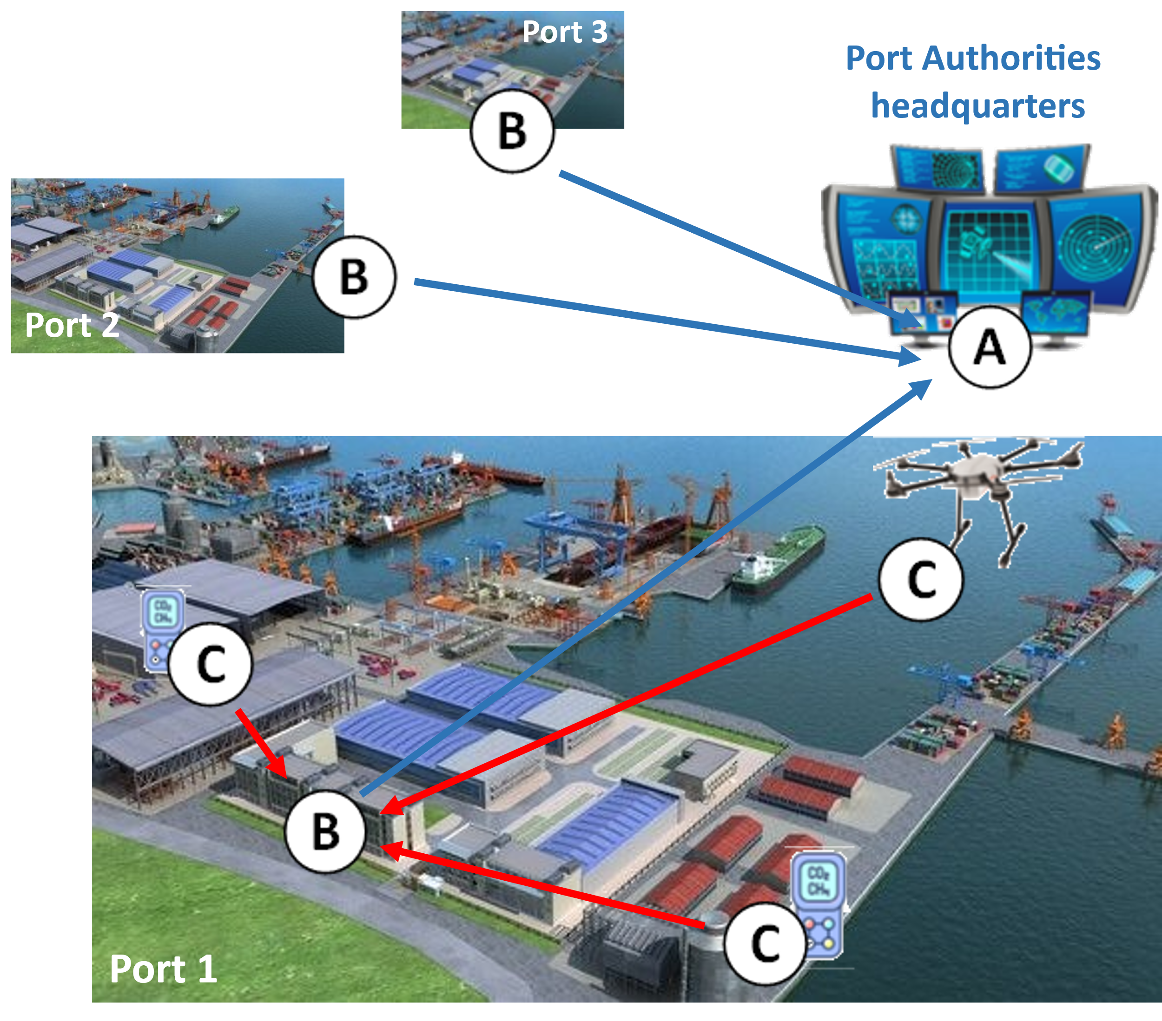
Wide portfolio of apps...
Ports monitoring
Construction site monitoring
Firefighting support
Hazardous industry

Slide 10
IEoT Project Grand demo

Slide 11
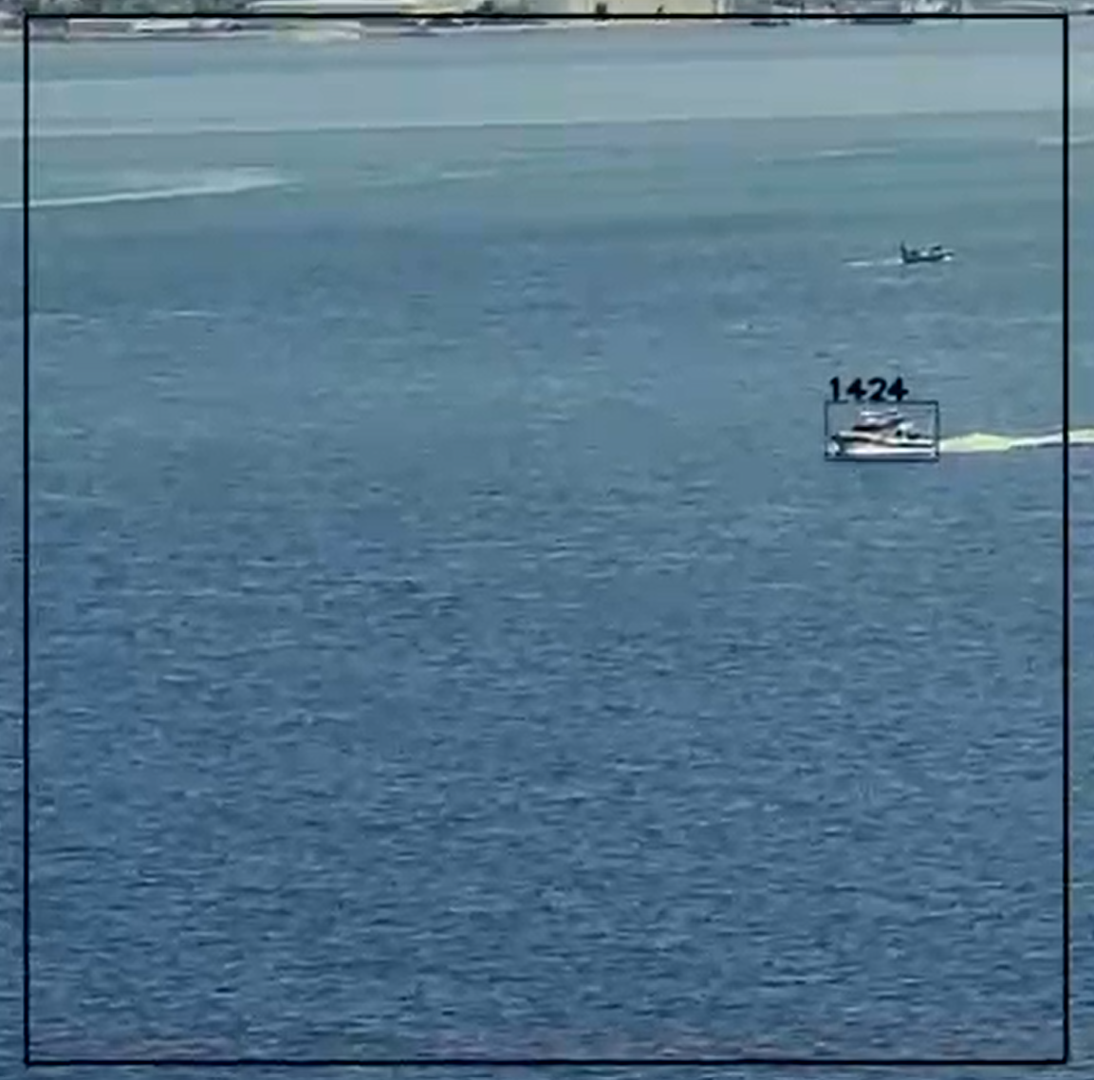
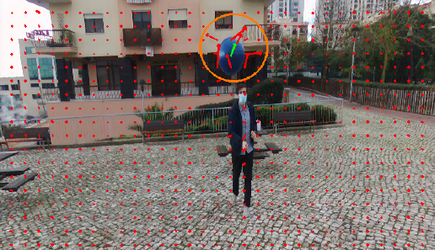
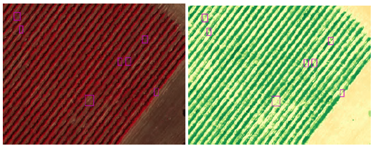
Using AI on-board
Smart farming
Asset tracking and monitoring
Collision avoidance

Slide 12

About BV...
Beyond Vision
Created in 2013
Drone group
Initiated in 2018
Entered the drone market in 2021
7 European/National projects completed. 3 ongoing
Several National and International awards
First „big sell“ in 2023
2nd place SPRIN-D in Germany in 2024
Number of employees in 2025 : ~70
Expected revenues in 2025: ~13M€

Slide 13
Obrigado!

