Slide 1






Proposers Day on CELTIC-NEXT, the Eureka ICT cluster for a secure, trusted, and sustainable digital society
The ICT Σeureka cluster for next-generation communications is celebrating 22 years of successful innovative projects!
5G & 6G
Xavier Priem, CELTIC-NEXT Director priem@celticnext.eu

Slide 2
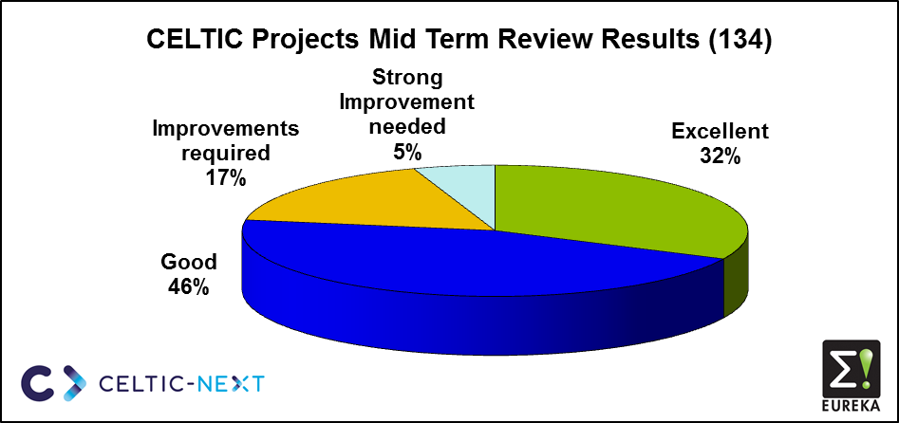
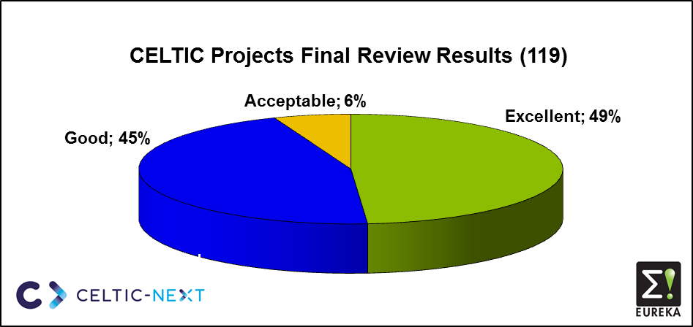
CELTIC NEXT
The value of the CELTIC-NEXT Programme lies not only in the administrative management of Calls and Projects but also in the high-quality expertise and recommendations provided by its Experts and Reviewers.
Recommendations from Experts

Slide 3
I would also like to personally thank you for your continued support and guidance throughout the project.
Your involvement has been key to keeping us on track and ensuring the quality of the work delivered.
We hope to have the opportunity to collaborate again in the near future under the CELTIC-NEXT programme. It would be a pleasure to work together on new challenges and innovative initiatives.

Slide 4
“Your CELTIC-NEXT project should be successful and beneficial, and it must be managed and controlled properly in order to achieve this”
Give confidence to the Experts and the Public Funders that you will be in control !
“It should be used as a tool to develop your business, if the project scope is aligned with your strategies and future plans. However, it may take some time to reach commercial success.”
Provide a clear outlook on your commercialisation plan, per product/partner and as a whole !
Key points
1/2

Slide 5
Key points
2/2
“The best practices that help to carry out the project activities properly are based on the commitment of the consortium from the beginning to the end of the project”
Build a strong and committed consortium and show clearly its commitment in the proposal!
“The success of the project relies on three actions: deliverables, dissemination and exploitation of project activities”
Write a good proposal (not only research but also business impact, exploitation plan and dissemination; coordination and WP structure)!
“Be aware that there may be changes in the project (consortium, activities, funding, etc.) that might affect the initial plans (Project Description)”
Provide a well-described risk analysis section!

Slide 6
CELTIC-NEXT Services & Fees
Hosted as a not-for-profit Division of EURESCOM GmbH, member of the Core Group, Heidelberg, Germany
Major Expenses:
Office Staff costs (including travel) and daily operational management
Travel costs for Experts
Calls, Events, Marketing & Dissemination
IT tooling & hosting
Costs are exclusively balanced through projects’ fees, as 1.5% of the eligible budget!
see “Fees” website page:
https://www.celticnext.eu/celtic-next-fee-invoicing-and-payment-procedure/

Slide 7




Thank you for your attention!
Xavier Priem CELTIC-NEXT – Director
Mobile: +49 1515 796 2180 Fax: +49 6221 989 209
Email: office@celticnext.eu Web: https://www.celticnext.eu
CelticNextEurekaCluster
@CelticNext
CELTIC-NEXT Video Channel
www.celticnext.eu

