Slide 1
CELTIC Proposers Day in Aveiro on 11.09.25
Ayman Radwan
Instituto Supioer Tecnico Instituto de Telecomunicações

Slide 2

Best Practices
hands-on experience
by Ayman Radwan

Slide 3
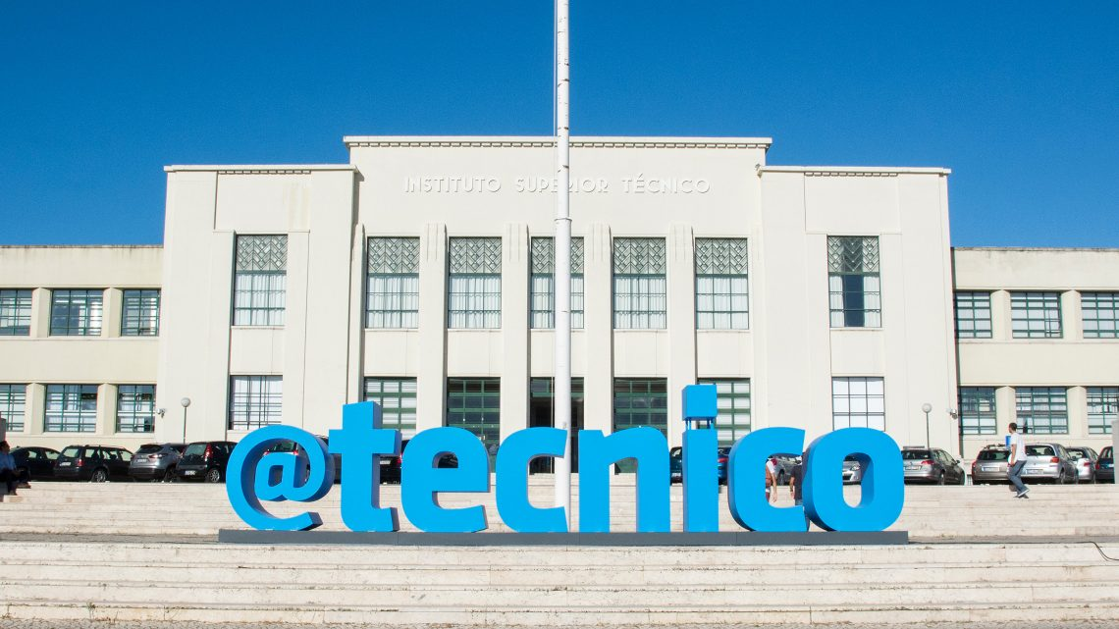
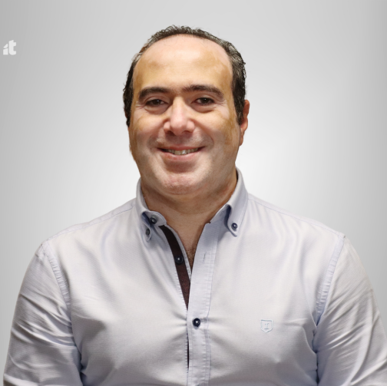

Who am I?
Professor
Instituto Superior Tecnico
Universidade de Lisboa
Lisboa, Portugal
Researcher
Instituto de Telecomunicações
Lisboa, Portugal
Project Coordinator
Green-T
MUSCLES
SAFE-HOME
Ayman Radwan

Slide 4




Down the history lane
GREEN-T
07/2011
MUSCLES
01/2017
06/2019
SAFE-HOME
04/2021
10/2024
06/2014
GREEN-T aims to overcome the energy trap of 4G mobile systems by exploiting the combination of cognitive radio and cooperative strategies while still enabling the required performance.
MUSCLES aims to develop a new low-cost intelligent network structure, extending the idea of femto cells to the outdoor scenario, through mobile small cells, on demand.
SAFE-HOME targets a system for monitoring the activity and movement of elders within a confined space (Home), to understand their activity level, with ability to identify emergencies.
Technical Manager
Project Coordinator

Slide 5
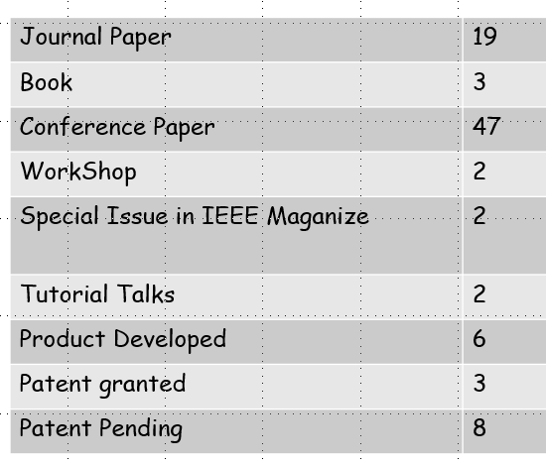
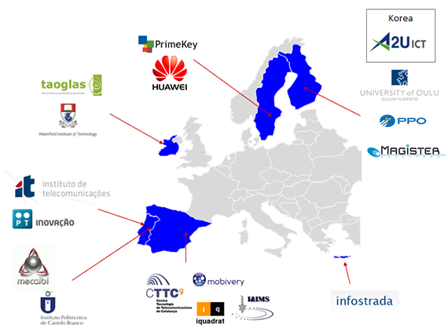
GREEN T
GREEN-T
07/2011
MUSCLES
01/2017
06/2019
SAFE-HOME
04/2021
10/2024
06/2014
GREEN-T aims to overcome the energy trap of 4G mobile systems by exploiting the combination of cognitive radio and cooperative strategies while still enabling the required performance.
MUSCLES aims to develop a new low-cost intelligent network structure, extending the idea of femto cells to the outdoor scenario, through mobile small cells, on demand.
SAFE-HOME targets a system for monitoring the activity and movement of elders within a confined space (Home), to understand their activity level, with ability to identify emergencies.
Technical Manager

Slide 6
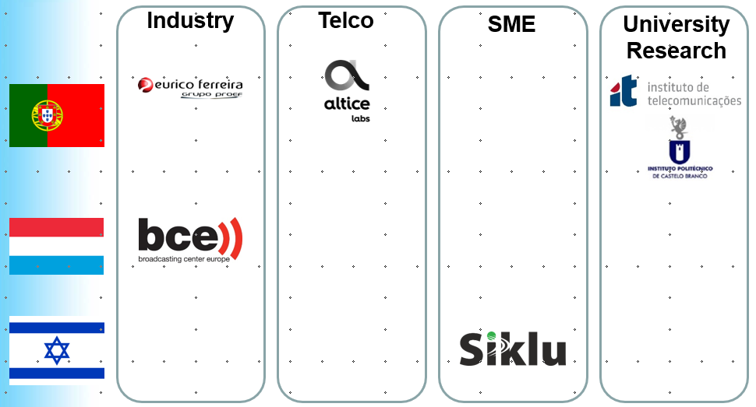
MUSCLES
GREEN-T
07/2011
MUSCLES
01/2017
06/2019
SAFE-HOME
04/2021
10/2024
06/2014
GREEN-T aims to overcome the energy trap of 4G mobile systems by exploiting the combination of cognitive radio and cooperative strategies while still enabling the required performance.
MUSCLES aims to develop a new low-cost intelligent network structure, extending the idea of femto cells to the outdoor scenario, through mobile small cells, on demand.
SAFE-HOME targets a system for monitoring the activity and movement of elders within a confined space (Home), to understand their activity level, with ability to identify emergencies.
Journal Paper | 5
Conference Paper | 8
Master theses | 2
New Products | 4
Enhanced Products | 4
Project Coordinator

Slide 7
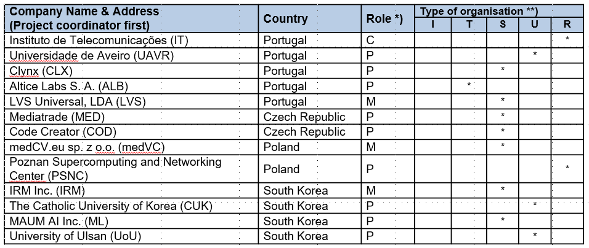
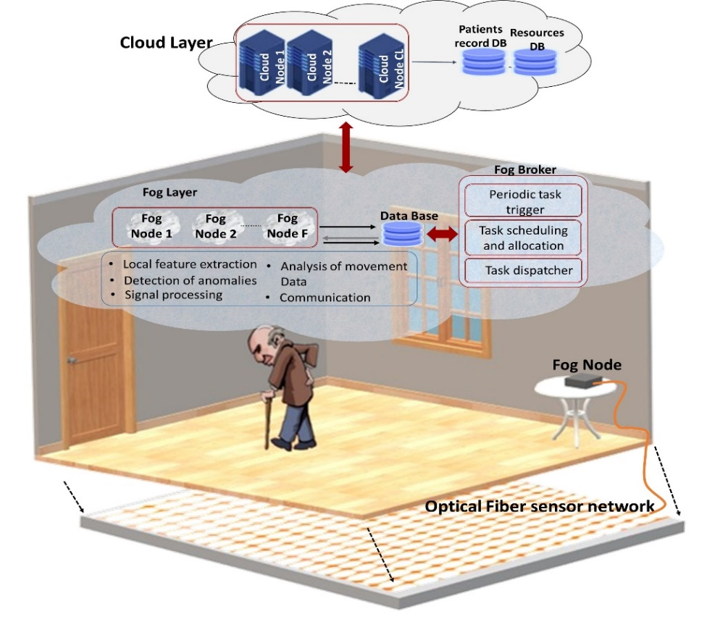
SAFE-HOME
GREEN-T
07/2011
MUSCLES
01/2017
06/2019
SAFE-HOME
04/2021
10/2024
06/2014
GREEN-T aims to overcome the energy trap of 4G mobile systems by exploiting the combination of cognitive radio and cooperative strategies while still enabling the required performance.
MUSCLES aims to develop a new low-cost intelligent network structure, extending the idea of femto cells to the outdoor scenario, through mobile small cells, on demand.
SAFE-HOME targets a system for monitoring the activity and movement of elders within a confined space (Home), to understand their activity level, with ability to identify emergencies.
Journal Paper | 10
Conference Paper | 14
Master theses | 3
New Products | 3
Enhanced Products | 3
Project Coordinator

Slide 8


Success Stories
GREEN-T
07/2011
MUSCLES
01/2017
06/2019
SAFE-HOME
04/2021
10/2024
06/2014
GREEN-T aims to overcome the energy trap of 4G mobile systems by exploiting the combination of cognitive radio and cooperative strategies while still enabling the required performance.
MUSCLES aims to develop a new low-cost intelligent network structure, extending the idea of femto cells to the outdoor scenario, through mobile small cells, on demand.
SAFE-HOME targets a system for monitoring the activity and movement of elders within a confined space (Home), to understand their activity level, with ability to identify emergencies.
EXCELLENT
Technical Manager
Project Coordinator
Notes:
MUSCLES received “Very Good”

Slide 9
Takeaways
Different experiences
Variable consortium size
Variable Achievements
Success takes different forms

Slide 10
Best practices
General principles
Clear goals and measurable outcomes
Effective and continuous communication and documentation
Iterative improvement (learning from mistakes)
Balance innovation with reality and reliability
Start implementation and pilots EARLY
DO NOT reinvent the wheel → Stay up to date with Standards
Collaboration
Build diverse, multidisciplinary teams
Encourage open feedback and brainstorming
Define roles early, but allow flexibility
Use agile methods (milestones, reviews)

Slide 11
CELTIC projects – Specifics
Bottom-up Calls
Target: close to market and business needs
Societal and Economic Impact
Collaborative projects – multiple consortia
Different goals/targets at national levels
Flexible → PCRs are your friends

Slide 12
Challenges You Will Face
No Synchronization between national calls
Coordinators need to be flexible and agile
Change is the only constant
Consortium changes constantly
Addition of partners / withdrawal of partners
The beginning of the project is very challenging
Partners get their funding decision at different times
The lifetime of the project is different for each National Consortium
Coordinator must always keep track of different lifetimes
Partners have to be always active and take initiatives
Partners should be willing to work a bit outside their funding window

Slide 13
CELTIC Friends & support
CELTIC officers
Stay connected with them over the whole project lifetime
Efficient
Helpful
Monthly phone-call
National Contact Points (NCPs)
Contact the NCPs early on
Always stay connected with NCPs
Project Change Request (PCR)
Get familiar with the system and how to submit a PCR
You will submit many over the lifetime of the project
They are very useful
CELTIC Tools / support
Very useful tools

Slide 14
Summary & key Takeaways
Calls are open
Any idea / any topic
Very business oriented
Close-to-markets → market ready products
Flexible
Consortium is constantly changing
Can join projects at any time
Challenging start to the project
Funding decisions in different countries completely independent
Funding percentage and level are variable among countries
Testbeds and products
Start very early on the implementation
Constant communication
With partners
With Celtic office
With National Contacts

Slide 15
Final Advice
Get involved in CELTIC projects
If you have an idea, prepare a pitch
OR find a proposal and join it (at any point)
As coordinator, get familiar with CELTIC tools, and connect with CELTIC office
Always target the final product

Slide 16
Stay flexible, stay connected, and start building early — success will follow.

Slide 17
Contacts:
Ayman Radwan
Instituto Superior Tecnico
Instituto de Telecomunicações
Lisboa, Portugal
Email:
aradwan@av.it.pt
ayman.radwan@tecnico.ulisbo.pt

Slide 18

Motivation
Our population is getting older
Population of 60 and more years old has doubled in 2017 compared to 1980
[UN report]
Burdens are increasing on healthcare systems
UN 2030 Sustainable goals: “Ensuring healthy lives and promote well-being for all at all ages”

Slide 19
Motivation
Aging Population
60+ years olds has doubled in 2017 compared 1980
This trend is foreseen to continue, with the number doubling again in 2050
Burdens are increasing on an already overwhelmed health systems
especially, in EU
Such older population still likes to live independently at the comfort of their home
economic burden on individuals, who live on pension, to hire home-carers
Impact of COVID (post-pandemic)
The pandemic highlighted the importance of remote care and monitoring systems, as elderly individuals faced increased isolation and difficulty accessing in-person care.
Existing solutions have limitations
depend heavily on wearables → burdens and responsibility on elders
Lack of real-time monitoring
privacy issues: cannot use solutions depending on cameras (everywhere)

Slide 20
SAFE-HOME Project Goals
Ensure Elderly Safety: Provide a real-time, non-invasive monitoring system that detects falls and emergencies, enabling timely responses.
Maintain Independence: Support elderly individuals in living independently at home by offering continuous monitoring with least intrusion.
Integrate Smart Technologies: Leverage AI, machine learning, and sensor networks to provide intelligent decision-making and event detection.
Enable Remote Care: Facilitate remote monitoring and emergency response, especially in light of increased isolation due to events like the COVID-19 pandemic.
Achieve Scalability: Design a system that can be deployed in various environments, from individual homes to large care facilities, and scaled for different levels of monitoring needs

Slide 21
SAFE-HOME Initial Scenario

Slide 22
SAFE-HOME Architecture - Detailed
Details are provided in D2.1 and D2.2

Slide 23
Achievements – Technology Innovations
Non-Invasive Sensing Technologies: Advanced sensor networks that allow real-time monitoring without intruding on the daily lives of elderly individuals.
Fog-Cloud Hybrid Architecture: A scalable architecture that processes critical data locally (on fog nodes) for immediate responses, while utilizing cloud resources for long-term data analysis.
Privacy-Preserving Technology: Security measures integrated into the system to ensure that personal data is processed and stored in a way that protects the user’s privacy. Personal sensitive data are not shared over the cloud.
Real-Time Data Processing: Systems that ensure near-instantaneous detection of emergencies, enabling timely intervention in critical situations.
ML-Driven Fall Detection: High-accuracy fall detection models using machine learning, achieving over 96% accuracy in detecting falls in real-time.
AI Native Networking: ML based algorithms to manage resources efficiently, reducing latency and improving data privacy.
Seamless Integration with Healthcare Systems: Integrate and share the data directly with healthcare providers or emergency services for a more automated response chain.

Slide 24
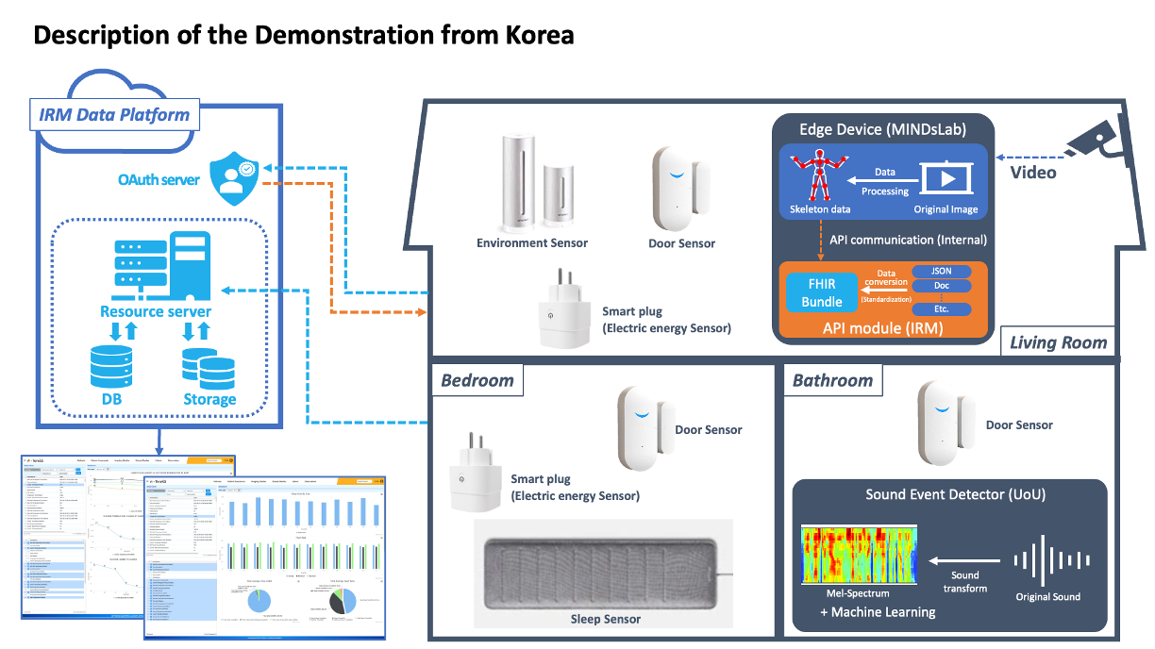
SAFE-HOME Fall Detection & Activity Monitoring
ML-based Sound Event Detector Development
Edge-based AI processing for immediate detection
Seamless integration of sensors and devices with cloud-based data platform
Service Model Design & Data Analysis
Data Integration Platform
Standardized data management for higher interoperability

Slide 25
Project Impact
New Products: 3
TeleLocation Application - Altice Labs
TeleAlert Application - Altice Labs
Emergency Videoconferencing Application – medVC & PSNC
Enhanced/Updated Products: 3
medVC improved the core videoconferencing platform
IRM improved the Cloud based Data Platform
Clynx improved immersive serious gaming application (Clynx platform)

Slide 26
Project Impact
Employees hired: 7
Patents filed: 5
Field trials: 23
Publications
Published Journals: 10
Conference proceedings: 14
Students
PhD Students: 1
Master Students: 3

Slide 27
Encountered Issues
The synchronization of the funding decisions between different national consortia: This lack of synchronization in funding decisions usually makes it hard for the collaboration between different partners from different national consortia;
Departure of partners: some partners have not been able to secure national funding;
Initially: 8 countries with 26 partners → 4 countries with 13 partners
Issues with UK and Brexit; funding of UK partners.
Difficulty in traveling: SAFE-HOME kicked-off in the period of post-pandemic period, where some companies/institutions (some of the partners) did not allow traveling for meetings or any other events. Those partners recommended remote online meetings and events;
Lower levels of funding in multiple consortia: This made traveling and in-person meetings more difficult; SAFE-HOME partners only had one in-person meeting around the time of mid-term review.

