Slide 1


CELTIC-NEXT
Proposers Day
5th February 2019, London
Self-Healing Intelligent Engine for
Layered Defence (SHIELD)
Dr Robert Hercock, Chief Researcher, BT Labs
Robert.Hercock@bt.com

Slide 2

Teaser
Enhanced security & resilience in future networks
Reduced operational costs and enhanced service to end-users
BT has extensive exerience in advanced AI
and Cyber security R&D
www.celticnext.eu SHIELD Dr Robert Hercock BT

Slide 3
Organisation Profile
BT is one of the world’s leading communications services companies, serving the needs of customers in the UK and in more than 170 countries worldwide. Our main activities are the provision of fixed telephony lines and calls, broadband, mobile and TV products and services as well as managed networked IT services.
BT is the largest communications services provider, with around 10 million voice lines, around 7.3 million retail broadband customers, a TV base of 1 million customers and over 5 million wifi hotspots. We also provide network services to other licensed operators. For further details see http://www.bt.com/.
www.celticnext.eu SHIELD Dr Robert Hercock BT

Slide 4

Proposal Introduction (1)
This proposal will develop a novel AI driven architecture to enable a step-change in the security and resilience of complex virtual networks.
Current cyber security paradigms are failing in existing network systems and are not scalable in a future: 5G, SDN and IOT fabric network environment.
This proposal will conduct industrial research to develop novel machine learning algorithms and supporting architecture to enable fully self-healing and high resilience service capability in future networks.
www.celticnext.eu SHIELD Dr Robert Hercock BT

Slide 5
Proposal Introduction (2)
Create a distributed self-organising and healing cyber defence layer that spans any network.
Impact: enables secure operation in 5G and future IOT networks
Three year programme, with live trials by 18 month stage.
www.celticnext.eu SHIELD Dr Robert Hercock, BT

Slide 6
Partners
Expertise: 5G & IOT network simulation and design,
or AI experience in distributed networks,
Deep learning and Agent-based systems
Partners: 1 academic, 2 SME or Enterprise
www.celticnext.eu SHIELD Dr Robert Hercock BT

Slide 7

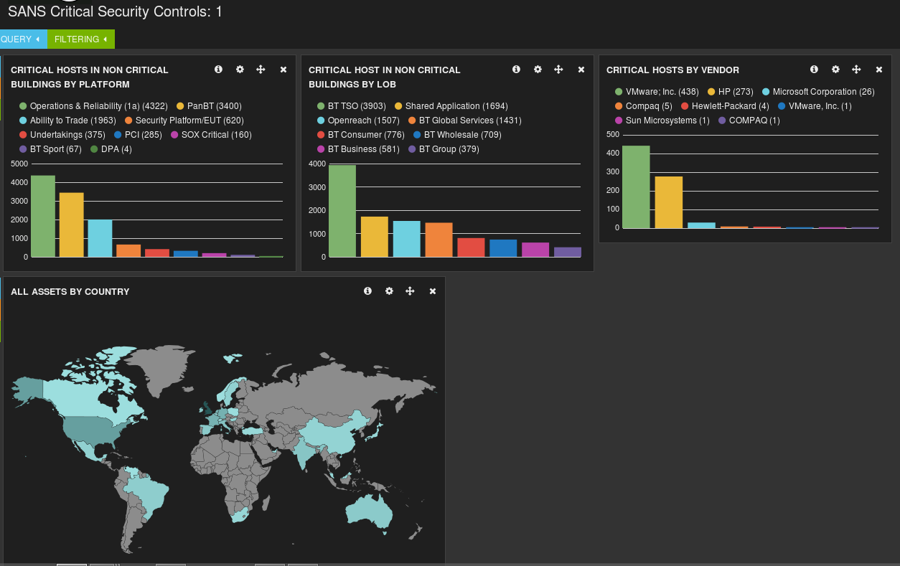
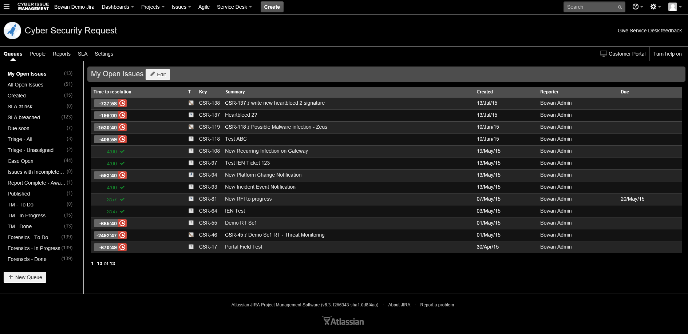
AI Driven Visualisation
www.celticnext.eu SHIELD Dr Robert Hercock BT

Slide 8
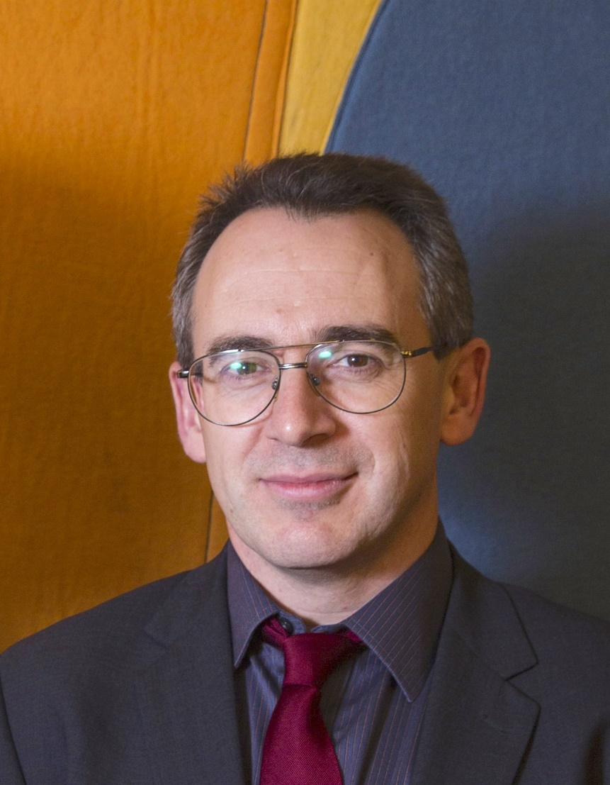

Contact Info
For more information and for interest to participate please contact:
Dr Robert Hercock
Robert.Hercock@bt.com
07445250920
BL Labs, MLB5, PP10,
Ipswich, UK, IP53RE
                Presentation available via:
                www.tiny.cc/proposalidea

