Slide 1


CELTIC-NEXT
Proposers Day
5th February 2019, London
Pitch of the Project Proposal
Distributed Sensor
Data Format Services (DS2)
Clemens Schmuck, Geodata Austria
Clemens.schmuck@geodata.at

Slide 2





Teaser
Solve the Babylonian confusion in monitoring
Means to have contract certainty
Basis for information security (non-repudiation)
Basis for near-real-time, AI driven data analysis
Goals
Enabling new business models
Unique selling point
New higher-level services (e.g. AI based analyses)
Main
Benefits
Added
value
Adaptability to local standards and therefore wider market
New insights provide new consulting opportunities
Similar pains
Similar gains
Similar business
Why
participate?
www.celticnext.eu DS2, Clemens Schmuck, Geodata Austria, clemens.schmuck@geodata.at

Slide 3



Organisation Profile
Geodata is an Austrian-based, international supplier of solutions and services in the test and measurement field and in engineering surveys.
Mainly active in the area of tunneling, mining, environmental control.
About us
Privately owned SME (total ~200 p.)
Small departments for Hardware & Software development
Own data integration software products since ~2008
Key Facts
Metro Tel Aviv, Israel
Metro Sydney, Australia
Tames Tidway, GB
Amsterdam Sydhavn, Danmark
… and many more
Recent
Projects
www.celticnext.eu DS2, Clemens Schmuck, Geodata Austria, clemens.schmuck@geodata.at

Slide 4





Proposal Introduction (1)
Motivation
Vision
We suffer from Babylonian Confusion in data formats.
We see new possibilities that we currently cannot exploit (e.g. AI)
We see new markets that we want to target (data integration expertise)
We see new possibilities to exploit and sell our expert knowledge
We envision an open and distributed sensor data format service (DS2) that allows the secure, decentralized specification, extension and versioning of data formats used to exchange, store and analyze monitoring data with no need for a central authority. This shall enable us to apply new methods of data analysis.
www.celticnext.eu DS2, Clemens Schmuck, Geodata Austria, clemens.schmuck@geodata.at

Slide 5



Proposal Introduction (2)
Tailored meta-language definition (OGC SWE based, if possible)
Free & open Source: generic SDKs, auto compiling SDKs, Distributed Specification Service with open API, Specification Generation UI, generic format converters, blockchain based specification security
Closed source: Integration of DS2 in our own Data Integration Software
Outcome
Change the way we think about sensor data in monitoring by providing tailored standards AND free tools. Govern the development of new sensor data ecosystems in the monitoring business.
Impact
Schedule
12-24 Month, depending on actual scope of work
www.celticnext.eu DS2, Clemens Schmuck, Geodata Austria, clemens.schmuck@geodata.at

Slide 6





Partners
No formally existing consortium yet but some interested parties
Research Partners
Georesearch, AT
University Graz, AT
Security Experts
N.N. (Block Chain, Digital Signatures)
Monitoring
Companies & Consultants
Tre Altamira, IT/SP
N.N. (e.g. TBM)
Sensor, IoT Experts
N.N. (e.g. OGC SWE)
www.celticnext.eu DS2, Clemens Schmuck, Geodata Austria, clemens.schmuck@geodata.at

Slide 7
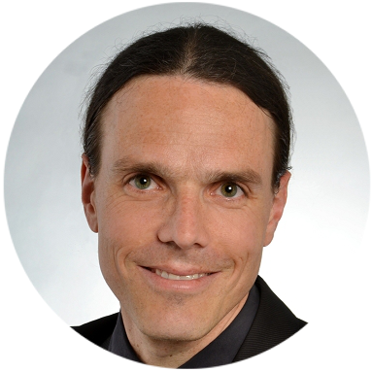
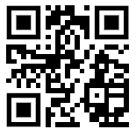
Contact Info
For more information and for interest to participate please contact:
Clemens Schmuck, Geodata
E-mail: clemens.schmuck@geodata.at
Mobile: +43 664 20 5000 92
Address: Hans-Kudlich-Straße 28, 8700 Leoben, Austria
Web: www.geodata.at
                Presentation available via:
                www.tiny.cc/proposalidea

Slide 8

Join the follow-up Telco
12 Feb. 9.00 CET
Join Webex meeting
Meeting number (access code): 950 271 572
Meeting password: mXSKpRVy
Join by phone
+49-6925511-4400 Germany toll
Global call-in numbers
Can't join the meeting?
www.celticnext.eu office@celticnext.eu

