Slide 1


CELTIC-NEXT
Proposers Day
5th February 2019, London
INCYP 5G: Integrated 5G and Cloud Platforms for Industrial Cyber-physical Systems
CRISTINA SECELEANU
Mälardalen University, Sweden
cristina.seceleanu@mdh.se

Slide 2

Teaser
5G + Cloud services + Industrial Cyber-Physical System (ICPS) infrastructure will promote
  next generation of intelligent and autonomous systems
  real-time connected device monitoring and control
  increased quality, efficient production and sustainable industrial systems.
Faster time-to-market, more flexible collaboration and data sharing for European cyber-physical system industry
Contribute to accelerating new growth opportunities to both communications service providers and ICPS providers
Create intelligent, connected ICPS Ecosystems and 5G Services
www.celticnext.eu INCYP5G, Cristina Seceleanu, Mälardalen University, cristina.seceleanu@mdh.se

Slide 3



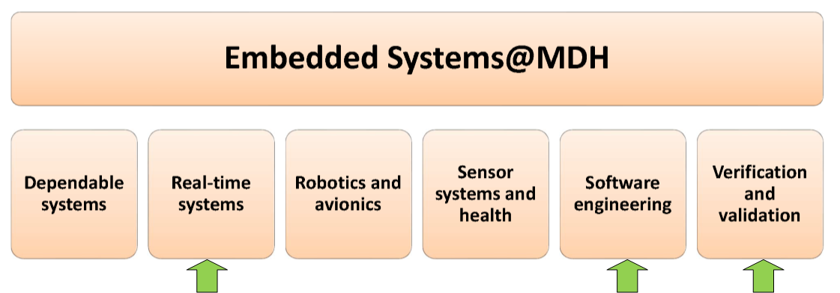
Organisation Profile
Mälardalen University (MDH)
  One hour from Stockholm
  14 000 students
  900 employees
  MDH has a long tradition and history of close cooperation with industry
    Preferred research partner of ABB and Volvo
  Embedded Systems research direction
    Largest, 6 prioritized areas
www.celticnext.eu INCYP5G, Cristina Seceleanu, Mälardalen University, cristina.seceleanu@mdh.se

Slide 4

Proposal Introduction (1)
INCYP 5G Vision
  Provide dependable cloud-based platforms for industrial cyber-physical systems by merging 5G’s service-based architecture, private and public cloud services and sensor-based devices
  Enable complex partner ecosystems with shared cloud, network and commercial systems
INCYP 5G Motivation
  Need to scale, manage, secure, analyze complex data generated by digital services and content of ICPS
  Manage large nr. of devices that are connected and communicate with each other
  Leverage service based architectures and dynamic network slices to meet specific application requirements for reliability, timeliness, security etc.
INCYP 5G content
  5 technical WPs: Use cases (WP2), Data, QoS and hazards (WP3), 5G-based Network Architecture and Platform Virtualization (WP4), Advanced 5G-enabled services (WP5), Integration, validation, demo (WP6)
  2 organizational WPs: Project management (WP1), Dissemination & exploitation (WP7)
www.celticnext.eu INCYP5G, Cristina Seceleanu, Mälardalen University, cristina.seceleanu@mdh.se

Slide 5
Proposal Introduction (2)
Expected outcome
  models, methods and tools that facilitate a substantial increase of dependability:
    consistency, security and interoperability of data, operation safety, and timing predictability of using shared virtual resources
  efficient decision-making algorithms for dynamic virtual machines placement and scheduling based on 5G network slicing
  new 5G-enabled cloud services for ICPS
    based on artificial intelligence/machine learning algorithms to deliver personalized services
    create and evolve services from intelligent device data
Impact
  Substantial boost of dependability of cloud-based ICPS platforms based on 5G
  Increased cross-industry collaboration and data sharing
  Reliable, secure 5G-enabled ICPS cloud-based platforms
Schedule
  Start: June 2020 End: May 2013
www.celticnext.eu INCYP5G, Cristina Seceleanu, Mälardalen University, cristina.seceleanu@mdh.se

Slide 6
Partners
Sweden
  Mälardalen University
  ABB
  Ericsson
  Volvo Group Truck Operations (Volvo GTO)
International Academic partners with expertise in
  Real-time systems
  Artificial intelligence/Machine learning
  Fog/Cloud Computing, Network traffic management
  Heterogeneous network architecture
  Verification and Validation : Formal methods and testing
Industrial partners – automotive, aviation, industrial automation, manufacturing etc.
www.celticnext.eu INCYP5G, Cristina Seceleanu, Mälardalen University, cristina.seceleanu@mdh.se

Slide 7
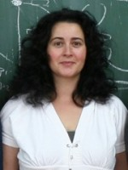

Contact Info
For more information and for interest to participate please contact:
Cristina Seceleanu,
Mälardalen University, Sweden
E-Mail: cristina.seceleanu@mdh.se
Telephone: + 46 70 2837717
Postal Address: Högskoleplan 1, Västerås, Sweden
Web: https://www.mdh.se/ (MDH) http://www.es.mdh.se/staff/173-Cristina_Seceleanu
                Presentation available via:
                www.tiny.cc/proposalidea

Slide 8

Join the follow-up Telco
11 Feb. 16.00 CET
Join Webex meeting
Meeting number (access code): 951 625 645
Meeting password: hZu5pmF8
Join by phone
+49-6925511-4400 Germany toll
Global call-in numbers
Can't join the meeting?
www.celticnext.eu office@celticnext.eu

