Slide 1


CELTIC-NEXT
Proposers Day
5th February 2019, London
Pitch of the Project Proposal
Intelligent Edge of Things (I-EoT)
Erkki Harjula, University of Oulu, ITEE/CWC
erkki.harjula@oulu.fi

Slide 2

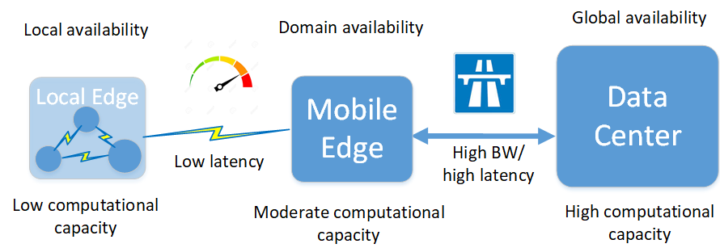
Teaser
Considering decentralized & virtualized three-tier Edge IoT architecture, in this proposal we focus on…
How AI / machine learning can be used in:
  Finding optimal placement of services and resources in the correct architectural tier?
  Optimizing the resource utilization & management in the edge infrastructure?
…to achieve:
  Improved cost- & resource-
  efficiency
  Higher QoE
  Higher level of security & privacy
Three-tier Edge IoT architecture
www.celticnext.eu Intelligent Edge of Things (I-EoT) - Erkki Harjula, University of Oulu, erkki.harjula@oulu.fi

Slide 3



Organization Profile
University of Oulu
One of the largest universities in Finland: ~16 000 students, ~3 000 staff
Focus research areas:
  Information Technology
  Biosciences and Health
  Cultural Identity and Interaction
  Environment, Natural Resources and Materials
Faculty of Information Technology and Electrical Engineering (ITEE)
~2 000 students, ~500 staff
Strengths & success factors:
  High-quality teaching and research
  Multi- and interdisciplinary collaboration
  Strong external funding
  Close collaboration with industry & research organizations
Available research infrastructures
World’s first 5G test network: 5GTN
Smart campus environment
MEC development environment
6Genesis research program
CWC
One of the leading research institutes globally in the area of wireless communications
Focus areas include e.g.: 5G, 6G, IoT, Edge, Security, …
Ubicomp
The largest cluster of ubiquitous computing & HCI researchers in Finland, and one of the largest in Europe
Focus areas include e.g.: IoT + Edge, machine learning, Big data, UX, …
www.celticnext.eu Intelligent Edge of Things (I-EoT) - Erkki Harjula, University of Oulu, erkki.harjula@oulu.fi

Slide 4

Introduction
Some of today’s most relevant technology trends:
  Artificial Intelligence (AI)
    The most active field of AI is Machine Learning (ML) with a new trend distributed ML methods
  Virtualization
    One of the most active fields is decentralized virtual microservice architectures
    Lightweight container technologies
  Edge computing
    Lot of buzz around Mobile Edge Computing (MEC)
    The newest trend is Local edge computing, e.g. IoT Edge
www.celticnext.eu Intelligent Edge of Things (I-EoT) - Erkki Harjula, University of Oulu, erkki.harjula@oulu.fi

Slide 5
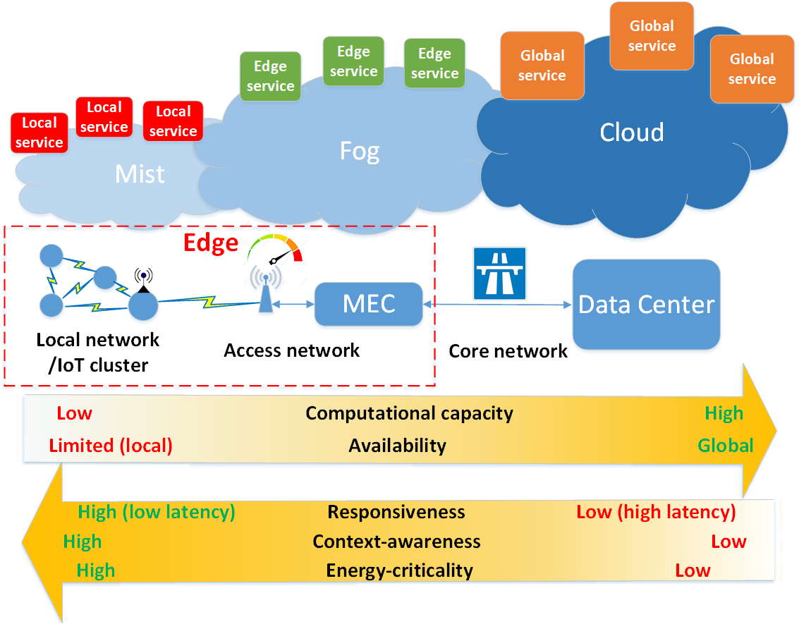
Our proposal: I-EoT (1)
AI
Where to deploy computing tasks?
Considering e.g.:
-latency,
-availability,
-needed comp. Capacity?
Where is data?
User mobility?
Computing task
This proposal: How can AI/ML be used in this context?
-Goal: to research & develop
methods to address the challenges,
-Bidirectional approach:
AI=>Edge, Edge=>AI
Security & privacy
How to limit propagation of sensitive data?
Considering e.g.:
-who needs what kind of data?
-can raw data be kept local,
while only analysis results
are sent to public cloud?
-is there enough local computing
capacity for local processing?
-which organization controls the infra
and can it be trusted?
Edge infrastructure
How to optimize capacity/resource placement?
Considering e.g.:
-performance
-resource-efficiency,
-user mobility,
-manageability&maintenance?
www.celticnext.eu Intelligent Edge of Things (I-EoT) - Erkki Harjula, University of Oulu, erkki.harjula@oulu.fi

Slide 6
Our proposal: I-EoT (2)
Benefits / Business potential of AI-assisted Edge computing
  Subscribers/users will benefit from:
    Faster low latency content delivery and increased privacy, interactivity and reliability
  3rd party developers will benefit from:
    Cost-effective deployment of applications and advanced data-analytic capabilities for resource utilization
  Network / system / edge platform Operators will benefit from:
    Optimized utilization and intelligent management and maintenance of their resources
Overall business value based on reductions in operational costs and improved QoE
www.celticnext.eu Intelligent Edge of Things (I-EoT) - Erkki Harjula, University of Oulu, erkki.harjula@oulu.fi

Slide 7
Potential partners:
We are looking for project collaboration within the scope of the proposal
  For initiating a new project proposal (or alternatively joining in a related existing proposal)
The potential partners include:
    Cloud infrastructure providers
    Big data / data analytics providers
    Edge/ Fog infrastructure providers
    Telecom infrastructure providers and operators
    IoT device manufacturers
    Potential customer organizations on application areas such as industry/office/home automation/surveillance, e-health, smart traffic, logistics, city infrastructure, etc.
    Cybersecurity specialists
    Research partners focusing on e.g. Edge, AI/ML, Security, Distributed systems
www.celticnext.eu Intelligent Edge of Things (I-EoT) - Erkki Harjula, University of Oulu, erkki.harjula@oulu.fi

Slide 8
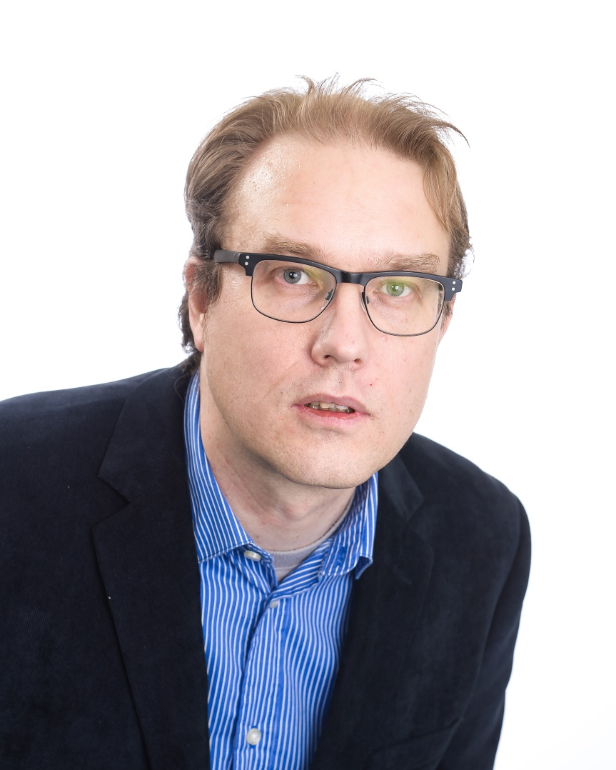
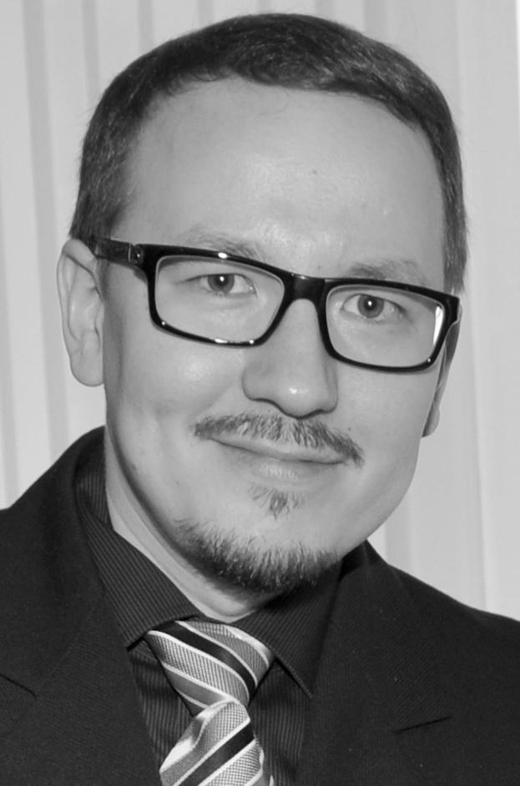
Contact Info
For more information and for interest to participate please contact:
Dr. Erkki Harjula Dr. Teemu Leppänen
Project manager, postdoc Postdoc researcher
University of Oulu / CWC University of Oulu / Ubicomp
erkki.harjula@oulu.fi teemu.leppanen@oulu.fi
+358 50 4643758
P.O.Box 8000
FI-90014 University of Oulu,
Finland

Slide 9

Join the follow-up Telco
13 Feb. 9.00 CET
Join Webex meeting
Meeting number (access code): 959 805 64
Meeting password: KtmB3pMf
Join by phone
+49-6925511-4400 Germany toll
Global call-in numbers
Can't join the meeting?
www.celticnext.eu office@celticnext.eu

