Slide 1


CELTIC-NEXT
Proposers Day
5th February 2019, London
Economic Smart agritech hubs
for farming
Betty Bonnardel, CEO
betty@ab5consulting.com

Slide 2


AB5 Consulting
What we do
Innovative solutions
in an enabled environment
Communications, satellite, clean energy, defence, transport, tech
Regulations, ITU, CEPT, ECC
ESA Study on tram/train 5G
Integration of technologies
Winner of multiple awards
Member of UK Space
What we can offer
Business studies, system engineering,
standards and regulations, programme
and project management, strategy, marketing
and communication solutions
Feedback on innovation ideas/problem solving
Partnership in projects
www.celticnext.eu Smart Agritech Hubs Betty Bonnardel AB5 Consulting betty@ab5consulting.com

Slide 3
Smart Agritech Hub
Main Benefits Optimisation of agricultural practices via the IoT, to enhance production and reduce the impact of agriculture on nature | Added Value Cost effectiveness Local involvement Resilience of agricultural system Crop production improved Wise use of water & pesticides Counter the effects of climate change Sustainable agriculture | Why participating Innovative application of IoT in rural areas, strengthened by satellite and 5G technology Cooperation only can make the deployment of a similar service possible Once tested, it could be sold to various countries/communities
www.celticnext.eu Smart Agritech Hubs Betty Bonnardel AB5 Consulting betty@ab5consulting.com

Slide 4






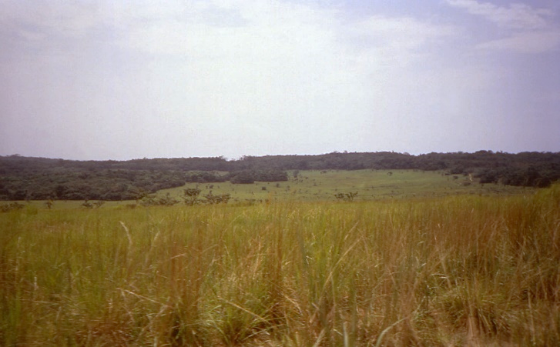



Smart Agritech Hub
Cloud & Artificial Intelligence tools
Satellite or other technology technology
will allow the hub
to be connected
Info will be transmitted
directly to the farmers
via the Internet
Smart sensors can be placed in the fields
to gather information
www.celticnext.eu Smart Agritech Hubs Betty Bonnardel AB5 Consulting betty@ab5consulting.com

Slide 5
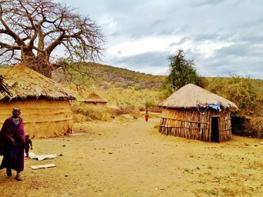
Smart Agritech Hub
Expected Outcome & Impacts
Implementation of local involvement
Enhanced resilience of the agricultural system
Optimisation of crop production
Wisely use of water
Limitation and appropriate use of pesticides
Facing the effect of the climate change
Support to sustainable agriculture
www.celticnext.eu Smart Agritech Hubs Betty Bonnardel AB5 Consulting betty@ab5consulting.com

Slide 6


Partners
We are already working with
We are looking for
Universities
Satellite operators
Local & sector partners
Investors
Partners (IoT specialists, agritech specialists, representative users, AI specialists)
www.celticnext.eu Smart Agritech Hubs Betty Bonnardel AB5 Consulting betty@ab5consulting.com

Slide 7
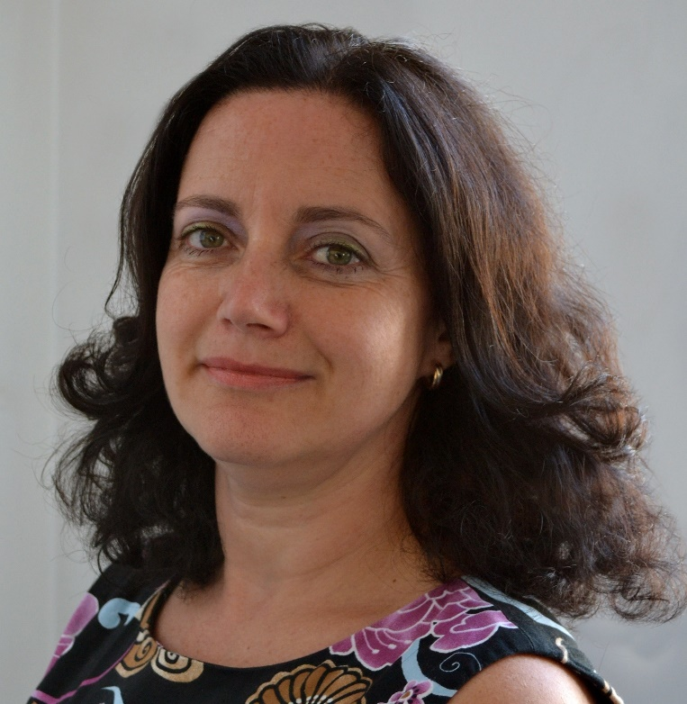
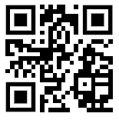
Contact Info
For more information and for interest to participate please contact:
Betty Bonnardel
betty@ab5consulting.com
+44 (0)208 9972987
27 Queens Walk, London W51TP
www.ab5consulting.com
                Presentation available via:
                www.tiny.cc/proposaltidea

Slide 8

Join the follow-up Telco
11 Feb. 13.00 CET
Join Webex meeting
Meeting number (access code): 952 013 832
Meeting password: 9GFwdKMP
Join by phone
+49-6925511-4400 Germany toll
Global call-in numbers
Can't join the meeting?
www.celticnext.eu office@celticnext.eu

