Slide 1







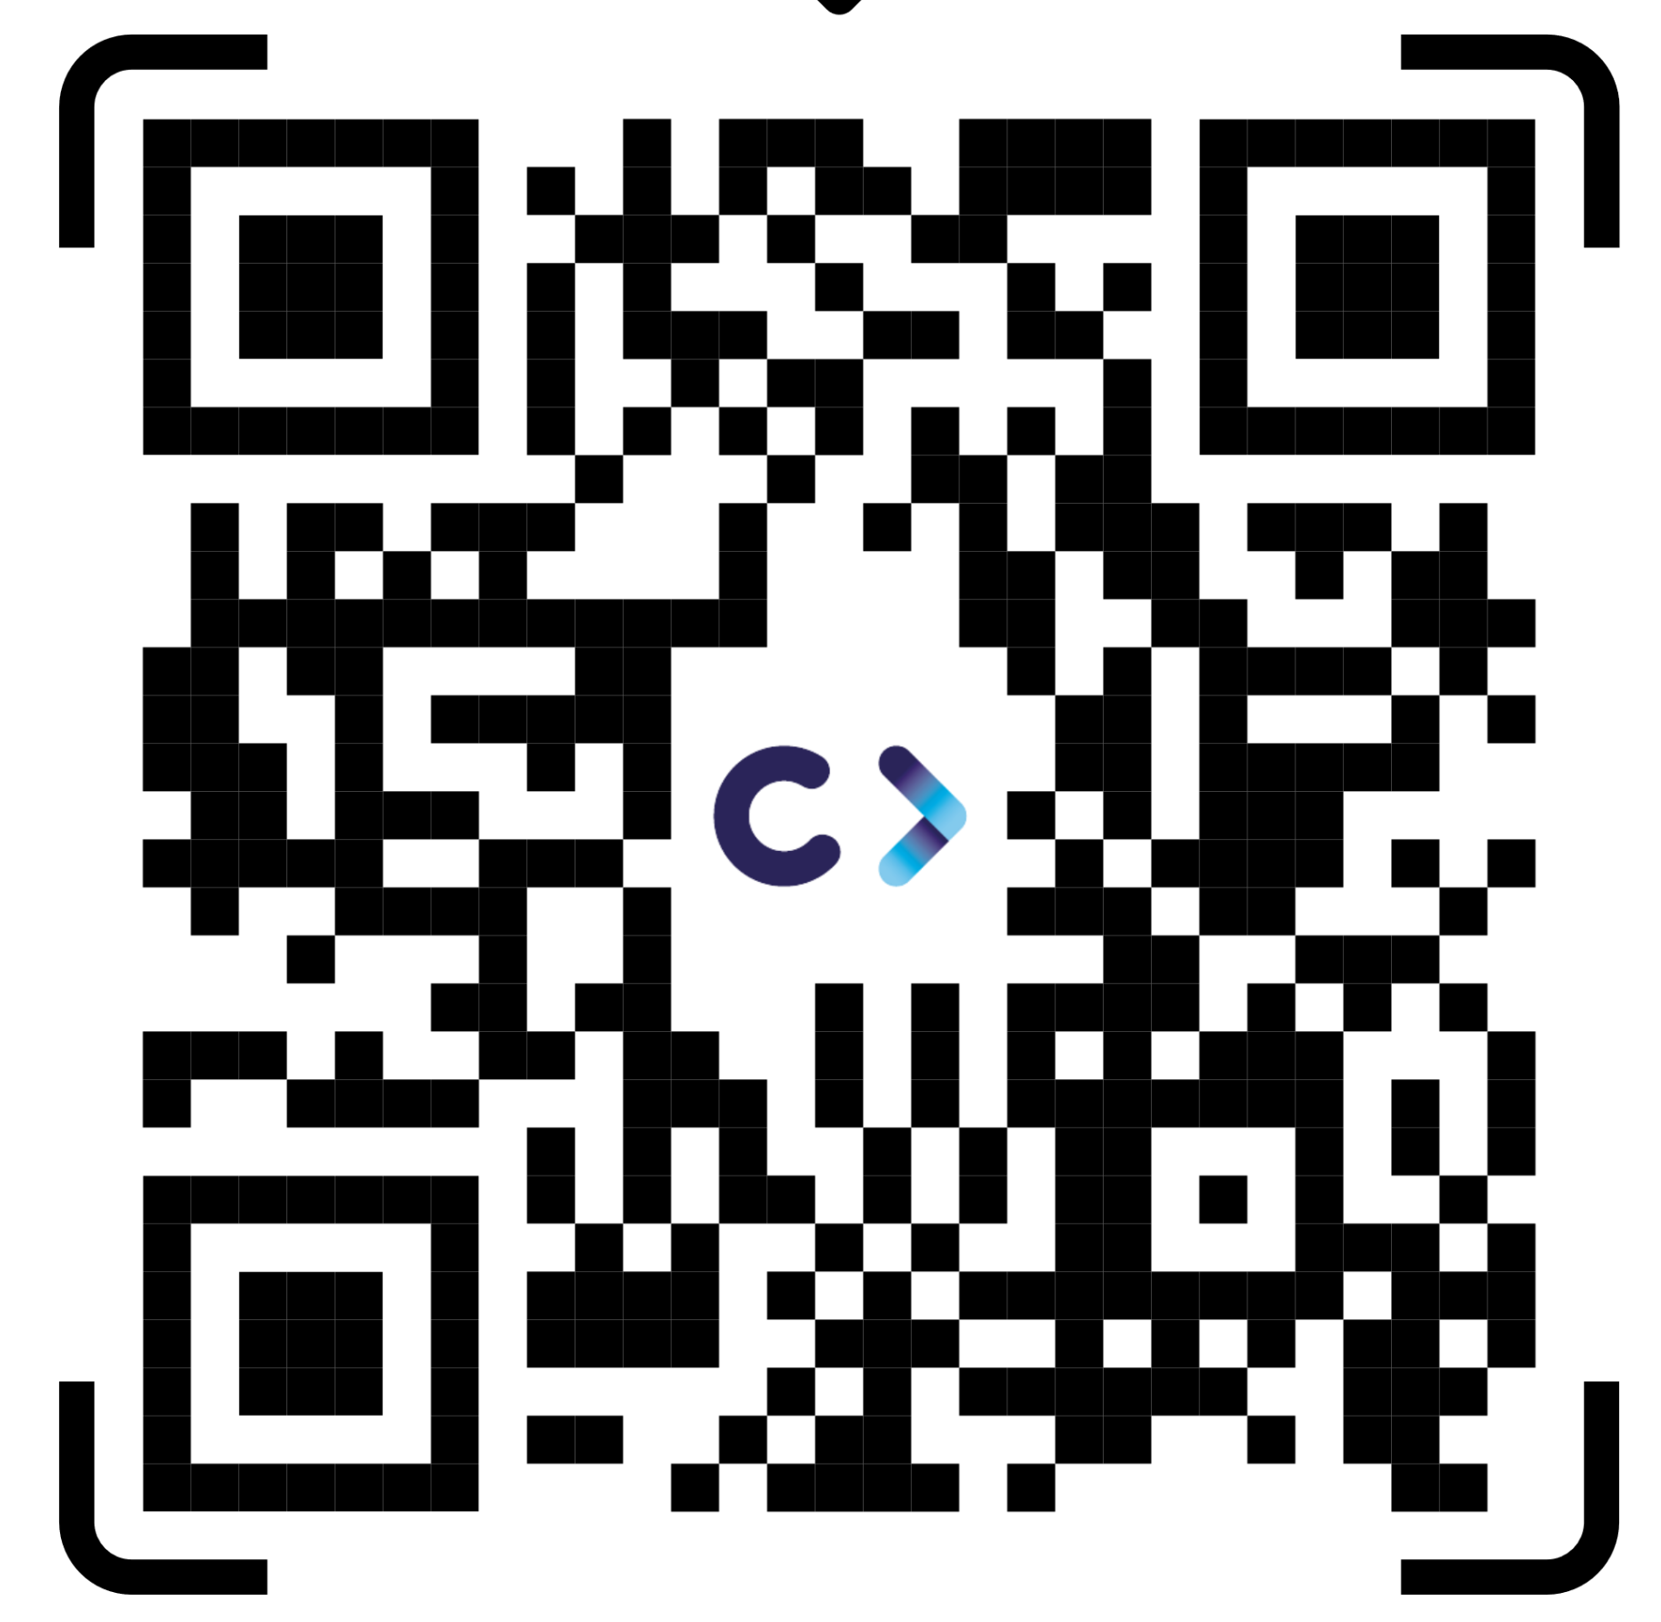
SUSTAINET Public Event
Berlin 6G Conference
8th September 2026
Anastasius Gavras,
Director Eurescom
www.celticnext.eu

Slide 2
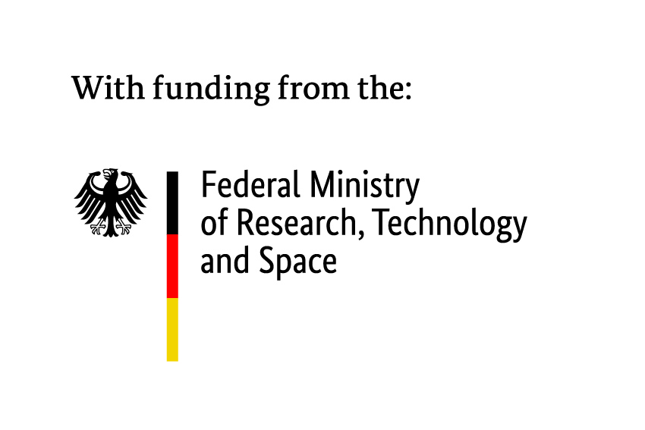
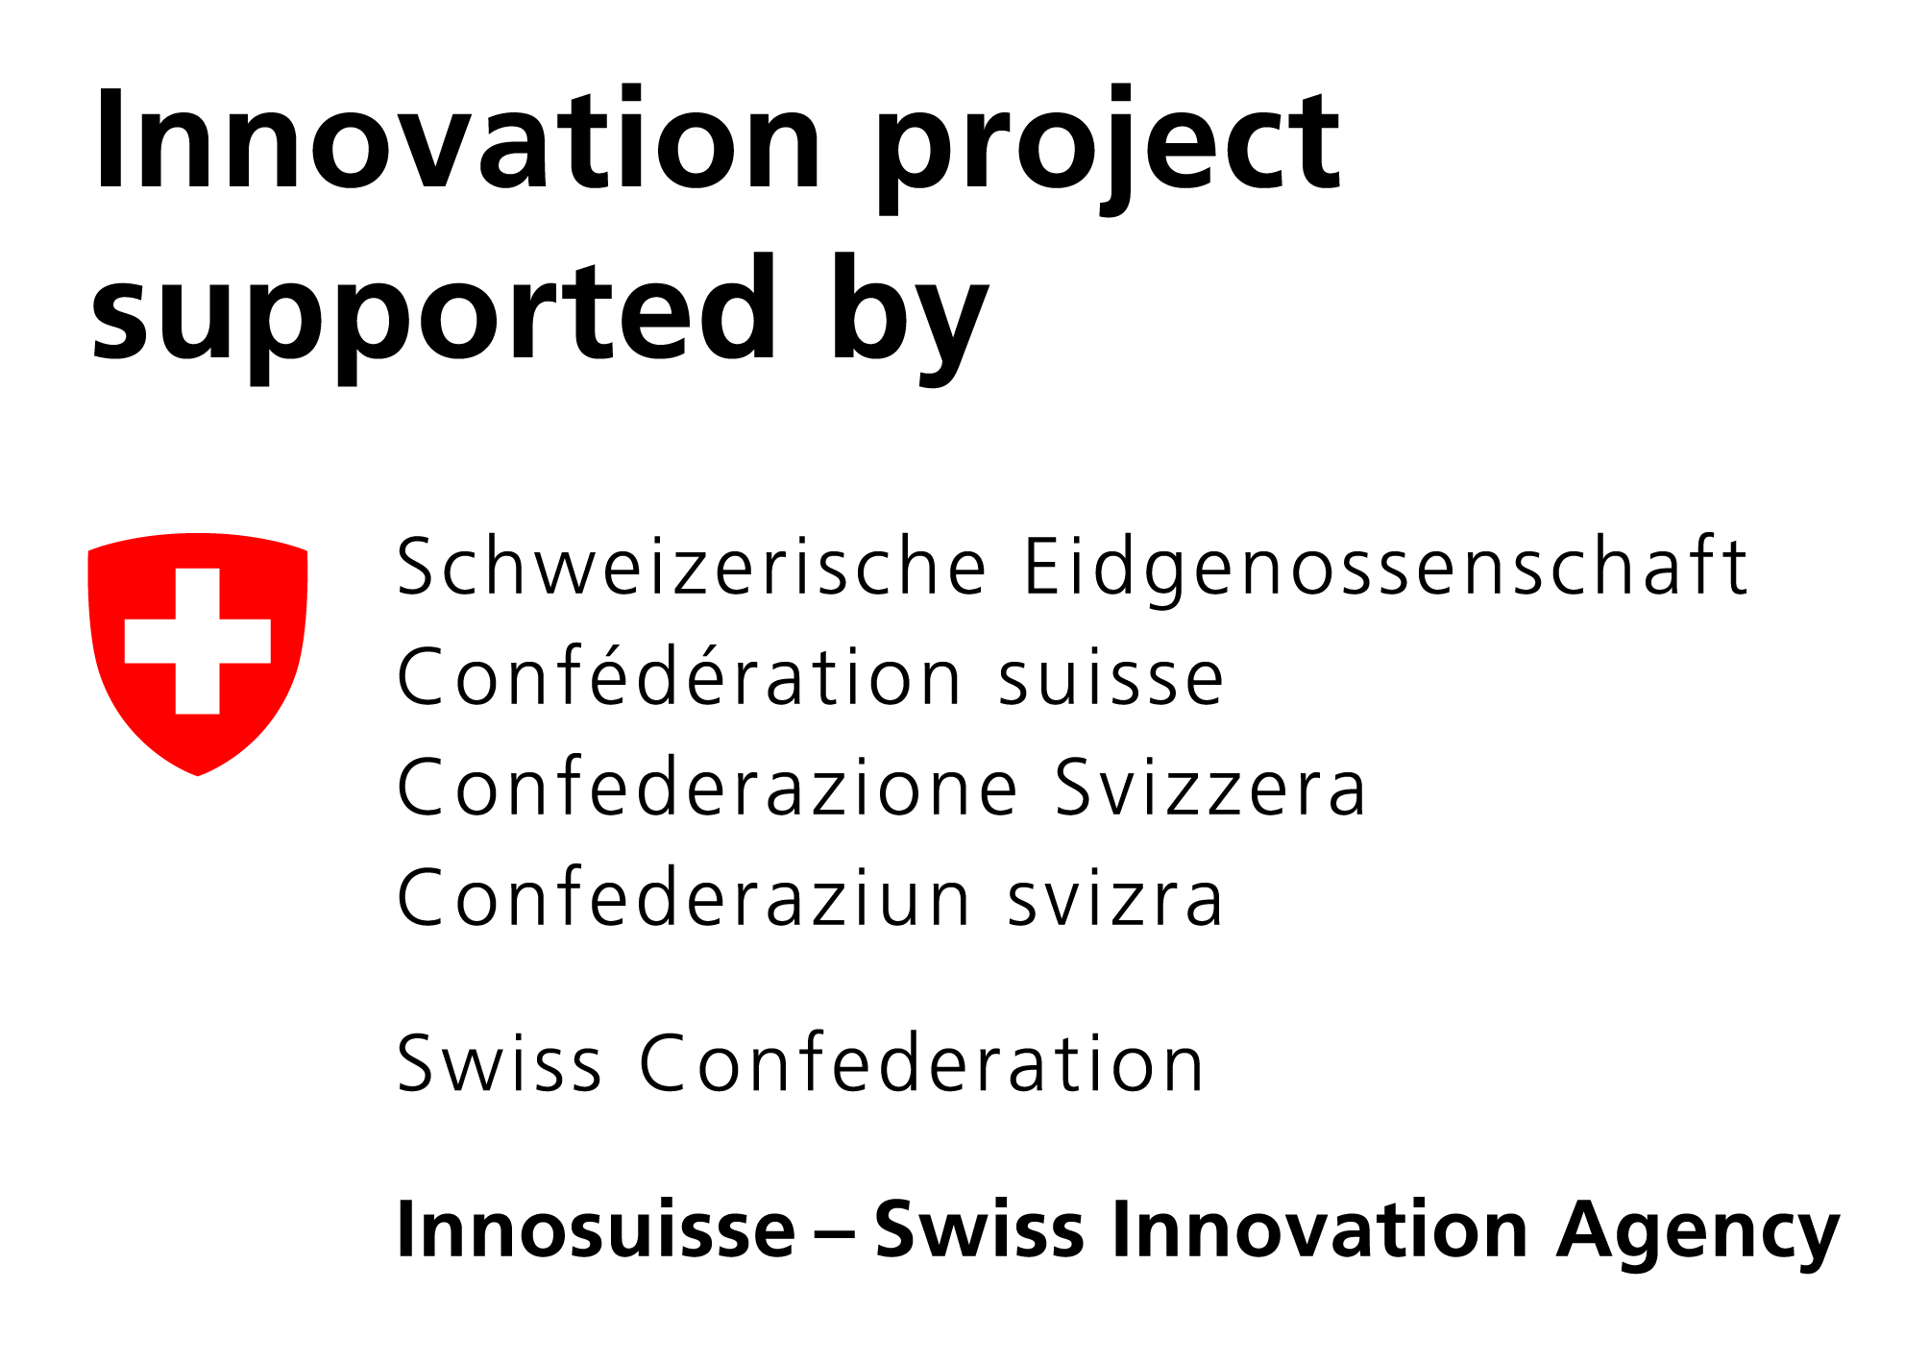







Agenda
Time slot | Slot | Presenter(s)
16:00-16:05 | Opening by Eurescom | Anastasius Gavras, Director Eurescom
16:05 – 16:15 | Opening by BMFTR | Dr. Mikael Gast, Federal Ministry of Research, Technology and Space (BMFTR)
20 min. | National Funding authorities: | Lars Gustafsson, Sweden’s Innovation Agency Vinnova, Sweden Vance Pan, Canadian Program Lead, Eureka CELTIC-NEXT, National Research Council, Canada
10 min | CELTIC-NEXT representative | Christiane Reinsch,CELTIC-NEXT Programme Coordinator
Presentation of SUSTAINET Umbrella project and Sub-projects
10 min | SUSTAINET Umbrella overview | Achim Autenrieth, Senior Director Advanced Technology, Adtran
12 min | SUSTAINET-Advance | Christoph Glingener, CTO, Adtran
12 min | SUSTAINET-Innovate | René Bonk, Lead Technology Strategist, CTO Office, Nokia, (Status: confirmed)
12 min | SUSTAINET-Guardian | Petr Ledl, Head of T-Labs (Deutsche Telekom) (Status: confirmed)
­­­­­­­17:25 – 18:00 35 minutes | Panel on Agentic AI impact on society and sustainability | Moderated by Anastasius Gavras, Director Eurescom with Panelists
Notes:
Eureka is the world’s biggest public network for international cooperation in R&D and innovation present in over 45 countries.
We fund R&D projects that result in innovative products, processes or services.
Since 1985, by mobilising some 48.4 BILLION euro of public-private investment, we have supported the R&D of over 7,000 groundbreaking projects that have positively impacted economic growth and changed people’s lives for the better.

Slide 3
Dr Mikael Gast,
Federal Ministry of Research,
Technology and Space (BMFTR)
www.celticnext.eu

