Slide 1






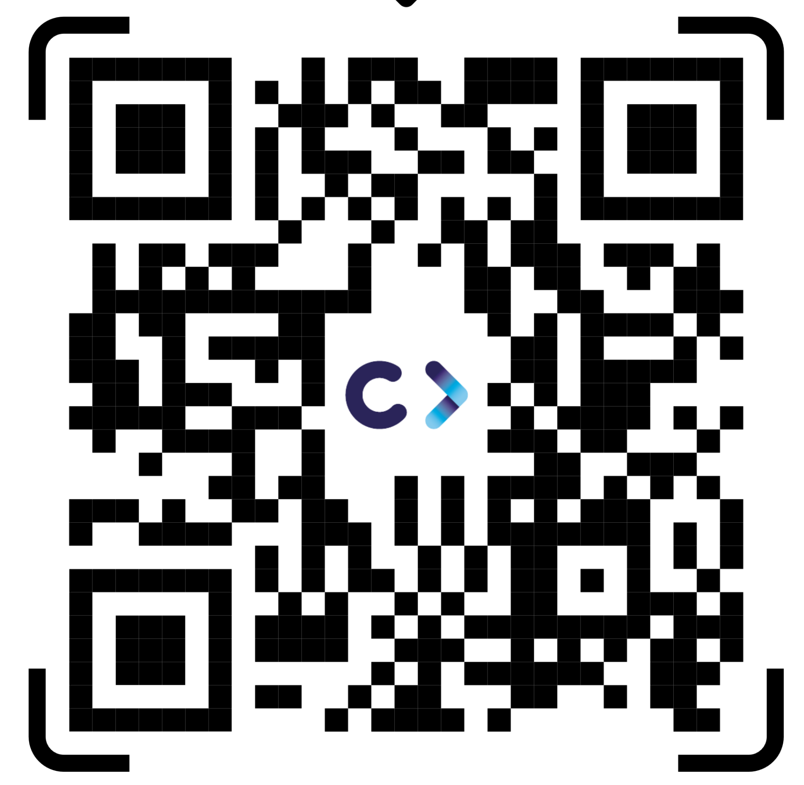
SUSTAINET Public Event
Berlin 6G Conference
8th September 2026
Christiane Reinsch,
CELTIC-NEXT Programme Coordinator
www.celticnext.eu

Slide 2






Introduction to the EUREKA ICT cluster for a secure digital society
The ICT Σureka cluster
for next-generation communications
with over 23 years of successful innovative projects!
5G & 6G
Christiane Reinsch, CELTIC-NEXT Programme Coordinator
reinsch@celticnext.eu

Slide 3


Who is CELTIC-NEXT?
CELTIC-NEXT is an industry-driven not for profit cluster involving all the major ICT industry players, service providers, many SMEs, and research institutions & academia to enable a secured, trusted, and sustainable digital society.
Eureka Clusters Program: renewal of clusters licences for another 7 years for CELTIC-NEXT in 2025

Slide 4

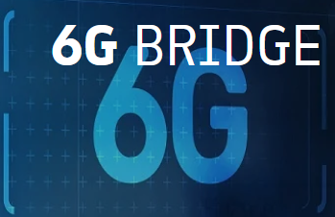






CELTIC-NEXT in the
European Funding Landscape
European Community Programmes
EUREKA
Cluster Programme
National
Innovation
Programmes
following
European Strategy
Develop & Maintain
Critical Mass & Differentiation
Trans-National Programmes
following
National Priorities

Slide 5
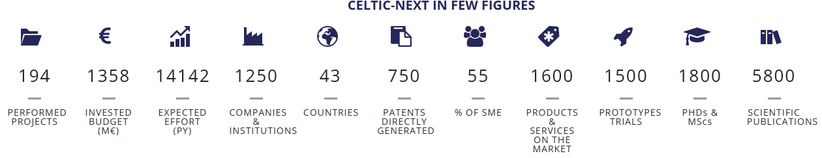
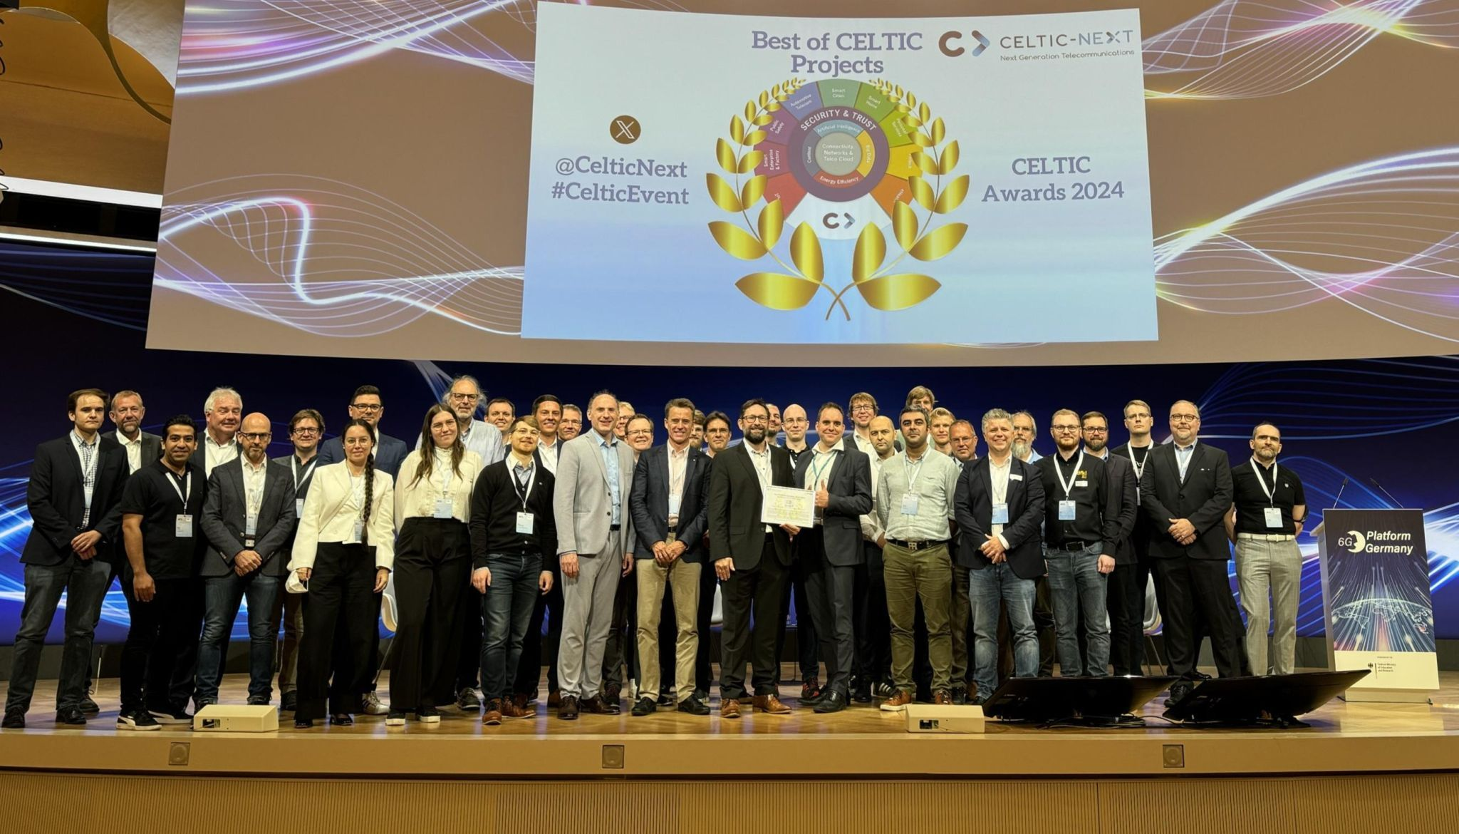
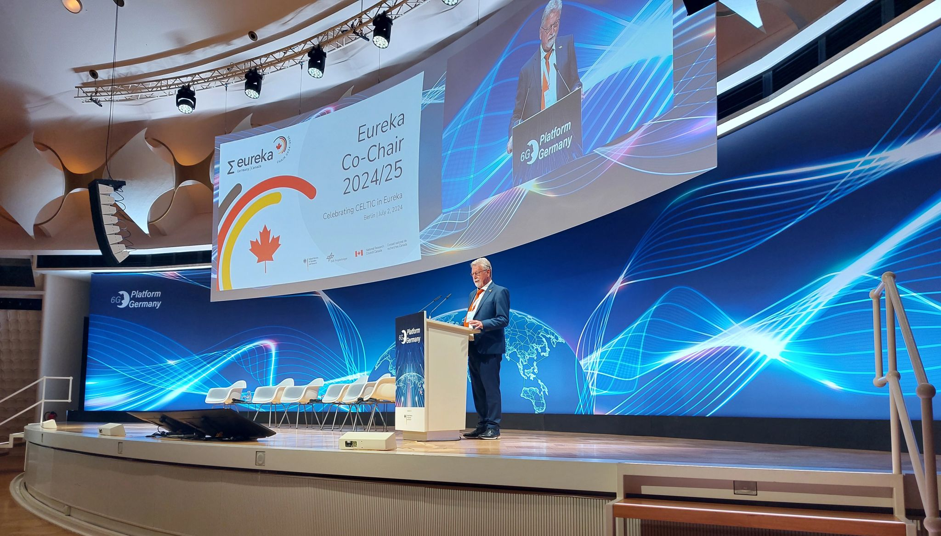
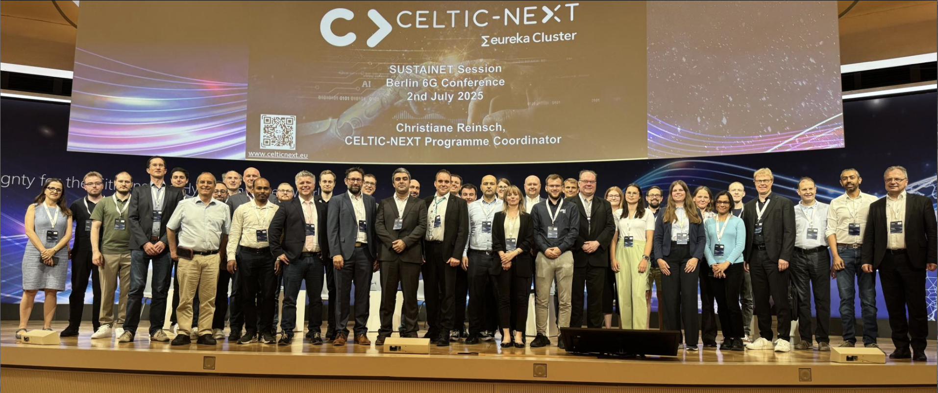
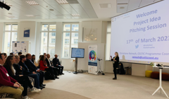
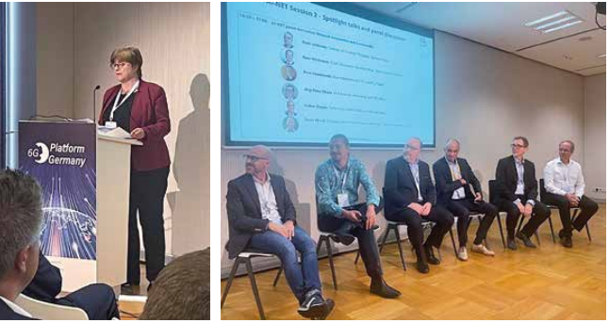
Achievements since 2003
Key Numbers (2025):
Key events:
Berlin, 2/07/2024:
CELTIC-NEXT Awards Ceremony at the
Berlin 6G Conference
Berlin, 2/07/2024:
CELTIC-NEXT 21st Anniversary Celebration the Berlin 6G Conference 2024
Berlin,2/07/2025:
SUSTAINET Kick-Off Event
Berlin 6G Conference
Vienna, 30/01/2026:
CELTIC-NEXT Proposers’ Brokerage Day at FFG, Austriaatapult

Slide 6

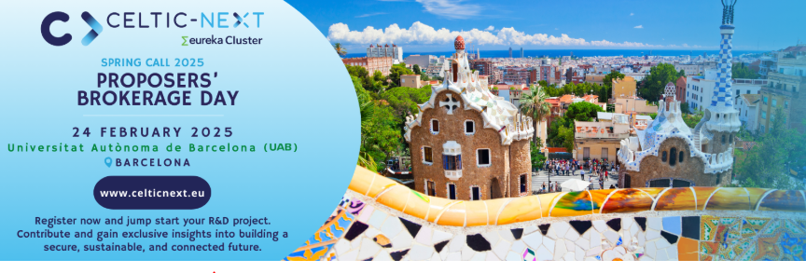



What CELTIC-NEXT does ...
CELTIC-NEXT manages an international Quality Label that enables international consortia to apply more successfully to National Funding schemes and assemble them to fund international cooperative innovation.
CELTIC Bottom-up calls
CELTIC Flagship projects & open calls
EUREKA ECP Joint Calls

Slide 7

















Strategic Roadmap & Key research Areas
CELTIC-NEXT INDUSTRIAL CORE GROUP
CELTIC PROJECTS
RESEARCH AREAS
Clean
growth
AI RAN
Smart Health
Metaverses
ICT
Digitalisation
EDGE
EUROPEAN PROGRAMMES
&
NATIONAL PRIORITIES
Critical Comms
6G
Smart
Agriculture
Digital Education
Smart cities
Consumer IoT
5G
Industry 5.0
Rescue Services
Private
Networks
Terrestrial Networks
Convergence
Cybersecurity
AI
Logistics
Digital
Sustainability
Critical Resilient Infrastructures

Slide 8


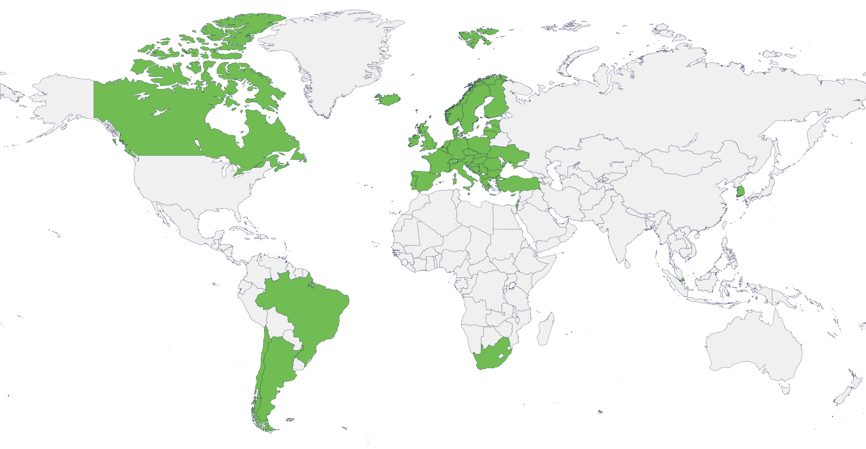






Opportunities to collaborate globally
Europe (large)
UK
Canada
Chile
South-Korea
South-Africa
Singapore
Brazil
and potentially more countries in the future...
https://www.celticnext.eu/national-public-contacts-funding-schemes/

Slide 9


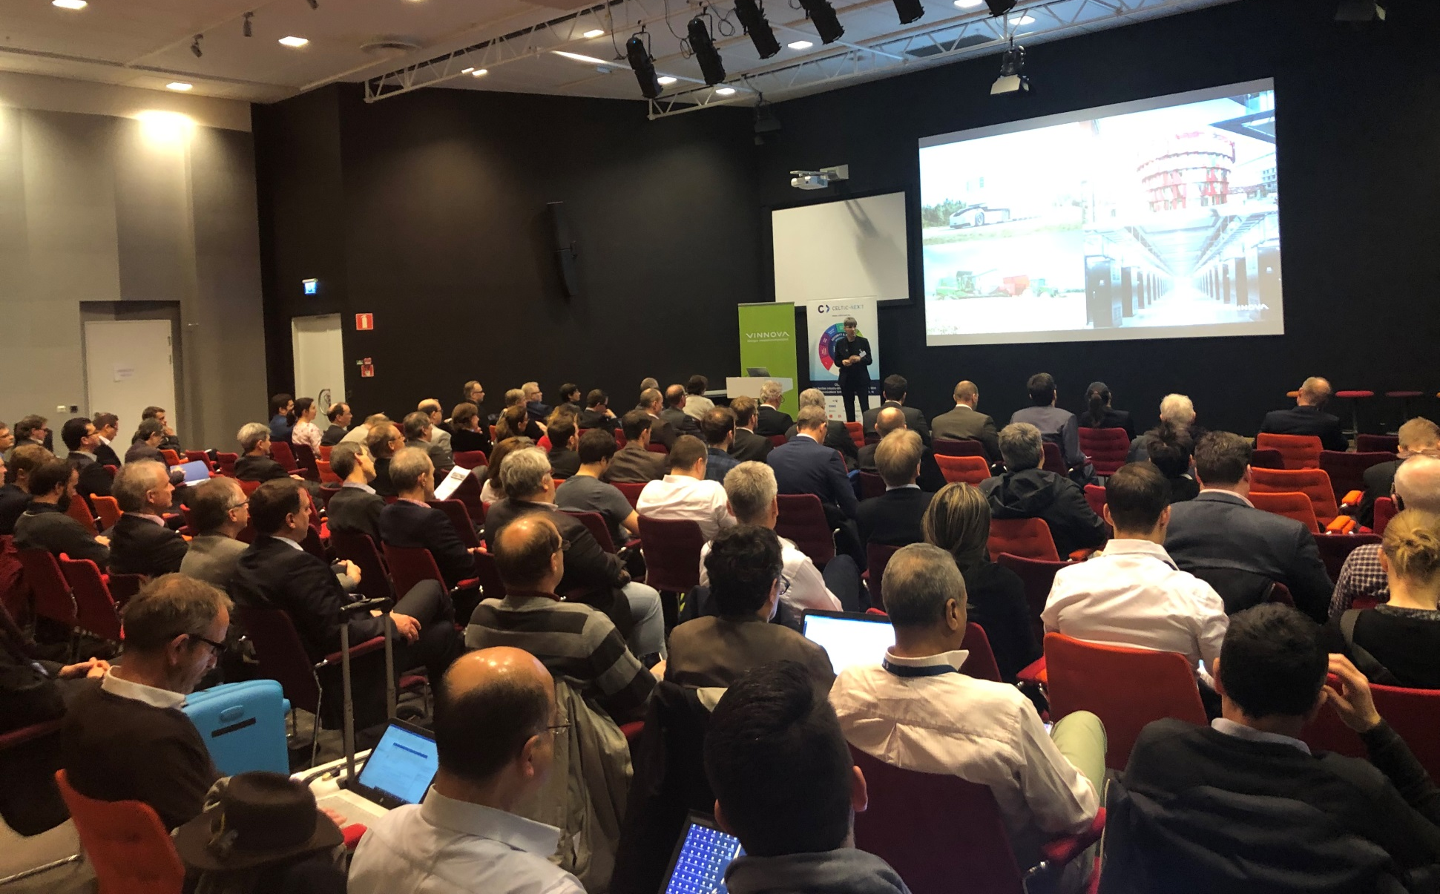
CELTIC Flagship impacting the Business
112
Partners
66 M€
80
Partners
70M€
SENDATE
Secure Networking for a Data Center cloud in Europe
The world’s first 100G quantum safe transport over 2,800 km
The world’s first 400G link with single-photodiode for DC Interconnect
Edge Computing shifts high traffic loads away from Core DC
Secure cloud close to the customer allows low latency applications
AI-NET
Accelerating digital transformation in Europe by Intelligent NETwork automation
72 IPRs, 84 PhD and Master Thesis, 43 hirings, 77 proof of concepts
Highly competitive solutions in the area of energy efficient edge data centers reached with 1-1.2 PUE
SENDATE Closing Event in Ericsson’s HQ in Kista, March 2019
AI-NETClosing Event at 6G Platform Event in Berlin 2/7/2

Slide 10
CELTIC Flagship impacting the Business
SUSTAINET
Sustainable Technologies for Advanced Resilient and Energy-Efficient Networks
A novel path towards a digitally sovereign and climate-neutral future with focus on network resiliency and energy efficiency.
Sustainable 6G ecosystem enabling technologies on resilient compute platforms powering advanced and trustworthy AI.
Optimized power distribution in synergy with the network management
software layer solutions can be used as first entry point for the Telecom customer to access a Telco cloud
103
Partners
68,1 M€
SUSTAINET Kick-Off Event at 6G Platform Event in Berlin 2/7/25

Slide 11
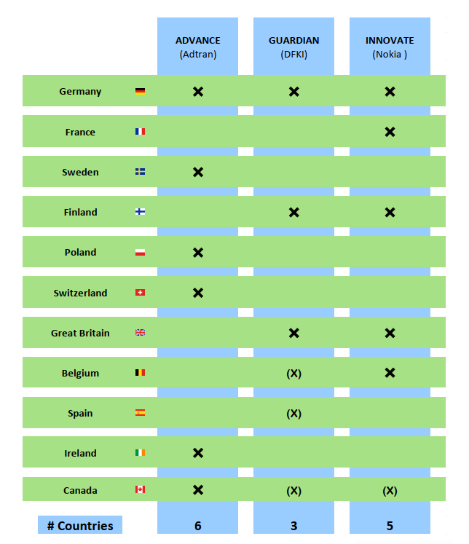

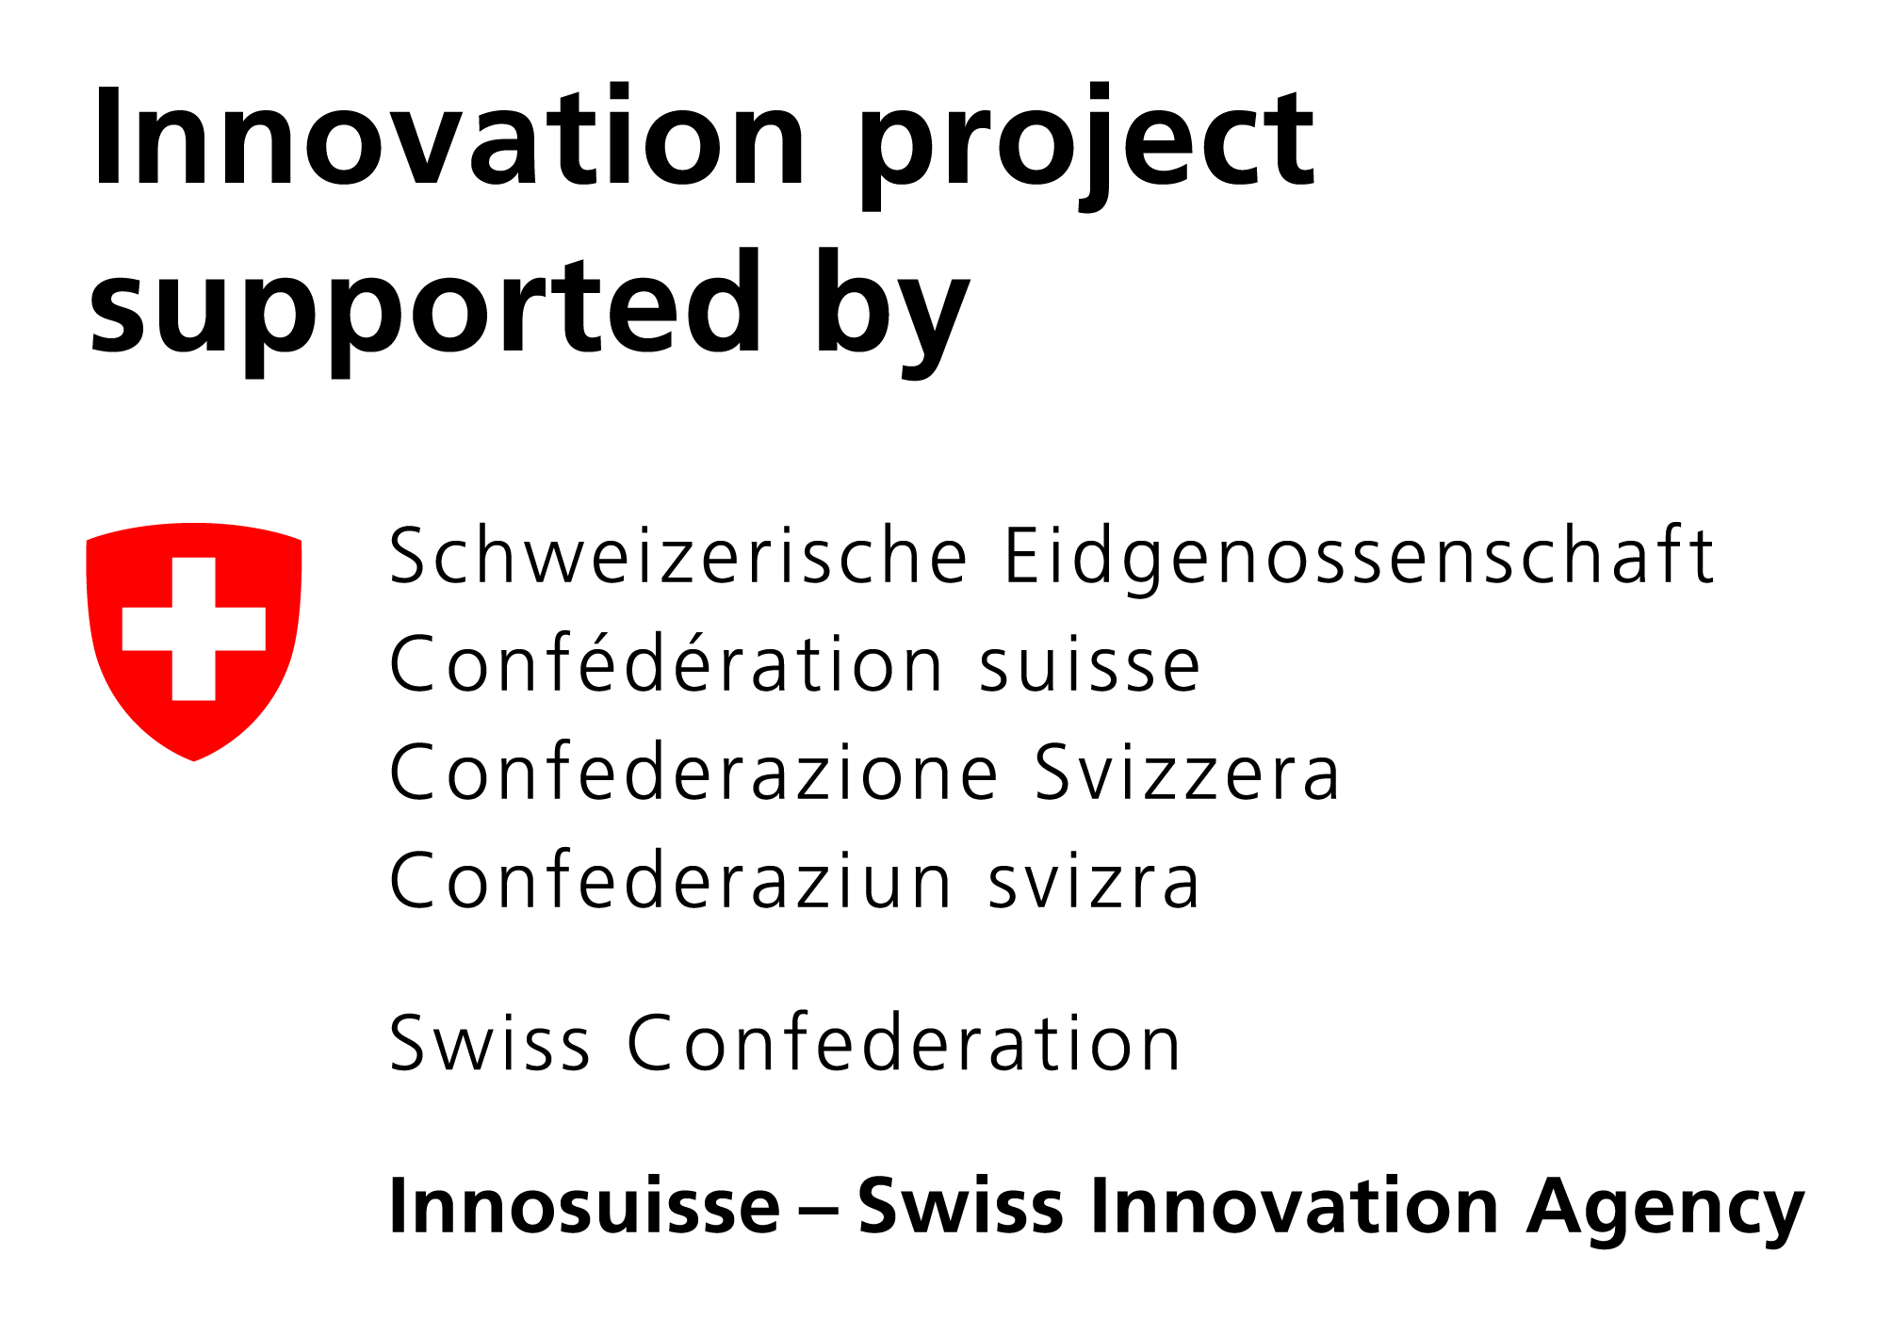








S
Notes:
Eureka is the world’s biggest public network for international cooperation in R&D and innovation present in over 45 countries.
We fund R&D projects that result in innovative products, processes or services.
Since 1985, by mobilising some 48.4 BILLION euro of public-private investment, we have supported the R&D of over 7,000 groundbreaking projects that have positively impacted economic growth and changed people’s lives for the better.

Slide 12
Agenda
Time slot | Slot | Presenter(s)
16:00-16:05 | Opening by Eurescom | Anastasius Gavras, Director Eurescom
16:05 – 16:15 | Opening by BMFTR | Dr. Mikael Gast, Federal Ministry of Research, Technology and Space (BMFTR)
20 min. | National Funding authorities: | Lars Gustafsson, Sweden’s Innovation Agency Vinnova, Sweden Vance Pan, Canadian Program Lead, Eureka CELTIC-NEXT, National Research Council, Canada
10 min | CELTIC-NEXT representative | Christiane Reinsch,CELTIC-NEXT Programme Coordinator
Presentation of SUSTAINET Umbrella project and Sub-projects
10 min | SUSTAINET Umbrella overview | Achim Autenrieth, Senior Director Advanced Technology, Adtran
12 min | SUSTAINET-Advance | Christoph Glingener, CTO, Adtran
12 min | SUSTAINET-Innovate | René Bonk, Lead Technology Strategist, CTO Office, Nokia, (Status: confirmed)
12 min | SUSTAINET-Guardian | Petr Ledl, Head of T-Labs (Deutsche Telekom) (Status: confirmed)
­­­­­­­17:25 – 18:00 35 minutes | Panel on Agentic AI impact on society and sustainability | Moderated by Anastasius Gavras, Director Eurescom with Panelists
Notes:
Eureka is the world’s biggest public network for international cooperation in R&D and innovation present in over 45 countries.
We fund R&D projects that result in innovative products, processes or services.
Since 1985, by mobilising some 48.4 BILLION euro of public-private investment, we have supported the R&D of over 7,000 groundbreaking projects that have positively impacted economic growth and changed people’s lives for the better.

Slide 13
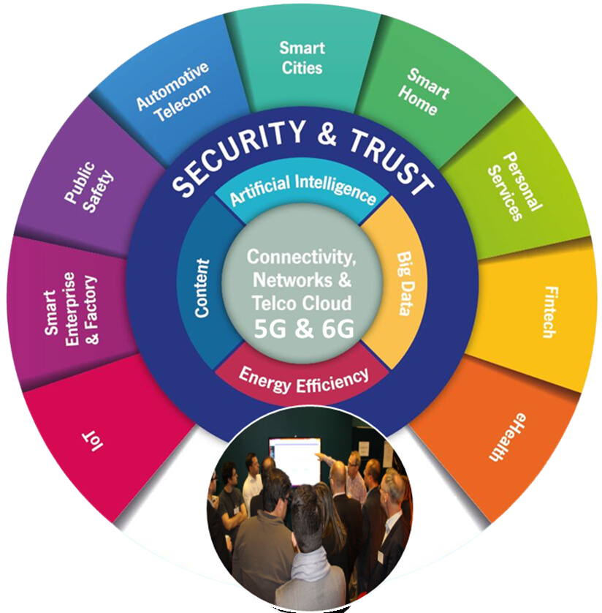


Thank you!
Christiane Reinsch
CELTIC-NEXT – Programme Coordinator
Mobile: +49 171 2861781
Email: reinsch@celticnext.eu
Web: https://www.celticnext.eu
CelticNextEurekaCluster
CELTIC-NEXT Video Channel
www.celticnext.eu

