Slide 1

Vinnova
We are Sweden’s innovation agency
Lars Gustafsson, Program Manager, Vinnova.
Berlin 6G Conference, 8 September 2026

Slide 2

Innovation is needed throughout society
as we face complex challenges
Notes:
To develop our societies within the planet’s boundaries, we must promote innovation in a broad sense.
It is not enough to innovate to create new products and services; we need innovation in our ways of working, innovation that changes our behaviors and habits, and innovation in how we collaborate better in complex ecosystems with people from business, research, politics, the public sector, civil society, and the general public.
We need innovation throughout society to successfully transform entire systems and transition towards a sustainable future. In short, we need to create the conditions for what we call system innovation – which not only solves our challenges but also creates a society that is better to live in for everyone. This gives Sweden competitiveness and makes a difference for the world.

Slide 3
We bring people together
From companies, academia, research, the public sector and civil society
Notes:
We bring together companies, researchers, the public sector, civil society, and the general public in a common direction to jointly create the development society needs. No single sector or organization can find solutions to the complex challenges we face alone; everyone must contribute and work in the same direction.
Examples: mission processes, government partnership programs, strategic innovation programs, challenge-driven innovation, and many, many collaborative projects.

Slide 4

Indentify, mobilise and fund
Our role is to
Notes:
What role does Vinnova play as an innovation agency?
An important one to facilitate innovation in a time when it is needed the most.
A responsibility to reinforce Sweden’s innovative capacity.
Innovation is needed throughout our society to meet the challenges we face and to increase Sweden’s competitiveness.
We note that we need to take on a broader role, not only as a provider of funding but as an agent of change sharing our expertise.
This can be a matter of identifying, mobilising and funding projects to reinforce Sweden’s innovative capacity.
Identify:
Identify is about finding areas where we need to strengthen the ability to innovate (to, for example, achieve the Agenda 2030 goals or strengthen Sweden's competitiveness).
We work continuously to analyze research reports, gather actors on various issues and identify needs where efforts are required.
Identifying can also be about:
find areas within the innovation system that need to be strengthened, through, for example, an incubator development program.
find societal challenges where market actors do not do the work themselves but need help to stimulate change
Identify the need for a strong niche in Sweden to remain competitive - where initiatives and funding from Vinnova can act as a catalyst.
Mobilize:
Based on the needs and opportunities that we identify, develop and initiate appropriate efforts to mobilize and strengthen the ability to innovate.
It can be about opening up for - or sometimes even forcing - collaborations nationally and internationally to enable change at the system level.
Initiating collaboration between (new) actors within a system becomes increasingly important when no actor can solve the challenge himself.
We annually arrange a number of meetings and events that create conditions for mobilizing different actors.
Here we become the lubricant for the machinery to start spinning.
We also initiate calls in areas where we want to promote innovation.
Fund:
Change to the next slide.

Slide 5
Sweden’s National 6G Initiative
Strengthening global leadership in wireless systems and connectivity
Lars Gustafsson, Programme Manager, Vinnova
Notes:
Good afternoon everyone, my name is Lars Gustafsson, Sweden´s representative in EU´s 6G-program Smart Networks and Services. I am at Sweden’s Innovation Agency Vinnova. Today, I’ll give you a concise overview of Sweden’s national 6G initiative — a government-backed effort to strengthen global leadership in wireless systems and connectivity.
6G and future wireless technologies are expected to transform industries, enable new applications like immersive communication and AI-driven networks, and address sustainability challenges. This is crucial for all of us.

Slide 6

Why & What
Government assignment: SEK 390M (EUR 36 M) (2024–2026)
Goals:
  Strengthen Sweden’s position in wireless innovation.
  Boost industrial competitiveness.
  Enable international collaboration.
Notes:
In March 2024, Vinnova and the Swedish Research Council received separate assignments from the government to strengthen Sweden’s global leadership in wireless systems and connectivity research. SEK 250 million (EUR 23 M) is allocated for Vinnova for this programme from 2024 to 2026. SEK 140 million (EUR 13 M) is allocated to the Swedish Research Council.
As you see here, Vinnova’s goals are clear: innovation, competitiveness, and collaboration.
Why is this important? Sweden has a strong tradition in wireless innovation, from early mobile systems to 5G leadership. Now, development is accelerating, and competition from countries like the USA, China, and South Korea is growing. With AI, this will move even faster. Applications include healthcare, smart factories, robotics, XR, and areas we do not yet know. It also impacts society’s resilience and security. This initiative ensures Sweden stays ahead globally.

Slide 7
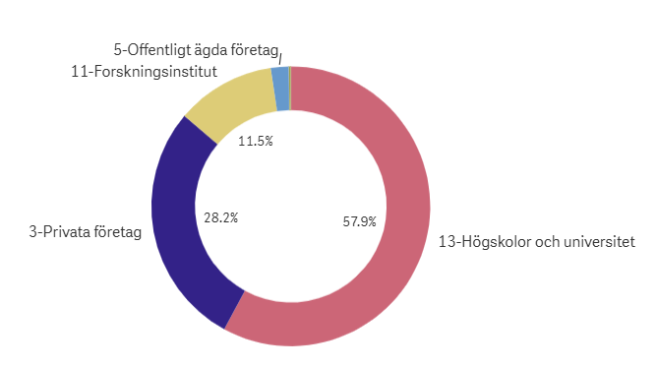
Vinnova’s Part in the 6G Government Assignment
79 funded projects (national + international).
Research and Innovation Collaboration
International Collaboration
Skills and Competence
Development Synergies Between Technology Areas
Publicly owned companies
Research insitutes
Universities
Private companies
Notes:
Currently, 79 projects are funded.
We have divided the funding of projects into different categories.
The largest share of actors are universities, followed by companies and research institutes.

Slide 8
Research and Innovation – Total funding: SEK 129 million (EUR 12 M)
National
15 projects in total
2024: 8 projects
2025: 7 projects
International
19 projects in total
2024: 9 projects
2025: 10 projects
Collaboration with:
USA, United Kingdom, Germany, Singapore, South Korea, Belgium, Netherlands, Denmark, Finland, Spain, Portugal, Poland, Italy, and India.
Actors
Universities such as: Uppsala University, KTH Royal Institute of Technology, Chalmers University of Technology, Lund University, Linköping University, Luleå University of Technology, Umeå University, Mid Sweden University.
Research institute: RISE.
Large companies such as: Ericsson, Atlas Copco, Telia, Telenor, Google, Vertiv, Altair Engineering.
SMEs such as: Advenica, Gapwaves, Gotmic, Beammwave, Qamcom, Radtonics, Northern Waves, Emickers, Nida Tech.
Notes:
Among the actors we find all the leading universities in Sweden and many abroad, also research institutes, and big companies like Ericsson and Google. There are also several small companies and startups.
These projects collaborate with partners from the USA, UK, Germany, South Korea, India, and more.
(Vinnova’s priority countries are: USA, Canada, Brazil, Germany, France, UK, India, Japan, South Korea, Israel, and Singapore.)

Slide 9
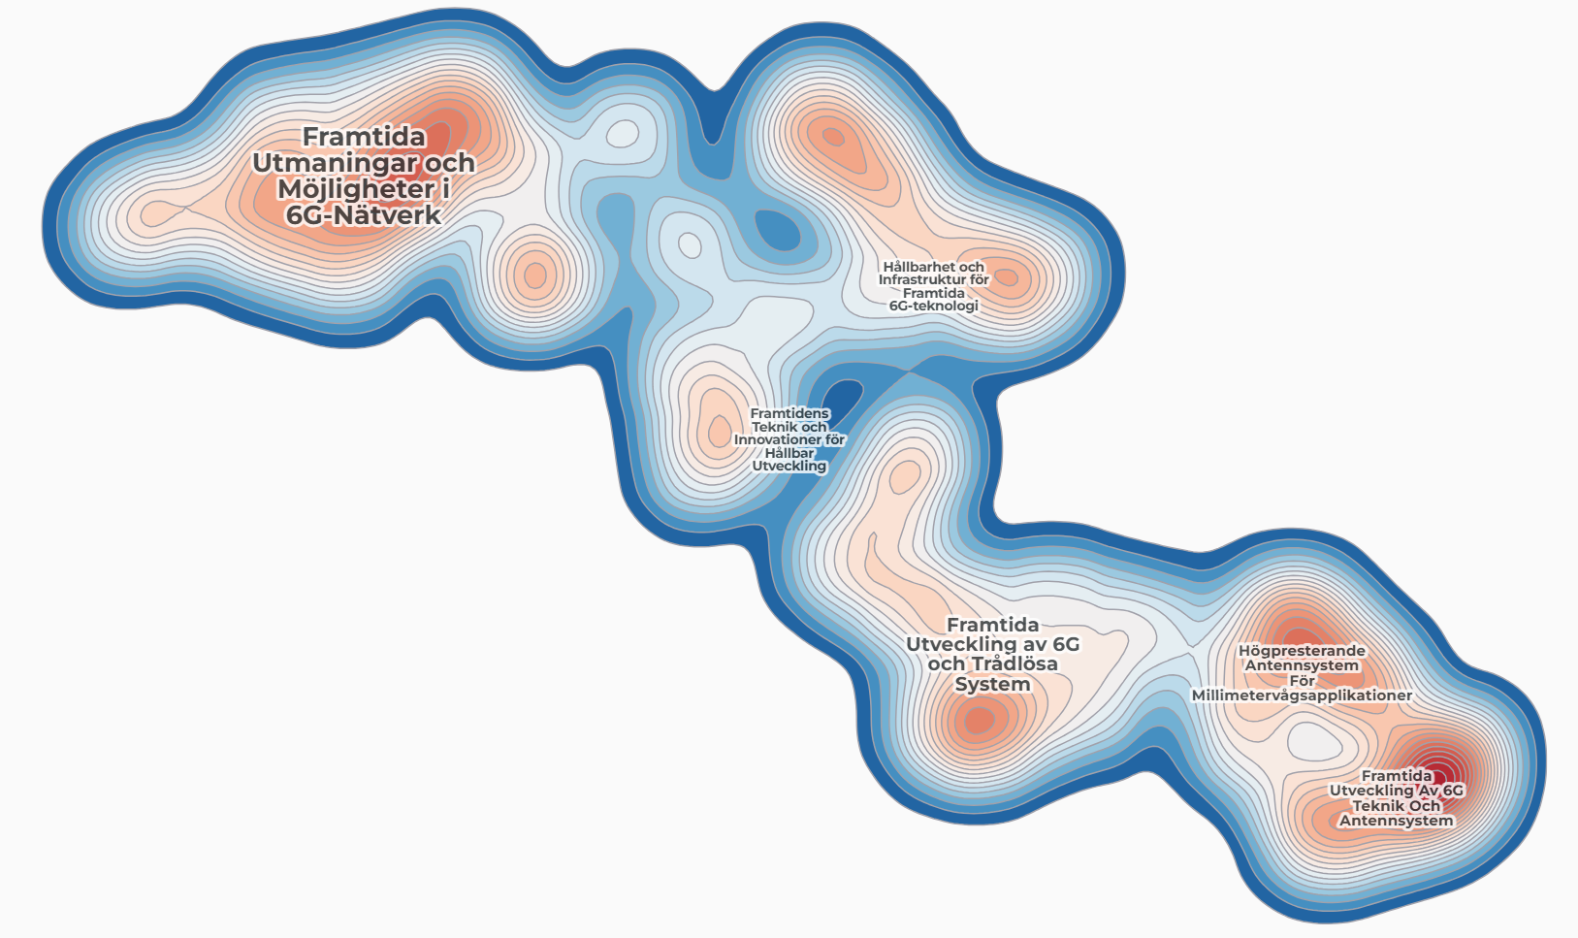
Sustainability and Infrastructure for Future 6G Technology
Technologies and Innovations for Sustainable Development
High-Performance Antenna Systems for Millimeter-Wave Applications
Future Challenges and Opportunities in 6G Networks
Future Development of 6G Technology and Antenna Systems
Future Development of 6G and Wireless Systems
Notes:
This is a very rough text clustering of the projects in the 6G portfolio.
Within Future Challenges and Opportunities in 6G Networks we find many projects around edge and AI technologies.
Within the theme 'Sustainability and Infrastructure for Future 6G Technology', many projects focus on heat recovery, load balancing, and power distribution.
Within 'Technologies and Innovations for Sustainable Development', many projects focus on energy efficiency.
Within 'Future Development of 6G and Wireless Systems', we find projects related to Distributed MIMO, ISAC, linearization, and testing techniques.
Within 'High-Performance Antenna Systems for Millimeter-Wave Applications', we find projects focusing on antennas, transceivers, signal processing, and power amplifiers for mm-wave applications.
Within 'Future Development of 6G Technology and Antenna Systems', we find projects related to design tools, antenna and microwave component manufacturing, fiber technology, and new types of materials.
Among these project we also find application such as healthcare, the automotive sector, urban planning, and industrial automation.

Slide 10
Notes:
Thank you — that’s all from me. 6G is not just about faster networks; it’s about creating a sustainable, inclusive digital future. We hope you’ll be part of that journey. You can find more information on Vinnova’s channels, shown here.
Now I’ll hand over to students who have participated in Vinnova-funded projects within the 6G programme. They will share what they did and what it meant for them.
We start with Yusheng Yang and Maria Joseph from Emickers and after that Raha Roosefid from Chalmers.

