Slide 1






Unlocking the Network of the Future:
How SUSTAINET-Advance is driving
Resilient, Sustainable and AI-Ready Enterprise Connectivity and Critical Infrastructure
SUSTAINET Public Event @ Berlin 6G Conference,
8 September 2026, Berlin
Christoph Glingener, CTO, Adtran Networks SE
Notes:
TIMING: 0:00 - 1:00
Opening. Good morning. Over the next fifteen minutes I want to make one argument: the networks that carry Europe's critical infrastructure now have to be resilient, sustainable and AI-ready at the same time - and none of those three can be retrofitted afterwards.
SUSTAINET-Advance is where we are building exactly that. It is a CELTIC-NEXT flagship subproject, it is running today, and it is producing results.
Say who you are and that Adtran coordinates both the umbrella programme and this subproject - it establishes credibility for everything that follows.
[Sources]
Internal: Adtran SUSTAINET public event deck, cover slide.
External: https://sustainet-project.eu/ ; https://sustainet-project.eu/sustainet-advance/

Slide 2

Trends, driving the future of connectivity
Industry Update
Fiber everywhere era continues
Mix of public and private funding remains strong
Connecting all homes, businesses, 5G sites and critical infrastructure
AI infrastructure reshaping networks
Rapid expansion of cloud infrastructure led by AI
Large-scale training sites today. Edge and on-prem sites to follow next
Resilience, security, sovereignty
Trusted vendors with local presence/supply chains
Legacy infrastructure networks need to be digitized and encrypted
AI transforming network operations
Applying AI to automate operations and improve subscriber experience
Significantly reduces operational expenses
Continued growth in scalable, secure and AI-optimized fiber networks

Slide 3
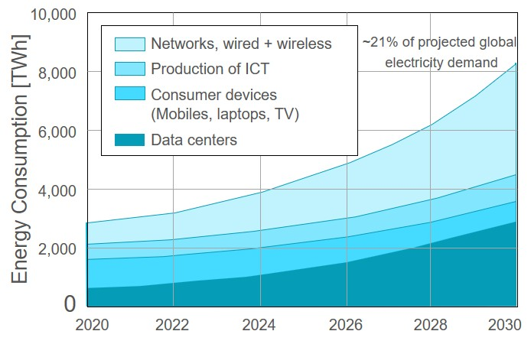

AI is reshaping the world – creates new challenges
Industry Update
Agentic AI
Infrastructure growth
Impact on fiber networks
Growing complexity
AI-assisted operation
Scale expert knowledge
Faster fault resolution
Better network insights
Faster service delivery
Accelerate decisisons
Validate before acting
Sustainability
By 2030, ICT incl. AI could
consume around 20% of the
global electrical energy demand
contribute around 5% of the
global carbon emissions
Trusted autonomy
Autonomous agents
create new security, operational
and societal risks
requires governance, reasoning,
observability, consistency.
Energy efficiency and trustworthy autonomy must be addressed by regulation and research

Slide 4

SUSTAINET-Advance
Sustainable & resilient comMs for enterprise, communication and energy
1. Sustainable and resilient architecture
2. Scalable connectivity and transport networks
3. AI-driven network control,
operation and automation
Business solutions
Fiber
monitoring
ONT
Access & aggregation (Nx10/100G)
Regional
transport (Nx100/400/800G)
DWDM systems
Residential Wi-Fi
Fiber access platforms
5G
NID
Edge router
4. Planning and provisioning of trustworthy, resilient & secure networks
5. PoCs and demonstrators in real-world labs, use cases and outreach

Slide 5
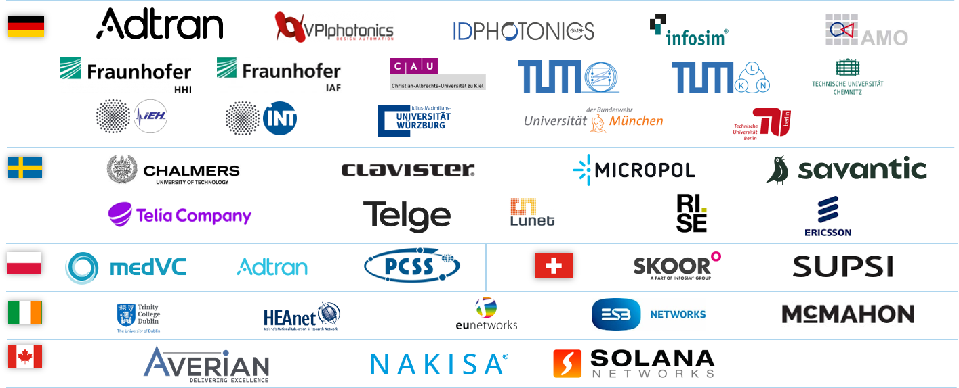

Project partners and key facts
SUSTAINET-Advance
6
countries
38
partners
147 PY
total effort
€20.5 M
total budget
Start Date: 01/2025
End Date: 12/2028
Project-ID: C2024/3-4
sustainet-project.eu/
sustainet-advance/
Strong European and Canadian consortium drives innovation and creates high impact

Slide 6
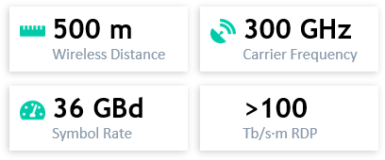
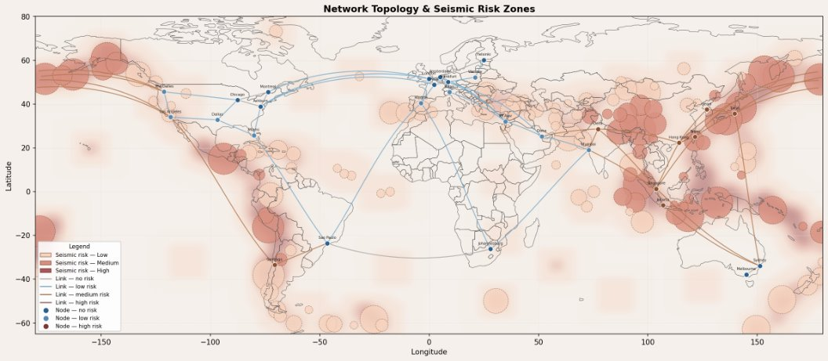
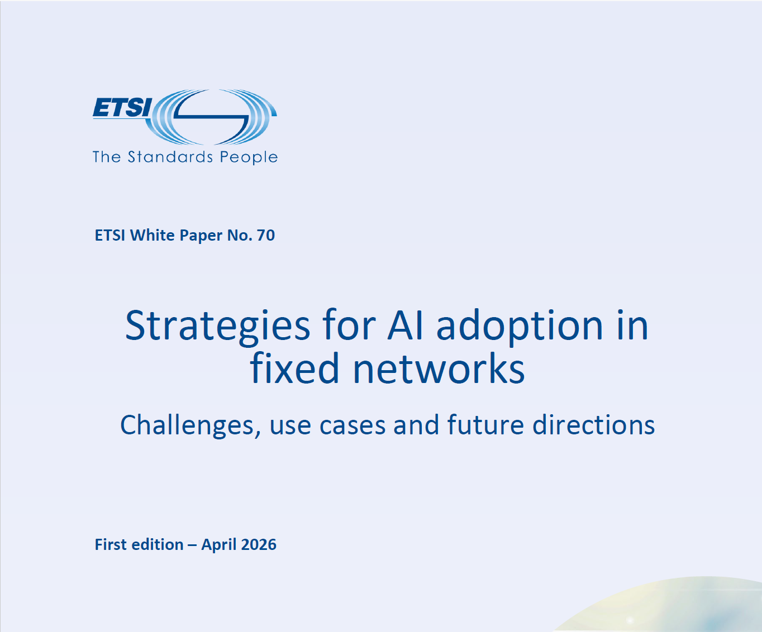

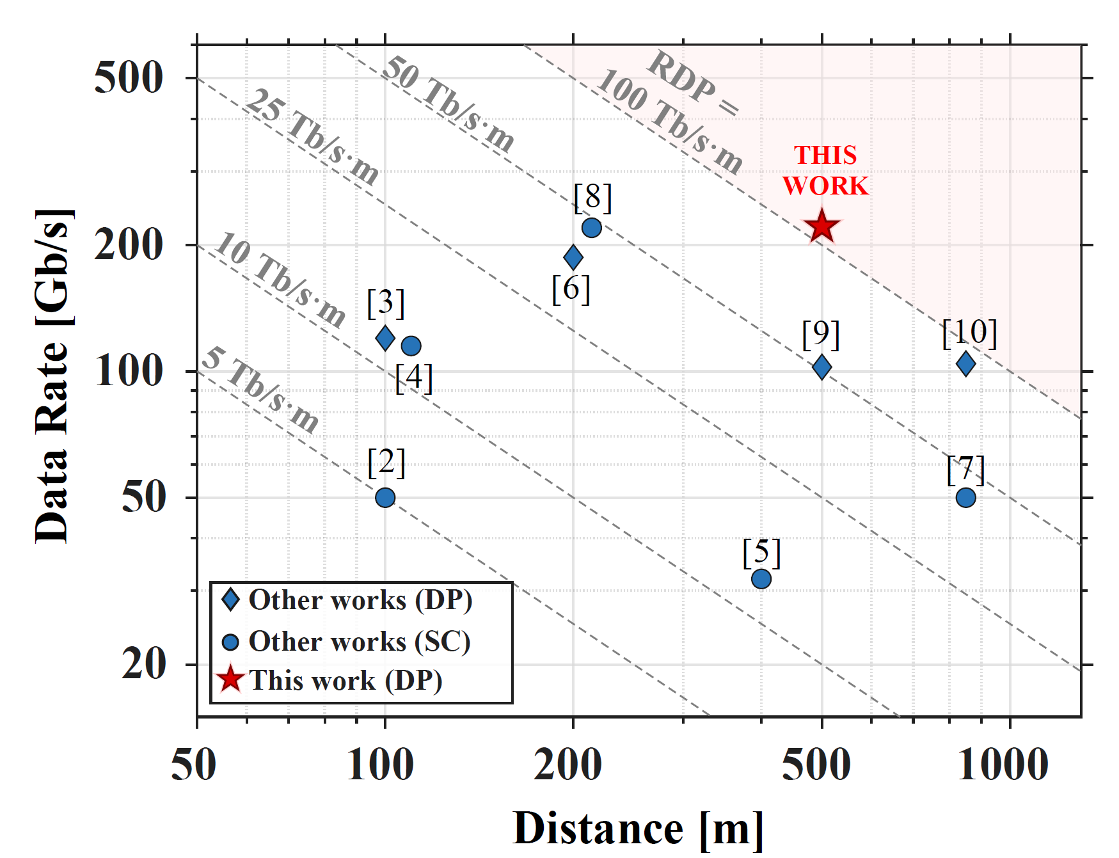
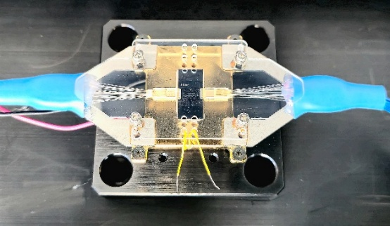
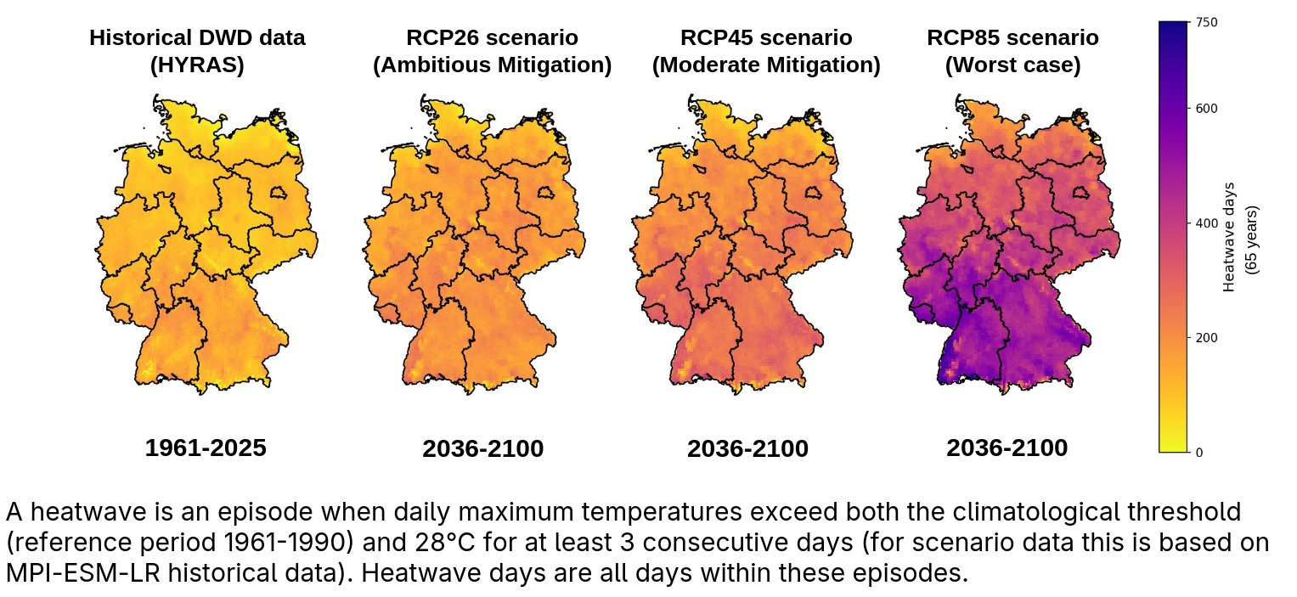
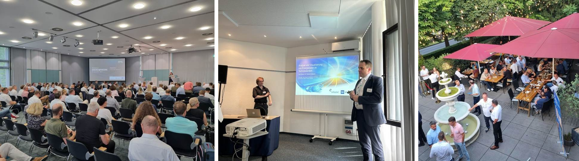
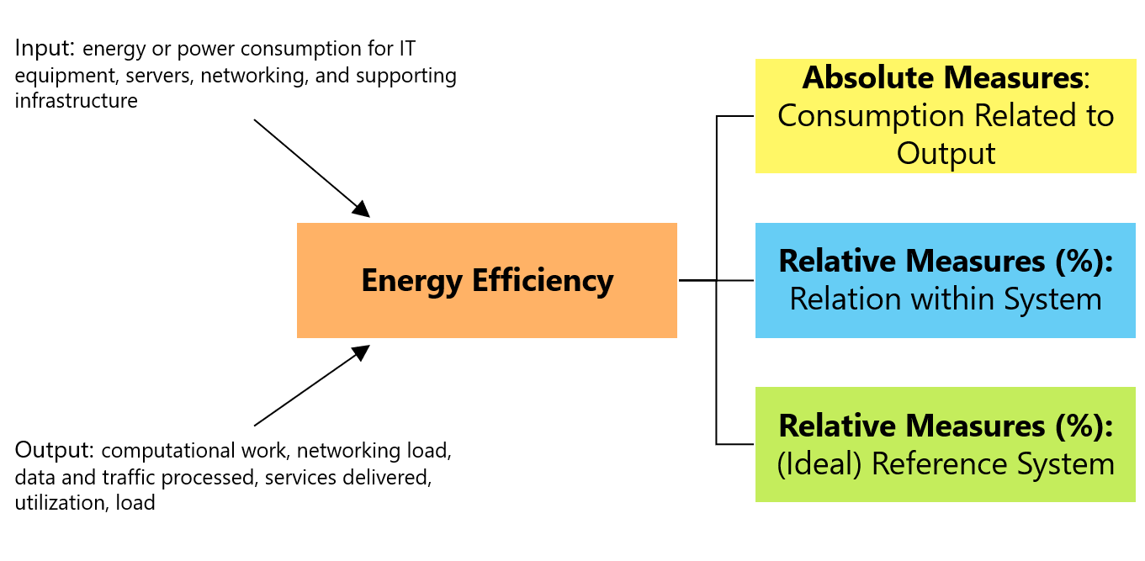
Project highlights and achievements
SUSTAINET-Advance
Sustainability | Energy-efficiency | Resilience | Trusted AI
Neuromorphic Photonic Equalizer and World Record Breaking THz Link
 AI-driven operation and automation
Resilience-aware network planning: seismic-risk-informed routing across global topologies
ETSI Whitepaper Strategies for AI adoption in fixed networks
TIP OOPT PoC IPoDWDM orchestration
Impact of climate change and extreme weather on networks
User workshops & industry events
Sustainability assessment framework
→ Live demos
visit us at the SUSTAINET booth

Slide 7

Impact for Europe and Canada
Strategic importance
Broadband and AI infrastructure
  SUSTAINET-Advance supports broadband growth, 5G and AI infrastructure, enhancing connectivity across Europe’s service providers.
Enterprise connectivity solutions
  SUSTAINET-Advance is driving secure and resilient networking technologies for business continuity and disaster recovery solutions.
Wide market reach
  Adtran-powered networks are reaching over 100 million users, driving digital transformation and economic competitiveness
Support for critical infrastructure
  Adtran’s technology underpins critical infrastructure, including finance, healthcare, energy, and public administration sectors.
SUSTAINET-Advance – Unlocking the network of the future
Notes:
Adtran plays a significant role in enabling Europe’s digital infrastructure and supporting the connectivity needs of both service providers and enterprises. The company maintains strong relationships with many of the region’s top communication service providers, offering essential technology solutions that support broadband expansion, optical transport, 5G rollouts, and enterprise connectivity. Adtran’s platforms serve tens of millions of broadband customers across Europe, reinforcing its position as a core contributor to the region’s digital transformation. Beyond communication service providers, Adtran supports many of Europe’s top enterprise customers, including institutions in finance, energy, transportation, healthcare, and public administration. These customers rely on Adtran’s secure, resilient, and high‑performance networking technologies to deliver mission‑critical digital services. The breadth of the company’s impact spans consumer connectivity, enterprise digitalization, critical infrastructure protection, and national security use cases. By powering networks that reach over 100 million users—alongside supporting leading enterprises and public institutions—Adtran helps accelerate innovation, economic competitiveness, and technological sovereignty across Europe.

Slide 8
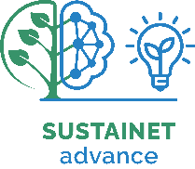

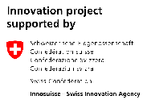


The CELTIC-NEXT flagship project SUSTAINET-Advance is receiving funding by the BMFTR (Germany), Vinnova (Sweden), NCBR (Poland), Innosuisse (Switzerland), IRC (Ireland), and NRC-CNRC (Canada)
Christoph Glingener • CTO • Adtran Networks SE

