Slide 1

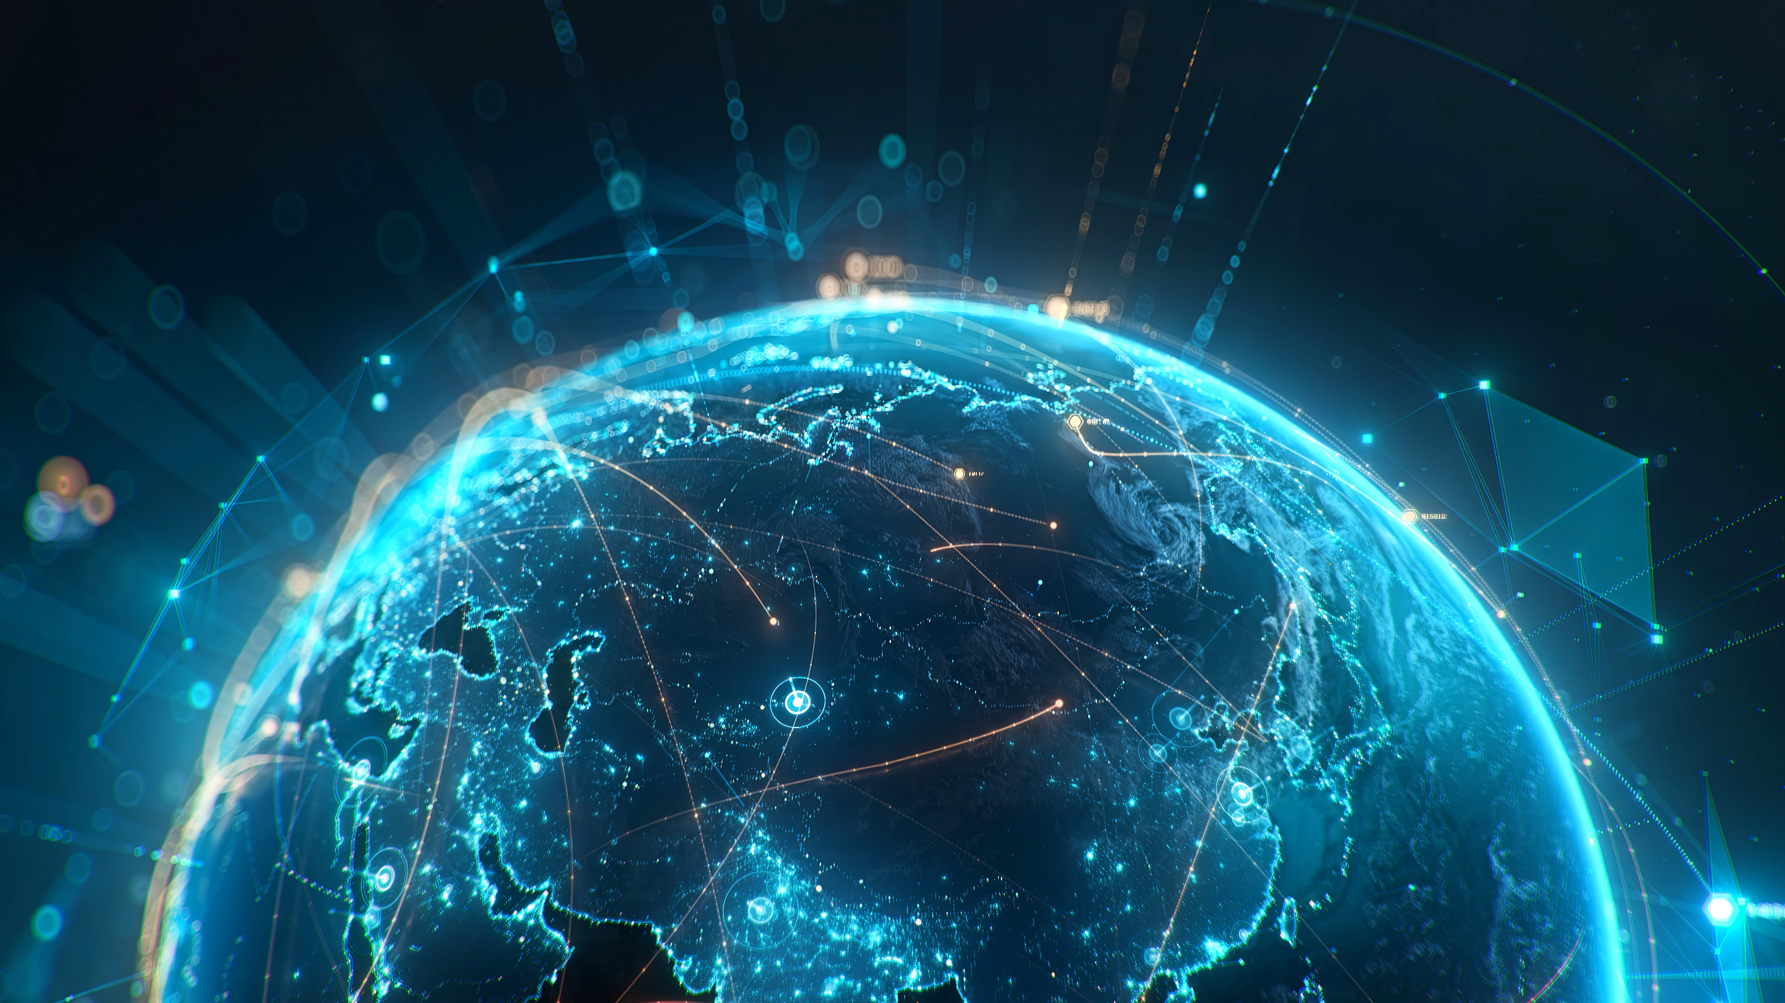

Frictionless, Secure, & Resilient Communication Networks for the Dynamic Digital World
Notes:
Good afternoon. My name is René Bonk from Nokia and today I’ve the honor to provide you with a status and impact update from the SUSTAINET-Innovate project.
Communication networks are becoming a critical part of society's digital infrastructure. AI, cloud services, industrial automation and connected systems all increase our dependence on networks.
At the same time, expectations are growing. Networks must not only provide connectivity. They must be frictionless to use, secure against attacks, resilient against disruptions, and sustainable from an energy perspective.
This is the challenge that SUSTAINET addresses.

Slide 2
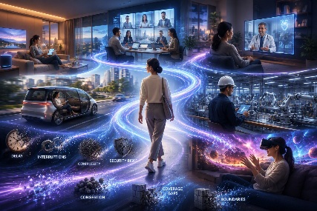
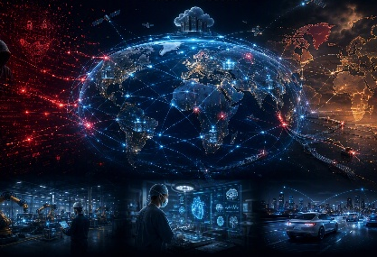
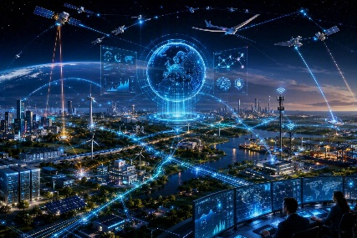
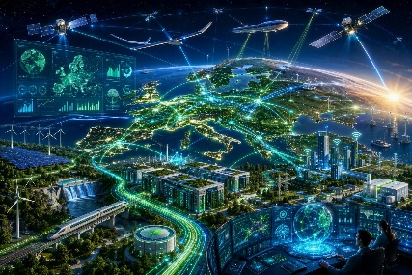
Towards Frictionless, Secure, Resilient and Sustainable Communication Networks
Frictionless
Secure
Resilient
Sustainable
AI revolution and
society digitalization
Cyber threats and geopolitical tensions
Climate events and societal dependence
Energy constraints & ESG expectations
Notes:
Communication networks are becoming a critical part of society's digital infrastructure. AI, cloud services, industrial automation and connected systems all increase our dependence on networks.
At the same time, expectations are growing. Networks must not only provide connectivity. They must be frictionless to use, secure against attacks, resilient against disruptions, and sustainable from an energy perspective.
This is the challenge that SUSTAINET addresses.
We identified four major trends shaping future communication networks.
First, AI and digitalization increase performance and connectivity requirements.
Second, cyber-security threats and geopolitical tensions require stronger security and sovereignty.
Third, society's growing dependence on digital infrastructure means networks must remain operational even during failures, attacks and natural disasters.
Finally, energy consumption and sustainability targets require more efficient solutions.
These drivers directly translate into the four pillars of SUSTAINET: frictionless, secure, resilient and sustainable networking.

Slide 3
From Vision to Innovation: Eight Research Areas of SUSTAINET-INNOVATE
Frictionless
Secure
End-to-end architectures
Seamless connectivity
Deterministic connectivity
AI-ready Time-Sensitive Networking
Secure systems
Confidential & trustworthy compute
Intent-based automation
Closed-loop & AI network control
INTEGRATED
AUTONOMOUS
Resilient
Sustainable
DIGITAL
Network-as-a-sensor
Distributed sensing platform
Resilient systems
Cloud infrastructure
INFRASTRUCTURE
Digital twin
Virtual replicas for analytics
Energy-efficient AI
Neuromorphic and generative AI
SUSTAINET-Innovate vision
Notes:
To address these four pillars, SUSTAINET is organized into eight complementary innovation areas.
Rather than focusing on a single technology, SUSTAINET takes a holistic approach.
We address the challenges through eight innovation areas covering seamless connectivity, AI-ready networks, security, automation, sensing, resilience infrastructures and systems, digital twins, and energy-efficient AI.
You can think of these as the building blocks of an integrated autonomous digital infrastructure.
Together they support our four strategic pillars while ensuring that innovations are not developed in isolation but as part of a common architectural framework.

Slide 4
SUSTAINET reference architecture integrating services, AI and digital twins
Notes:
That architectural framework is shown here.
This slide illustrates how the different innovation areas fit together.
At the top we have the applications and services.
Beneath that, AI, automation, intent-based control and digital twins provide intelligence and operational optimization.
The network infrastructure provides deterministic, secure and resilient connectivity.
The important message is not the individual blocks, but the integration of networking, AI and digital twins into one coherent system architecture.
This architecture provides the foundation for the technical demonstrations I will show next.

Slide 5
Frictionless
Low-latency
Deterministic industrial AI over PON
Low-jitter
(= latency variation)
Service Requirements:
High- reliability
Status: Demonstrated virtual PLC operation over PON with bounded latency and jitter
Impact: Enables predictable performance for industrial AI over heterogeneous device / system connectivity
Notes:
Let me illustrate the architecture through one representative result from each of our four pillars.
The first pillar is frictionless networking.
Industrial applications increasingly require deterministic communication characteristics such as bounded latency, low jitter and high reliability.
Within SUSTAINET we demonstrated virtual PLC operation over a PON infrastructure while maintaining predictable communication performance.
This shows how access networks can evolve beyond traditional broadband connectivity and support industrial AI and automation workloads.
The key message is that network performance becomes predictable and transparent to the application.

Slide 6
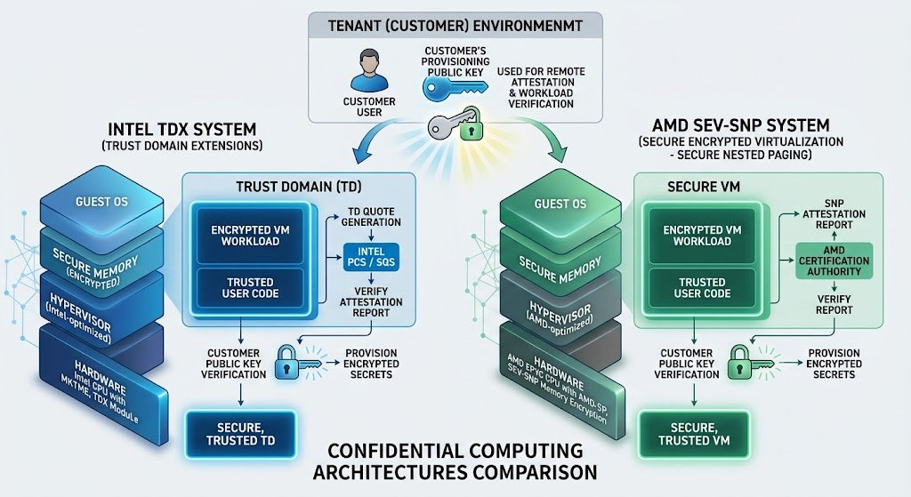
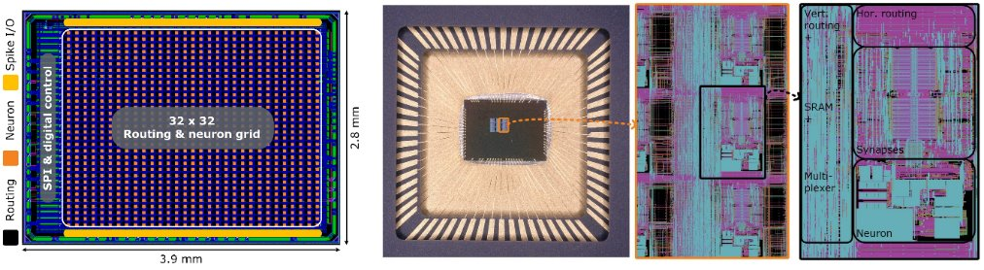
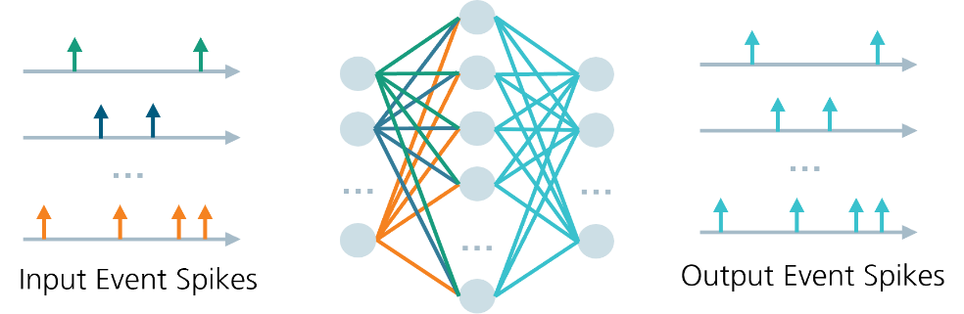
Secure
Confidential cloud computing
Neuromorphic computing
Status: CCC with first deprivileged firmware for ARM-based devices, N-TSN applications defined
Impact: Combine secure, power efficient and new processing speeds to achieve a sovereign future AI compute
Notes:
Frictionless operation alone is not sufficient. Future AI infrastructures must also be secure and trustworthy.
Our second pillar focuses on secure systems.
We are investigating confidential cloud computing technologies that allow workloads to be executed in protected environments, helping to strengthen trust and sovereignty.
We have already demonstrated initial confidential computing implementations on ARM-based platforms.
In parallel, we investigate neuromorphic computing approaches for future AI processing with significantly improved energy efficiency.
Together these technologies support a future AI infrastructure that is both trustworthy and efficient.

Slide 7
Resilient
Distributed Acoustic Fiber Sensing
Satellite – disaster recovery using secure links
Status: DAS field testing performed and secure link for satellite feeder modem demonstrated
Impact: Enhance the resiliency of today’s communication infrastructure – our digital nervous system
Notes:
Beyond security, future networks must also continue operating under adverse conditions.
Resilience represents our third pillar.
We investigate multiple approaches and present two complementary ones today.
The first is distributed acoustic sensing over optical fiber, transforming communication infrastructure into a sensing platform that can detect events affecting the network and provide environmental information from e.g. wind and water impacts.
The second is satellite-based disaster recovery solutions using secure communication links.
Together these capabilities strengthen the resilience of what has effectively become society's digital nervous system.
We have already completed field testing of distributed sensing and demonstrated secure satellite connectivity.

Slide 8
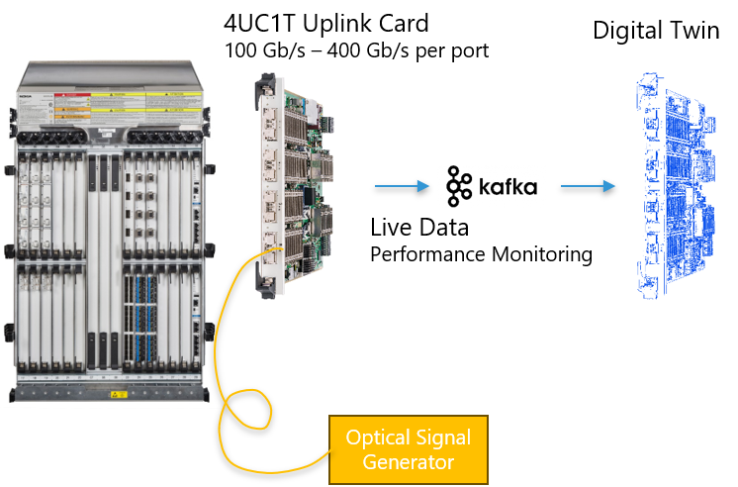
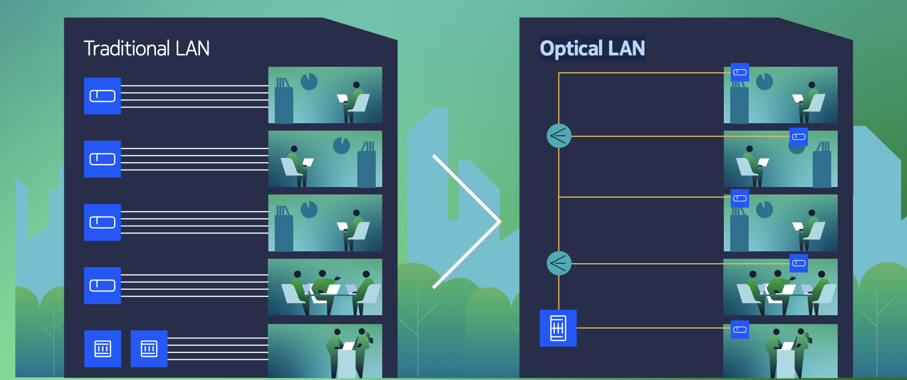
Sustainable
Digital Twin for Sustainable operation
Towards PON based Optical LAN for increased energy efficiency
Status: Initial digital twin demonstrated and model of energy efficiency verified
Impact: Replacing fewer TRx’s and operate networks with improved power efficiency
Notes:
The final pillar focuses on sustainability.
Sustainability is increasingly becoming a first-order design objective.
Within SUSTAINET we are developing digital twin technologies that allow operators to evaluate and optimize network operation before changes are implemented in the real network.
We have demonstrated an initial digital twin and verified energy-efficiency models.
We also investigate PON-based optical LAN solutions which can improve power efficiency while simplifying network infrastructures.
Together these solutions contribute to more sustainable communication networks with lower operational energy consumption.

Slide 9

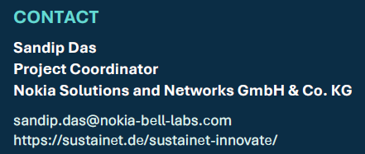
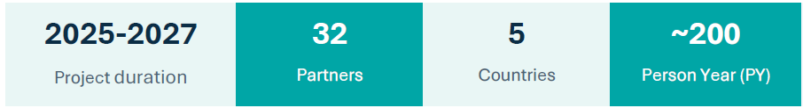
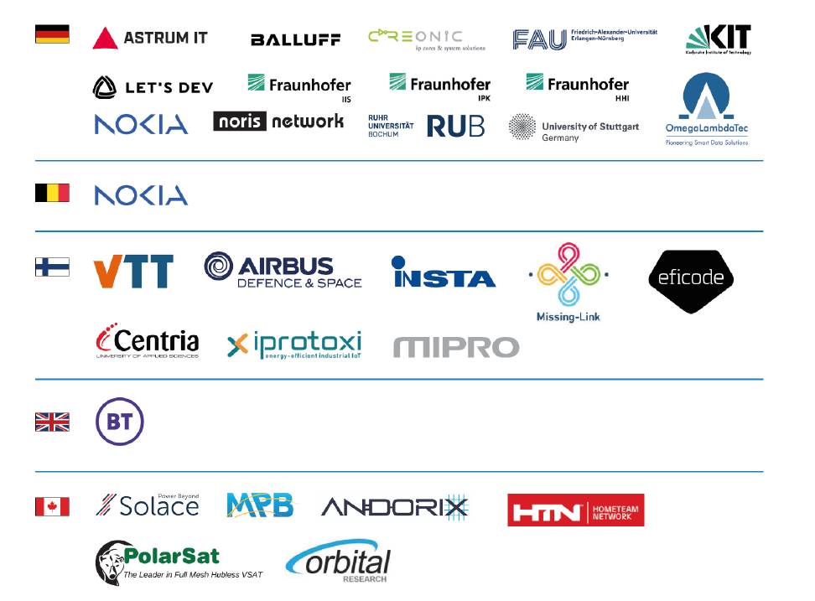
Notes:
None of these developments happen in isolation.
SUSTAINET brings together a broad ecosystem of industrial and academic partners.
The consortium combines expertise spanning communications, cloud infrastructure, AI, optical networking and systems research.
The project is a collaborative effort across Germany, the United Kingdom, Canada and Finland.
This international cooperation enables us to address challenges that no single organization could solve alone.

Slide 10
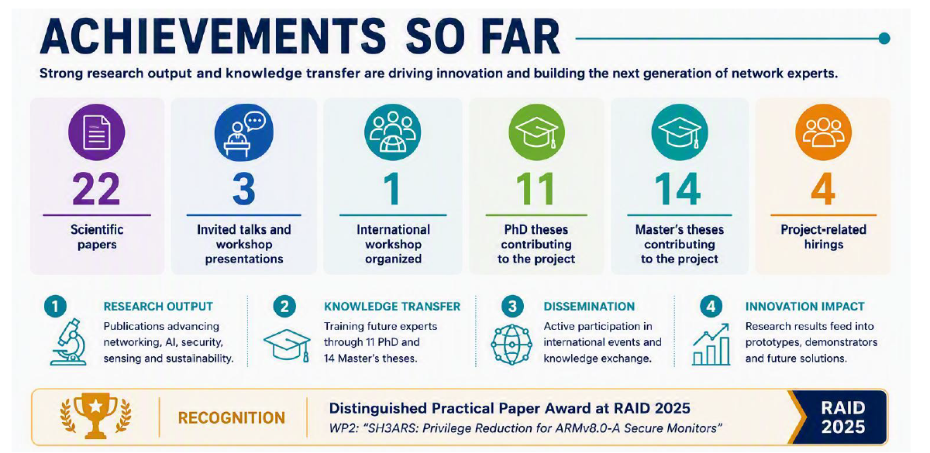
Notes:
SUSTAINET-innovate has been successful in the first 18 months and achieved already more than 20 scientific puplications, received invitations for talks and workshop at major events and support the development of fresh talents for our future. We also have been awarded a best paper award at a conference on security.

Slide 11
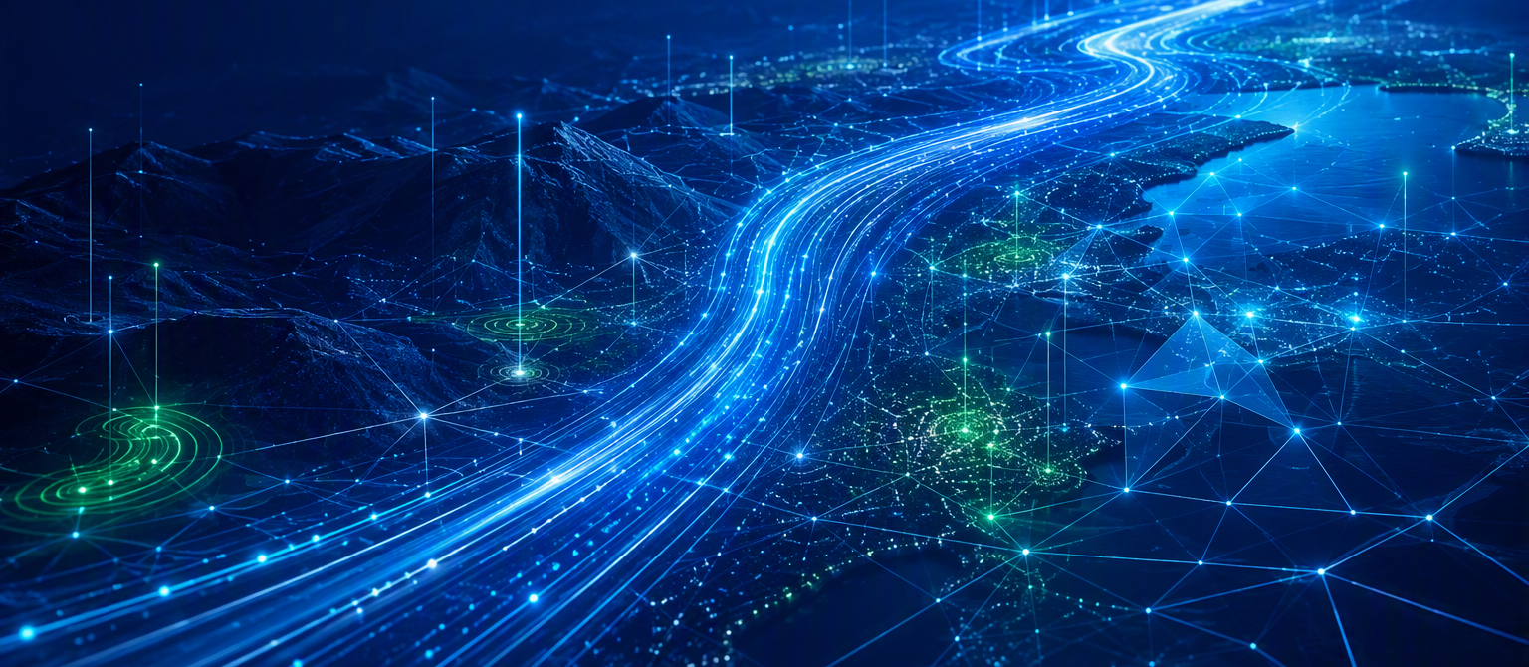
Expected impact of project beyond 2027
OUR 8 INNOVATION AREAS
01
02
03
04
End-to-end architecture
Deterministic connectivity
Secure systems
Intent-based automation
TOWARDS
TOWARDS
TOWARDS
TOWARDS
Unnoticed networks
Best-in-class quality of experience
Ensuring government and society interests
Level 4–5 AI-inspired autonomous networking
05
06
07
08
Networks-as-a-Sensor
Resilient systems
Digital twin
Energy-efficient AI
TOWARDS
TOWARDS
TOWARDS
TOWARDS
Hardening networks and enabling new revenue streams
Geopolitical and natural-disaster sovereignty
The network optimization engine
Continuing the move into a sustainable society
FUNDING HORIZON
Need extending funding beyond 2027
Notes:
Let me close with the long-term impact we expect from SUSTAINET-innovate.
Looking beyond individual demonstrations, our objective is to contribute to the foundations of future autonomous digital infrastructure.
The eight innovation areas support a vision of networks that are increasingly invisible to users, autonomous in their operation, secure and resilient by design, and significantly more sustainable.
While the current project runs until 2027, we believe these topics will remain central for communication networks well beyond that timeframe.
Many of the innovations being developed today will help shape future 6G, DC networks, connectivity engines and digital infrastructure evolution.

Slide 12
SUSTAINET-innovate creates the foundations of an autonomous digital infrastructure that is
frictionless, secure, resilient and sustainable
Email to sandip.das@nokia-bell-labs.com
Notes:
To summarize...
Communication networks are becoming critical societal infrastructure.
SUSTAINET addresses this challenge through four pillars: frictionless, secure, resilient and sustainable networking.
Through eight innovation areas and a unified architecture, we are developing technologies that support the next generation of autonomous digital infrastructure.
Thank you for your attention, and I look forward to your questions.

