Slide 1

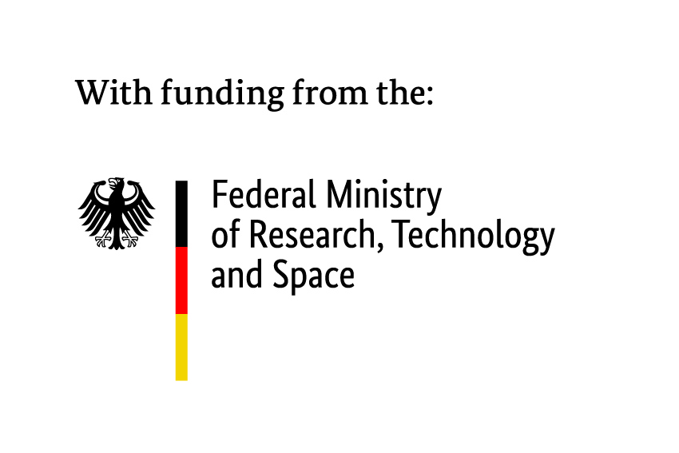
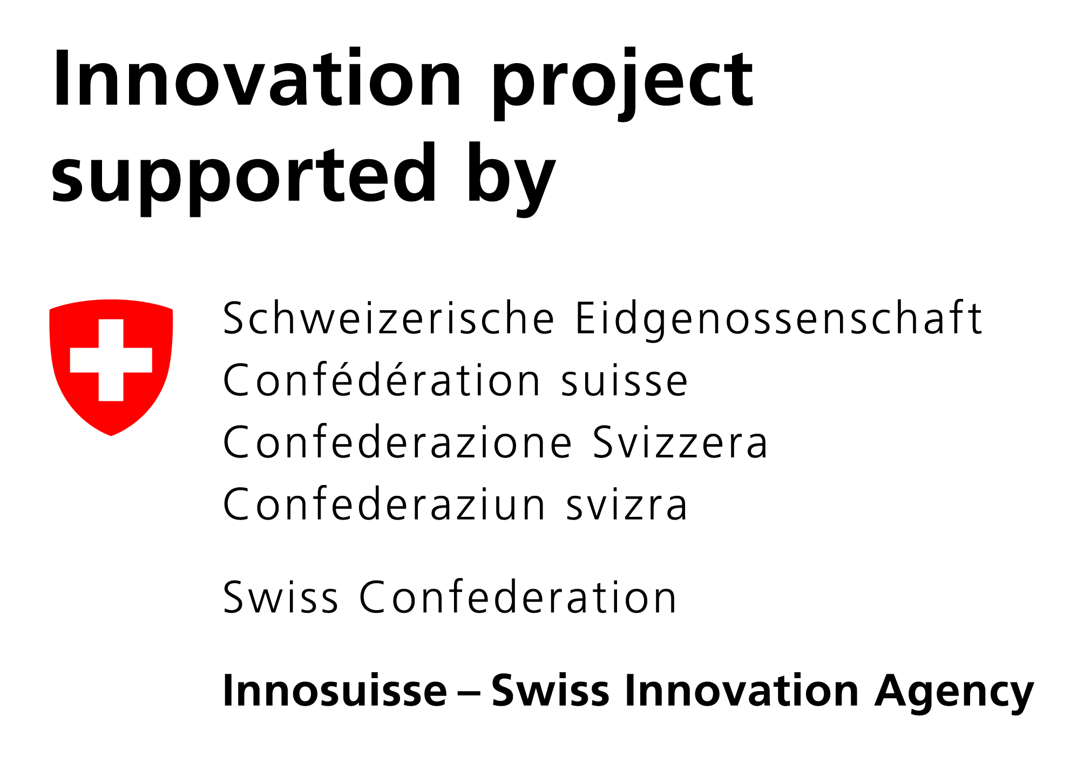
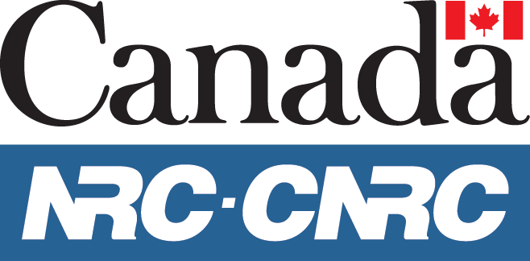
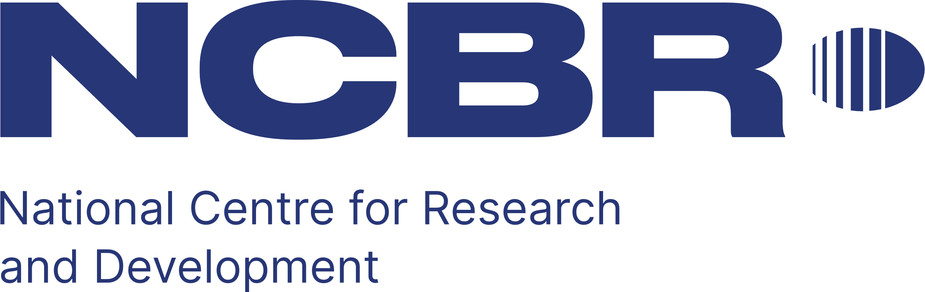





Petr Ledl,
Head of T-Labs
Notes:
Eureka is the world’s biggest public network for international cooperation in R&D and innovation present in over 45 countries.
We fund R&D projects that result in innovative products, processes or services.
Since 1985, by mobilising some 48.4 BILLION euro of public-private investment, we have supported the R&D of over 7,000 groundbreaking projects that have positively impacted economic growth and changed people’s lives for the better.

